Slide 1
Products, Services and Brands: Building Customer Value

Slide 2
Session Outline
What Is a Product?
Product and Service Decisions
Branding Strategy: Building Strong Brands
Services Marketing

Slide 3
What is a Product?
Product
Anything that can be offered to a market for attention, acquisition, use, or consumption that might satisfy a want or need.
Service
Any activity or benefit that one party can offer to another that is essentially intangible and does not result in the ownership of anything.

Slide 4
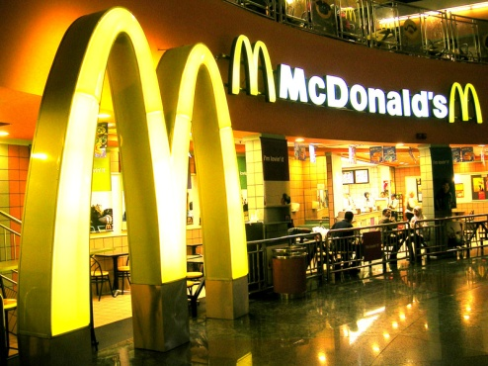
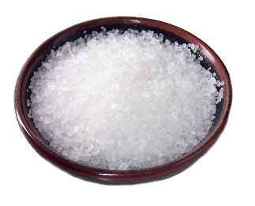
Products, Services and Experiences
Pure Intangible
Pure Tangible

Slide 5
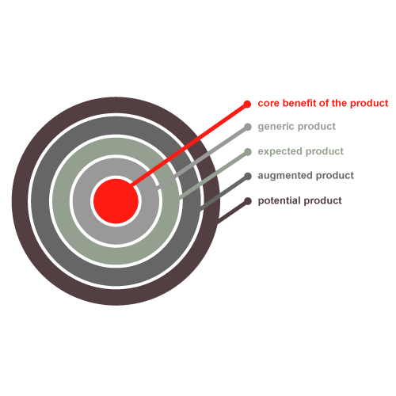
Levels of Product and Services

Slide 6
Product and Services Classifications
Products and Services
Consumer Products
Industrial Products
Organizations, Persons, Places, Ideas
Convenience
Shopping
Specialty
Unsought

Slide 7
Types of Consumer Products
Convenience Products Frequent purchase, little planning, little planning or shopping effort, low customer involvement Low price Widespread distribution Convenient locations Mass promotion | Shopping Products Less frequent purchase, much planning and shopping effort, comparison of brands on price, quality, style Higher price Selective distribution in fewer outlets Advertising and personal selling
Specialty Products Strong brand preference and loyalty, special purchase effort, little comparison of brands, low price sensitivity High price Widespread distribution in many outlets per market area Carefully targeted promotion | Unsought Products Little product awareness, knowledge Price varies Distribution varies Aggressive advertising and personal selling

Slide 8
Product and Service Decisions
Individual Product and Service Decisions
Product attributes
Branding
Packaging
Labeling
Product support services

Slide 9
Product and Service Attributes
Developing a product or service involves defining the benefits that it will offer such as:
The characteristics of a product or service that bear on its ability to satisfy stated or implied customer needs
Product Quality
Differentiates the product from competitors’ products
Product Features
Style – Appearance of a product
Design – Involves shaping the customer product use experience
Product Style and Design

Slide 10
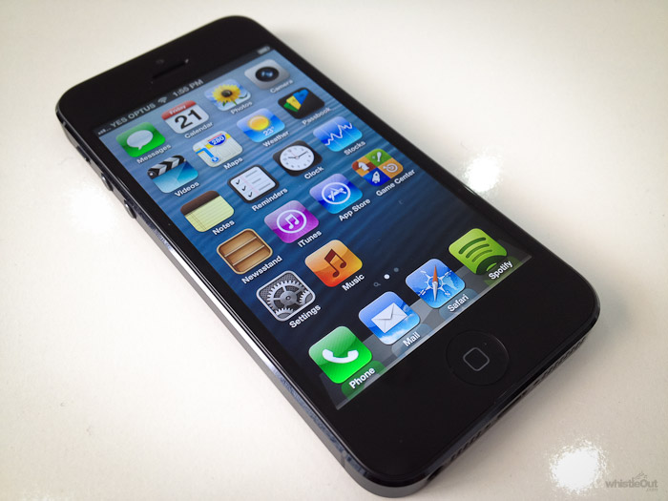
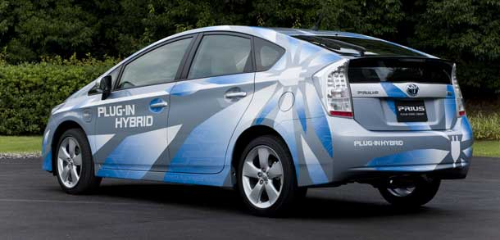
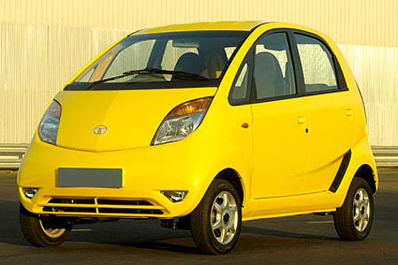

Slide 11
Branding
Brand
A name, term, sign, symbol, design or a combination of these that identifies the products or services of one seller or group of sellers and differentiates them from those of competitors.

Slide 12
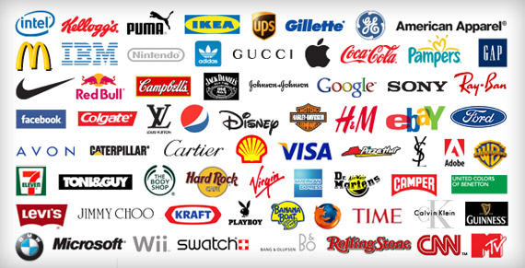

Slide 13
Branding (Cont.)
Branding has become so strong that today hardly anything goes unbranded.
Brands can be the major enduring asset of a company, outlasting the company’s specific products and facilities.
Branding helps buyers in many ways.

Slide 14
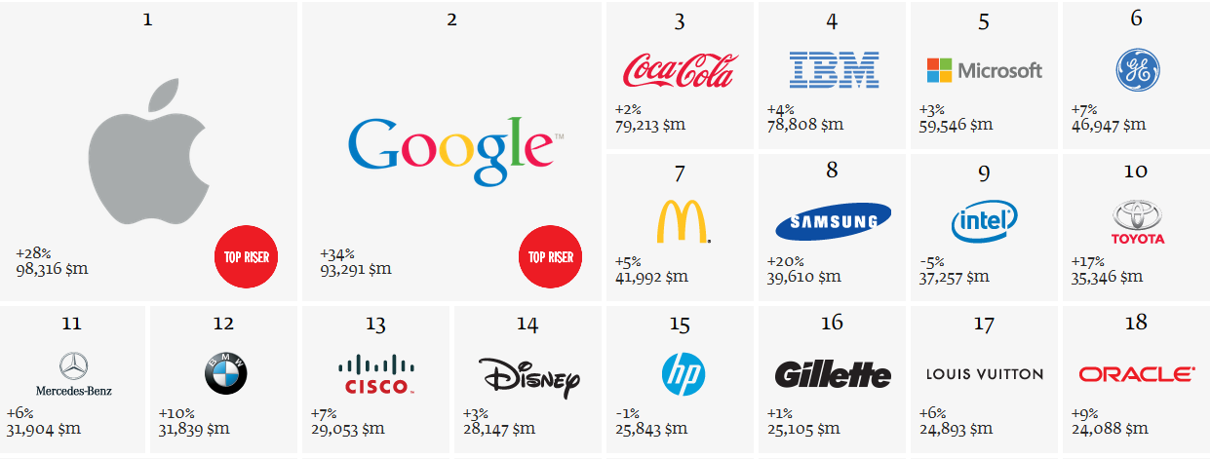
The World's Top Brands in 2013

Slide 15
Brand Name Selection
A good name can add greatly to a product’s success.
It begins with a careful review of the product and its benefits, the target market and proposed marketing strategies.
Naming a brand becomes part science, part art and a measure of instinct.
Desirable Qualities for a Brand Name
Related to benefits and qualities
Easy to pronounce, recognize and remember
Distinctive
Extendable
Easy to translate
Capable of registration and legal protection

Slide 16
Packaging
The activities of designing and producing the container or wrapper for a product.
Traditionally,
To hold and protect the product (Primary function )
Today,
From attracting, attention to describing the product to making the sale
Packaging

Slide 17
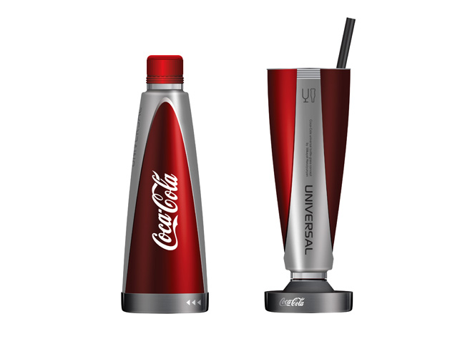
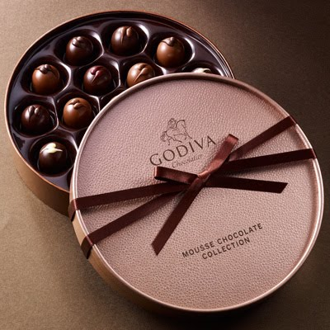
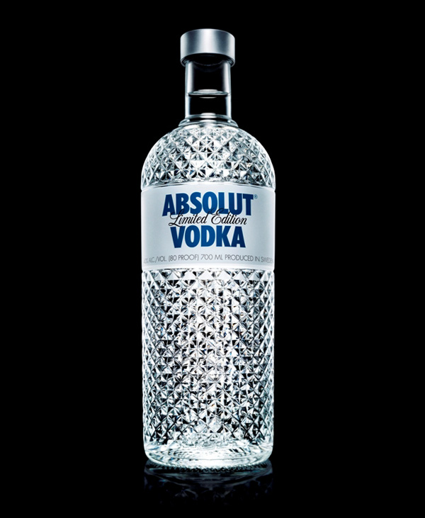
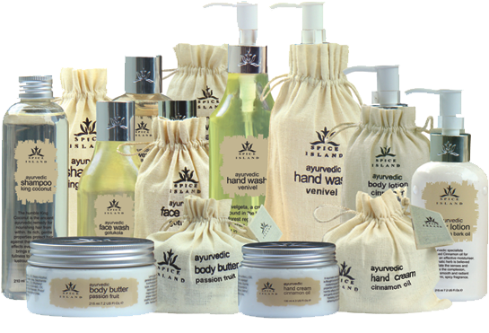

Slide 18
Labeling
Labels range from simple tags attached to products to complex graphics that are part of the package.
Label perform several functions
Label identifies the product or brand
Describe several things
Promote the brand

Slide 19
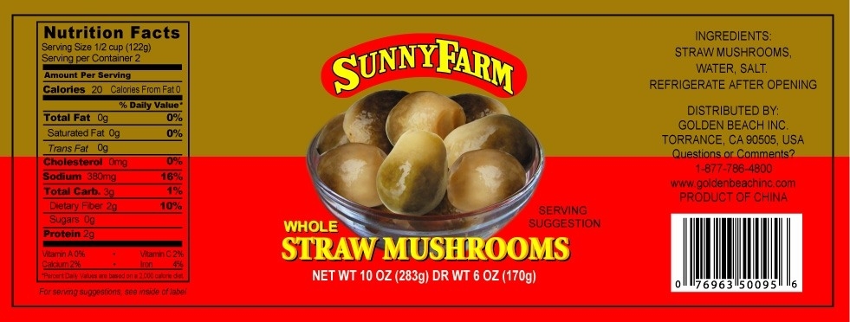

Slide 20
Product Support Services
Customer service is another element of product strategy. A company’s offer usually includes some support services, which can be a minor or a major part of the total offering.
Services that augment actual products.
Many companies are now using a sophisticated mix of phone, e-mail, fax, internet, interactive voice and data technologies to provide support services that were not possible before.

Slide 21
Product Line Decisions
A group of products that are closely related because they function in a similar manner, are sold to the same customer groups, are marketed through the same type of outlets, or fall within given price ranges.

Slide 22
Product Line Decisions
Product Line Length
The number of items in the product line
Line Filling – Adding more items within the present range of the line
Line Stretching – Lengthens its product line beyond its current range
Downward
Upward
Both Directions

Slide 23
Product Mix (Portfolio) Decisions
The set of all product lines and items that a particular seller offers for sale.
A Company’s Product Mix Has Four Important Dimensions
Width | The number of different product lines the company carries
Length | The total number of items company carries within its product lines
Depth | The number of versions offered of each product in the line
Consistency | How closely related the various product lines are in end use, production requirements, distribution channels or some other way

Slide 24
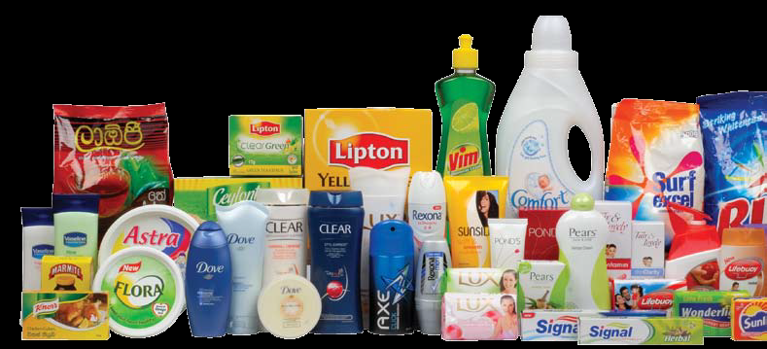

Slide 25
Additional 3Ps for Services

Slide 26
Process
How firm does things may be as important as what it does
Customers often actively involved in processes, especially when acting as co-producers of service
Process involves choices of method and sequence in service creation and delivery
Badly designed processes waste time, create poor experiences, and disappoint customers

Slide 27
Physical Environment
Design servicescape and provide tangible evidence of service performances
Create and maintain physical appearances
Buildings/landscaping
Interior design/furnishings
Vehicles/equipment
Staff grooming/clothing
Sounds and smells
Other tangibles
Manage physical cues carefully can have profound impact on customer impressions

Slide 28
People
Interactions between customers and contact personnel strongly influence customer perceptions of service quality
The right customer-contact employees performing tasks well
Job design
Recruiting
Training
Motivation
The right customers for firm’s mission
Contribute positively to experience of other customers
Possess—or can be trained to have— needed skills (co-production)
Can shape customer roles and manage customer behavior

Slide 29
Summary and Conclusions

