Slide 1
Communicating Customer Value: Integrated Marketing Communications Strategy

Slide 2
Session Outline
The Promotion Mix
Integrated Marketing Communications
Communication Process
Developing Effective Marketing Communication
Setting the Total Promotion Budget and Mix

Slide 3
The Promotion Mix
Promotion Mix (Marketing Communication Mix)
The specific blend of promotion tools that the company uses to persuasively communicate customer value and build customer relationships.

Slide 4
The Promotion Mix
Advertising
Sales Promotion
Personal Selling
Public Relations and Publicity
Direct Marketing
Events and Experiences
Word of Mouth Marketing
Interactive Marketing

Slide 5
Integrated Marketing Communications (IMC)
Large companies now routinely invest millions or even billions of money in television, magazine or other mass-media advertising, reaching tens of millions of customers with a single ad.
However, no other area of marketing is changing so profoundly as marketing communications, creating both exiting and scary times for marketing communications.

Slide 6
The Need for Integrated Marketing Communications
Carefully integrating and coordinating the company’s many communications channels to deliver a clear, consistent and compelling message about the organization and its products.

Slide 7
Carefully Blended Mix of Promotion Tools
Consistent, clear and compelling company and brand messages
Adv
SP
PS
PR & Pub
DM
IM
Events & Exp
WoM

Slide 8
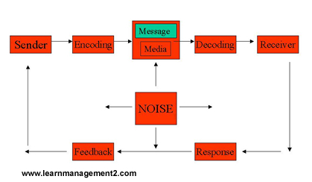
Communication Process

Slide 9
Developing Effective Marketing Communication

Slide 10
1. Identifying the Target Audience
Target Audience
What will be said?
How it will be said?
When it will be said?
Where it will be said?
Who will say it

Slide 11
2. Determining the Communication Objectives
Once the target audience has been defined, the marketer must decide what response they seek.
Buyer-Readiness Stages
The stages consumers normally pass through on their way to purchase, including awareness, knowledge, liking, preference, conviction and purchase.

Slide 12
Buyer-Readiness Stage
Awareness
Knowledge
Liking
Preference
Conviction
Purchase

Slide 13
3. Designing a Message
The message should be able to get Attention, hold Interest, arouse Desire and obtain Action (AIDA).
Message Content
Message Structure
Message Format

Slide 14
4. Choosing Media
The communicator must now select channels of communication.
Personal Communication Channels
Nonpersonal Communication Channels

Slide 15
5. Selecting the Message Source
Credibility of sources??

Slide 16
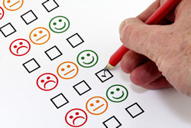
6. Collecting feedback
After sending the message, the communicator must research its effect on the target audience.

Slide 17
Setting the Total Promotion Budget and Mix

Slide 18
Setting the Total Promotion Budget
Affordable Method
Percentage of Sales Method
Competitive Parity Method
Objective and Task Method

Slide 19
Shaping the Overall Promotion Mix
The concept of integrated marketing communications suggests that the company must blend the promotion tools carefully into a coordinated promotion mix.
But how does the company determine what mix of promotion tools it will use?
Companies within the same industry differ greatly in the design of their promotion mixes.

Slide 20
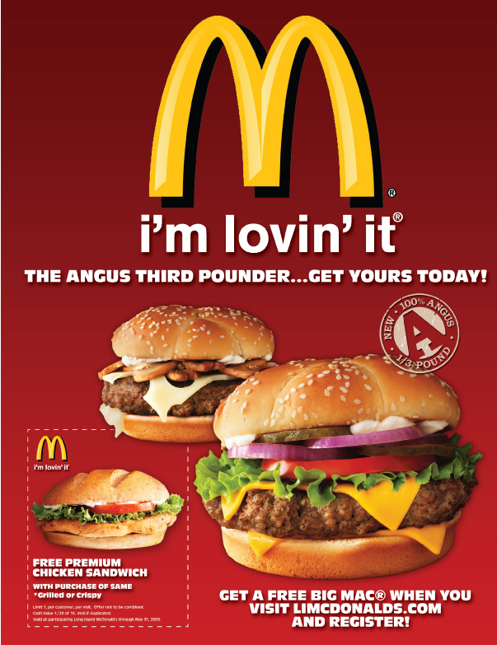
Advertising
Any paid form of nonpersonal presentation and promotion of ideas, goods or services by an identified sponsor.

Slide 21
Sales Promotion
Short-term incentives to encourage the purchase or sale of a product or service.
“Buy it now”

Slide 22
Personal Selling
Personal presentation by the firm’s sales force for the purpose of making sales and building customer relationships.

Slide 23
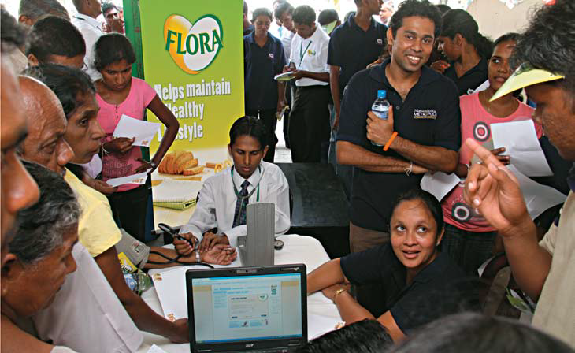
Public Relations & Publicity
Building good relations with the company’s various publics by obtaining favorable publicity, building a good corporate image, and handling or heading off unfavorable rumors, stories and events.

Slide 24
Direct Marketing
Direct connections with carefully targeted individual customers to both obtain an immediate response and cultivate lasting customer relationships.
Direct mail
Online marketing
E-mail

Slide 25
Interactive Marketing
Online activities and programmes designed to engage customers or prospects and directly or indirectly raise awareness, improve image or elicit sales of products and services.

Slide 26
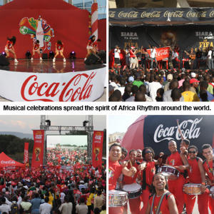
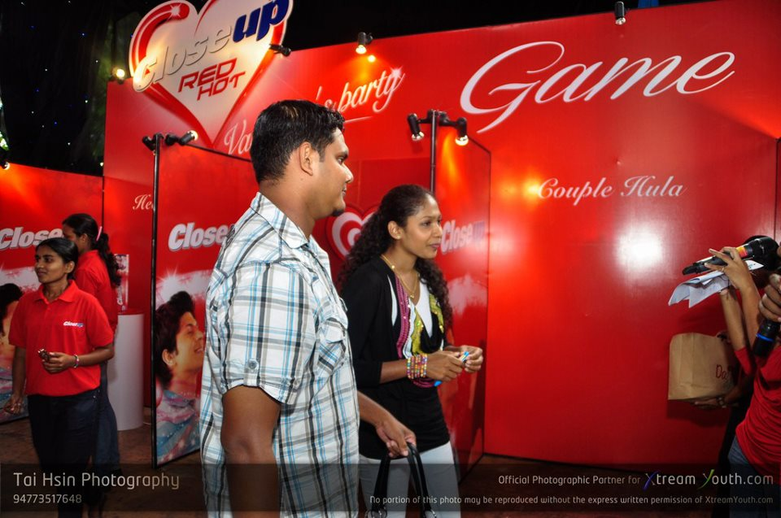
Events and Experiences
Company-sponsored activities and programmes designed to create daily or special brand-related interactions.

Slide 27
Word of Mouth
People-to-people, oral, written or electronic communications that relate to the merits or experiences of purchasing or using products or services.

Slide 28
Promotion Mix Strategies
Push versus Pull Promotion Strategy
Push strategy
Producer marketing activities
Reseller marketing activities
Producer
Retailers and wholesalers
Consumers

Slide 29
Push versus Pull Promotion Strategy
Pull strategy
Demand
Demand
Producer
Retailers and wholesalers
Consumers
Producer marketing activities

Slide 30
Integrating the Promotion Mix
Start with customers
Analyze trends – internal and external – that can affect the company’s ability to do business
Audit the pockets of communications spending throughout the organization
Team up in communications planning
Create compatible themes, tones and quality across all communications media
Create performance measures that are shared by all communications elements
Appoint a director responsible for the company’s persuasive communications effort

Slide 31
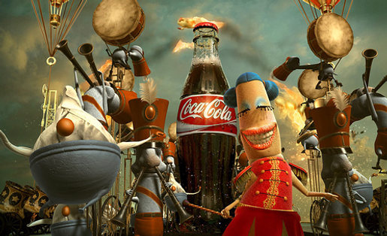
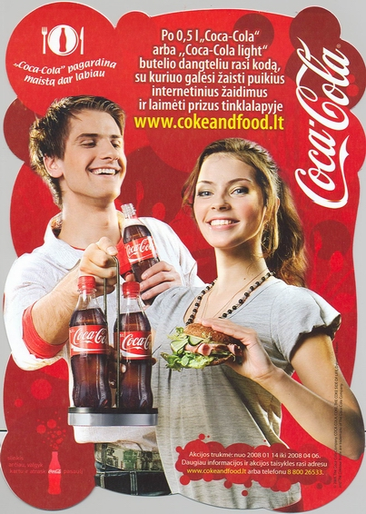
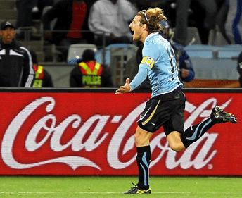
Consistent, clear and compelling company and brand messages

Slide 32
Summary and Conclusions

