Slide 1
Information Systems and Technologies in Organizations

Slide 2
Information System
One that collects, processes, stores, analyzes, and disseminates information for a specific purpose
  Is school register an information system?
  What are the information systems you know?
Components of an information system
  Hardware, software, data, procedures and people
  Also possible to have smaller information systems
    Application programs are usually developed for these

Slide 3
Data, Information and Knowledge
Data: Elementary descriptions of things, events, activities and transactions that are recorded, classified and stored, but not organized to convey any specific meaning
  What could be data in a student information system?
Information: Data that have been organized so that they have a meaning and value to the recipient.
  Interpret meanings and draw conclusions
Knowledge: consists of data and/or information that has been processed, organized, and put into context to be meaningful and to convey understanding, experience, accumulated learning, and expertise as they apply to a current problem or activity

Slide 4
Data, Information and Knowledge

Slide 5
IS architecture
POS Data

Slide 6
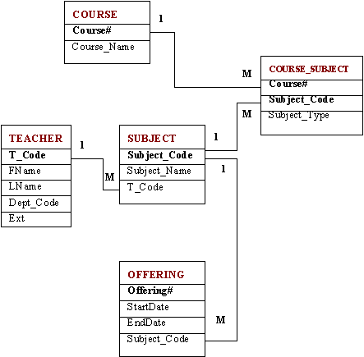
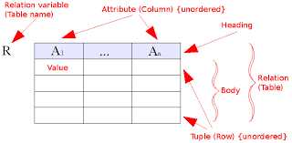
Relational Model
https://upload.wikimedia.org/wikipedia/commons/8/8d/Relational_model_concepts.png
https://www.dlsweb.rmit.edu.au/toolbox/knowmang/content/models/images/relational_schema_with_many.gif

Slide 7
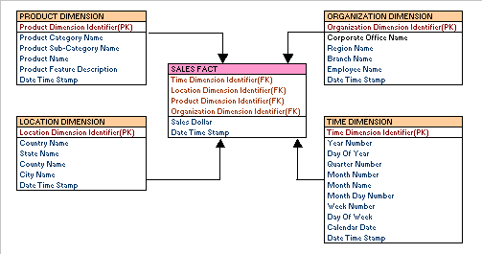
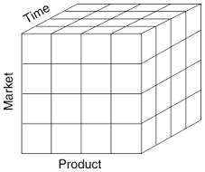
Dimensional Model
https://www.google.lk/url?sa=i&rct=j&q=&esrc=s&source=images&cd=&cad=rja&uact=8&ved=0CAcQjRxqFQoTCOLBwp3mp8gCFdMZjgodE4oCYA&url=http%3A%2F%2Flearndatamodeling.com%2Fblog%2Fdimensional-data-modeling%2F&psig=AFQjCNHAfF5RPqHcXZsq1nSU599J7p-stA&ust=1444010605728188

Slide 8
Information Systems

Slide 9
Types of Information Systems
Transaction Processing Systems
  Processing basic business transactions ensuring the smooth functionality and efficiency
  Processing could be done either as batches or online
    OLTP and web technologies enables inter-organizational interaction
  What are the examples for such systems?
  What are the devices involved?

Slide 10
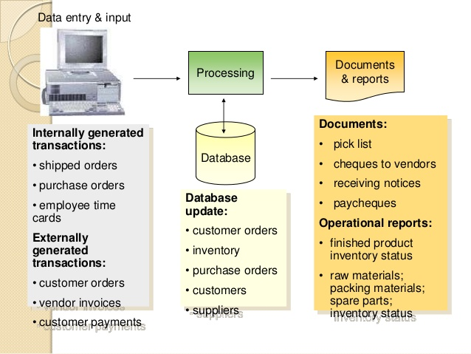
Transaction Processing System Overview
http://image.slidesharecdn.com/module21-130803073434-phpapp01/95/management-information-system-module2-57-638.jpg?cb=1375515555

Slide 11
Types of Information Systems
Management Information Systems
  Providing routine information for management activities in functional areas
  What are the examples of such systems?
    In different functional areas
Communication and Collaboration Systems
  Enables customers and employees to interact more closely and work together more efficiently
  What are the examples of such systems?

Slide 12
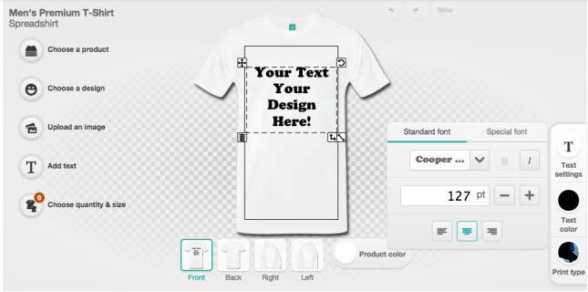
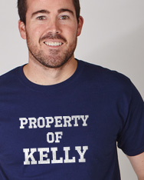
Design Your Own Product

Slide 13
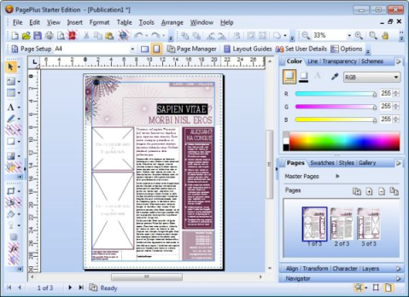
Types of Information Systems
Desktop Publishing Systems
  Combines texts, photos and graphics to produce professional quality documents
https://www.google.lk/url?sa=i&rct=j&q=&esrc=s&source=images&cd=&cad=rja&uact=8&ved=0CAcQjRxqFQoTCOrptPjrp8gCFVcHjgod5eoHgw&url=http%3A%2F%2Fwww.techsupportalert.com%2Fbest-free-desktop-publishing-program.htm&psig=AFQjCNHN4Wm5cy3EJT866BtRE9B9LsNFLA&ust=1444014627783449

Slide 14
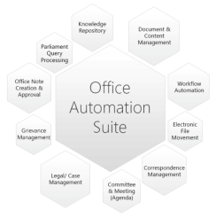
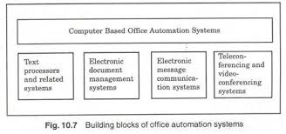
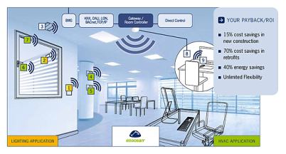
Office Automation Systems
Office Automation Systems (OAS):
  Increases productivity of office workers
https://www.enocean-alliance.org/typo3temp/pics/vm_office_en_int_02_40f7cac1e4.jpg
http://www.google.lk/imgres?imgurl=http://cdn.yourarticlelibrary.com/wp-content/uploads/2013/10/clip_image014_thumb2.jpg&imgrefurl=http://www.yourarticlelibrary.com/information-technology/importance-of-office-automation-system-for-business-enterprises/10427/&h=222&w=472&tbnid=50EMfNuTGXko1M:&docid=5Zzdbym_QzFTfM&ei=E5cQVqG2H4nkuQTqz4v4BQ&tbm=isch&ved=0CBwQMygCMAJqFQoTCOGL9qnqp8gCFQlyjgod6ucCXw

Slide 15
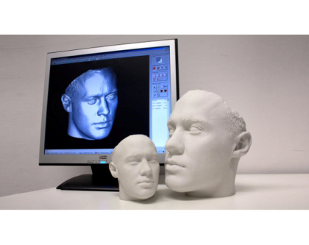
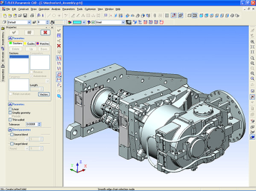
Types of Information Systems
CAD/CAM
  CAD: Computer Aided Design
  CAM: Computer Aided Manufacturing
  Allows engineers to design and test prototypes; transfer specifications to manufacturing facilities
  Part of Computer Integrated Manufacturing (CIM)
https://www.google.lk/url?sa=i&rct=j&q=&esrc=s&source=images&cd=&cad=rja&uact=8&ved=0CAcQjRxqFQoTCJqgxe_sp8gCFRMcjgodElcNXQ&url=http%3A%2F%2Fwww.computerweekly.com%2Ffeature%2FHow-3D-printing-impacts-manufacturing&psig=AFQjCNEeG1q547fgFDEHfnTrnfDceFk6kA&ust=1444014853891107
https://www.google.lk/url?sa=i&rct=j&q=&esrc=s&source=images&cd=&cad=rja&uact=8&ved=0CAcQjRxqFQoTCJ_N-ZHtp8gCFdAajgody3gOXQ&url=http%3A%2F%2Fschools-training.com%2Ftag%2Fcad-courses-online&psig=AFQjCNHZO2-HLDRGywzDYi1v2fAu5-1F2w&ust=1444014781586841

Slide 16
Types of Information Systems
Decision Support Systems (DSS)
  Combines models and data to solve semi-structured problems with extensive user involvement
  What is a model?
  What is a semi structured problem?
    Some structured elements and some unstructured elements
    Eg. Setting up a marketing budget or analyzing sales trends
  Characterized by what-if and goal seeking capabilities

Slide 17
How DSS Work

Slide 18
Types of Information Systems
Executive Support Systems
  Support decisions of top managers
  Two parts:
    Executive Information Systems: Satisfies information requirements of top executives
      What are the characteristics of such information?
        Rapid access, timeliness, direct access
      What are the characteristics that a EIS user interface should have?
        User friendliness
    Executive Support Systems
      Goes beyond EIS to include analysis support, communications, office automation and intelligence support

Slide 19
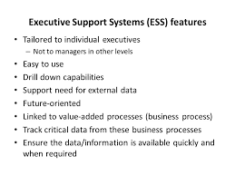

Slide 20
Intelligent Systems
AI is: behavior by a machine that, if performed by a human being, would be considered intelligent
Intelligent behaviors:
  Learning or understanding from experience
  Making sense of ambiguous or contradictory messages
  Responding quickly and successfully to a new situation
Knowledge base: Human fed data to a computer for it to have experience or to study and learn
  Organized as could be read and understood by a computer

Slide 21
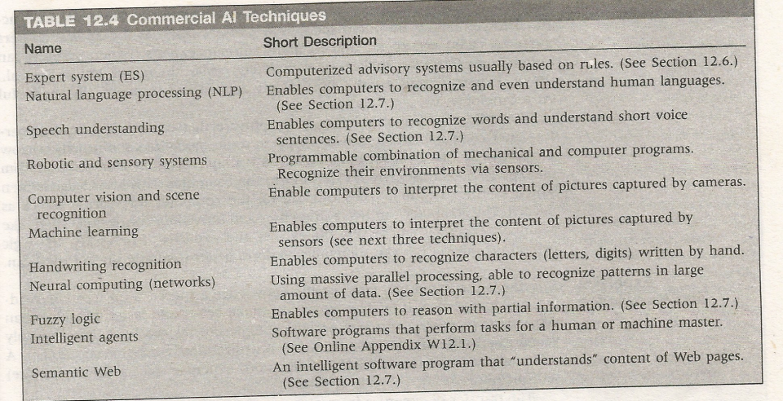
AI techniques

Slide 22
Types of Information Systems
Group Decision Support System
  Supports working processes of groups of people (including those in different locations)
  Supports solving semi-structured and unstructured problems as groups
  Objective is to support the process of arriving at a decision
  Read the case of virtual meetings at the world economic forum

Slide 23
Simulations
A technique for conducting experiments (such as “what-if”) with a computer on a model of a management system
Ideal for semi-structured and unstructured situations
Frequently used in DSSs

Slide 24
Types of Information Systems
Data Warehouse
  Stores huge amounts of data that can be easily accessed and manipulated for decision making
  Used for business intelligence
Geographical Information Systems
  A computer-based system for capturing, storing, checking, integrating, manipulating and displaying data using digitized maps

Slide 25
Types of Information Systems
Business Intelligence
  Gathers and uses large amounts of data for analysis by DSS, ESS and Intelligent Systems
  Enables information and knowledge discovery
  Uses:
    Online Analytical Processing (OLAP)
      Multi-dimensional analysis
    Data Mining
      Predictions of trends and behaviors
      Discovery of previously unknown patterns

Slide 26
Business Intelligence
combines software architectures, databases, analytical tools, applications, graphical displays, and decision- making methodologies
Main objective
  Provide timely access to data
  Support the analysis of managers and business analysts

Slide 27
Business Intelligence

Slide 28
IS Infrastructure and Architecture
Information Infrastructure:
  Physical facilities, services and management that support all shared computing resources in an organization
Information Technology Architecture:
  A high-level map or plan of the information assets in an organization including the physical design of the building that holds the hardware

Slide 29
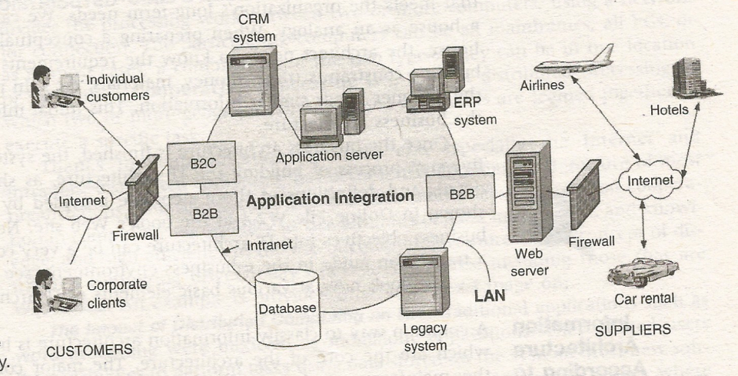
IT Architecture of a Travel Agent

Slide 30
Computing Environments in Organizations
Mainframes
  Processing is done at the mainframe computer(s)
  Users connect through ‘dumb’ terminals
PC Environments
  LANs
Distributed Processing
  Divides the processing work between two or more computers connected by a network
Legacy Systems
  Older, matured information systems
  Kept reengineered than replacing due to the high cost invested

Slide 31
Computing Environments in Organizations
Internet
  A worldwide system of computer networks (network of networks)
Intranet
  A private network in an organization created using web technologies
Extranet
  Connect several intranets via Internet

Slide 32
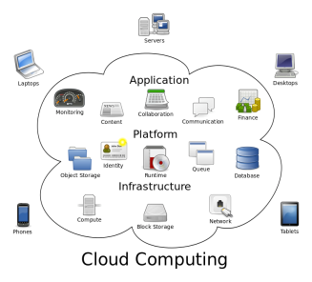
New Computing Environments
Utility Computing
  Computing that is as available, reliable and secure as electricity, water and telephony
  Cloud Computing
    Infrastructure as a service
    Platform as a service
    Software as a service
Grid Computing
  Unused processing power of all computers in the network could be used to generate more powerful computing capabilities

Slide 33
New Computing environments
Pervasive Computing:
  Computation becomes part of the environment
  Internet of Things and Ubiquitous computing
Web Services
  Self-contained, self-describing business and consumer modular applications, delivered over the Internet, that users can select and combine through almost any device, ranging from personal computers to mobile phones
Big Data
  Very large data repositories and associated techniques to process and analyze data

