Slide 1
Global Marketing

Slide 2
Global Firm
A firm that by operating in more than one country, gains R&D, production, marketing and financial advantage in its costs and reputation that are not available to purely domestic competitors

Slide 3
The WTO & GATT
The World Trade Organization and the General Agreement for
Tariffs and Trade promotes world trade by reducing tariffs in
other international trade barriers

Slide 4
Understanding the Marketing Environment
Economic Environment:
Subsistence economies: engage in simple agriculture, they consume most of there out put and barter the rest.
Raw material and exporting economics: rich in one resource poor in others. Revenue is generated by exporting them. Saudi Arabia –oil
Industrializing economics: manufacturing accounts for 10 -20% of countries economics – eg: India
Industrial economics: major exporters of manufacturing goods
Political-legal environment: Consider countries attitude towards international buying, government bureaucracy, political stability and monitory regulation
Cultural Environment:
Each country has its own folkways, norms and taboos, companies must understand how culture effects consumer reactions. Understanding culture and traditions could avoid embarrassing mistakes :eg Nike in China

Slide 5
To go Global or not?
Factors that draw companies into internal arena
Attack the home market by offering better products at lower price
Home market is shrinking, foreign markets offer higher sale and profit
Customers might be expanding abroad and require international services
Keu questions to answer?
Can it understand its consumers
Can it offer competitive products
Do the managers have international expereince
Impact of regulations and politics

Slide 6
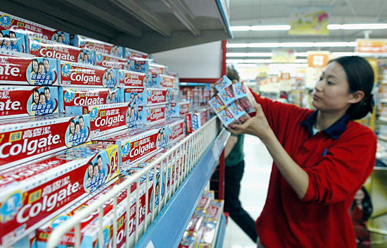
Which markets to enter?
Define international market objectives and policies
What volume of foreign sales it wants
How many countries it wants to market
Types of countries to enter
Eg: Colgate entering China
Indicators of Market Potential
Demographic characteristics
Geographic characteristics
Economic factors
Social cultural factors
Political and legal factors

Slide 7
Deciding how to enter the market

Slide 8
Exporting
Entering a foreign market by selling goods produced in the
companies home country, often with little modification.
Indirect Exporting: working through independent
international marketing intermediaries. Requires less
investment and less risk.
Direct exporting: companies handle their own exports.
Investment and risk is higher. Key ways to conduce direct exports:
Set up domestic export department
Overseas sales branch
Home based sales people
Foreign based distributors or agents

Slide 9
Joint venturing
Joining a Foreign company to produce or market products or
services. There are four types of joint ventures
Licensing: company enterers into a agreement with a licensee in the foreign market
Contract Manufacturing: company contracts with a manufacturers in a foreign market to produce or provide services
Management Contracting: domestic firm supplies the management know-how to a foreign company that supplies the capital
Joint Ownership: Company joins investors in a foreign market to create a local business in which the company shares joint ownership

Slide 10
Direct Investment
The development of a foreign-based assembly or a
manufacturing facility: Key advantages of direct investment:
Lower cost in the form of cheaper labor and raw material
Foreign government investment incentives and freight savings
Improve its image in the host country due to job creations
Develops cheaper relationship with the government, customers, suppliers, distributors
Has full control over the investment

Slide 11
The Marketing strategy

Slide 12
Standardized Marketing Mix
An international marketing strategy for using basically the same product, advertising, distribution and other marketing elements in all the company's international market.
Adapted Marketing Mix
An International marketing strategy for adjusting the marketing mix elements to each international target markets, bearing more costs but hoping for a large market share and returns.

Slide 13
Adapting Strategy to global markets
Product
Don’t change products
Develop New Product
Adapt Product
Straight Extension
Product Adaptation
Product Invention
Don’t change
communications
Communication
Adapt
communication
Communication Adaptation
Dual Adaptation

Slide 14
Product
Straight product extension: Marketing a product in a foreign market without any changes
Product adaption: Adapting a product to meet local conditions or wants a foreign markets
Product Invention: Creating new products or services for foreign markets

Slide 15
Promotion
Communication adaption: A global communication
strategy of fully adapting advertise messages to local markets.
Eg : Kelloggs in India – switch to lighter breakfast
*Some companies standardize their advertising around the world, adapting to meet cultural differences
Eg: Kellogs Brand Buds in Sweden

Slide 16
Price
Key problems in setting internal prices
Standardized mark up could lead to products being out of the market where costs are high
For comparable products foreign prices will be higher than domestic product due to transport and tariff : Gucci bags
Setting a price for good sold to a foreign subsidiary. If charges higher will end up paying higher tariffs, whilst paying duty, if charged lower will end up dumping (access supplies)

Slide 17
Distribution channel
Whole-channel view: Designing international channels that
take into account all the necessary links in distributing the
sellers products to final buyers, including the sellers
headquarters organization, channels amongst the nation, and
channels within nations

Slide 18
Sellers headquarters organization for international markets
Seller
Channel between nations
Channels within nations
Final user or buyers

