Slide 1
Market Structure and Pricing
Class 4

Slide 2
Market Structures
A market is an arrangement which links buyers and sellers.
Ebay
Local fish market
A ticket counter at rugby match
Amazon
Stock market
The term market structures refers to certain market characteristics. i.e Firms output and pricing behavior
Perfect Competition
Monopoly
Monopolistic Competition
Oligopoloy

Slide 3
Perfect Competition
There are many buyers and sellers in the market so no single firm has any control over the price of the product
Perfectly Competitive firms are PRICE – TAKERS
Stock markets, agricultural markets show some characteristic of perfectly competitive markets.
Identical products offered by sellers. – No differentiation
Freedom of Entry and Exit
Buyers know the prices charged by all the firms.
Perfect knowledge

Slide 4
Monopoly
One firm dominates the market.
Examples
Dutch East Indian Company (1602)
The Sri-Lankan Cricket Board.
De Beers Diamonds
Railways
Monopolists are price makers
In Class assignment
What are the advantages of a monopoly?

Slide 5
Monopolistic Competition and Oligopoly
Monopolistic competition
Large Number of firms
Selling Differentiated products
Price Differentiations are small.
Oligopoly
A handful of large firms are able to control supply
Car companies are oligopolies.

Slide 6
Market types
 | Perfect Competition | Monopolistic Competition | Oligopoly | Monopoly
Firms | Large number | Large Number | Small Number | One
Products | Identical | Differentiated | Similar. Differentiated | No close substitutes
Barriers to entry and exit | No barriers | Freedom of entry and exit | Some barriers to entry | Effective barriers to entry
Control over market price | No Control | Small Control | Substantial control | Significant control.

Slide 7
Revenue Concepts
Total Revenue
TR = P * Q
Average Revenue
AR = TR/Q = (P*Q)/Q = P
Marginal Revenue
MR = Change in TR/ Change in Quantity
Objectives of the firm
Traditional objectives of the firm is profit maximization (TR-TC)
Sales Maximization is maximizing TR

Slide 8
Equilibrium Analysis
Equilibrium – is when a firm reaches MR = MC
Slope of TR is MR
Slope of TC is MC
TR-TC = Profit
The slopes of TR and TC are equal when P is highest.
Hence the highest profit is when MR=MC
In a purely competitive market we find three types of equilibrium
Of the firm
Of the market
Of the industry
The two questions a firm has to ask
Whether to produce anything at all.
How much to produce if at all

Slide 9
Nuwara Eliya Milk Farms
Quantity (Q) | Total Revenue (TR) | Total Cost (TC) | Profit (TR-TC) | Marginal Revenue (MR=(∆TR/∆Q) | Marginal Cost (MC = ∆TC/∆Q) | Change in profit (MR-MC)
0 | 0 | 3 | -3 | - | - | -
1 | 6 | 5 | 1 | 6 | 2 | 4
2 | 12 | 8 | 4 | 6 | 3 | 3
3 | 18 | 12 | 6 | 6 | 4 | 2
4 | 24 | 17 | 7 | 6 | 5 | 1
5 | 30 | 23 | 7 | 6 | 6 | 0
6 | 36 | 30 | 6 | 6 | 7 | -1
7 | 42 | 38 | 4 | 6 | 8 | -2
8 | 48 | 47 | 1 | 6 | 9 | -3

Slide 10
We learned that rationale people think on the margin (Class 1)
If Marginal Revenue > Marginal Cost – The farm should increase production
If Marginal Revenue < Marginal Cost – the farm should reduce production
The cost curves have three primary features
MC Curve is upward sloping
ATC curve is U Shaped
MC curves crosses the ATC curve at the minimum of ATC

Slide 11
Perfect Competition
The Market price is horizontal (Because the firm is a price taker)
The profit Maximizing condition for a perfectly competitive firm is
MR = MC = P

Slide 12
Temporary Shut Down Vs Permanent Exit
Shut Down – Short run decision to not produce anything
Permanent exit – Long run decision to exit the market.
Most firms cannot avoid fixed costs in the short run
Firms Decision to Shut Down
Total Revenue < Total Variable Cost
Price < Average Variable Cost
Firms Decision to Exit Permanently
Total Revenue < Total Cost
Price < Average Total Cost
If this is the exit then
Price > ATC – is the entry

Slide 13
Measuring Profit
Profit = TR – TC
[(TR/Q)-(TC/Q)]* Q (We have not changed anything)
[Average Revenue (AR) – Average Total Cost (AC)]* Q
Price = AR
Profit = (P-ATC) *Q
So if ATC < P then you increase production
If ATC >P then you decrease production
What do perfectly competitive firms stay in business if they make 0 profit.

Slide 14
Monopoly
A monopoly is a price maker
Competitive market P=MC
Monopoly P> MC
The monopolist profit is not unlimited because of the demand curve
Why monopolies arise
Simply its due to the barriers of entry
Monopoly resources – a key resource used for production is owned by one firm (Diamonds)
Government regulation – the government gives a single firm the right to produce some good or service (railways)
The production process – economies of scale so the costs are much lower in one firm over the others.

Slide 15
Monopoly
Q | P | T2R (PQ) | AR (TR/Q) | MR (∆TR/∆Q)
0 | 11 | 0 | -
1 | 10 | 10 | 10
2 | 9 | 18 | 9
3 | 8 | 24 | 8
4 | 7 | 28 | 7
5 | 6 | 30 | 6
6 | 5 | 30 | 5
7 | 4 | 28 | 4
8 | 3 | 24 | 3

Slide 16
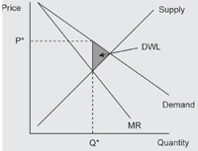
The monopolist profit
We know the optimal point is when MC intersects the demand curve
However monopolies charge the monopoly price and they get an excess profit

Slide 17
Price Discrimination
Price discrimination is when a monopolist charges different prices for the same product to minimize the dead weight loss.
Examples
Airline tickets
Books sold to different regions.
Class Exercise: Explain the Dead Weight Loss?

Slide 18
Imperfect Competition
Imperfect Competition
Monopolistic
Competition
Competition

Slide 19
Shortcomings of the monopolistic markets
A monopolistic competitive firm is inefficient. Average total cost is not at a minimum.
There is a lot of information for the consumer to collect and process to make the best decisions.
Advertising increases cost but advertising is essential to differentiate.

Slide 20
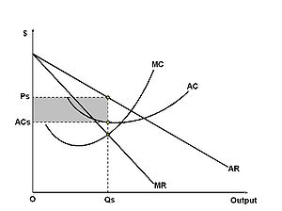
Monopolistic Competition Graph

Slide 21
Oligopoly
Competition amongst a few
Reasons
Economies of scale
Barriers to entry
Mergers
Horizontal Mergers – Involves firms selling a similar product
Vertical Merger – A merger between suppliers and buyers
Conglomerate merger – A merger between firms selling unrelated products
Strategic Alliances

Slide 22
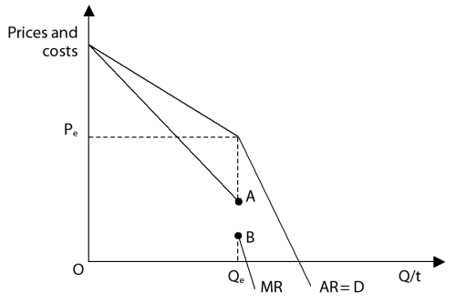
The kinked demand curve
An oligopoly’s demand curve is usually described as “kinked”
There are two assumptions in play
A price increase in one firm will not result in a price increase in the other
A price decrease in one
will result in a price decrease
in the other.
So when prices increase the
curve is elastic
When prices decrease the
curve is inelastic
This creates the kink.

Slide 23
Other Price Policies in Oligopoly Markets
Price Leadership
One firm is accepted as the price leader, the price leader will be the first to adjust prices
Predatory Pricing
A large diverse firm that can stand temporary losses, will cut prices to run others out of business. (This is illegal)
Price Fixing
Formal agreements (This is somewhat illegal too)
For example Cartels (OPEC)

Slide 24
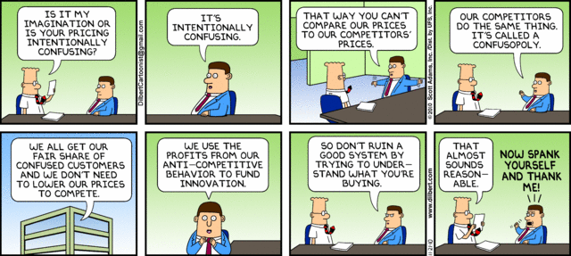
Break Time

