Slide 1
Promotion Mix
University of Kelaniya
S.Uditha Bandara
Senior Lecturer
Department of Marketing Management

Slide 2
Think
Of a time where you really influence someone to do something…
Could you able to change the behavior of that person …?
Or
was it changed your behavior …?

Slide 3
Marketing Communication
The ultimate goal of marketing communication is to reach some audience to affect their behavior.
Three Major Objectives
Inform
Remind
Persuade

Slide 4
The Communication Process
Sender
Encode
Media
Decode
Receiver
Message
Noise
Feedback

Slide 5
Steps in Developing Effective Communication
Identify the target audience
Determine objectives
Design the Message
Select the channel
Establish the budget
Manage Integrated Marketing Communication
Measure results
Decide on media mix

Slide 6
Identifying the Target Audience
The audience may be
potential buyers or current users;
those who make the buying decisions or those who influence it; or
individuals, groups, special publics or general public.
Image Analysis
Notes:
Image is the set of beliefs, ideas and impressions of person holds regarding an object

Slide 7
Determining the Communication Objectives
Response Hierarchy Models
Stages | AIDA Model | Hierarchy of Effects Model | Innovation-Adoption Model | DAGMAR Model | Communications Model
Cognitive Stage | Attention | Awareness Knowledge | Awareness | Awareness | Exposure Reception Cognitive response
Affective stage | Interest Desire | Liking Preference | Interest Evaluation | Comprehension | Attitude Intention
Behavior stage | Action | Conviction Purchase | Trial Adoption | Conviction Action | Behavior
Cognitive Stage - marketer may want to put something into the consumer’s mind through by creating knowledge and awareness.
Affective Stage - change an attitude using the response that had been created in the consumer’s mind.
Behavioral Stage - get the consumer to act.
Modelling for Marketing Communication

Slide 8
Design the Message
the message should gain
attention, interest, arouse desire and provoke action (AIDA)
Solving four problems
what to say (message content)
how to say it logically (message structure)
how to say it symbolically (message format) and
who should say it (message source).

Slide 9
Message Content
Rational Appeals | Emotional Appeals | Moral Appeals
Engage self-interest. They claim the product will produce certain benefits. Eg: Message demonstrating quality, economy, value, performance. Industrial buyers are most responsive to rational appeals. | Attempt to stimulate negative or positive emotions that will motivate purchases. Marketers search for right Emotional selling proposition (ESP). Product may be similar to the competition but have unique association that can be promoted. Can work with negative appeals (fear, guilt) to get people to do things or stop doing things or can work with positive appeals like humor, love, pride, joy, etc. | Directed to the audience’s sense of what is right and proper. They are often used to motivate people to support social causes.
In determining message content, management searches for an appeal, theme or unique selling proposition (USP).

Slide 10
Message structure
Under this following aspects are given consideration.
Order of presentation
Conclusion drawing
Important content and other details
Verbal vs. visual messages

Slide 11
Message Format
Must develop a strong format
For example,
in a print add, headline, copy, illustration and color.
For a message carried over the radio, the communicator has to choose words, voice qualities and vocalization.
If the message is for the television, all of this plus body language has to be planned.

Slide 12
Message Source
“Source” means the person involved in communicating marketing message either directly or indirectly.
Source attributes
Credibility -
extent to which the recipient sees the source as having relevant knowledge, skill or experience and trusts the source to give unbiased, objective information.
Attractiveness -
encompasses similarity and likeability.
Power -
Source can administer rewrds and punishments to the receiver

Slide 13
Communication Channel
Communication Channels
Personal
communication channels
Non-personal
communication channels

Slide 14
Budget
Affordable
approach
Objective &
task method
Competitive
party
Percentage of
sales or profit

Slide 15
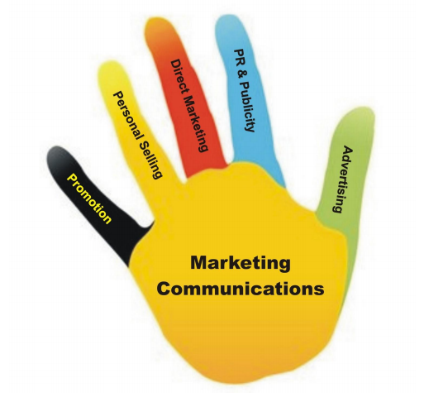
Deciding upon and integrating the elements of Promotions Mix
Budget has to be allocated between several promotional tools, such as advertising, sales promotions, public relations, and publicity, sales force and direct marketing.

Slide 16
Advertising
Motion Pictures
Web Pages
Posters
Advertising is “Any paid form of non-personal presentation and promotion of ideas, goods or services by an identified sponsor.”
Print adds
Newspapers
Strengths | Weaknesses
Can easily reach many buyers and simulate them | Reaches many people who are not potential buyers
Effective way to create image of the brand | Ads are subject to criticism
Flexible | Exposure time is short
Variety of media to select from | People tend to Skip advertisements
 | Total cost is high
Radio
Billboards
Brochures

Slide 17
Sales Promotions
Exhibitions
These are temporary tools available with the marketer to persuade the customer to purchase products.
Coupons
Contests
Strengths | Weaknesses
Variety of sales promotion tools available | Impact may be limited to short-term
Effective in changing short-term behavior | Price-related sales promotion may damage the brand image
Easy link to other communications | Easy for competitors to copy
Product samples
Rebates
Trade shows

Slide 18
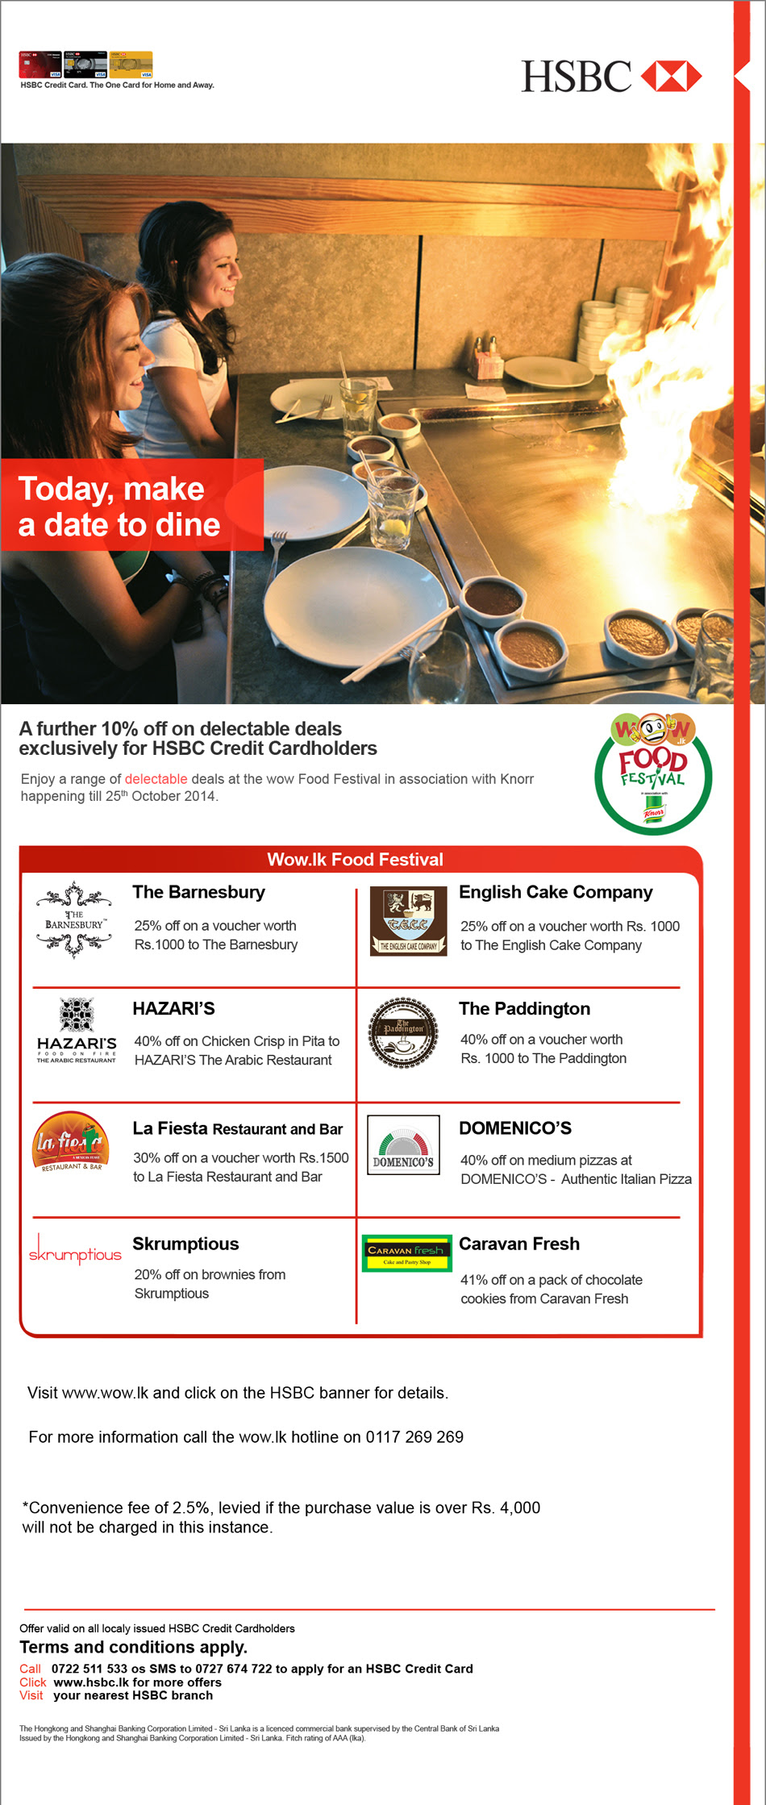
Direct Marketing
Direct marketing is about direct connections with carefully targeted individual consumers to both obtain an immediate response and cultivating lasting customer relationships – the use of telephone, mail, fax, e-mail, internet and other tools to communicate directly with specific consumers.
Mobile messaging
E - mail
Online display ads
Strengths | Weaknesses
Message can be customized and prepared quickly | Often low customer response
Can facilitate a relationship with customer | Managing and maintaining accurate database can be costly
E - fliers
Promotional letters

Slide 19
Personal Selling
Personal representation by the firm’s sales force for the purpose of making sales and building relationships. It is helpful in building up the buyer’s preference, conviction and action
Sales presentation
Strengths | Weaknesses
Message can be targeted to specific individuals weaknesses | Cost per contact is high
Salespeople can be persuasive and influential | Salespeople may be hard to recruit and motivate
Two-way communication allows for questions and other feedback | Presentation skills may vary between salespeople
Sales meetings
Sales training
Telemarketing

Slide 20
Public relations
Public relations means building good relations with the company’s various publics by obtaining favorable publicity, building up a good corporate image and handling or heading off unfavorable rumors stories and events.
Issue Advertising
Newspaper and magazine article
Strengths | Weaknesses
Total cost may be low | Media may not cooperate
Media-generated stories seen as more credible than marketer-sponsored messages | Heavy competition for media attention
 | Marketer has little control over the message
Report
TVs and radio presentation
Charitable contribution

Slide 21
Measuring the results
Quantitative Measures
Qualitative Measures

Slide 22
Managing integrated marketing communication

Slide 23
THANK YOU

Slide 24
Individual Assignment
Select a brand of your choice and write a report to analyze the communication tools that the company has used in communication and promoting the brand.
You are supposed to give recommendations as well.
Marks = 20
Submission date = on or before 11th November

