Slide 1
Product
Marketing Mix
S. Uditha Bandara
MBA (PIM, Sjp), B. B. Mgt (Mkt) Special
Senior Lecturer
Department of Marketing Management
University of Kelaniya

Slide 2
Marketing Mix
Product
Variety
Brand Name
Quality
Design
Packaging
Warranty
Features
Services
Price
List Price
Discounts
Price discrimination
Payment Period
Credit Terms
Bundling
“Controllable factors in the marketing environment and managers can change them strategically in order to get higher benefits”
Target Market
Promotion
Advertising
Personal Selling
Sales Promotions
Public Relations
Direct Marketing
Promotional Strategy
Place
Channels
Market Coverage
Inventory
Locations
Transportation
Logistics
Warehousing

Slide 3
Activity
List down the products you know….
and
Categorize them into different categories according to their features

Slide 4
Product
Anything that can be offered to a market for attention, acquisition, use or consumption that might satisfy a want or a need (Kotler).
Products includes
Physical objects
Ideas
Tangible goods ?
Services
Events
Places
Experiences
Persons
Mixes of these entities
Organizations
Notes:
Friends don’t let Friends Drive Drunk…

Slide 5
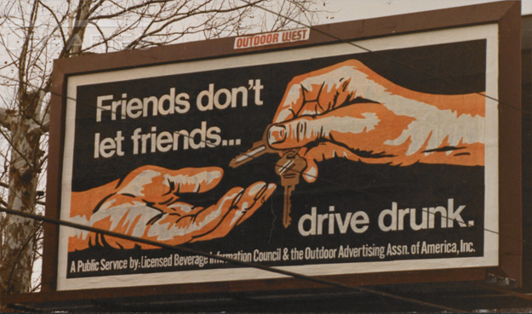

Slide 6
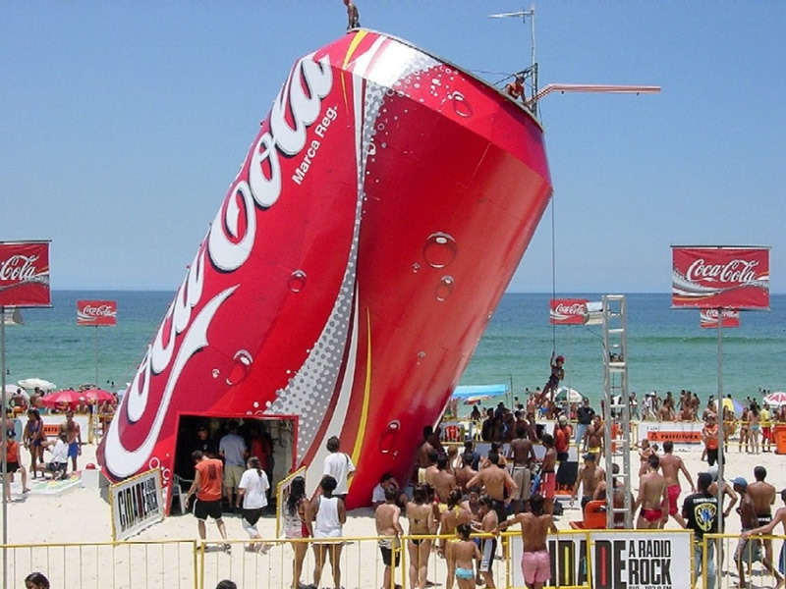

Slide 7
Group Activity
Discuss with your group members about the application of each of the entities mentioned above and identify examples from the market (in Sri Lanka or Internationally)

Slide 8
Services
Service is any act or performance that one party can offer another that is essentially intangible and does not result in the ownership of anything.
(Kotler, 1991:254)

Slide 9
Service
Intangibility - The inability to touch and feel the production of the service.
Inseparability – Cannot separate the service provider.
Variability – Every time a service is performed, it will vary depending on the service provider or other factors.
Perishability – One cannot store services.
Pure Tangibles
Eg-Toothpaste,
Salt, Sugar
Tangible goods with an accompanying service
Eg- Automobile
Hybrid – Equal parts of goods and service
Eg- Restaurant
A major service with accompanying goods
Eg- Air line
Pure Services
Eg- Baby sitting
Consulting

Slide 10
The best way to hold
customers is to
constantly figure out
how to give them
more for less.
More for Less ?

Slide 11
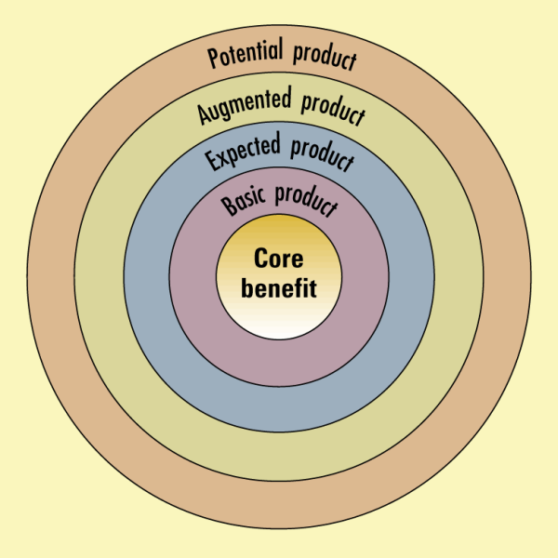
Levels of the product
POTENTIAL PRODUCT : Future augmentation & transformation of product
AUGMENTED PRODUCT : Exceeds customer expectations
EXPECTED PRODUCT : Set of attributes & condition buyer expects
BASIC PRODUCT : To turn core benefit into basic product
CORE BENEFIT : The fundamental service customer is buying

Slide 12
Group Activity
Select 2 products or services of your choice and explain the levels of those products
Present your findings to the class and get their ideas

Slide 13
Product classifications
Durable / Non durable
Tangible / Intangible
Consumer / Industrial

Slide 14
Consumer goods
Products and services that are purchased by final consumers for their own consumption
Convenience Goods
Shopping Goods
Specialty Goods
Unsought Goods
Goods that the customer purchases frequently, immediately, and with a minimum comparison and buying effort
Convenience Goods
Staple Goods - Goods that consumer buy on regular basis – Soap, Bread
Impulse Goods – Purchase with little planning or search effort. – Candy bars, Chocolate
Emergency Goods – Purchase for emergency purposes. – Umbrellas during a rainy season.

Slide 15
Shopping Goods
Includes mainly durable and semi durable goods where the customers spend time in gathering information and comparing.
Furniture, Computers

Slide 16
Specialty Goods
Products which are characterized by an extensive search, consumers are reluctant to accept substitutes for those products. Goods with unique characteristics and brand identification.
Branded Cars

Slide 17
Unsought Goods
Goods that customers do not actively seek for. These are consumer goods that the consumer either doesn’t know about the product or, doesn’t normally think of buying.
Insurance Policies, Encyclopedias, Novels

Slide 18
Type of Consumer Product
Market Considerations | Convenience | Shopping | Specialty | Unsought
Consumer buying behavior
Price
Distribution
Promotion
Examples

Slide 19
Type of Consumer Product
Market Considerations | Convenience | Shopping | Specialty | Unsought
Consumer buying behavior | Frequent purchase, little planning, little comparison or shopping effort, low customer involvement | Less frequent purchase, must planning and shopping effort, comparison of brands on price, quality, style | Strong brand preference and loyalty, special purchase effort, little comparison of brands, low price sensitivity | Little product awareness, knowledge (or if aware, little or even negative interest)
Price | Low price | Higher price | High price | Varies
Distribution | Widespread distribution, convenient locations | Selective distribution in fewer outlets | Exclusive distribution in only one or a few outlets per market area | Varies
Promotion | Mass promotion by the producer | Advertising and personal selling by both producer and reseller | More carefully targeted promotion by both producer and resellers | Aggressive advertising and personal selling by producer and resellers
Examples | Toothpaste, magazines, laundry detergent | Televisions, furniture, clothing | Luxury goods, such as Rolex watches or fine crystals | Life insurance, Red Cross blood donations

Slide 20
Industrial Goods
Material & Parts
Suppliers & Services
Capital items

Slide 21
Branding Strategies
Brands associate with some meanings of characteristics.
Attributes Benefits
Values Culture
Personality User

Slide 22
Individual Product Decisions
Product Attributes
Branding
Packaging
Labeling
Product Support Services

Slide 23
Product and service attributes
Product Quality
Product Features
Product Style and Design

Slide 24
Branding
What is a brand ?

Slide 25
Major Brand Strategy Decisions
Brand Decisions
Brand
No Brand
Brand Strategy Decisions
Line Extension
Brand Extension
Multi-brands
New Brands
Co-Branding
Brand Sponsorship
Manufacturer’s Brand
Private /Distributor Brands
Licensed Brands
Brand Name
Individual Names
Family Names
Company & Individual Names

Slide 26
Branding Strategies
Brand
No Brand
Manufacturer’s Brand
Private Brand
Individual Brands
Family Brands
Combination
Individual Brands
Family Brands
Combination

Slide 27
Brand Name Decision
Individual brand name- they develop individual brand names for each separate product.
Blanket family brand name- every products promoted under the same brand name.
Eg. – Harischandra Products
Separate Family Brand name – Put separate product categories under a family name, under these product categories they make several similar products.
Eg. – Separate brand name for household appliances, Separate brand name for electronic items
Company trade names combine with the individual product name
E g. - Maliban Cream Cracker, Maliban Chocolate Cream, Maliban double cream

Slide 28
Brand Strategy Decision
Line Extension
Brand Extension
Multi Brand
New brand
Co-Branding

Slide 29
Packaging
Primary Package
Secondary package
Shipping Package
Self service
Consumer affluence (consumers are willing to pay additional money for the package for convenience, appearance, durability and prestige)
Innovative opportunity - (Innovative packages provide large benefits to the consumer and the marketer also.)
Improving company image and brand image
Attract attention
Protection
Knowledge
Advertising

Slide 30
Labeling
Product support services

Slide 31
Product Mix Decisions
Width of a product mix
Length of product mix
Depth of the product mix
Consistency of product mix

Slide 32
Personal and Beauty | House and Home | Health and Wellness | Baby and Family | Pet Nutrition and Care
Antiperspirants & Deodorants Old Spice, Secret | Air Fresheners | Health Care | Baby & Child Care Pampers | Pet Nutrition
Colognes Old Spice | Dish Washing Dawn, Ivory, Joy | Prescription Drugs
Cosmetics CoverGirl, Max Factor | Household Cleaners
Feminine Care | Laundry & Fabric Care Ivory, Tide
Hair Care Head & Shoulders Herbal Essences Pantene | Paper Products
Hair Color | Snacks Pringles
Prestige Fragrances BOSS, HUGO, PUMA
Shaving Gillette Fusion, Gillette M3
Skin Care Olay

Slide 33
Product Life Cycle PLC
B.S.S.U. Bandara
Lecturer
Department of Marketing Management
University of Kelaniya

Slide 34
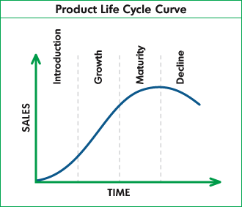

Slide 35
1) Introduction Stage
A period of slow sales growth as the product is new to the market. Within this period following characteristics can be identified.
Low sales volume
Low or no profit
Low competition
Potential buyers are innovators and early adopters
Consumer awareness is low.
Promotional expenses are high in this stage

Slide 36
2) Growth Stage
A period of rapid market acceptance and substantial profit improvement. In this stage following characteristics can be identified,
Potential buyers are early adopters and early majority.
Sales volume and profit is growing
New competitors are entering to the market.
In this stage marketer can use several strategies
Improve product quality and add some additional features
Enter in to new market segments
Add new models
Increase distributing coverage and select new distribution channels
Shift from product awareness advertisements to product preference advertising
Introduce lower prices to obtain the next layer of price sensitive buyers.

Slide 37
3) Maturity Stage
A period of slow down in sales growth because of the product has already archived acceptance by most potential buyers.
Marketing strategies
Market modification
Convert non users to users
Enter in to new market segments
Win competitor’s customers
Product Modification
Increase quality
Introduce new features
Marketing Mix modification
Price - Find new channels and modifies existing outlets
Advertising - Use remind ads
Sales promotion - Provide free items, gift items, reduce price
Personal selling - Increase quality of the sales people
Service - Increase the service quality

Slide 38
4) Decline stage
The period when sales and profits will slow down.
Strategies
Increase investments
Maintain investments as fix rate until uncertainty is solved
Decrease investments
Harvesting
Diverting

Slide 39
New Product Development-NPD New product development is common practice of modern organizations. There are several steps involve with the process of new product development.
Idea Generation
Screening
Concept Development & Testing
Commercialization
Marketing Strategy
Market Testing
Business Analysis
Product Development

