Slide 2
Segmentation, Targeting & Positioning
B.S.S.U. Bandara
Lecturer
Department of Marketing Management
University of Kelaniya

Slide 3
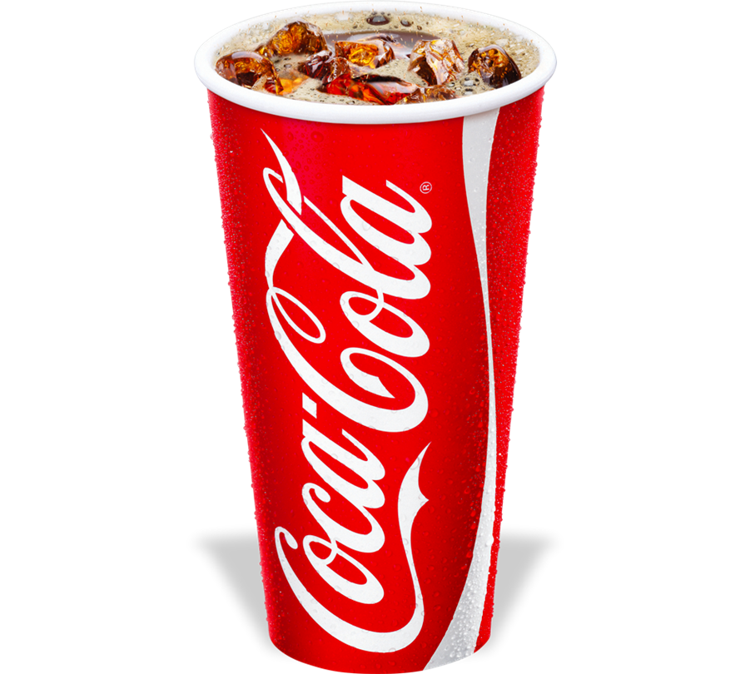
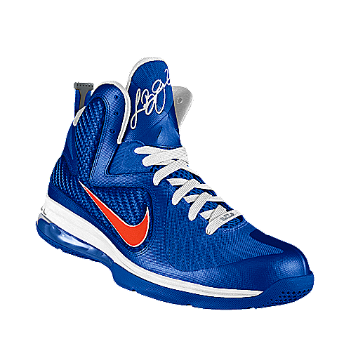
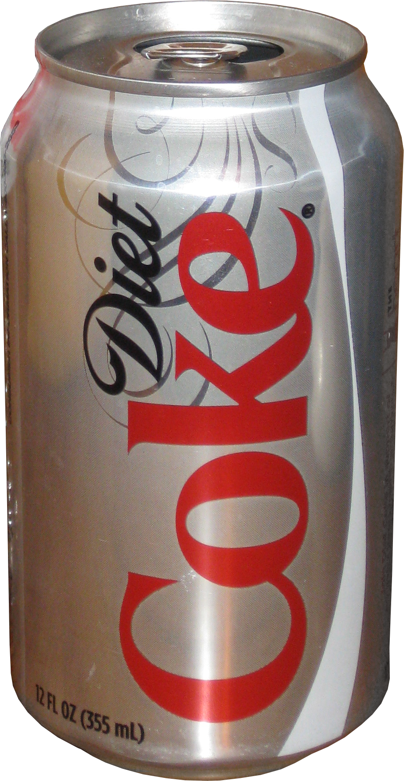
Segmentation
Market
Cluster of individuals, organizations
Have specific needs and wants
Necessary financial resources and authority to purchase
3 approaches to handle Markets
Mass Marketing
Target
Marketing
Mass Customization
Notes:
Mass market product is Coca Cola, McDonald's hamburgers. Mass market products have highly general utility and universal appeal.
…Coca Cola Diet Coke…
Benefits of Mass Market
Wide Audience
Low Risky
‘ Cost of Marketing Activities is relatively low
Economies of Scale (Low production cost

Slide 4
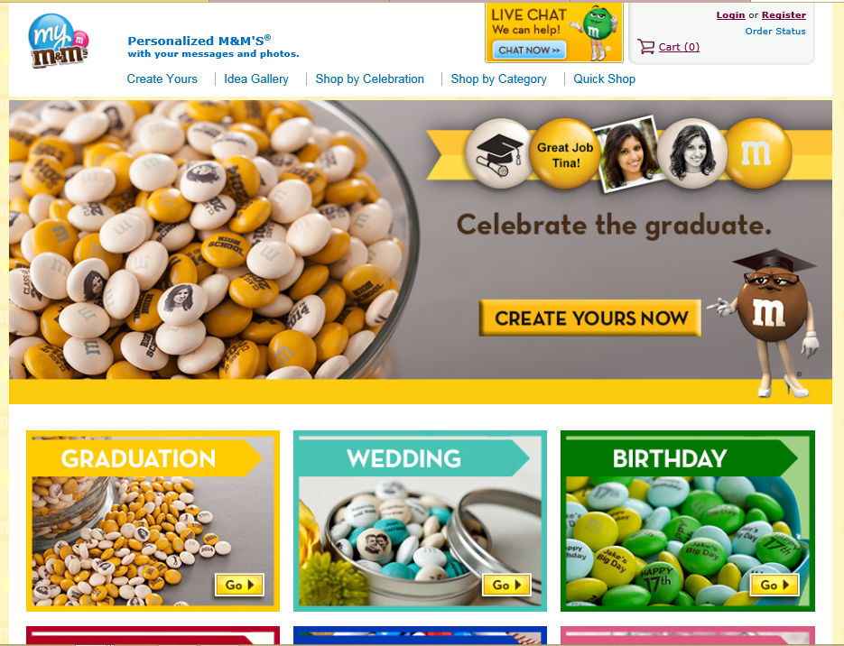
Mass Customization

Slide 5
Segments
Target ?
…………………………
Ladies
Gents
Kids
Teenagers
Mass Market

Slide 6
Process of Target Marketing
Market Segmentation
Market Targeting
Market Positioning
Segment the Market
Develop Segmentation Profile
Evaluation of the Segment
Select the Target
Identify Possible Positioning Options
Select , Develop and Communicate the chosen positioning Strategy
Source: Philip Kotler, Marketing Management (1994) P.265

Slide 7
Market Segmentation
What and Why Segmentation?
Bases of Segmentation
Segmentation Variables
Geographic Segmentation
Demographic Segmentation
Psychographic Segmentation
Behavioral Segmentation
Region
City
Density
Climate
Age
Gender
Family Size
Family Life Cycle
Income
Occupation
Education
Religion
Race
Social Class
Life Style
Personality
Occasions
Benefits
User Status
Usage Rate
Loyalty Status
Attitudes
Readiness
Notes:
Life Style: Natural fiber products as ideal for a Natural, Healthy, Active life.
Personality : Cosmetics, Cigarettes, Insurance and Alcoholic drinks.

Slide 8
Effective Segmentation
Measurable : The size of the segment, the purchasing power of customers, etc should be able to be measured.
Accessible: The segment should be effectively reached and served.
Substantial: The segment/segments should be sufficiently large so that the company can earn profits.
Differentiable: The segment should be distinctive in the buying behavior. (Each segment should response differently to different marketing mixes)
Actionable: Effective marketing programs can be planned and implemented for serving the segments.

Slide 9
Targeting
The act of selecting one or more segments to enter.
Evaluating the attractiveness of each segment
Deciding how many and what segments to enter.
1. Evaluating the segments
To identify the attractive segments to cater, the organizations must evaluate each segments using following criteria.
Segment size and growth
Structural attractiveness
Should consider about the long-term profitability of the segment. Can use Michael Porter’s five forces model to measure this.
Company objectives and resources (Competencies and capabilities)
Whether catering to some segments are meeting the long-run objectives of the company. Whether the company has required skills and resources to succeed in the segment.

Slide 10
Selecting the Market Segment
M1
M2
M3
P1
Single – Segment Concentration
P2
P3
M1
M2
M3
P1
Selective Specialization
P2
P3

Slide 11
M1
M2
M3
P1
Product Specialization
P2
P3
M1
M2
M3
P1
Market Specialization
P2
P3

Slide 12
M1
M2
M3
P1
Full Market Coverage
P2
P3

Slide 13
Target Market Strategies
Undifferentiated Target Market Strategy
Segment 1
Company Marketing Mix (One mix)
Segment 2
Segment 3
2. Differentiated Target Market Strategy
Marketing mix 1
Segment 1
Marketing mix 2
Segment 2
Marketing mix 3
Segment 3
3. Concentrated Target Market Strategy
Company Marketing Mix (One mix)
Segment One

Slide 14
Positioning

Slide 15
Differentiation and Positioning the Marketing Offer
Positioning is concerned with the perception customers hold regarding a product or a company.
Differentiation
The act of designing a set of meaningful differences to distinguish the company’s offer from competitors’ offer.

Slide 16
Basic Dimensions for Differentiation
Product Differentiation
Differentiating the physical product.
Eg- Feature, Performance, Durability, Reliability, Reparability, Style, Design
2. Service Differentiation
Differentiating the accompanying services.
Eg – Delivery, Installation, Customer Training, Repair, Miscellaneous Services
3. Personal Differentiation
Differentiating the people. This can be achieved by hiring and training better people than competitors do
4. Image Differentiation
Company can create different image to the company and its brands and it can gain a valuable competitive advantage through this.

Slide 17
Positioning starts with a product. A piece of merchandise, a service, a company, an institution, or even a person…. But positioning is not what you do to a product. Positioning is what you do to the mind of the prospect. That is, you position the product in the mind of the prospect.
Al Ries & Jack Trout
Market Positioning
Positioning is an art that places the product in the minds of the customer to gain a unique mental picture for the products in relation to competing products.

Slide 18
Positioning strategy mainly calls for two decisions.
How many differences to promote?
Which differences to promote?
Answering these, one reputed way is to promote one benefit to the target market (Single Benefit Positioning).
If company uses this, the benefit will act as the Unique Selling Proposition (USP) of the brand.
Some companies are using Double-Benefit Positioning.
Positioning Strategies
Attribute Positioning : Promote one or more attributes of the product.
Benefit Positing : Promoting a benefit/s directly
Use Positioning :Promote type of usage that is ideal for the product.
User Positioning :Promoting the product for certain type of customers.
Competitor positioning :Positioning with comparison to competitors
Product Category Positioning :positing as a different product class.
Quality/Price Positioning

Slide 19
Steps towards Positioning
Identifying possible competitive advantages
Choosing the right competitive advantages
Communicating & delivering the chosen positioning
Activity
Select few brands of a product category and plot them in a positioning map

Slide 20
Assignment 1
Choose a product of your choice and develop a segmentation profile, select the appropriate target market out of those segments and develop a positioning map with a rational.

