Slide 2
Consumer ???

Slide 3
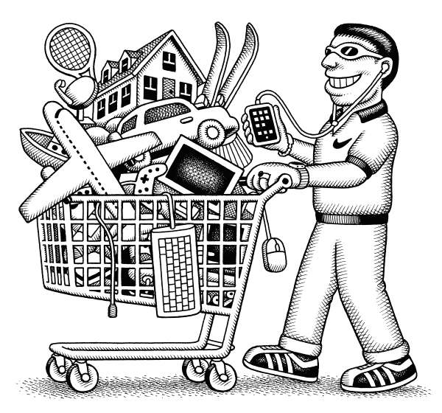
Buyer behavior in Consumer market

Slide 4
Stimulus Respond Model

Slide 5
The Major Factors Effect on Consumer Behavior

Slide 6
Cultural Factors
1.1 Culture
Way of doing things
Clothing and Food
1.2 Sub culture
Way of doing things
University subculture, Religion subculture
1.2 Social class
Relatively homogeneous and enduring in the society
Upper class, Middle class, Lower class

Slide 7
(2) Social Factors
2.1 Reference Groups
Membership Groups – Family , Friends, relatives
Secondary Groups - Religion groups, professionals, trade unions
Aspiration groups
Disassociate groups
2.2 Family
2.3 Roles and Status
Eg: Family, Business organizations, Clubs, Unions

Slide 8
3) Personal Factors
3.1 Age & Stages of Life cycle
Bachelor Stage-Unmarried person
Newly married stage-Young couple without children
Full nest one-Youngest child below 6 years old
Full nest two-youngest child 6 years or over
Full nest Three –Old couple with depended children
Empty nest one-Older couple, No children living with them
Empty nest two- Older children, not living with parents, Head of the household retired.
Solitary survivor – (In labor force)-One person in the household, still included to the labor force
Solitary Survivor (retired)
3.2 Occupation and Economic circumstances
3.3 Life style
3.4 Personality and Self concept
Actual self concept.- How he or she view her/him self
Ideal self concept – How he would like to see him self
Other selves concept – How he thinks about others

Slide 9
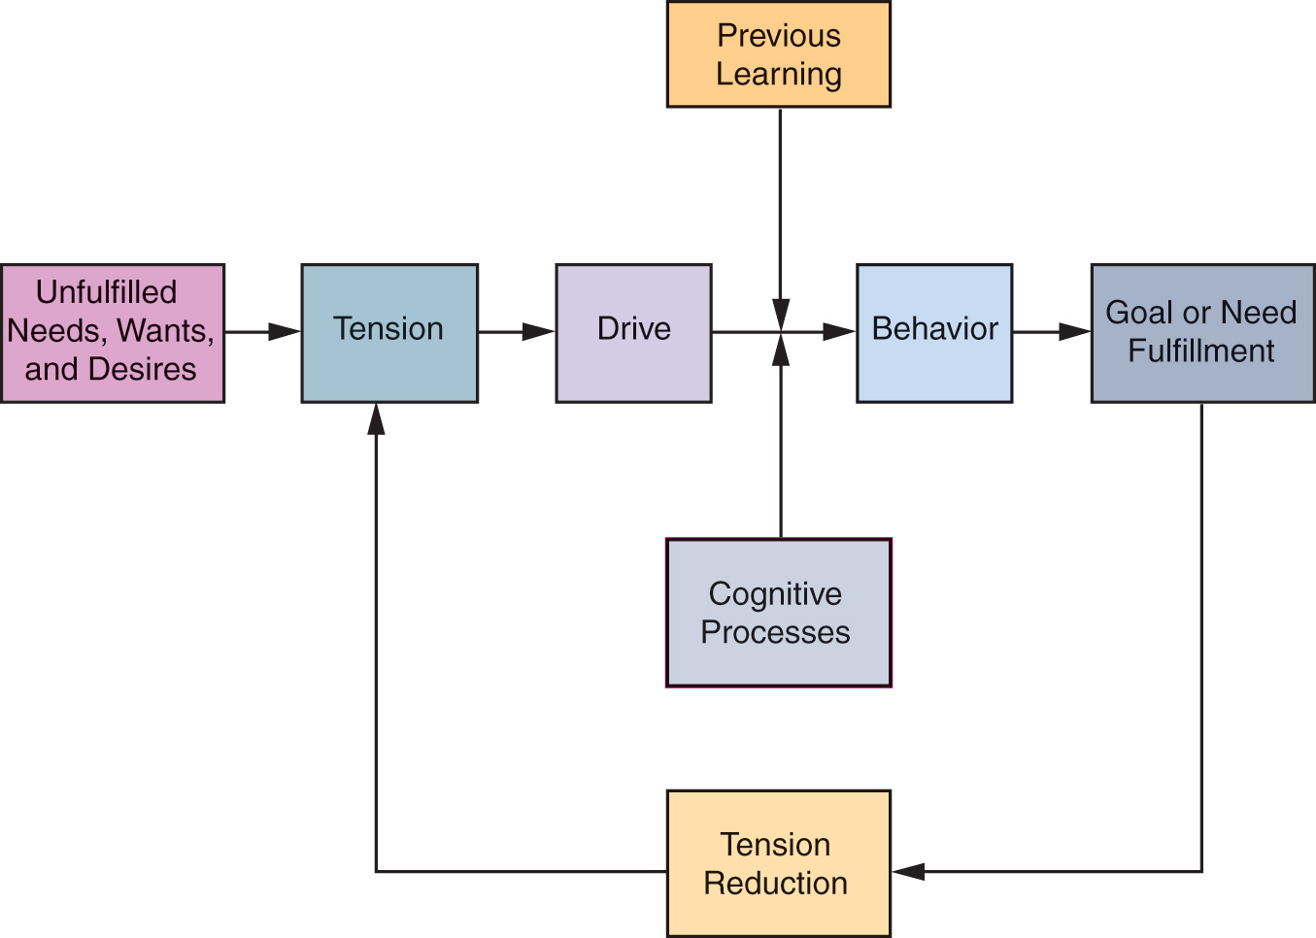
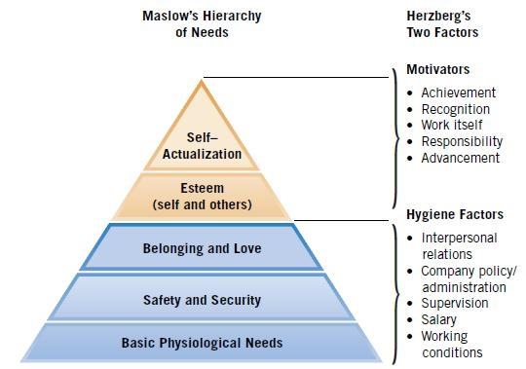
(4) Psychological Factors
4.1 Motivation

Slide 11
4.2 Perception
Select, organize and interpret information to create a meaningful picture about the world.
4.3 Learning
Learning is individual’s behavior arising from the experience.
4.1 Beliefs and attitudes
Thought that person hold about something.

Slide 12
Group Activity - Find
Different cultures in Sri Lanka
Religions
Ethnic groups
Regional Differences
The products and services they love
Different cultures in different countries and the products/services they love
10 marks which will be added to your final marks of the subject.
Date of Submission : 30th June 2018

Slide 13
Who Makes Buying Decisions
Initiator – Person who make the first decision to buy something.
Influencer- Person who influence or advise the initiator.
Decider – Person who decide to buy.
Buyer – Person who purchase the product
User – Person who consume the product

Slide 14
Types of Buying Behaviors
Complex Buying Behavior Computer, Vehicle | Variety Seeking Buying Behavior Chocolate
Dissonance Reducing buying behavior Carpeting | Habitual Buying Behavior Salt
High
Significance Differences Among Brands
Low
High
Low
Consumer Involvement

Slide 15
Stages of Buying Decision Process
Need /Problem
Recognition
Information Search
Evaluating
Alternatives
Purchase Decision
Post Purchase behavior
Buying Decision Process of New products
Awareness - Consumer become aware of the product
Interest - Seek information about the new product
Evaluation - Evaluate new product with the existing brand categories
Trial - Try out new product in small scale to evaluate
Adoption - Consumers decide to make full and regular use.

Slide 16
2.5 %
13.5 %
34 %
34 %
16 %
Innovators
Early Adopters
Early Majority
Late Majority
Laggards

