Slide 1
BEC 30325: MANAGERIAL ECONOMICS
Session 09
Market Structures Part I
Dr. Sumudu Perera

Slide 2
Session Outline
Introduction
Perfect Competition
Monopoly

Slide 3
Market Structures
More Competitive
Perfect Competition
Monopolistic Competition
Oligopoly
Monopoly
Less Competitive

Slide 4
Perfect Competition
Many buyers and sellers
Buyers and sellers are price takers
Product is homogeneous
Perfect mobility of resources
Economic agents have perfect knowledge
Example: Stock Market

Slide 5
Monopolistic Competition
Many sellers and buyers
Differentiated product
Perfect mobility of resources
Example: Fast-food outlets

Slide 6
Oligopoly
Few sellers and many buyers
Product may be homogeneous or differentiated
Barriers to resource mobility
Example: Automobile manufacturers

Slide 7
Monopoly
Single seller and many buyers
No close substitutes for product
Significant barriers to resource mobility
  Control of an essential input
  Patents or copyrights
  Economies of scale: Natural monopoly
  Government franchise: Post office

Slide 8
Perfectly Competitive Firm
The perfectly competitive firm is a price-taking firm. This means that the firm takes the price from the market.
As long as the market remains in equilibrium, the firm faces only one price—the equilibrium market price.

Slide 9
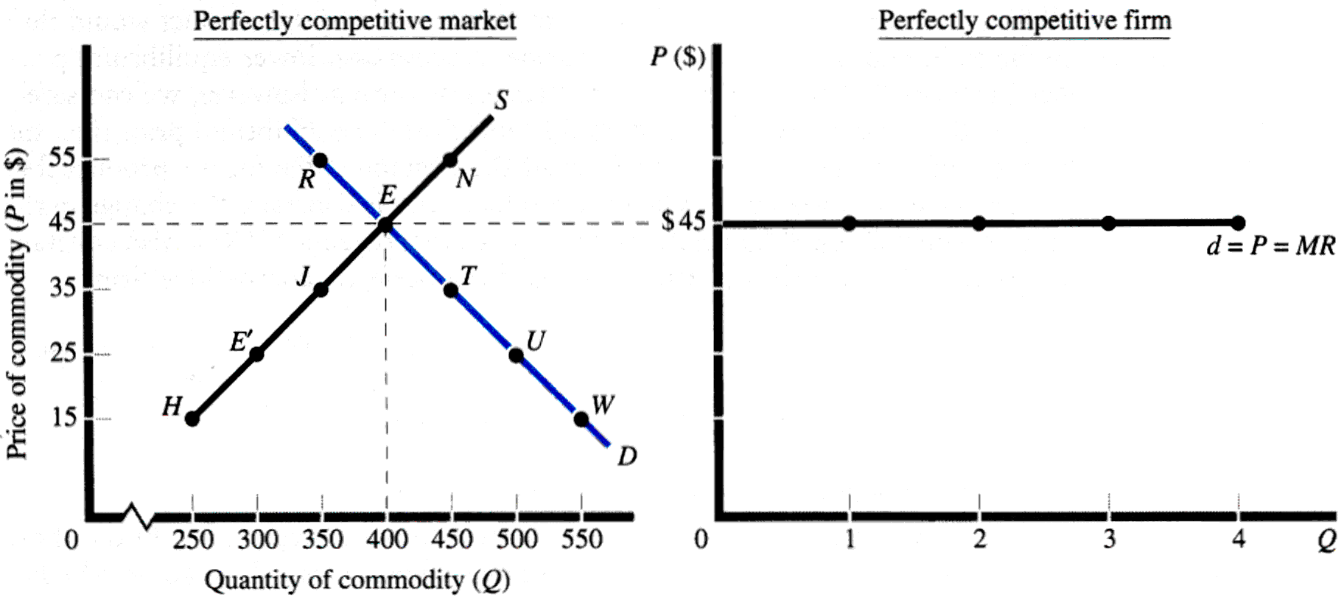
Perfect Competition:
Price Determination

Slide 10
Perfect Competition:
Price Determination

Slide 11
Perfect Competition:
Short-Run Equilibrium
Firm’s Demand Curve = Market Price
= Marginal Revenue
Firm’s Supply Curve = Marginal Cost
where Marginal Cost > Average Variable Cost

Slide 12
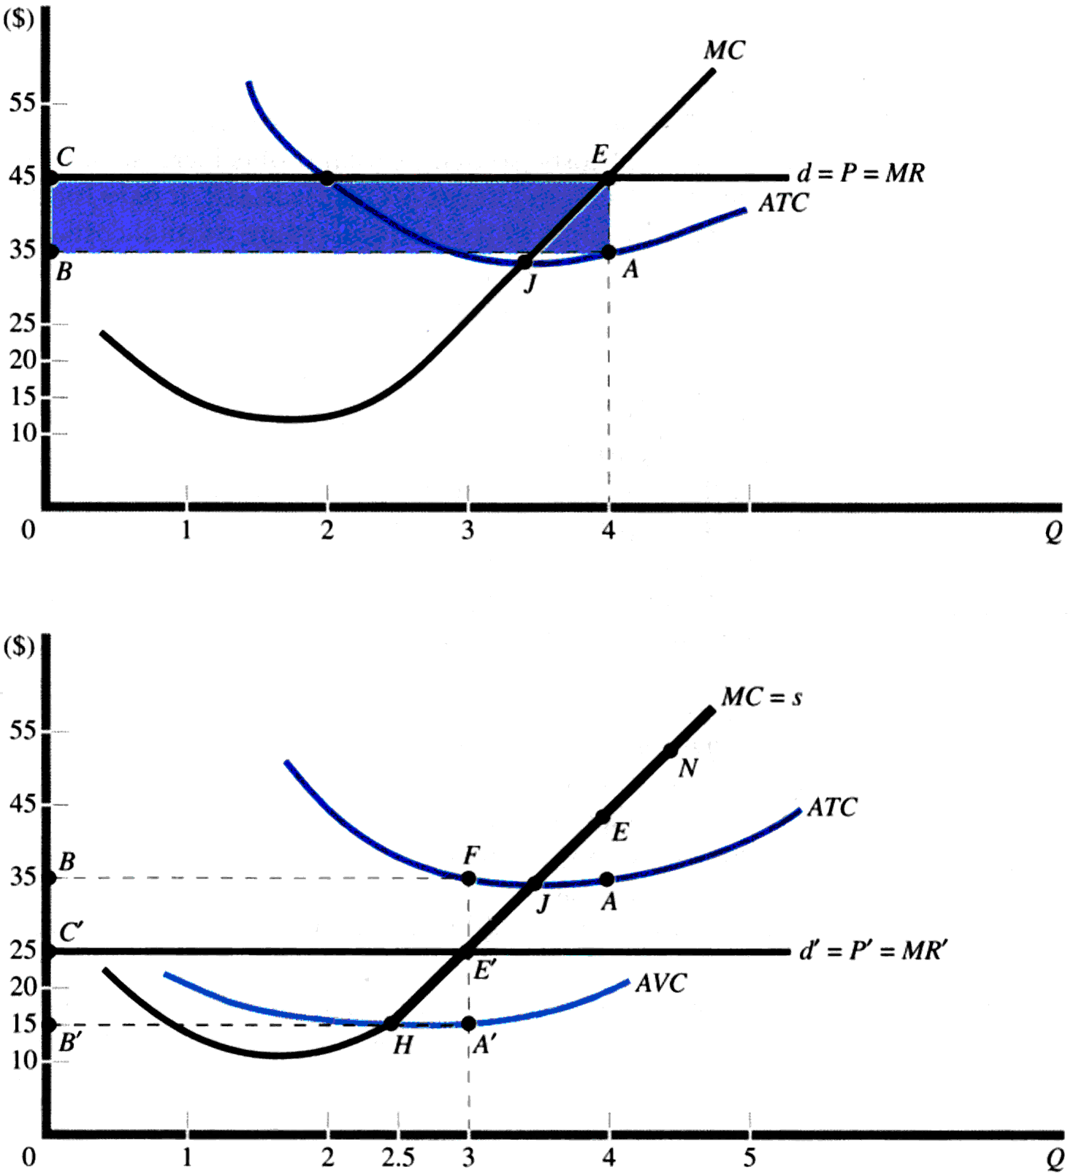
Perfect Competition:
Short-Run Equilibrium

Slide 13
Perfect Competition:
Long-Run Equilibrium
Quantity is set by the firm so that short-run:
Price = Marginal Cost = Average Total Cost
At the same quantity, long-run:
Price = Marginal Cost = Average Cost
Economic Profit = 0

Slide 14
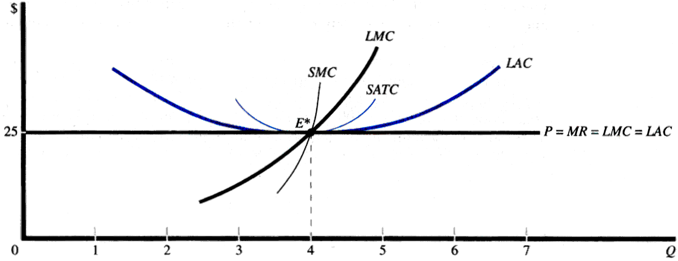
Perfect Competition:
Long-Run Equilibrium

Slide 15
Perfect Competition and Economic Efficiency in Long Run
Allocative Efficiency
P = MC
Productive Efficiency
P = MC, Where AC is minimized
Economic Efficiency = Allocative Efficiency + Productive Efficiency

Slide 16
Monopoly and Monopoly power
There is a single seller
There are no close substitutes for the commodity it produces
There are barriers to entry

Slide 17
The Main Causes that lead to Monopoly
Ownership of strategic raw materials, or exclusive knowledge of production techniques
Patent rights for a product or for a production process
Government licensing or the imposition of foreign trade barriers to exclude foreign competitors
The size of the market may be such as not to support more than one plant of optimal size. The market creates a 'natural' monopoly
The existing firm adopts a limit‑pricing policy, this is the case of monopoly established by creating barriers to new competition.

Slide 18
Monopoly
Short-Run Equilibrium
Demand curve for the firm is the market demand curve
Firm produces a quantity (Q*) where marginal revenue (MR) is equal to marginal cost (MR)
Exception: Q* = 0 if average variable cost (AVC) is above the demand curve at all levels of output

Slide 19
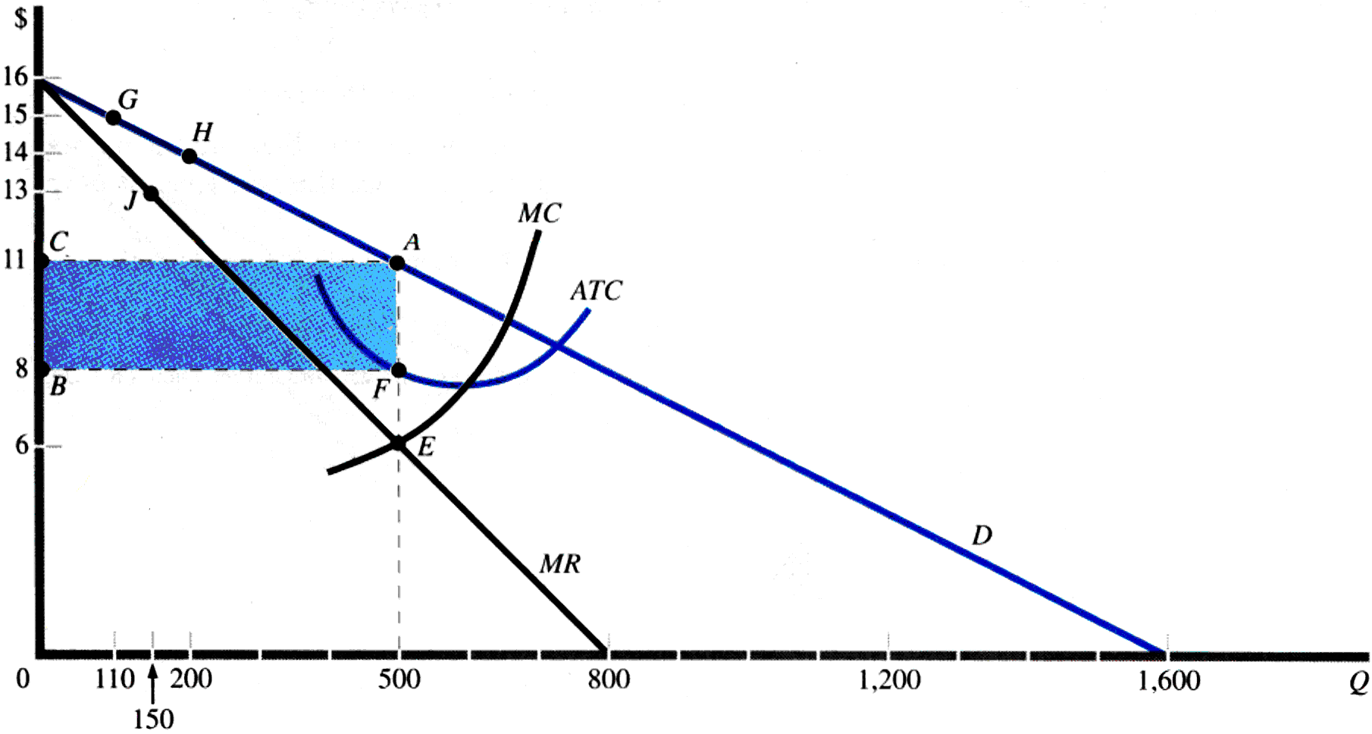
Monopoly
Short-Run Equilibrium
Q* = 500
P* = $11

Slide 20
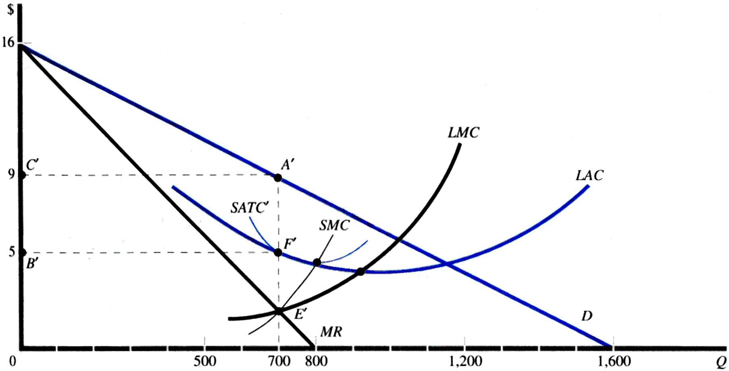
Monopoly
Long-Run Equilibrium
Q* = 700
P* = $9

Slide 21
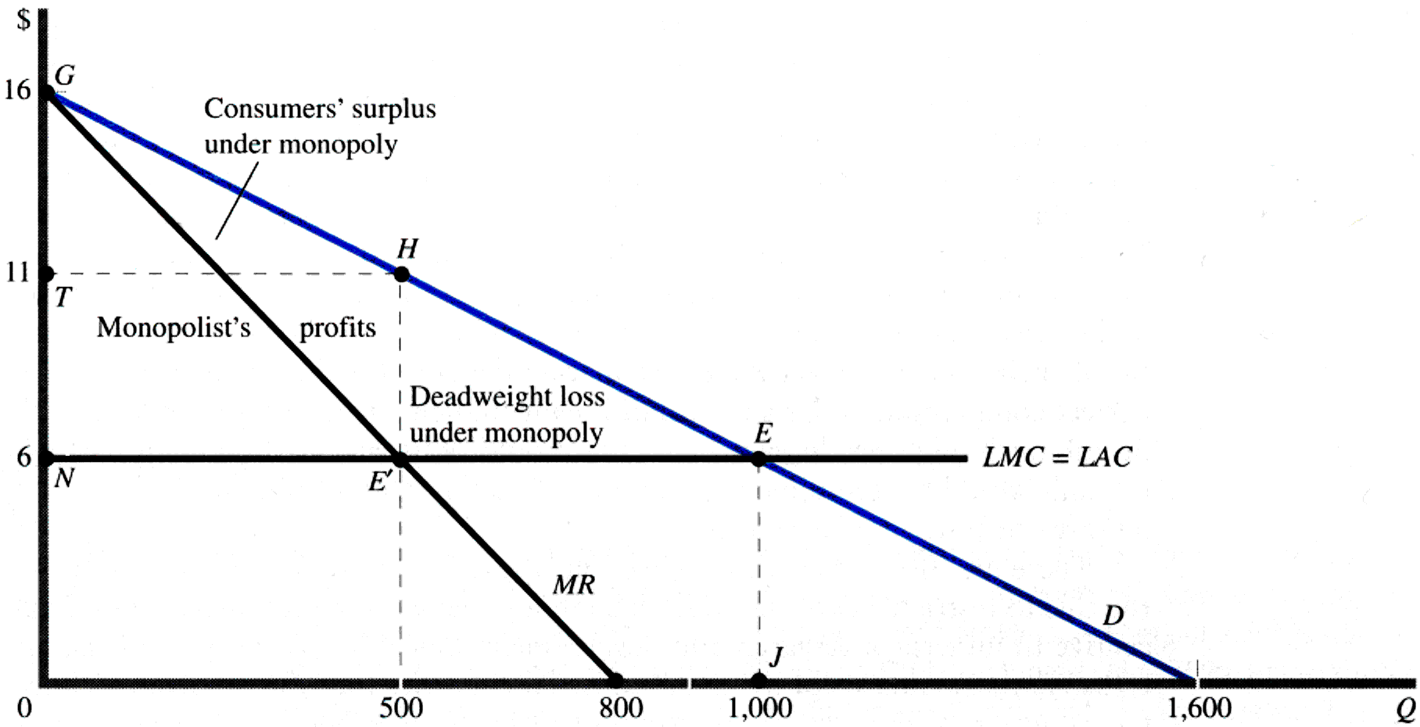
Social Cost of Monopoly

