Slide 1
BEC 30325: MANAGERIAL ECONOMICS
Session 08
Cost Theory and Estimation Part II
Dr. Sumudu Perera

Slide 2
Session Outline
Profit Maximization
Economies of Scale
Diseconomies of Scale
Economies of scope
Learning Curves
Cost-Volume-Profit Analysis
Break-even Analysis
Operating Leverage

Slide 3
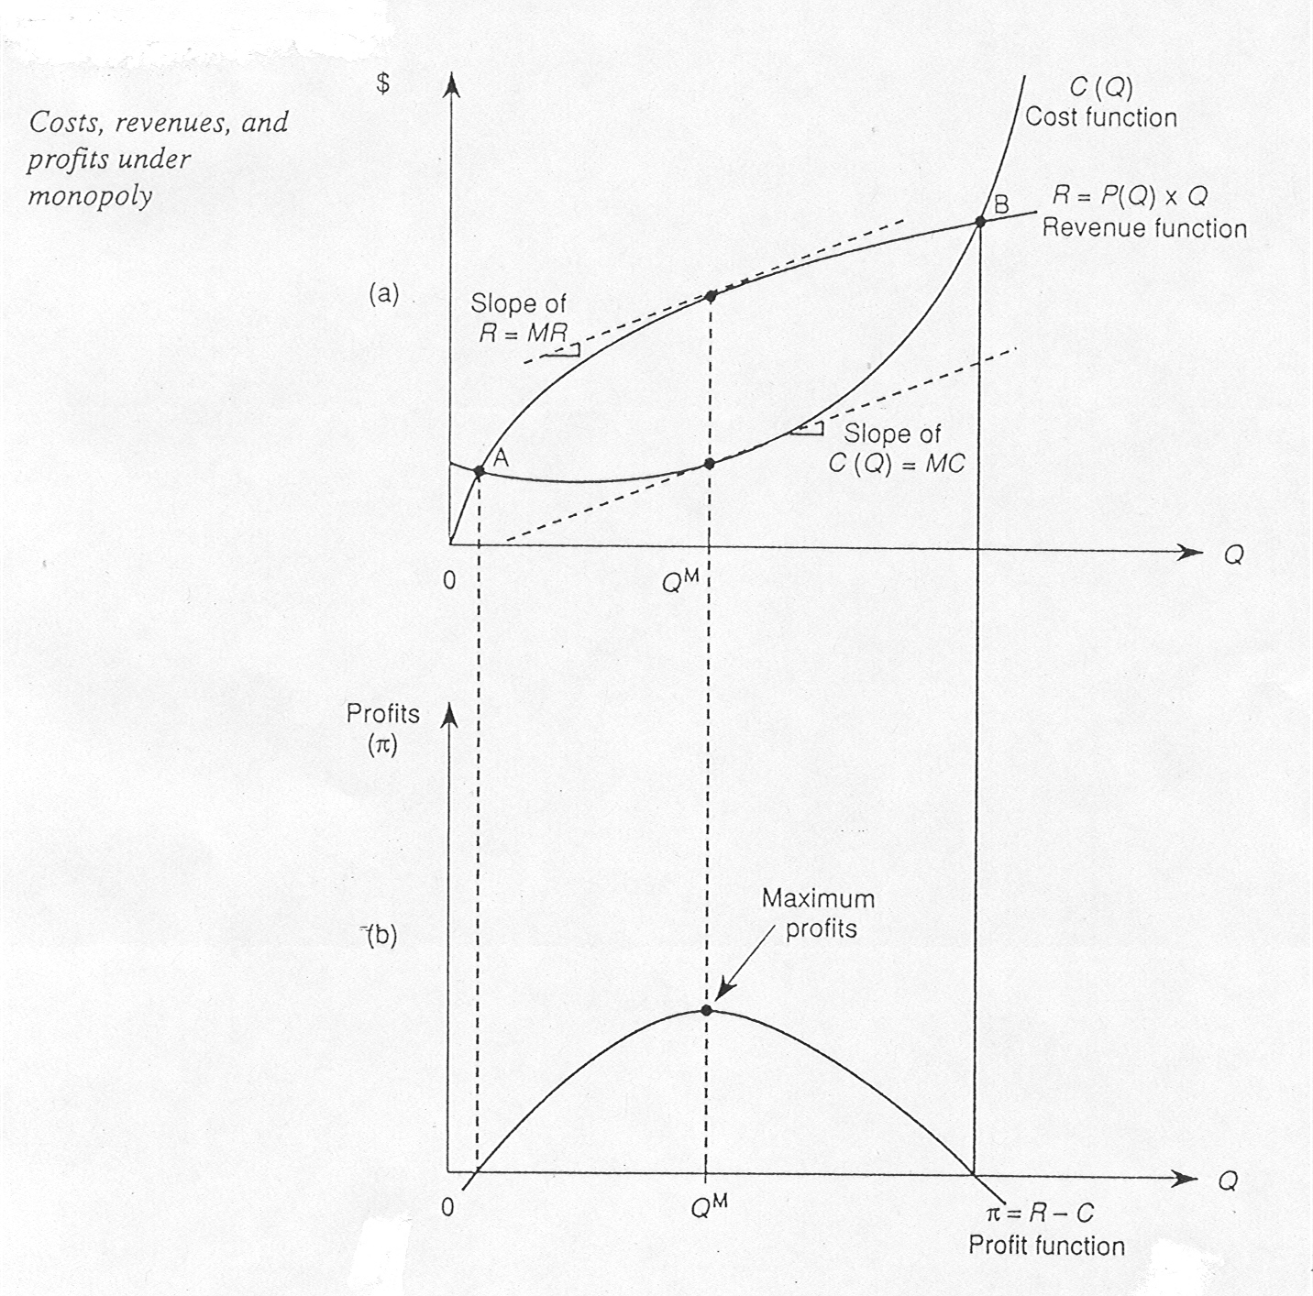
Profit Maximization
Total Approach
To maximize profit firm should;
  -Produce quantity of output where vertical distance between TR and TC curves is greatest and
  -TR curve should lie above TC curve

Slide 4
Profit Maximization
To maximize profits the firm should produce the level of output closest to point where MC = MR
    Level of output at which the MC and MR curves intersect
Important exception to this rule
  Sometimes MC and MR curves cross at two different points
  In this case, profit-maximizing output level is the one at which MC curve crosses MR curve from below

Slide 5
Marginal approach
Dollars
600
MC
500
400
300
200
100
0
1
2
3
4
5
6
7
8
Output
–100
–200
profit rises
profit falls
MR

Slide 6
Economies of Scale
The advantages of large scale production that result in lower unit (average) costs (cost per unit)
AC = TC / Q
Economies of scale – spreads total costs over a greater range of output
The optimum output occurs at the Minimum Efficient Scale (MES)

Slide 7
Economies of Scale
Unit Cost
Scale A
82p
Scale B
54p
LRAC
MES
Output

Slide 8
Internal Economies of Scale
Internal – advantages that arise as a result of the growth of the firm
  Technical
  Commercial
  Financial
  Managerial
  Risk Bearing

Slide 9
Internal Economies of Scale continued…
Technical
  Specialisation – large organisations can employ specialised labour
  Indivisibility of plant – machines can’t be broken down to do smaller jobs!
  Principle of multiples – firms using more than one machine of different capacities - more efficient
  Increased dimensions – bigger containers can reduce average cost

Slide 10
Internal Economies of Scale continued…
Commercial
  Large firms can negotiate favourable prices as a result
  of buying in bulk
  Large firms may have advantages in keeping prices higher because
  of their market power

Slide 11
Economies of scope
If the cost of producing two products jointly is less than the cost of producing those two products separately then there are economies of scope between the two products.
  Cost(Q₁, Q₂) < Cost(Q₁) + Cost(Q₂)
Notes:
Discussion 1 Answer: Because the firm sells only a single product—breakfast sausage—it cannot exploit the scope economies associated with distributing a full product line. The firm has two choices. It could sell out to one of the larger, full-line companies, like ConAgra. Such a company could exploit the scope economies associated with distribution, thus placing a higher value on the firm. Or it could outsource its distribution function. Several regional and nationwide distribution companies distribute a variety of food products, and these companies could realize scope economies by distributing a full portfolio of meat products.

Slide 12
Internal Economies of Scale continued…
Financial
  Large firms are able to negotiate cheaper finance deals
  Large firms are able to be more flexible about finance – share options, rights issues, etc.
  Large firms are able to utilise skills of merchant banks to arrange finance

Slide 13
Internal Economies of Scale continued…
Managerial
  Use of specialists – accountants, marketing, lawyers, production, human resources, etc.
Risk Bearing
  Diversification
  Markets across regions/countries
  Product ranges
  R&D

Slide 14
External Economies of Scale
External economies of scale – the advantages firms can gain as a result of the growth of the industry – normally associated with a particular area
  Supply of skilled labour
  Reputation
  Local knowledge and skills
  Infrastructure
  Training facilities

Slide 15
Diseconomies of Scale
The disadvantages of large scale production that can lead to increasing average costs
  Problems of management
  Maintaining effective communication
  Co-ordinating activities – often across
  the globe!
  De-motivation and alienation of staff
  Divorce of ownership and control

Slide 16
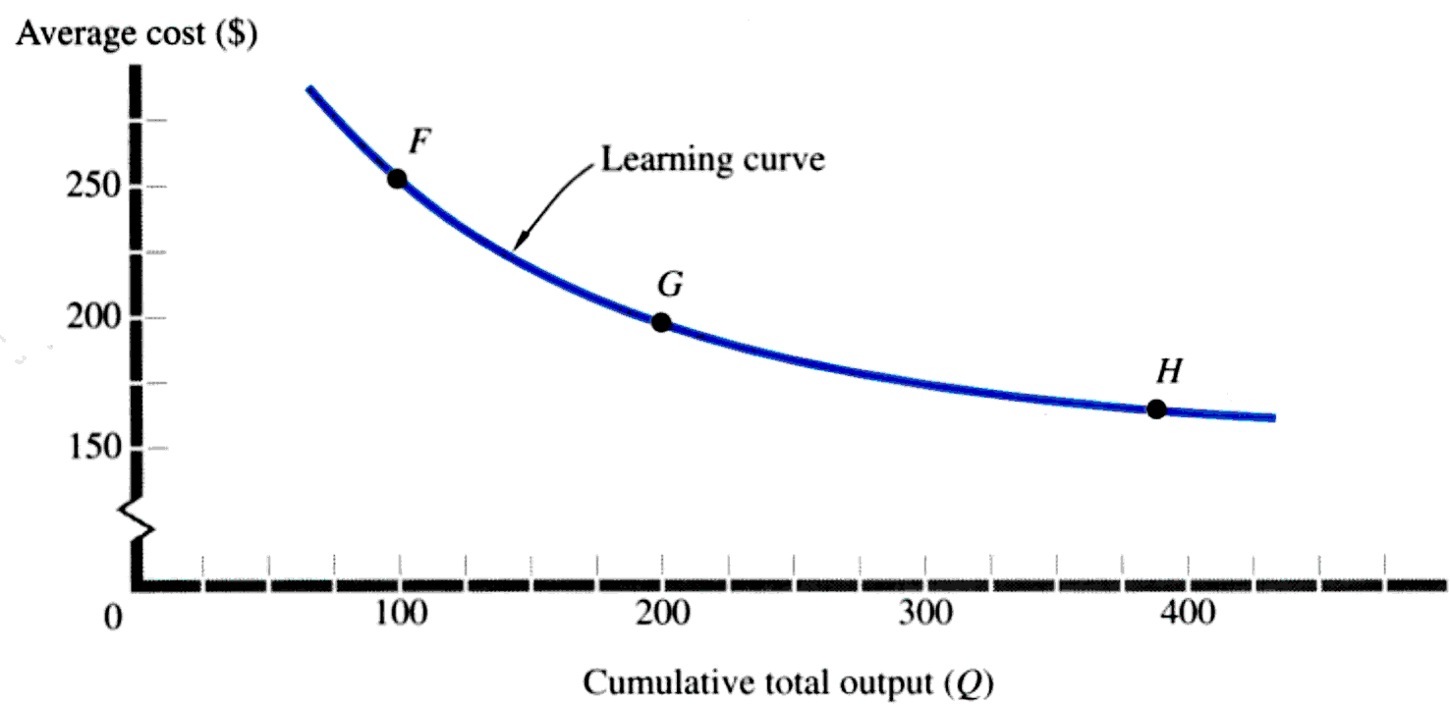
Learning Curves
The learning curve shows the decline in the average input cost of production with rising cumulative total outputs over time. The learning curve also shows that the average cost is about $ 250 for producing the 100th unit at point F etc..

Slide 17
Learning Curves
Average Cost of Unit Q = C = aQ^{b}
Estimation Form: log C = log a + b Log Q
The Learning curve can be express algebraically as follows:
(C is cost of the Q^{th} unit of output)
ln C = ln a + b ln Q
Linearized version, can be easily estimated and interpreted.
ln C = 3 – 0.3 ln Q
If Q increases by 1%, then unit (average) costs decrease by 0.3%.
Useful to make predictions for the future: how much does the average cost for the 100th unit as well as 200th:
lnC =3 – 0.3ln100 = 2.4 = => C = antilog of (2.4) =$251.19
lnC =3 – 0.3ln200 =2.31= =>C = antilog of (2.31) =$204.03

Slide 18
Cost-Volume-Profit Analysis
Cost-volume-profit or breakeven analysis examines the relationship among the TR, TC, and total profits of the firm at various levels of ooutput. This technique is often used by business executives to determine the sales volume required for the firm to break even and the total profits and losses at other sales levels. The analysis uses a cost-volume-profit chart in which the TR and TC curves are represented by straight lines and the break-even o/p (Q_{B}) is determined at their intersection.

Slide 19
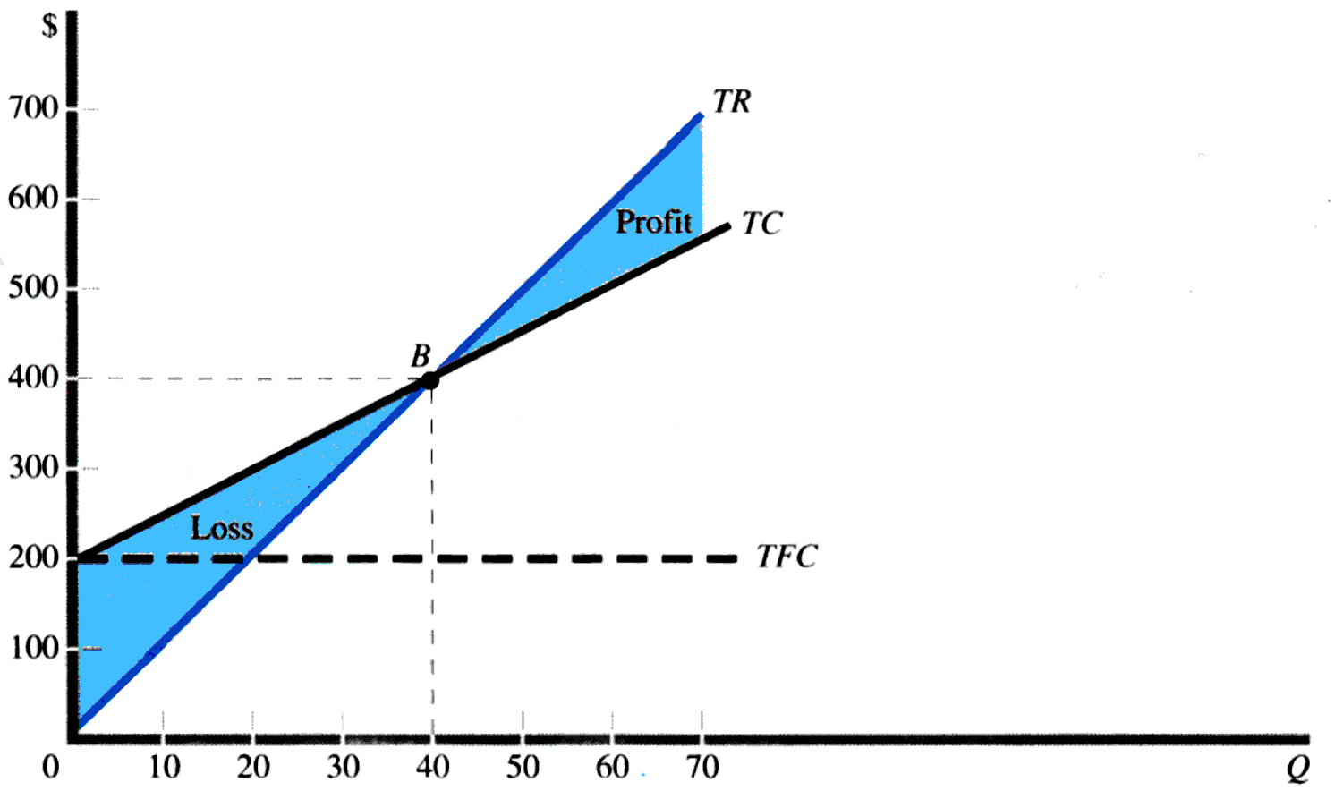
Cost-Volume-Profit Analysis
The slope of the total revenue TR curve refers to the product price of $10 per unit. The vertical intercept of the total cost of (TC) curve refers TFC of $200, and the slope of the TC curve to the AVC of $5. The break-even with TR=TC $400 at the output (Q) of $40 units per time period at the point B.

Slide 20
Cost-Volume-Profit Analysis
Total Revenue = TR = (P)(Q)
Total Revenue = TR = (P)(Q)
Total Cost = TC = TFC + (AVC)(Q)
Total Cost = TC = TFC + (AVC)(Q)
Breakeven Volume TR = TC
(P)(Q) = TFC + (AVC)(Q)
Q_{BE} = TFC/(P - AVC)

Slide 21
Break-even o/p
Q_{BE} = TFC/(P - AVC)
P = 40
TFC = 200
AVC = 5
Q_{BE} = 40

Slide 22
Operating Leverage and the other concepts
Operating leverage: The ratio of the firm’s total fixed costs to its total variable costs.
Contribution margin per unit: The excess of the selling price of the product over the average variable costs of the firm (i.e. P-AVC) that can be applied to cover the fixed costs of the firm and to provide profits.
Degree of operating leverage (DOL): The percentage change in the firm’s profits divided by the percentage change in output or sales; the sales elasticity of profits.

Slide 23
Operating Leverage
Operating Leverage = TFC/TVC
Degree of Operating Leverage = DOL

Slide 24
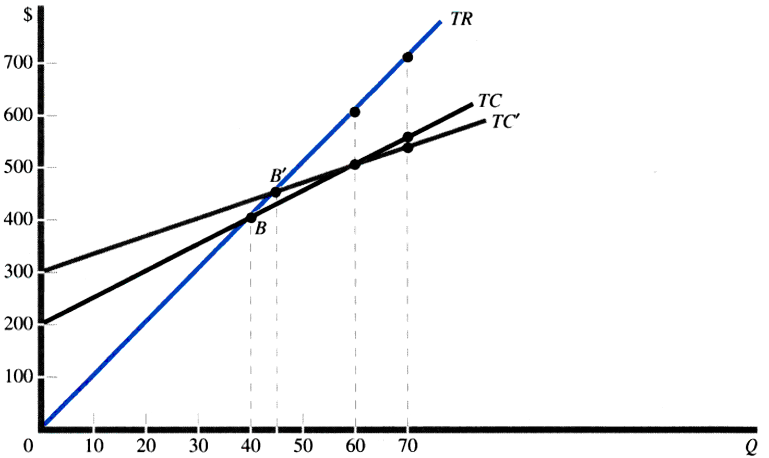
Operating Leverage
The intersection of TR and TC defines the break even quantity of Q_{B}=40. With TC’, the break even quantity increases to Q_{B’}=45.
TC’ has a higher DOL than TC and therefore a higher Q_{BE}

