Slide 1
BEC 30325: MANAGERIAL ECONOMICS
Session 04
Demand Estimation (Part – III)
Dr. Sumudu Perera

Slide 2
Session Outline
Multiple Regression Model
Test the Goodness of Fit
Coefficient of Determination
F Statistic
t Test Statistic
Problems in Regression Analysis
Steps in Demand Estimation

Slide 3
Multiple Regression Model
Relationship between 1 dependent & 2 or more independent variables is a linear function
Identification of variables:
Dependent Variable, Independent Variable
Identify/interpret the Intercept
Identification and Interpretation of Coefficients

Slide 4
Multiple Regression with the support of Software
Collect data
Data Entry
Selection of Variables
Selection of Measurements to each variable
Model Development
Run Regression
Test the Goodness of Fit
Interpret the Results

Slide 5
Test the Goodness of Fit
Coefficient of Determination -R Squared
Test the Overall Fitness of the Model
Test the significance of independent variables

Slide 6
Coefficient of Determination
It measures the proportion of the total variation in the dependent variable that is explained by the variation in the independent or explanatory variables in the regression.

Slide 7
Interpretation of Coefficient of Multiple Determination
  Value lies between 0 and 1.
  Ex: 0.95 means 95 % of total variation is explained by the model
  Closer to one shows that more of the variation is explained by the model

Slide 8
Testing for Overall Significance
It shows whether the variation in the independent variables is explained by the variations in the dependent variable.
Use F Test Statistic
Hypotheses:
  H₀: β₁ = β₂ = … = β_{k} = 0 (No independent variable affect the dependent variable)
  H₁: At least one β_{i} ≠ 0 ( At least one independent variable affects Y )

Slide 9
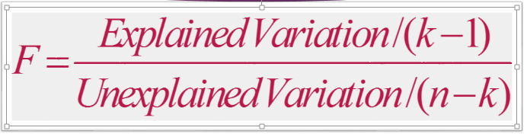
F Statistic

Slide 10
Test for Overall Significance
Excel Output: Example
k = 3, no of parameters
p-value
k -1= 2, the number of explanatory variables and dependent variable
n - 1

Slide 11
Test for Overall Significance:
Example Solution
H₀: β₁ = β₂ = … = β_{k} = 0
H₁: At least one β_{j} ≠ 0
α = .05 df = 2 and 12
Critical Value:
Test Statistic:
Decision:
Conclusion:
F
=
168.47
Reject at α = 0.05.
α = 0.05
There is evidence that at least one independent variable affects Y.
0
3.89

Slide 12
t Test Statistic
Test the significance of independent variables
Ho: b1=0
Have to do separately for each variable
If the hypothesis is rejected, it means the variable make a significant impact on the dependent variable
Use t statistic

Slide 13
t Test Statistic
Excel Output: Example
t Test Statistic for X₁ (Temperature)
t Test Statistic for X₂ (Insulation)

Slide 14
t Test : Example Solution
H₀: β₁ = 0
H₁: β₁ ≠ 0
df = 12
Critical Values:
Test Statistic:
t Test Statistic = -16.1699
Decision:
Reject H₀ at α = 0.05.
Conclusion:
There is evidence of a significant effect of temperature on oil consumption holding constant the effect of insulation.
Reject H
Reject H
0
0
.025
.025
-2.1788
0
2.1788

Slide 15
Example 01 – Regression Output
Summary Findings of the Consumer Survey- Lux Soap
Qd_{x} = | 38.597 | -0.071P_{x} | + 0.243C_{x} | + 0.104 S_{x} | - 0.652 I | + 0.005 A
t Statistic | ( 9.158 ) | ( -0.723 ) | ( 2.716 ) | ( 1.477 ) | ( -3.738 ) | ( 0.985 )
Where, P_{x} = Price of the Product, C_{x} = Price of the Competitive Products (Ayuruwedha Soaps), S_{x} = Price of the Substitution Products, I = per capita income, A = Advertising expenses, Qd_{x} = Lux Sales Quantity and the t-statistics are shown in parentheses. R² = 0.944 Sample Size = 23 Standard Error (Regression) = 1.980 F statistic = 57.633 Significance Level = 10%

Slide 16
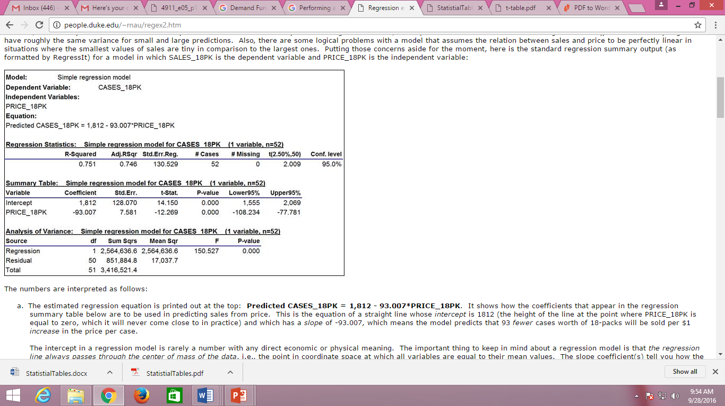
Example 02 – Regression Output

Slide 17
Questions
  The regression output is related to demand for 18PK type bottle cases. The estimated coefficients and the other statistics are provided in the following output table.
  Interpret the estimated demand function.
  What is implied by the t-statistic value of the estimate of PRICE_18PK?
  Using the P-value, discuss the significance of the independent variable.
  Discuss the overall explanatory power of the model for CASES_18PK.

Slide 18
Problems in Regression Analysis
Multicollinearity: Two or more explanatory variables are highly correlated.
Heteroskedasticity: Variance of error term is not independent of the Y variable.
Autocorrelation: Consecutive error terms are correlated.
Functional form: Misspecified by the omission of a variable
Normality: Residuals are normally distributed or not

Slide 19
Practical Consequences of Multicollinearity
Large variance or standard error
Wider confidence intervals
Insignificant t-ratios
A high R² value but few significant t-ratios
OLS estimators and their Std. Errors tend to be unstable
Wrong signs for regression coefficients

Slide 20
Multicollinearity
How can Multicollinearity be overcome?
Increasing number of observation
Acquiring additional data
A new sample
Using an experience from a previous study
Transformation of the variables
Dropping a variable from the model
This is the simplest solution, but the worse one referring an economic model (i.e., model specification error)

Slide 21
Heteroskedasticity
Heteroskedasticity: Variance of error term is not independent of the Y variable or unequal/non-constant variance. This means that when both response and explanatory variables increase, the variance of response variables does not remain same at all levels of explanatory variables (cross-sectional data).
Homoscedasticity: when both response and explanatory variables increase, the variance of response variable around its mean value remains same at all levels of explanatory variables (equal variance).

Slide 22
Residual Analysis for Homoscedasticity
Y
Y
X
X
SR
SR
X
X
✓
Heteroscedasticity
Homoscedasticity

Slide 23
Autocorrelation or serial correlation
Autocorrelation: Correlation between members of observation ordered in time as in time series data (i.e., residuals are correlated where consecutive errors have the same sign).
Detecting Autocorrelation: This can be detected by many ways. The most common used is DW statistics.

Slide 24
Durbin-Watson Statistic
Test for Autocorrelation
If d=2, autocorrelation is absent.

Slide 25
Residual Analysis for Independence
The Durbin-Watson Statistic
  Used when data is collected over time to detect autocorrelation (residuals in one time period are related to residuals in another period)
  Measures violation of independence assumption
Should be close to 2.
If not, examine the model for autocorrelation.

Slide 26
Residual Analysis for Independence
Graphical Approach
Not Independent
✓
Independent
e
e
Time
Time
Cyclical Pattern
No Particular Pattern
Residual is Plotted Against Time to Detect Any Autocorrelation

Slide 27
Using the Durbin-Watson Statistic
: No autocorrelation (error terms are independent)
: There is autocorrelation (error terms are not)
Reject H₀
(positive
autocorrelation)
Inconclusive
Reject H₀
(negative
autocorrelation)
Accept H₀
(no autocorrelation)
0
d_{L}
d_{U}
2
4-d_{U}
4-d_{L}
4

Slide 28
Steps in Demand Estimation
Model Specification: Identify Variables
Collect Data
Specify Functional Form
Estimate Function
Test the Results

Slide 29
Group Assignment - Group presentation on a real company in the business world
You are required to select a real company which either produces a good or renders a service, in the Sri Lankan context. Then it is expected to carry out an in-depth analysis on the Total Revenue and Total Cost of the company and thereby analyzing the determinants of the Profit of the company and analysis on Profit Optimization of the selected company.
In carrying out the analysis, the following specific requirements should be taken into consideration, under each sub topic.
Total Revenue
Identify the factors affecting demand of the product or service and form a demand equation
Estimate the demand function (using an appropriate statistical technique, preferably OLS Regression model) and interpret the results
Using actual prices or hypothetical prices based on the results of the previous section form a Total Revenue Function
( TR = P * Q)
Total Cost
  Identify the key components of the total cost (variable and fixed cost) of the company and form a Total Cost equation
  Identify the relationship between Total Cost, Average Cost and Marginal Cost of the company (use appropriate diagrams to interpret your results)

Slide 30
Total Profit
  After deriving the Total Revenue and Total Cost functions of the company, form the Total Profit function for the company
  Using both Total Cost-Total Revenue approach and Marginal approach, comment on the profit maximization quantity of the company
Instructions
You are required to form a group of 5 to 6 members and do a group presentation on the above mentioned analysis.
Note that all the group members should present and the time allocated per group is 15 minutes.
A hard copy of the report should also be submitted just before the presentation and the group member list along with the registration numbers should be included in the cover page.

