Slide 1
BEC 30325: MANAGERIAL ECONOMICS
Session 02
Demand Estimation (Part – I)
Dr. Sumudu Perera

Slide 2
Session Outline
Definition of Demand
Law of Demand
Price Elasticity of Demand
Elasticity and Total Revenue
Income Elasticity of Demand
Cross Elasticity of Demand
Demand Estimation
Identification Problem

Slide 3
DEMAND
Quantity demanded is the amount of a good that buyers are willing and able to purchase.
Law of Demand
The law of demand states that, other things equal, the quantity demanded of a good falls when the price of the good rises.

Slide 4
DEMAND continued…
The demand for a commodity arises from the consumers’ willingness and ability to purchase the commodity. Consumer demand theory postulates that the quantity demanded of a commodity is a function of or depends on the price of the commodity, the consumers’ income, the price of related commodities, and the tastes of the consumer.

Slide 5
The Demand Curve
The Demand Curve:
The Relationship between Price and Quantity Demanded
The demand curve is a graph of the relationship between the price of a good and the quantity demanded.
Demand Schedule
The demand schedule is a table that shows the relationship between the price of the good and the quantity demanded.

Slide 6
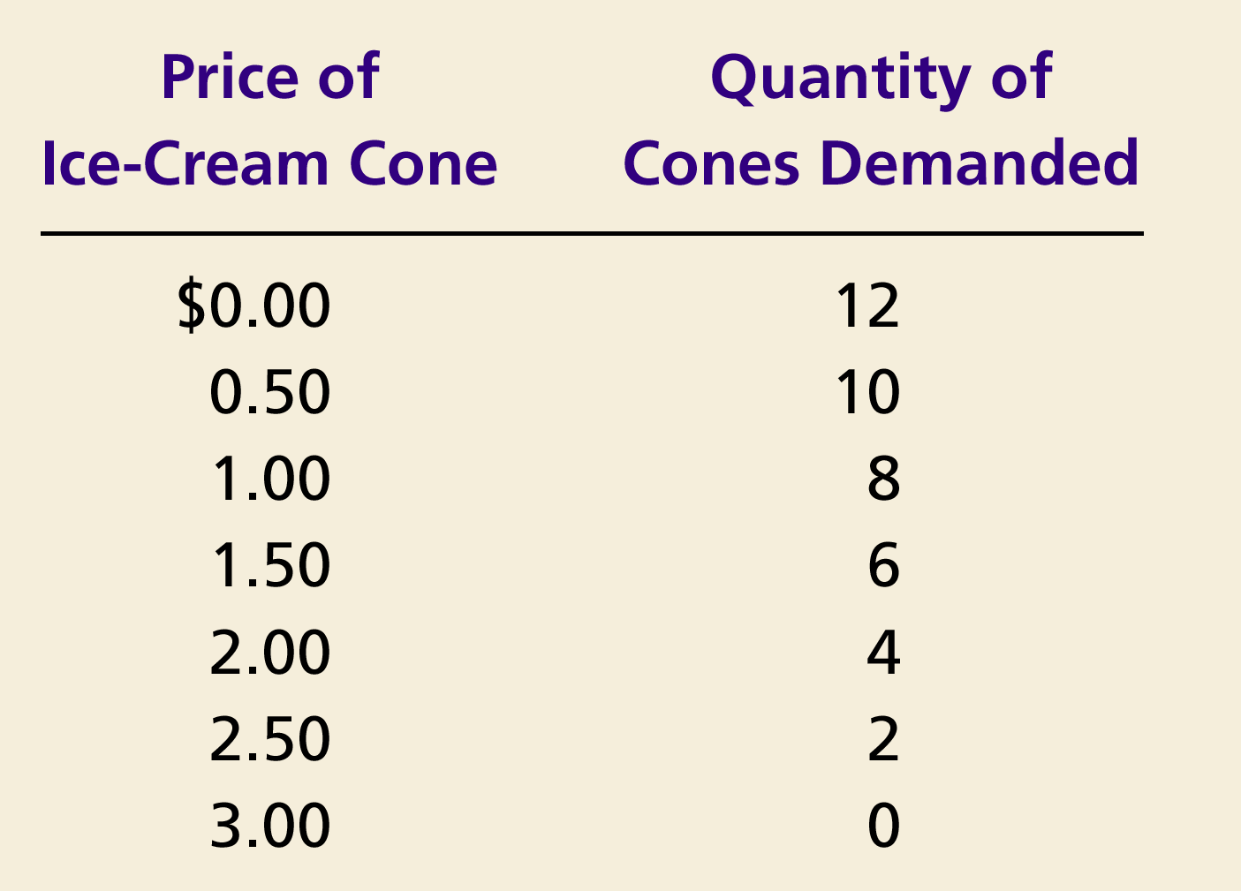
Demand Schedule and Demand Curve for Ice- Cream
Price of
Ice-Cream Cone
$3.00
2.50
1. A decrease
2.00
in price
...
1.50
1.00
0.50
0
1
2
3
4
5
6
7
8
9
10
11
12
Quantity of
Ice-Cream Cones
2.
...
increases quantity
of cones demanded.

Slide 7
Market Demand versus Individual Demand
Market demand refers to the sum of all individual demands for a particular good or service.
Graphically, individual demand curves are summed horizontally to obtain the market demand curve

Slide 8
Elasticity
A measure of the responsiveness of one variable to changes in another variable
It is the percentage change in one variable that arises due to a given percentage change in another variable.
The elasticity measure does not depend on the units in which we measure the variables.

Slide 9
Own Price Elasticity of Demand
Own price elasticity: A measure of the responsiveness of the quantity demanded of a good to a change in the price of that good;
Demand is elastic if the absolute value of the own price elasticity is greater than 1.
Demand is inelastic if the absolute value of the own price elasticity is less than 1.
Demand is unitary elastic if the absolute value of the own price elasticity is equal to 1.

Slide 10
Elasticity and Total Revenue
If demand is elastic, an increase (decrease) in price will lead to a decrease (increase) in total revenue.
If demand is inelastic, an increase (decrease) in price will lead to an increase (decrease) in total revenue.
Total revenue is maximized at the point where demand is unitary elastic.

Slide 11
8
E_{D} = 1
E_{D} < 1
D
4
5
6
7
8
Quantity
Revenue when the demand curve is unit-elastic
Revenue when the demand curve is elastic
Total Revenue
Revenue when the demand curve is inelastic
40
30
20
10
TR
1
2
3
4
5
6
7
8
Quantity

Slide 12
Factors Affecting the Own Price Elasticity
Available substitutes
The more substitutes available for the good, the more elastic the demand for it. A price increase leads consumers to substitute toward another product, thus reducing considerably the quantity demanded of the good.
When there are few close substitutes, demand tends to be relatively inelastic.
Time
Demand tends to be more inelastic in the short term than in the long term.
The more time consumers have to react to a price change, the more elastic the demand for the good. Time allows the consumer to seek out available substitutes
Expenditure share
Goods that comprise a relatively small share of consumers’ budgets tend to be more inelastic than goods for which consumers spend a sizable portion of their incomes.

Slide 13
Cross-Price Elasticity
Cross-price elasticity: A measure of the responsiveness of the demand for a good to changes in the price of a related good; the percentage change in the quantity demanded of one good divided by the percentage change in the price of a related good.
The cross-price elasticity is positive whenever goods are substitutes.
The cross-price elasticity is negative whenever goods are complements.

Slide 14
Income Elasticity
Income elasticity: A measure of the responsiveness of the demand for a good to changes in consumer income; the percentage change in quantity demanded divided by the percentage change in income.
The income elasticity is positive whenever the good is a normal good.
The income elasticity is negative whenever the good is an inferior good.

Slide 15
Advertising Elasticity
The own advertising elasticity of demand for good X defines the percentage change in the consumption of X that results from a given percentage change in advertising spent on X.

Slide 16
Example 01: Mobile Phones
The Demand of Axiaatar (Q_{A}), which is a well-known mobile phone, depends upon the price of an Axiaatar phone (P_{A}), average daily income of people (Y) and price of Boppo phone (P_{B}). Demand for Q_{A} is given by the equation below;
Q_{A} = 60000 – 8P_{A} + 3Y – 2P_{B}
Assume that, P_{A} is Rs.3000, Y is Rs.4000 and P_{B} is Rs.2000.
Find the value of quantity demanded of Axiaatar and the price elasticity of demand at that quantity.
Calculate Income elasticity of demand and Cross price elasticity of demand.
Interpret the above results and state how the interpretation would affect the decisions of Axiaatar’s managers.

Slide 17
Demand Estimation
Estimation attempts to quantify the links between the level of demand for a product and the variables which determine it.
To use these important demand relationship in decision analysis, we need empirically to estimate the structural form and parameters of the demand function-Demand Estimation.
Q_{dx}= (P, I, P_{c}, P_{s}, T)
Eg- The demand for hotel rooms depends upon:
their price
the price of bed and breakfast accommodation
household incomes in visitors’ home countries
natural events (the weather, foot-and-mouth disease)

Slide 18
Demand Estimation continued…
In general, we will seek the answer for the following qustions:
How much will the revenue of the firm change after increasing the price of the commodity?
How much will the quantity demanded of the commodity increase if consumers’ income increase
What if the firms double its ads expenditure?
What if the competitors lower their prices?
Firms should know the answers for the above mentioned questions if they want to achieve the objective of maximizing thier value.

Slide 19
The Identification Problem
The demand curve for a commodity is generally estimated from market data on the quantity purchased of the commodity at various price over time (i.e. Time-series data) or various consuming units at one point in time (i.e. Cross-sectional data).
Simply joinning priced-quantity observations on a graph does not generate the demand curve for a commodity. The reason is that each priced-quantity observation is given by the intersection of a different and unobserved demand and supply curve of commodity.
In other words, The difficulty of deriving the demand curve for a commodity from observed priced-quantity points that results from the intersection of different and unobserved demand and supply curves for the commodity is referred to as the identification problem.

Slide 20
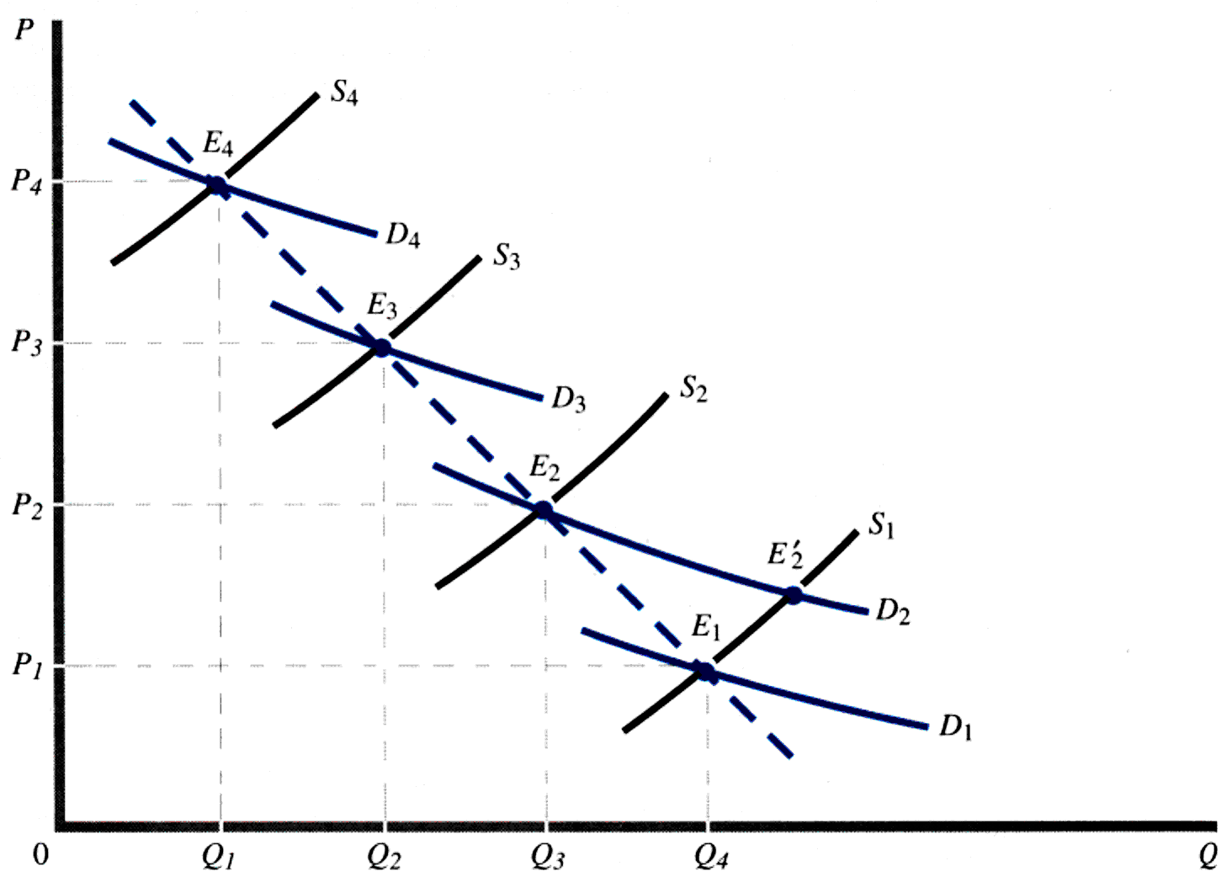
The Identification Problem
In the following demand curve, Observed price-quantity data points E₁, E₂, E₃, and E₄, result respectively from the intersection of unobserved demand and supply curves D₁ and S₁, D₂ and S₂, D₃ and S₃, and D₄ and S₄. Therefore, the dashed line connecting observed points E₁, E₂, E₃, and E₄ is not the demanded curve for the commodity. The derived a demand curve for the commodity, say, D₂, we allow the supply to shift or to be different and correct, through regression analysis, for the forces that cause demand curve D₂ to shift or to be different as can be seen at points E₂, E'₂. This is done by regression analysis.

