Slide 1
Accounting for Biological Assets and Agricultural Produce (LKAS 41: Agreeculture)
Rangajewa Herath
B.Sc. Accountancy and Financial Management(Sp.)(USJ)
MBA-PIM(USJ)

Slide 2
Scope of LKAS 41
Applied to account for the following when they relate to agricultural activity:
Biological assets except for bearer plant;
Agricultural produce at the point of harvest; and
Government grants covered by Paragraphs 34 and 35.

Slide 3
The Nature of Biological Assets
Biological Asset
A living animal or plant.
The harvest of the entity’s biological assets
Agricultural Produce

Slide 4
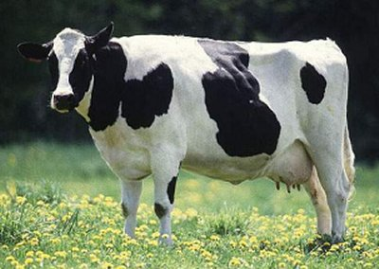
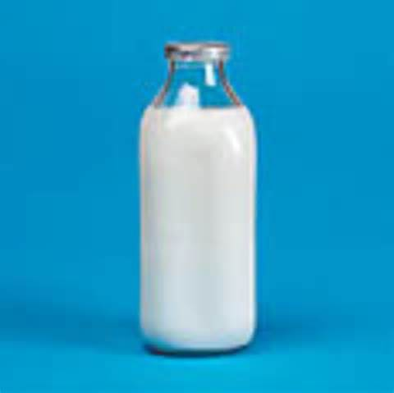
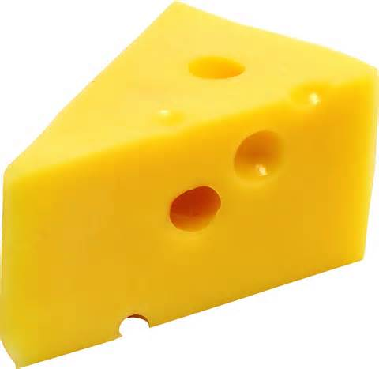
Biological asset
Agricultural produce
Products arise due to processing after harvest

Slide 5
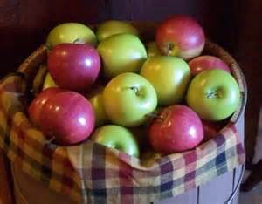
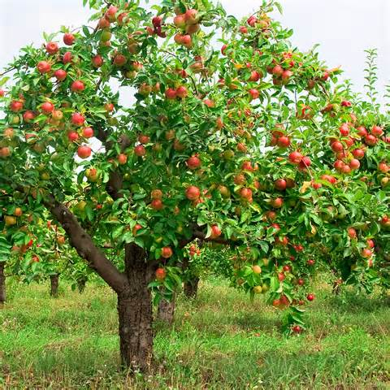
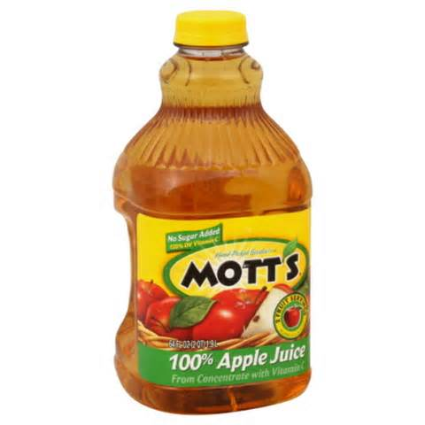
Biological asset
Agricultural produce
Products arise due to processing after harvest

Slide 6
The Nature of Biological Assets (Contd.)
Biological asset | Agricultural produce | Products arise due to processing after harvest
Sheep | Wool | Yarn, Carpet
Dairy cattle | Milk | Cheese
Trees in a timber plantation | Felled Trees | Logs, Lumber
Fruit trees | Picked fruit | Processed fruit
Tea bushes | Leaf | Tea
Tobacco plant | Leaf | Crude tobacco
Grape vines | Grapes | Wine
Oil palms | Picked Fruit | Palm oil

Slide 7
Agricultural Activity (Paragraph 5)
The management by an entity of the biological transformation and harvest of biological assets for sale or for conversion into agricultural produce or into additional biological assets.
Biological transformation comprises the processes of growth, degeneration, production and procreation that cause qualitative or quantitative changes in a biological asset.
Harvest is the detachment of produce from a biological asset or cessation of the biological asset’s life processes.

Slide 8
Agricultural Activity (Contd.)
Covers a diverse range of activities
Common features exist within this diversity:
Capability to change (living animals and plants are capable of biological transformation.)
Management of change (enhancing or stabilizing conditions necessary for the process to take place)
Measurement of change (change in quality or quantity brought about by biological transformation or harvest)

Slide 9
Bearer Plant
Bearer plant is a plant that :
Is used in production or supply of agricultural produce;
Is expected to bear produce over one accounting period and;
has a remote likelihood of being sold as agricultural produce, except for incidental scrap sales.

Slide 10
Bearer Plant (Contd.)
The following are not bearer plants:
plants cultivated to be harvested as agricultural produce (e.g. trees grown for use as lumber);
plants cultivated to produce agricultural produce when there is more than a remote likelihood that the entity will also harvest and sell the plant as agricultural produce, other than as incidental scrap sales (e.g. trees that are cultivated both for their fruit and their lumber);
annual crops (for example, padddy and wheat).

Slide 11
Unique Characteristics of BA
Natural capacity to grow and/or procreate has an impact on value
Great deal of increase in value of resulting from the input of free goods
Many costs early in the life, economic benefits until many years later
Long production (growing cycle) of assets
Not necessarily any relationship between the expenditure and ultimate benefits

Slide 12
Recognition (Paragraph 10)
An entity shall recognize a biological asset or agricultural produce when and only when:
The entity controls the asset as a result of past events;
It is probable that future economic benefits associated with the asset will flow to the entity; and
The fair value or cost of the asset can be measured reliably.

Slide 13
Measurement
Biological Asset
Fair value less costs to sell on initial recognition and at the end of each reporting period except in the case described in Paragraph 30 where fair value can not measures reliably. (Paragraph 12)
Agricultural produce
Fair value less costs to sell at the point of harvest. (Paragraph 12)

Slide 14
Definition - Fair value (SLFRS 13)
Fair value as the price that would be received to sell an asset or paid to transfer a liability in an orderly transaction between market participants at the measurement date.
Particular asset or liability
Orderly transaction (not a forced sale)
Market participants (market-based view)
Price (exit price)

Slide 15
Inability to Measure Fair Value Reliably
Presumption - fair value can be measured reliably for a biological asset.
If fair value of a biological asset cannot measured reliably - measure at cost less accumulated depreciation and accumulated impairment losses. (Paragraph 30)
The presumption in Paragraph 30 can be rebutted only at initial recognition.

Slide 16
Activity 1
ABC PLC purchased a timber plantation at the fair value of Rs.20 million including the land. The fair value of the raw land is Rs.12 million.
ABC PLC purchased a tea plantation at Rs.45 million. The fair value of the raw land is Rs.30 million. However, it is implacable to measure the fair value of the tea bushes or land with the tea bushes.
Required: Discuss the accounting treatment for A and B.

Slide 17
Gains and Losses arising from measurement at fair value less costs to sell
Biological Assets
Arising on initial recognition and from change in fair value at the end of reporting period
Agricultural Produce
Arising on initial recognition
Included in profit or loss for the period in which it arises (Paragraph 26)
Included in profit or loss for the period in which it arises (Paragraph 28)

Slide 18
Activity 2
ABC Farm had dairy cattle with carrying amount of Rs. 6 million as at 01.04.2017. The fair value of the crafts born during the year at the time of recognition was Rs.750,000 and the fair value of the dairy cattle and the crafts as at 31.03.2018 was Rs.8 million.
Required: Discuss the accounting treatment.

Slide 19
Disclosure (Paragraphs 40 to 57)
Description of each group of biological assets.
Quantitative description of each group of biological assets.
- between mature and immature biological assets
-between consumable and bearer biological assets ( applicable for Livestock)

Slide 20
Disclosure (Contd.)
Consumable biological assets
Bearer biological assets
Not agricultural produce but, rather, held only for bearer produce. (e.g. livestock from which milk is produced)
Mature biological assets
Attained harvestable specifications (for consumable biological assets) or sustain regular harvest (for bearer biological assets).
Harvested as agricultural produce or sold as biological assets. (e.g. livestock held for sale or livestock held for the production of meat)

Slide 21
Summary
Unique characteristics of biological assets
Resulting accounting issues
Addressing those issues through LKAS 41 -Agriculture

