Slide 1
The Practice of Strategy

Slide 2
Learning Outcomes (1)
Identify key people involved in strategy making, including top management, strategy consultants, strategic planners, and middle managers
Assess which people should be included in strategy making for different kinds of issues

Slide 3
Learning Outcomes (2)
Evaluate different approaches to strategising activity, including analysis, issue selling, decision-making structures and communications
Recognise key elements in the various methodologies commonly used in strategising, including strategy workshops, projects, hypothesis testing and writing business cases and strategic plans

Slide 4
Exhibit 15.1 The Pyramid of Strategy Practice
Strategists:
Who?
Strategising
activities:
What?
Strategising
methodologies:
Which?

Slide 5
The Strategists
Chief Executive Officer
Top management team
Non-executive directors

Slide 6
Characteristics of Effective Strategy Leaders
Mastery of analytical concepts and techniques
Social and influencing skills
Group acceptance as a player

Slide 7
What is a Strategic Planner?
Strategic planners, also called corporate development managers, are managers with a formal responsibility for contributing to the strategy process.

Slide 8
Tasks Performed by Strategic Planners
Information and analysis
Managers of the strategy process
Special projects

Slide 9
Roles Played by Strategy Consultants
Analysing, prioritising,
and generating options
Transferring knowledge
Promoting strategic decisions
Implementing strategic change

Slide 10
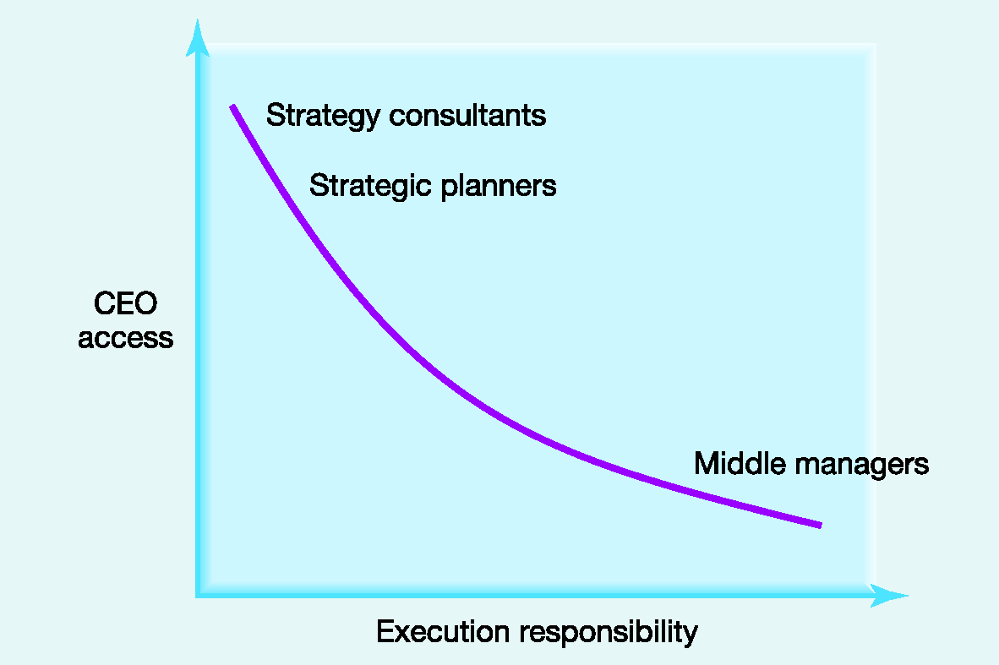
Exhibit 15.2 The Access/ Execution Paradox

Slide 11
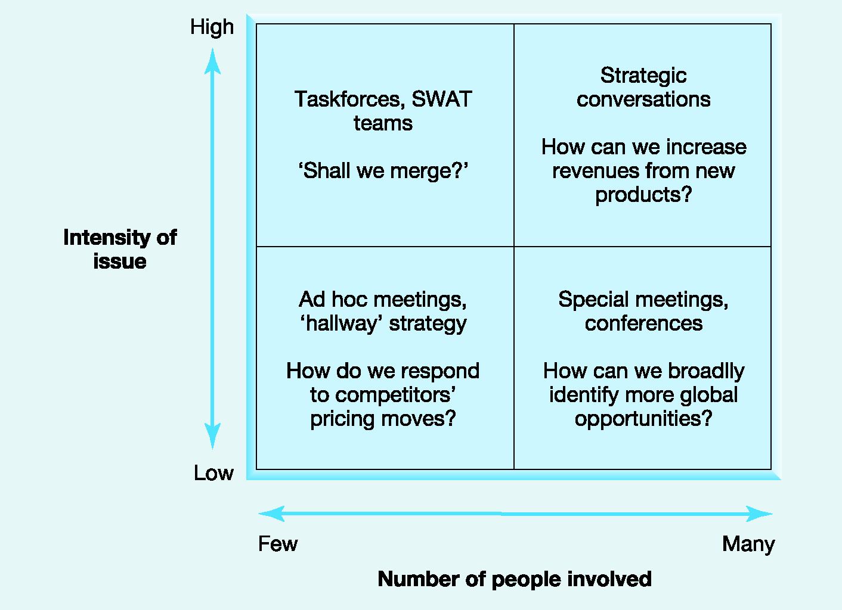
Exhibit 15.3 Who to Include in Strategy Making?
Notes:
SWAT / special weapons and tactics . Elite unite police force

Slide 12
What is Strategic Issue Selling?
Strategic issue selling is the process of winning the attention and support of top management and other important stakeholders for strategic issues.

Slide 13
Aspects of Strategic Issue Selling
Issue packaging
Formal or
informal channels
Sell alone
or in coalitions
Timing

Slide 14
Guidelines for Strategic Decision Making
Build multiple simultaneous alternatives
Track real-time information
Seek the views of trusted advisors
Aim for consensus, but not at any cost

Slide 15
Elements of a Communications Strategy
Focus
Impact
Media
Employee
engagement

Slide 16
Strategy Methodologies
Strategy workshops
Strategy projects
Hypothesis testing
Business cases and strategic plans

Slide 17
What is a Strategic Workshop?
Strategic workshops, also called strategy retreats, away-days, or off-sites, involve groups of executives working intensively for one or two days, often away from the office, on organisational strategy.

Slide 18
Workshops seeking to challenge existing preconceptions should…
Insist on prior preparation
Involve participants from outside the senior executive team
Involve outside consultants as facilitators
Break organisational routines

Slide 19
Workshops connecting to subsequent action should…
Make an agreed list of actions
Establish project groups
Circulate agreed actions
Make visible commitment by the top management

Slide 20
What is a Strategy Project?
Strategy projects involve teams of people assigned to work on particular strategic issues over a defined period of time.

Slide 21
Success Factors for Strategy Projects
A clear brief or mandate
Top management commitment
Milestones and reviews
Appropriate resources

Slide 22
What is Hypothesis Testing?
Hypothesis testing is a methodology used particularly in strategy projects for setting priorities in investigating issues and options.

Slide 23
Hypothesis Testing at a Bank
Define the problem/question
Develop a set of competing descriptive hypotheses about problem causes
Test the starting descriptive hypotheses
Develop prescriptive hypotheses
Make recommendations to the client
Notes:
prescriptive

Slide 24
What is a Business Case?
A business case provides the data and argument in support of a particular strategy proposal.

Slide 25
Chapter Summary (1)
The practice of strategy involves critical choices about who to involve in strategy, what to do, and which strategising methodologies to use
Top managers, strategic planners, consultants, and middle managers are all involved in strategising
Middle manager involvement in strategy can suffer from the CEO access/implementation responsibility paradox

Slide 26
Chapter Summary (2)
Strategising activity involves analysing, issue selling, decision making, and communicating
Practical methodologies to guide strategising activity include strategy workshops, strategy projects, hypothesis testing, and creating business cases and strategic plans

Slide 27
Key Debate: What Good Are Strategy Consultants?
What measures can a strategy consultant take to reassure a potential client of his or her effectiveness?
Are there any reasons to suspect that some people might want to exaggerate criticisms of strategy consultants’ conduct?

