Slide 1
Strategy Development Processes

Slide 2
Learning Outcomes (1)
Explain what is meant by intended and emergent strategy
development
Identify intended process strategy development in organizations including the role of vision and command, strategic planning systems, and externally imposed strategy
2

Slide 3
Learning Outcomes (2)
Identify emergent processes of strategy development such
as logical instrumentalism, resource allocation processes,
cultural processes, and organizational politics
Consider how different processes of strategy development
may be found in multiple forms and in different contexts
Explain some of the issues managers face in strategy
development
2

Slide 4
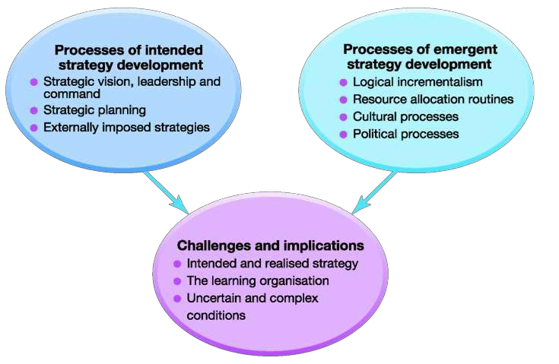
Exhibit 11.1 Strategy
Development Processes
2

Slide 5
What is an Intended Strategy?
An intended strategy is an expression of a desired strategy as deliberately formulated or planned by managers.

Slide 6


Slide 7


Slide 8


Slide 9

Stages of Strategic Planning
Initial guidelines
Business-level planning Corporate-level planning Financial and strategic targets
9

Slide 10
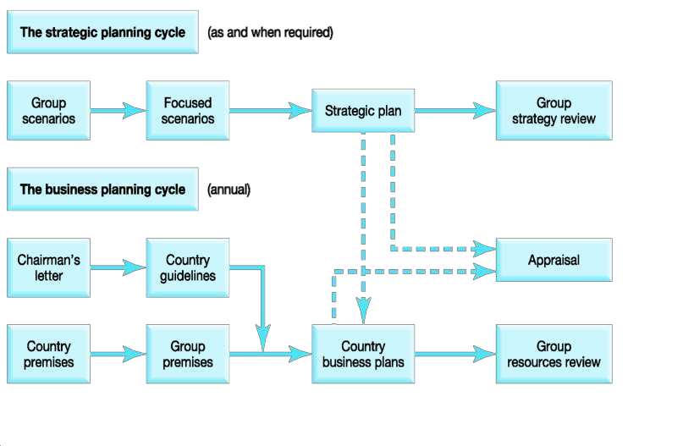
Strategic Planning at Shell
10

Slide 11
Possible Benefits of Planning
Help structure analysis and thinking
about complex problems
Encourage questioning
Encourage longer-term view
Enhance coordination
Improve communication
Provide agreed objectives
Involve people
Provide a sense of security

Slide 12
Dangers Associated with
Strategic Planning Programs
Confusing strategy with the plan
Detachment from reality
Lack of ownership
Dampening of innovation

Slide 13
What is an Emergent Strategy?
An emergent strategy comes about through everyday routines, activities, and processes in organisations leading to decisions that become the long-term direction of an organisation.

Slide 14
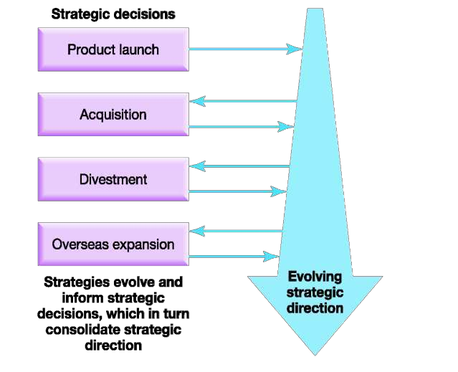
Exhibit 11.2 Strategic Direction
from Prior Decisions

Slide 15


Reasons for Logical Incrementalism
Logical incrementalism is the deliberate development of strategy by experimentation and
Environmental
uncertainty
Generalised view
of strategy
Coordinating emergent strategies
learning from partial
commitments
Experimentation

Slide 16

16

Slide 17
What is the
Resource Allocation Process?
The Bower–Burgelman
explanation of strategy development is that strategy develops as the outcome of resource allocation routines in organisations
The resource allocation process (RAP)
explanation of strategy development explains that realised strategies emerge as a result of the way resources are allocated in organisations.
17

Slide 18

18

Slide 19







Exhibit 11.3 Strategy
Development through RAP
Corporate level
Discrepancy to resolve
Proposals in line RAP
Business level
Discrepancy
to resolve
Proposals
in line RAP
Operating level
19

Slide 20




Influences on
Organisational Politics
Personal experiences
Competition for resources and influence Relative influence of stakeholders Different access to information
29

Slide 21


Possible Configurations of
Strategy Development Processes
Incremental Cultural Political
Imposed
Political
Planning
Incrementalism

Slide 22
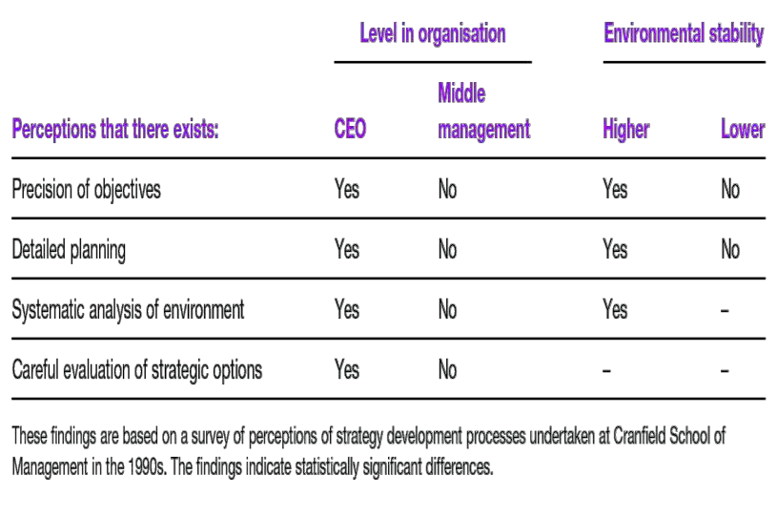
Exhibit 11.5 Managers’ Perceptions
of Strategy Development Processes

Slide 23


Exhibit 11.6 Strategy
Development Routes
Emergent
strategy
Realised
strategy
Intended strategy
Unrealised
strategy

Slide 24
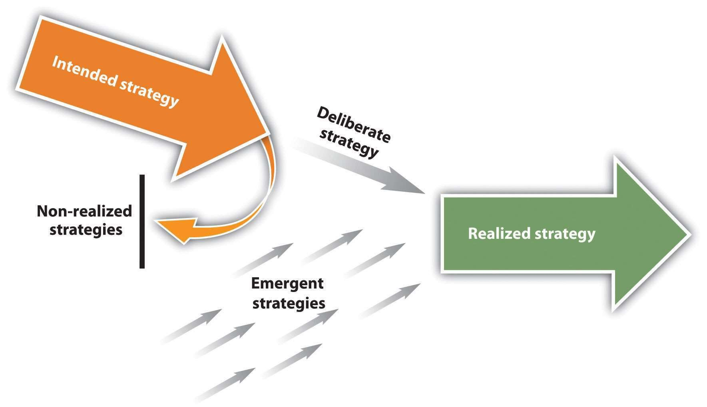
24

Slide 25
What is a Learning Organisation?
The learning organisation is capable of continual regeneration from the variety of knowledge, experience and skills of individuals within a culture which encourages mutual
questioning and challenge around a shared
purpose or vision.
25

Slide 26

26

Slide 27
Tenets of
Organizational Learning
Managers facilitate rather than direct
Information flows and relationships are lateral as well as vertical
Organizations are pluralistic
Experimentation is the norm

Slide 28
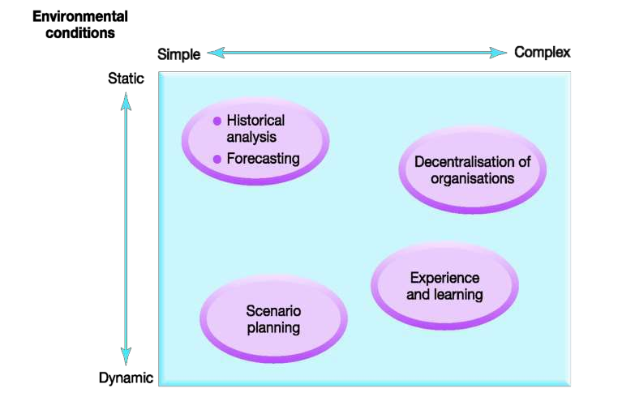
Exhibit 11.7 Strategy Development
in Environmental Contexts

