Slide 1
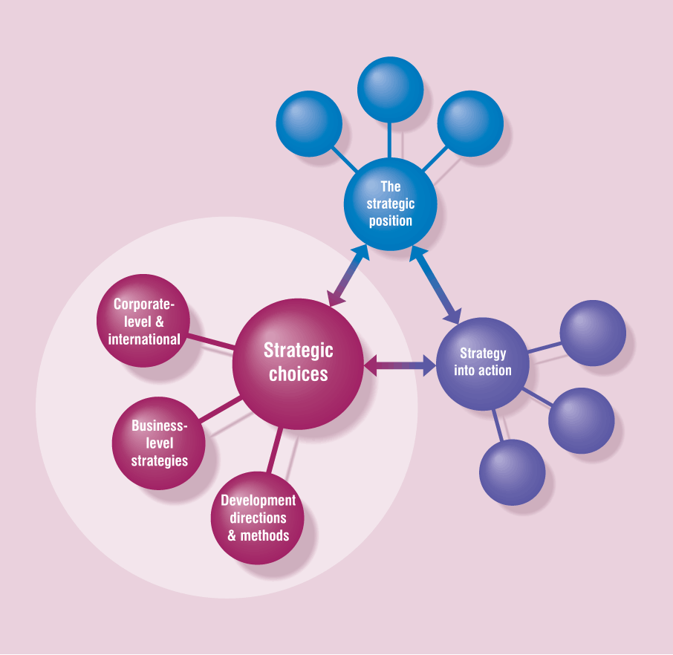
Part III
Strategic
Choices
Notes:
8

Slide 2
Directions and Methods
of Development

Slide 3
Directions and Methods of Development Outline
Directions for strategy development
Methods of strategy development
Internal, acquisition, alliance
Forms of strategic alliance
Success criteria for strategic choices
Suitability, acceptability, feasibility
Techniques to evaluate strategic options

Slide 4
Motives for Strategies
Environment-based
Fit strategies to changing business environment
Capability-based
Stretch and exploit organisational resources and competences
Expectations-based
Meet expectations deriving from cultural and political context

Slide 5
Development Directions
Development directions are the strategic options available to an organisation, in terms of products and market coverage, taking into account the strategic capability of the organisation and the expectations of stakeholders

Slide 6
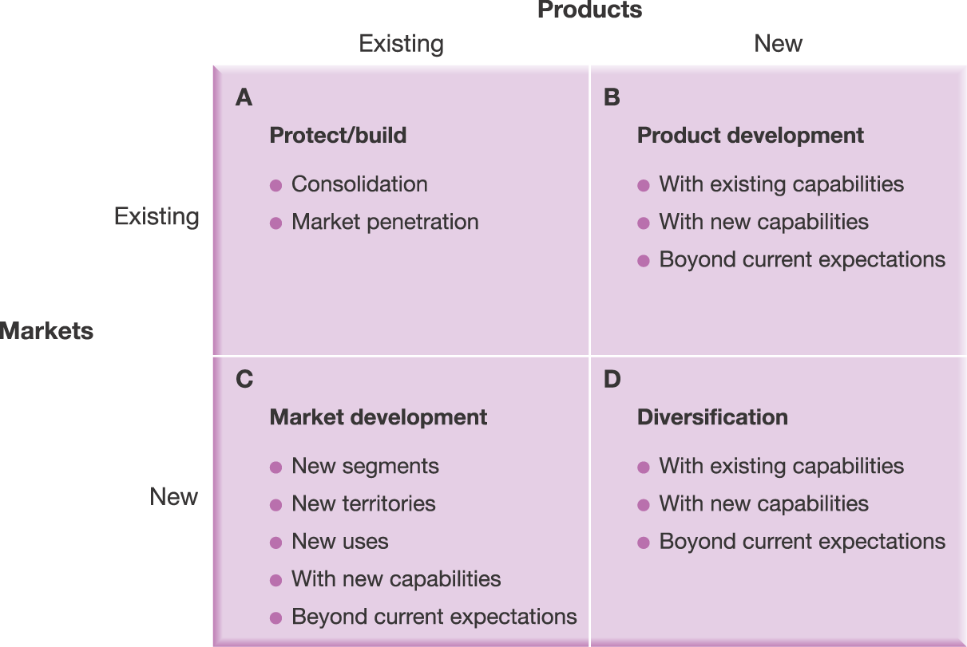
Strategy Development Directions
Source: Adapted from H. Ansoff, Corporate Strategy, Penguin, 1988, Chapter 6.
Exhibit 7.1

Slide 7
Protect and Build
Consolidation - Protect and strengthen position in current markets with current products
Downsizing or withdrawal from activities
Maintenance of market share
Market penetration - Organisation gains market share
Leverage competences
Desirability of dominant market share

Slide 8
Product Development
Deliver modified or new products to existing markets
With existing capabilities
Follow changing customer needs
Short product life cycles
Exploitation of core competence in market analysis
With new capabilities
Change of emphasis in customer needs
Change in Critical Success Factors (CSFs)
Associated dilemmas
Expense, risk and potential unprofitability
Unacceptable consequences of not developing new products

Slide 9
Market Development
Offer existing products in new markets
New market segments with similar CSFs
New uses for existing products
New geographic markets
Issues
Normally requires some product development and capability development
Credibility and expectations

Slide 10
Diversification
A strategy that takes the organisation away from both its current markets and products
Related diversification
Unrelated diversification

Slide 11
The TOWS Matrix
Exhibit 7.2

Slide 12
Methods of Strategy Development
Internal Development
Build on and develop an organisation’s own capabilities
Organic development
Mergers and Acquisitions
Take over ownership of another organisation
Strategic Alliances
Two or more organisations share resources and activities

Slide 13
Motives for Internal Development
Environment | Capabilities | Expectations
Lack of choice – breaking new ground/only one in field | Develop highly technical products in-house to create core competence | Avoid culture clash
Inability to find suitable acquisition target | Develop new markets – direct involvement to increase understanding & create core competence | Avoid potential incompatibility
 | Spread cost over time – easier for companies with limited resources

Slide 14
Motives for Mergers and Acquisitions
Environment | Capabilities | Expectations
Speed in fast-moving product/market | Exploit core competences in new arena | Institutional shareholders want continuing growth
Competitive situation – static market, avoid competitor reaction | Address lack of resources or competences | Ambitions of senior managers
Deregulation – created suboptimal units ripe for acquisition | Cost efficiency | Speculative to boost short-term share value
Financial – opportunistic acquisition of firm with low share value | Learning

Slide 15
Issues in Making Acquisitions Work
In many cases acquisitions fail to improve financial performance. Companies commonly overpay.
Difficult to add any value
Inability to integrate the new company
Difficult to identify which knowledge to transfer for organisational learning
Problems of cultural fit, especially for cross country acquisitions

Slide 16
Motives for Strategic Alliances
Need for critical mass
Cost reduction
Improved customer offering
Co-specialisation
Each partner concentrates on using own capabilities, e.g. geographical market entry, value chain activities, Public Finance Initiative
Learning
Helps to develop future competences

Slide 17
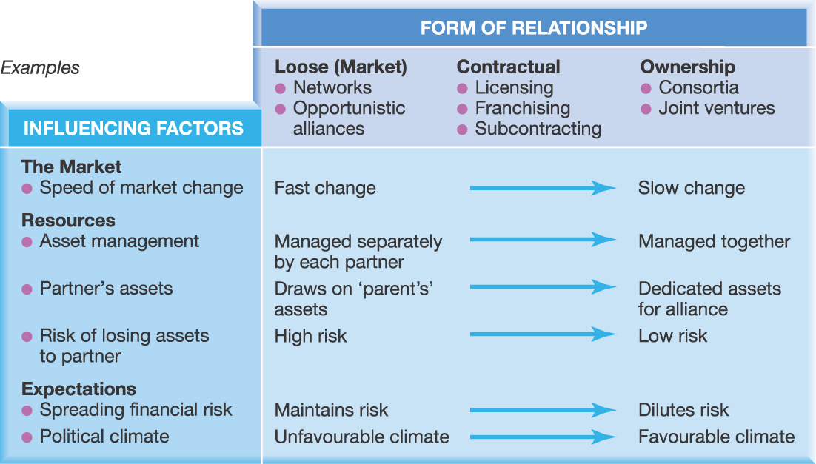
Types of Strategic Alliance
Exhibit 7.3

Slide 18
Ingredients of Successful Alliances
Clear strategic purpose with senior management support
Compatibility at operational level
Strong interpersonal relationships
Transcend national cultural differences
Defining and meeting performance expectations
Clear goals, governance and organisation
Simple, flexible, allowed to evolve and change
Trust
Most important for success
Competence based
Character based

Slide 19
Success Criteria for Strategic Options
Suitability
Whether strategy addresses circumstances in which organisation is operating
Linked to strategic position
Rationale of strategy
Acceptability
The expected performance outcomes (e.g. risk/return)
Meeting expectations of stakeholders
Feasibility
Whether strategy can be made to work in practice
Linked to strategic capability

Slide 20
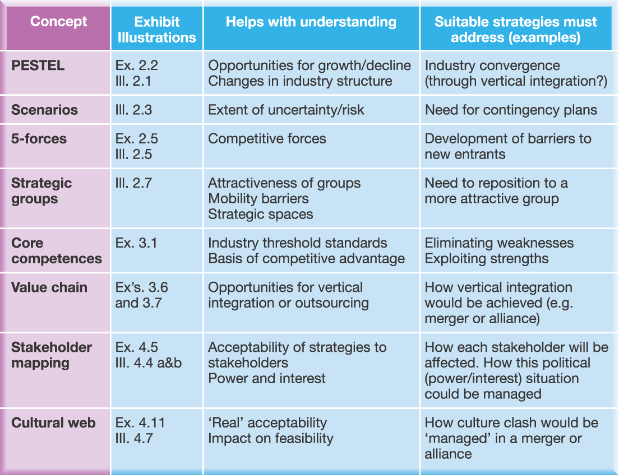
Understanding the suitability of strategic options by using concepts about the strategic postion
Exhibit 7.4

Slide 21
Suitability – Strategic Position
Concept | To understand | Strategy must address
PESTEL | Growth/decline Changes in industry structure | Industry convergence
Scenarios | Uncertainty/risk | Contingency plans
5-forces | Competitive forces | Barriers to new entrants
Strategic Groups | Attractiveness of groups, Mobility barriers, strategic spaces | Repositioning
Core Competence | Industry threshold standards Basis of competitive advantage | Eliminate weaknesses Exploit strengths
Value chain | Opportunities for vertical integration/outsourcing | How to integrate (e.g. merger/alliance)
Stakeholders | Acceptability to stakeholders Power and interest | Effect on stakeholders Manage power/interest
Cultural web | “Real” acceptability, impact on feasibility | Manage culture clash in merger/alliance
Amended Exh 7.4

Slide 22
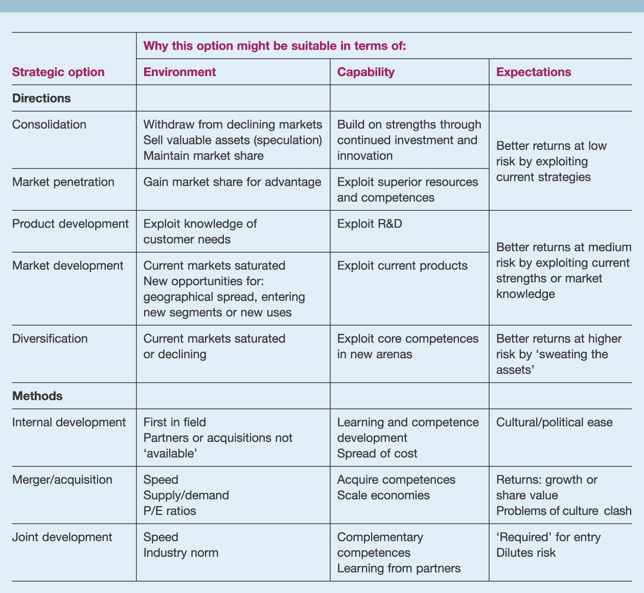
Some examples of suitability
Exhibit 7.5

Slide 23
Examples of Suitability - Directions for Growth
Strategic Option | Suitability in terms of
 | Environment | Capability | Expectations
Consolid-ation | Withdraw from declining markets Sell valuable assets Maintain market share | Build on strengths – invest and innovate | Better returns at low risk by exploiting current strategies
Market penetration | Gain market share for advantage | Exploit superior resources & competences
Product developm’t | Exploit knowledge of customer needs | Exploit R&D | Better returns at medium risk by exploiting current strengths or market knowledge
Market developm’t | Opportunities for new geographical market, new segments/uses | Exploit current products
Diversifi-cation | Current markets saturated/declining | Exploit core competences in new areas | Better returns at higher risk by seeking new business

Slide 24
Examples of Suitability - Methods of Growth
Strategic Option | Suitability in terms of
 | Environment | Capability | Expectations
Internal developm’t | First in field Partners/acquisitions not available | Learning and competence development Spread of cost | Cultural/political ease
M&A | Speed Supply/demand P/E ratios | Acquire competences Scale economies | Returns: growth or share value Problems of culture clash
Strategic alliance | Speed Industry norm | Complementary competences Learning from partners | Required for entry Dilutes risk Fashionable

Slide 25
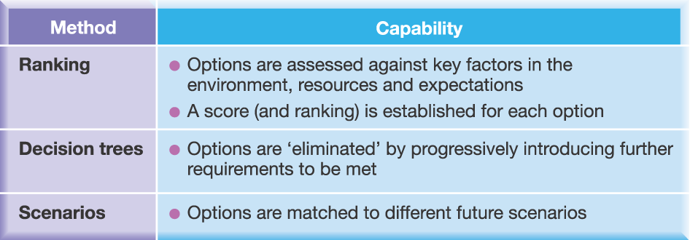
Understanding the relative suitability of
Strategic options
Exhibit 7.6

Slide 26
Why Strategies may be Unsuitable
Biased
Not addressing all three factors of environment, capability and expectations
Relative suitability
Other options may be more suitable
Elements of strategy not internally consistent
Competitive strategy, development direction and development method

Slide 27
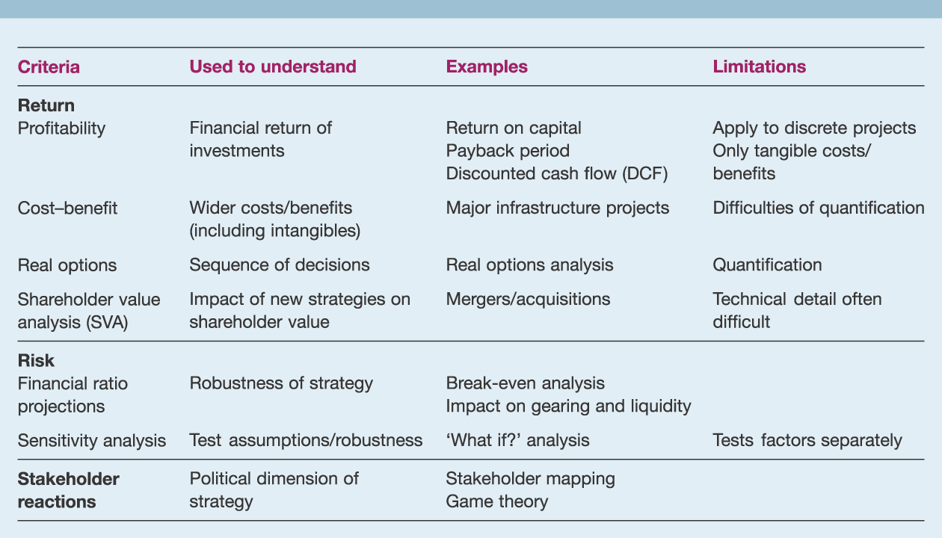
Some criteria for understanding the acceptability of strategic options
Exhibit 7.7

Slide 28
Criteria for Acceptability
Criteria | To Understand | Examples | Limitations
Return
Profitability | Financial return on investments | ROCE Payback period DCF | Apply to discrete projects Only tangible costs/benefits
Cost-benefit | Wider costs/benefits (incl. intangibles) | Major infrastructure projects | Difficulties of quantification
Real options | Sequence of decisions | Real options analysis | Quantification
Shareholder value analysis | Impact on shareholder value | Mergers and acquisitions | Technical detail often difficult

Slide 29
Criteria for Acceptability
Criteria | To Understand | Examples | Limitations
Risk
Financial ratio projections | Robustness of strategy | Break-even analysis Impact on gearing/liquidity
Sensitivity analysis | Test assumptions/ robustness | What if? analysis | Tests factors separately
Stakeholder reactions
 | Political dimension | Stakeholder mapping Game theory | Largely qualitative

Slide 30
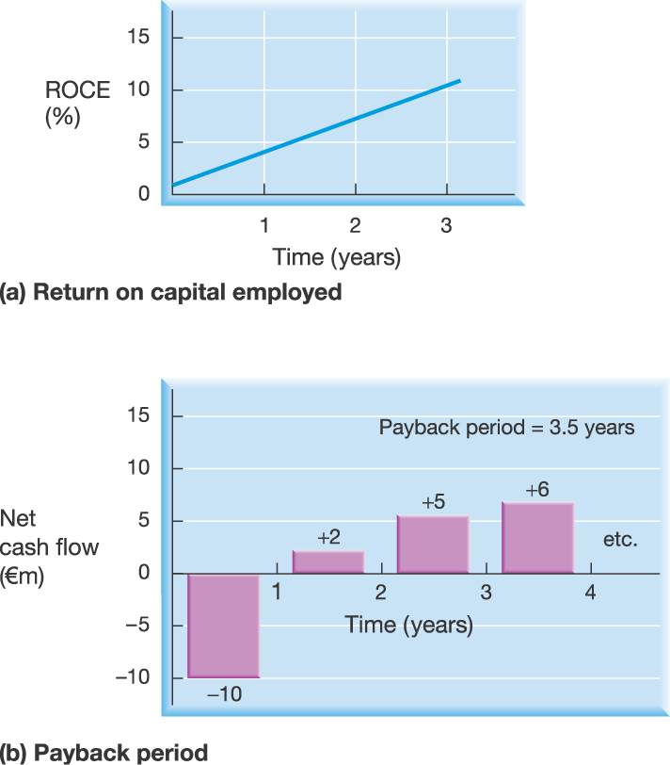
Assessing profitability (1)
Exhibit 7.8a

Slide 31
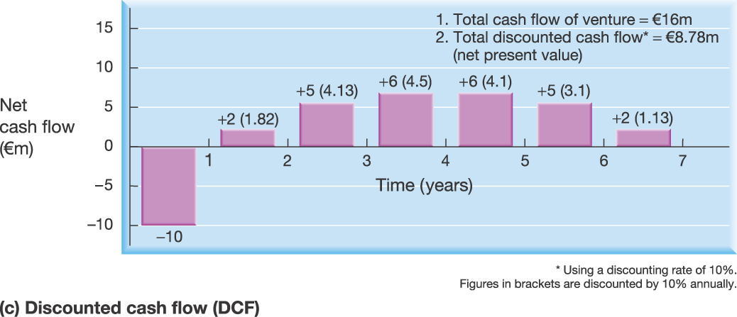
Assessing profitability (2)
Exhibit 7.8b

Slide 32
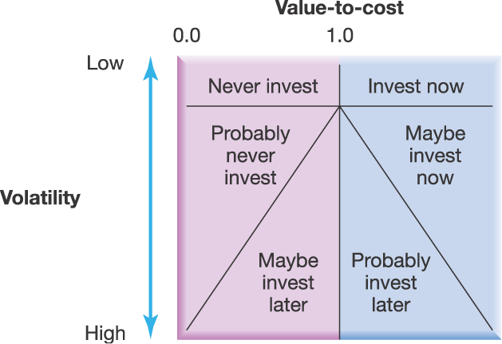
Real options framework
Source: Reprinted with permission of Harvard Business Review. Adapted from T.A. Luehrman, “Strategy as a portfolio of real options”, September-October, 1998, p. 3. Copyright © 1989 by the Harvard Business School Publishing Corporation; all rights reserved.
Exhibit 7.9

Slide 33
Feasibility
Financial
Funds flow forecasting – timing of new funding
Break-even analysis
Resource deployment
Resources and competences needed
Threshold
Unique resources/core competences
Scale, quality of resource, timetable for change

Slide 34
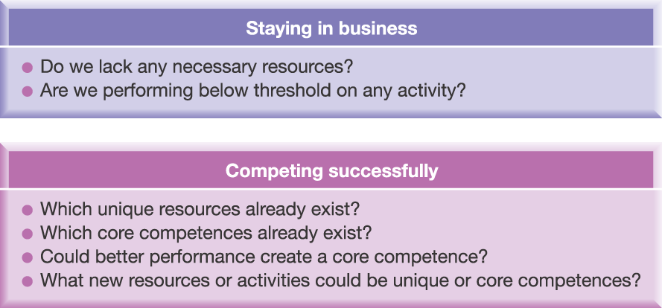
Resource Deployment
Exhibit 7.10

Slide 35
Key Points (1)
Three elements of strategic choice
Competitive strategy
Direction of development
Method of development
Four categories of development directions
Protect and build
Product development
Market development
Diversification

Slide 36
Key Points (2)
Three methods of strategy development
Internal development
Mergers and acquisitions
Strategic alliances
Three success criteria for strategic options
Suitability
Acceptability
Feasibility
Range of analytical techniques for evaluation of strategic options

