Slide 1
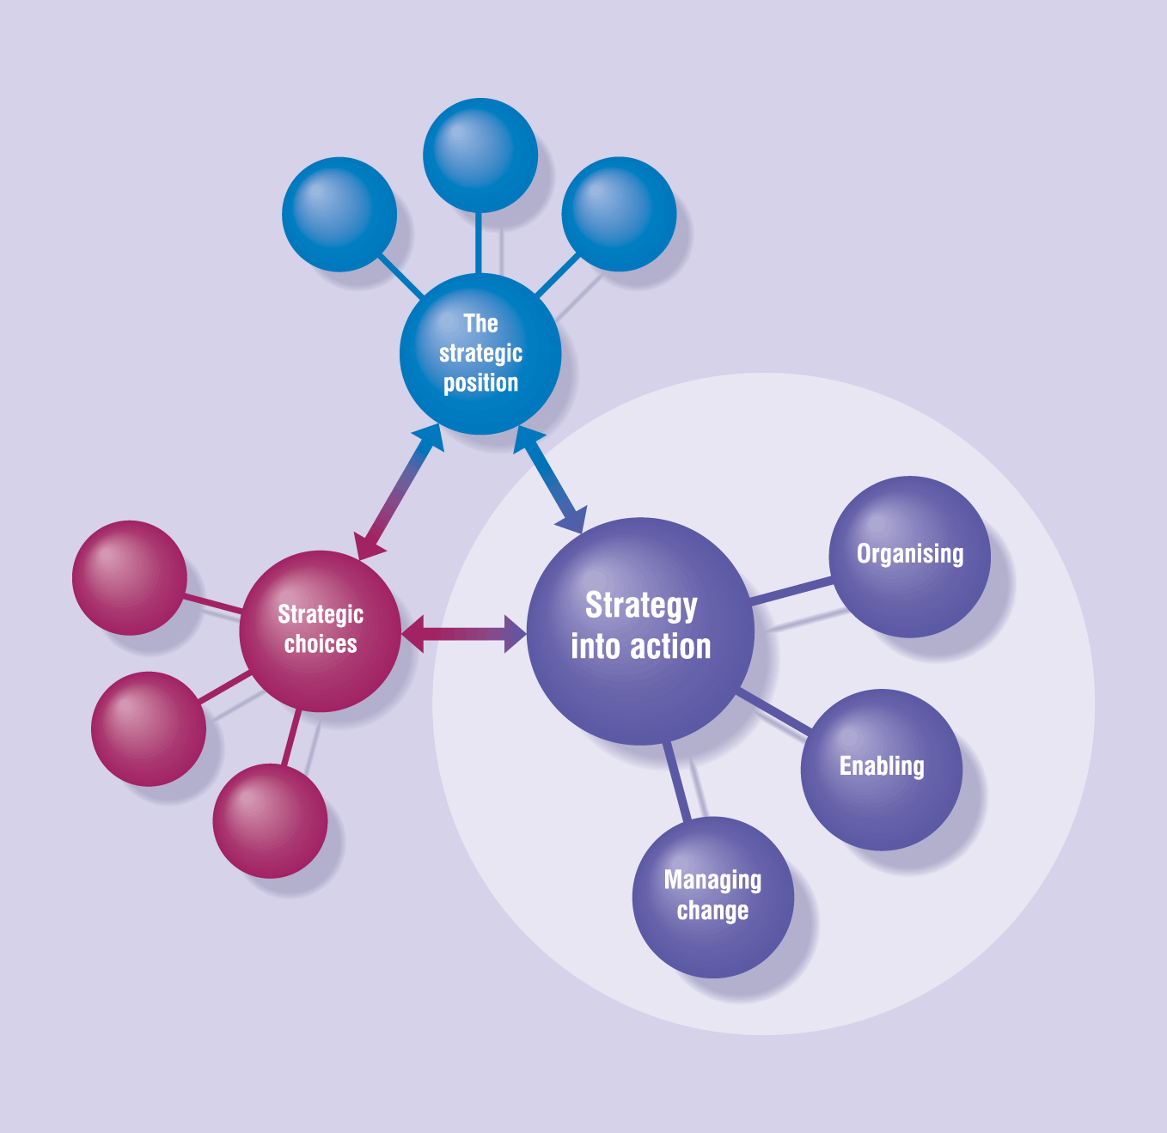
Part IV
Strategy
into
Action
Notes:
8

Slide 2
Enabling Success

Slide 3
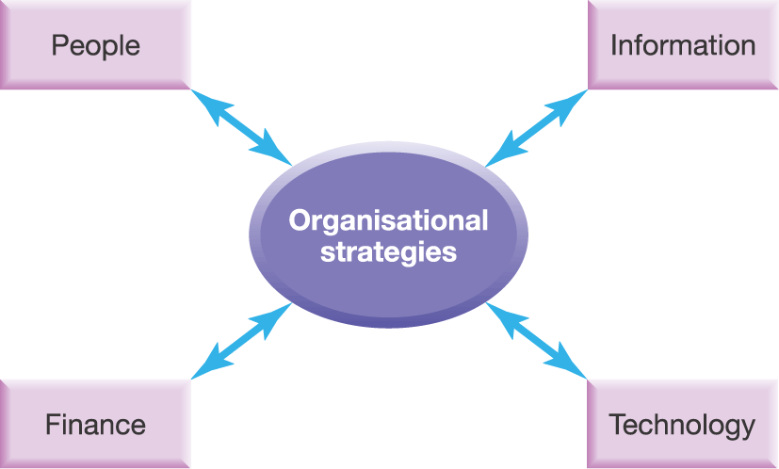
Enabling strategic success
Exhibit 9.1

Slide 4
Enabling Success – Outline
Resource management for enabling success
Management of people
Information processing
Management of finance
Effect of technology
Integration of resources and competences

Slide 5
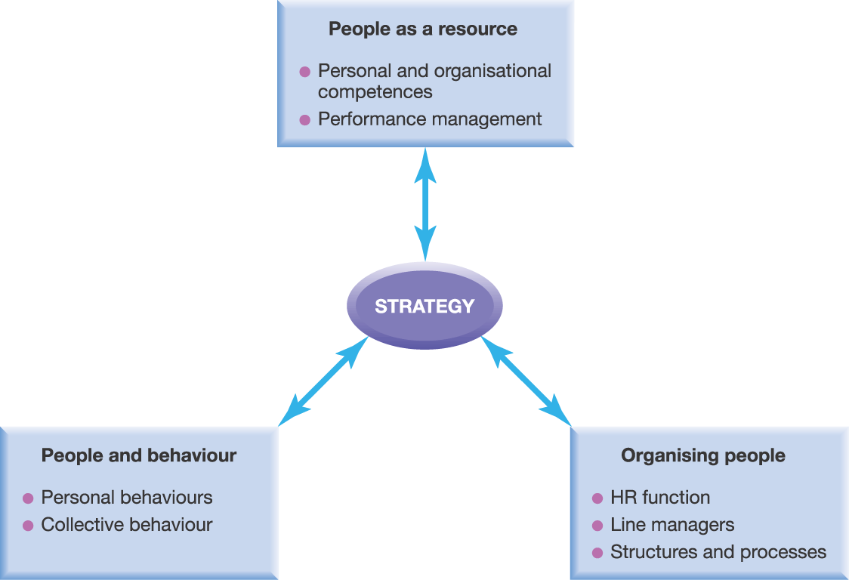
Strategy and People
Exhibit 9.2

Slide 6
People as a Resource
The ‘hard’ side of HR management
Concerned with issues of performance management
Performance management enables success via:
Audits to assess HR requirements
Goal-setting and performance assessment
Reward planning

Slide 7
People and Behaviour
The ‘soft’ side of HR management
Managing change requires understanding, addressing and changing behaviours
Link between managerial behaviour and success of strategy
Concerned with the behaviour of people – individually and collectively
Managers as shapers of context (cultural web)
Understanding relationships between behaviours and strategic choices
Being realistic about the difficulty and time-scale in achieving behaviour change (structures and systems)
Being able to vary style of managing change

Slide 8
Organising People (1)
Shift from HR function to line management
Roles of HR function
Service provider (e.g. recruitment, training)
Regulator (e.g. of pay and promotion)
Advisor on HR strategy
Change agent

Slide 9
Organising People (2)
Problems of middle (line) management involvement in HR
Not HR professionals
Short term pressures to meet targets - difficult to take strategic HR view
Trade unions/associations resist dispersion of HR responsibility
Managers may lack incentive to take on formal HR activities
‘Gatekeepers’ of status quo versus ‘change relayer’

Slide 10
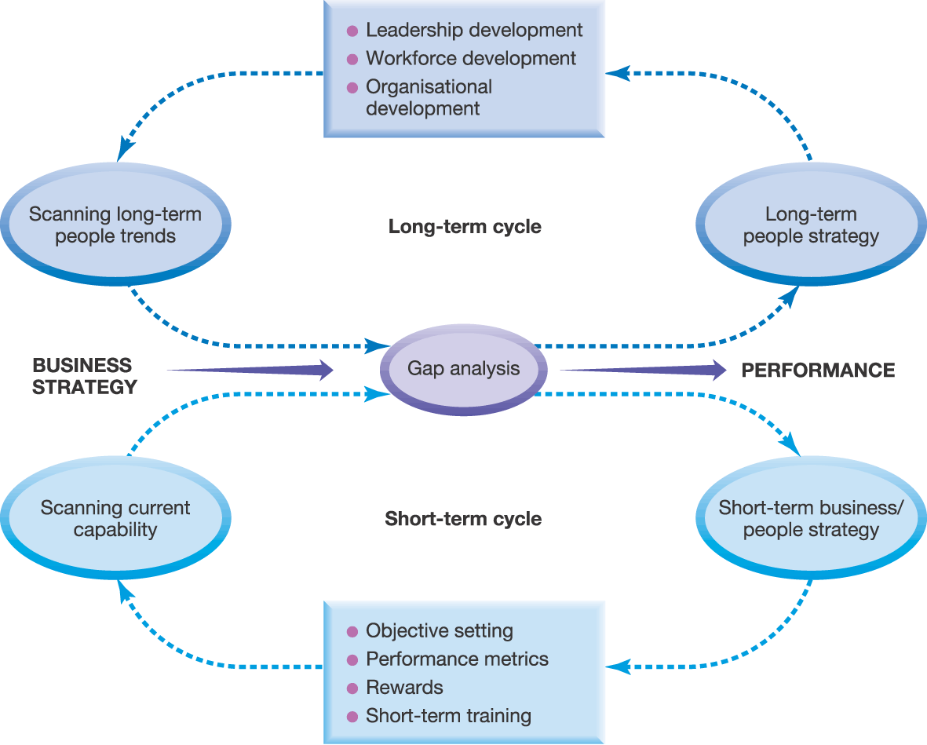
Competitive Advantage through People
Source: Adapted from L. Gratton, V. Hope Hailey, P. Stiles and C. Truss, Strategic Human Resource Management, Oxford University Press, 1999, p. 185.
Exhibit 9.3

Slide 11
Reasons for Failure to Deliver Success
HR strategies out of line with overall business strategy
People’s competences and/or behaviours out of line with either HR strategies and/or business strategies
Business strategies fail to capitalise on the strengths of an organisation’s capabilities and/or culture (behaviours)

Slide 12
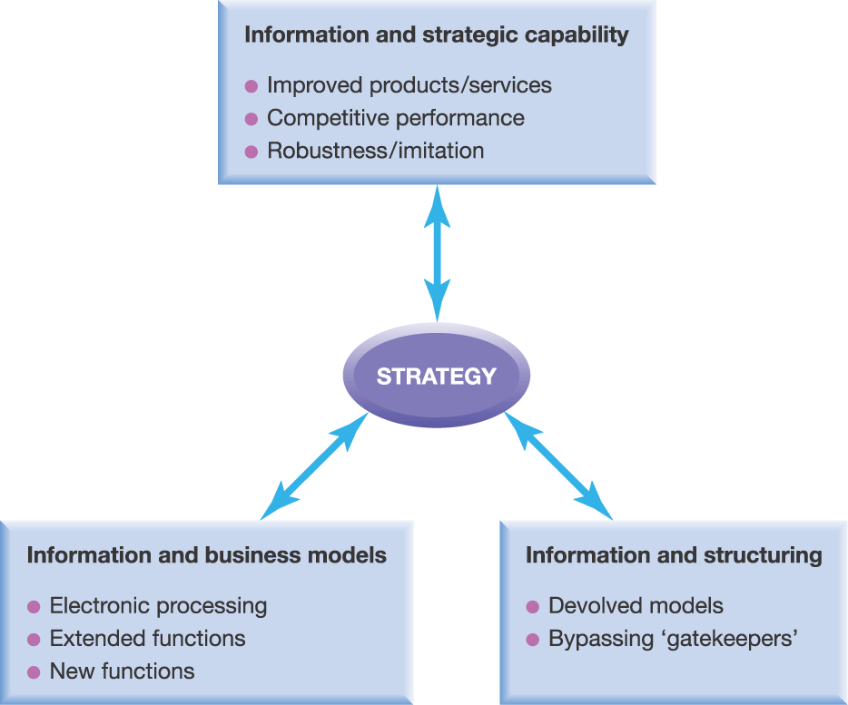
Strategy and Information
Exhibit 9.4

Slide 13
Information and Strategic Capability (1)
Product/service features
Lower prices (reduced costs)
Improved pre-purchase information
Easier and faster purchasing processes
Shorter development times for new features
Improved product/service reliability
Personalised products or services
Improved after-sales service

Slide 14
Information and Strategic Capability (2)
Competitive Performance
Higher general customer expectations
Emphasis on services rather than products
IT alone not enough (Dot.com lessons)
Data mining can give competitive advantage
Robustness
Rarity, inimitability, causal ambiguity of resources/competences being eroded

Slide 15
Information and Strategic Capability (3)
Competitive Strategy
Routinisation (Positions 1 & 2 on strategy clock)
Mass customisation (Position 3)
Customisation (Positions 4 & 5)
IT laggards – still require traditional information provision

Slide 16
Information and Changing Business Models
A business model describes the structure of product, service and information flows and the roles of the participating parties
IT impacts in three ways:
Replacing physical or paper-based processes with electronic processes
Extending the functions that traditional business models offer
Transformational models

Slide 17
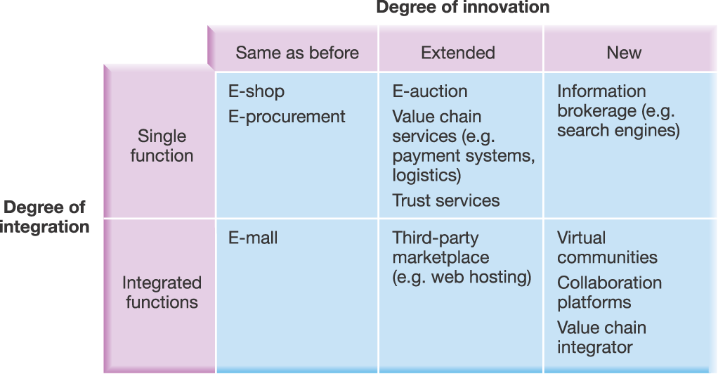
New Business Models
Source: Adapted from P. Timmers, Electronic Commerce, Wiley, 2000, Chapter 3. Copyright © 2000 John Wiley & Sons Ltd. Reproduced with permission.
Exhibit 9.5

Slide 18
Information and Structuring (1)
Information management should fit organisational type:
Strategic planning
routinised business processes, low cost, threshold quality
Financial control
accurate, timely information on performance against targets
Strategic control
coordination of bottom-up plans; reliable information to support planning and customer/supplier relationships; performance information

Slide 19
Information and Structuring (2)
Better information helps bypass ‘Gatekeepers’
Gatekeepers are individuals or groups who gain power from control of information
Flattened structures
More direct communication of strategy
Interaction informed by common database

Slide 20
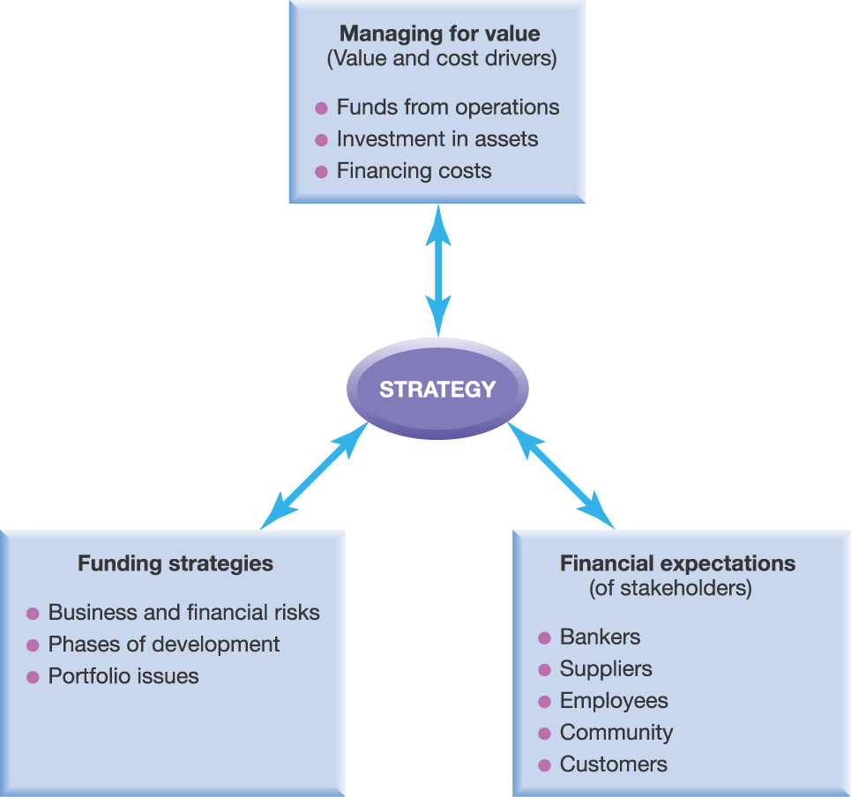
Strategy and Finance
Exhibit 9.6

Slide 21
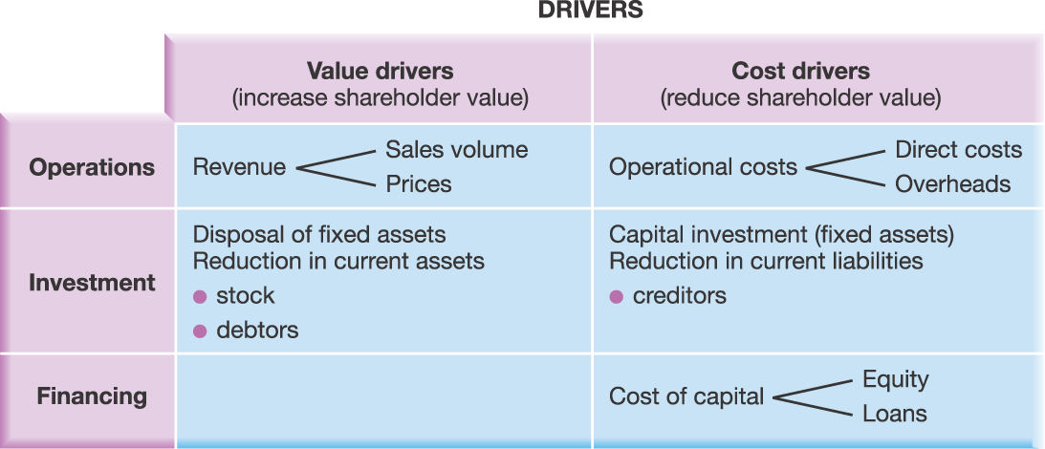
Determinants of Value Creation
Exhibit 9.7

Slide 22
Managing for Value
Managing for value is concerned with the long-term cash-generating capability of an organisation
Critical to understand key value and cost drivers:
The factors that have most influence on the cash generation capability of an organisation
Value drivers drive cash inflows
E.g. revenues, disposals
Cost drivers drive cash outflows
E.g. Capital expenditure, cost of capital (sources of capital)

Slide 23
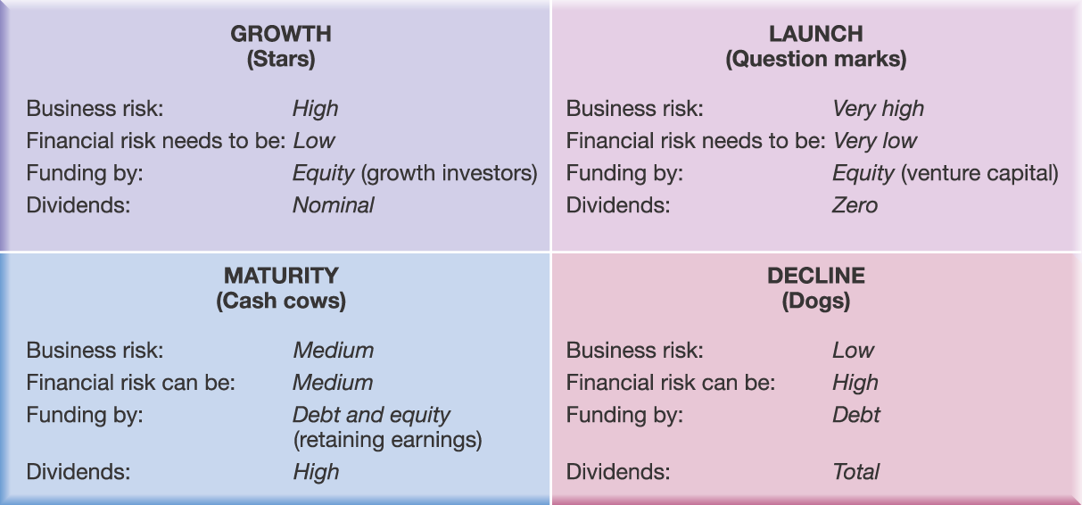
Funding Strategies in Different Circumstances
Source: Adapted from K. Ward, Corporate Financial Strategy, Butterworth/Heinemann,1993, Chapter 2.
Exhibit 9.8

Slide 24
Strategy and Finance
Funding to match strategy, e.g.
Focus on high-growth, high-risk investments needs more equity and less debt
Focus on mature cash cow businesses needs more debt and less equity
Focus on new and innovative businesses might require company to act as own venture capitalist
Funding circumstances also drive strategy, e.g.
Ownership dictates sources and amounts of funding
Motives for acquisition might be financial rather than strategic

Slide 25
Financial Expectations of Stakeholders
Institutional shareholders
Pressures to maximise short term earnings
Bankers (loan providers)
Risk and competence
Suppliers and employees
Good prices and liquidity
Community
Jobs and social costs
Customers
Best-value

Slide 26
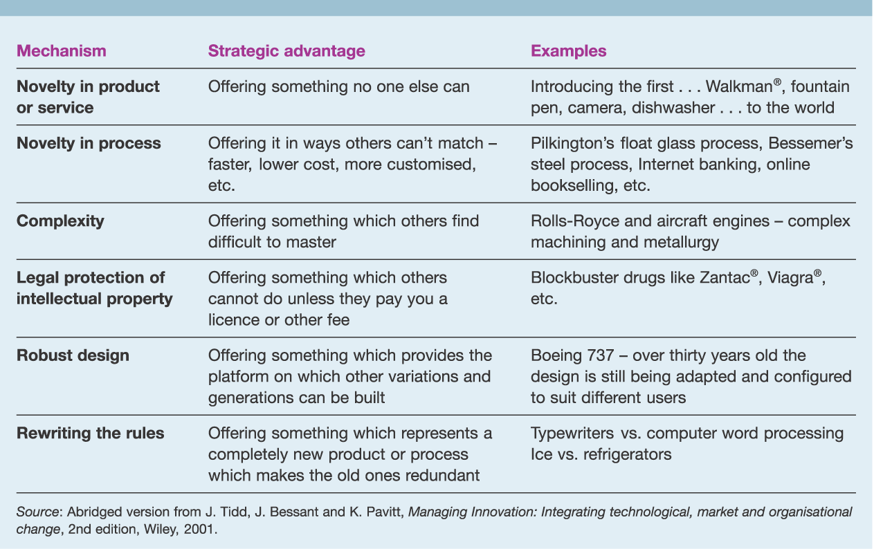
Strategic advantage through technology development
Exhibit 9.9

Slide 27
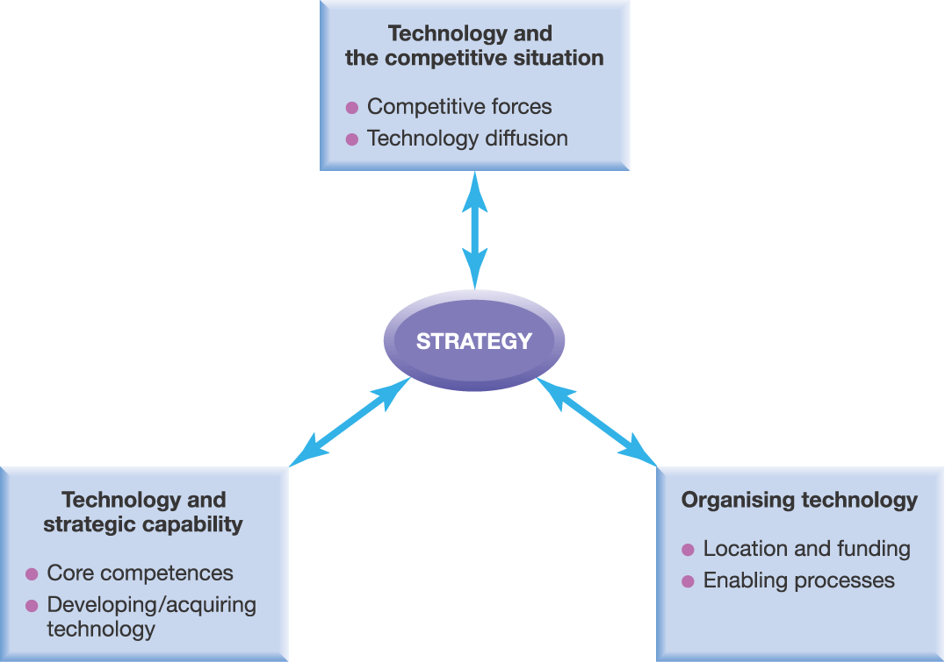
Strategy and Technology
Exhibit 9.10

Slide 28
Technological Paths
A technological path identifies the major factors that are influencing technological developments
Supplier-dominated developments
Agriculture
Scale-intensive developments
Complex manufacturing, e.g. cars
Information-intensive developments
Financial services, retailing
Science-based developments
Pharmaceuticals, electronics

Slide 29
Technology and Competitive Situation
Competitive Forces
Barriers to entry
Lower (e.g. reduced economies of scale/capital)
Higher (e.g. complexity)
Substitution
Higher (New products, displaced need)
Lower (Tying usage of one product to another)
Power of Suppliers and Buyers
Higher (Increased source of supply, standards)
Lower (Tying usage of one product to another)
Competitive rivalry
Higher (generic specifications)
Lower (patented product/process)

Slide 30
Diffusion of Innovation (1)
Diffusion is the extent and pace at which a market is likely to adopt new products
Supply-side issues
Degree of improvement
Compatibility
Complexity
Experimentation
Relationship management

Slide 31
Diffusion of Innovation (2)
Demand-side issues
Market awareness
Observability
Innovators (first to adopt) & laggards
Tipping point
Slow adoption followed by sudden take-off or decline
Influence of important people, a memorable message and changes in context

Slide 32
Technology and Strategic Capability
Tying strategy to a single technology is risky
Core competences may develop by linking technologies together, rather than from individual technologies
Dynamic capabilities are important in rapidly changing environment - pioneering
Advantage also accrues to technological followers

Slide 33
Developing or acquiring technology
Source: Adapted from J. Tidd, J Bessant and K. Pavitt, Managing Innovation: Integrating technological, market and organisational change, 2nd edition, Wiley 2001. Copyright © 2001 John Wiley & Sons Ltd. Reproduced with permission.
Exhibit 9.11

Slide 34
Developing or Acquiring Technology
Method Influencing Factors | In-house | Alliances | Acquisition
Importance of technology | Key | Threshold | Key or threshold
Prior knowledge & reputation | High | Low | Very low
Complexity | Low/medium | High | High
Willingness to take risk | High | Medium | Low
Desire to lead or follow | Lead | Follow | Follow
Speed | Slow | Medium | High

Slide 35
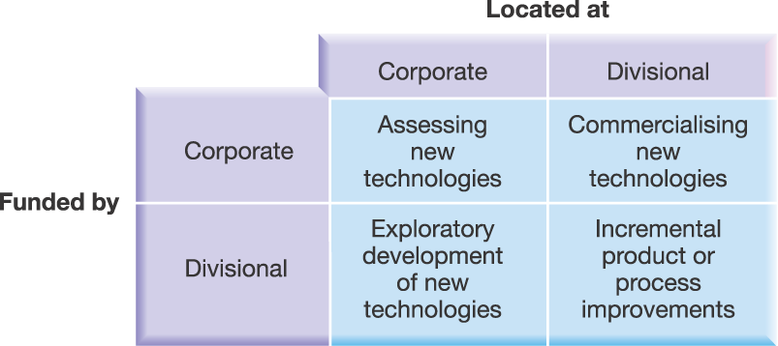
Funding and Location of R&D
Source: Adapted from J. Tidd, J Bessant and K. Pavitt, Managing Innovation: Integrating technological, market and organisation change, 2nd edition, Wiley, 2001. Copyright © 2001 John Wiley & Sons Ltd. Reproduced with permission.
Exhibit 9.12

Slide 36
Enabling Processes (1)
Organisational processes are critical for technology development
Scanning the business environment (technology and market developments)
Resourcing developments adequately
Past experience
Benchmarking
Investment appraisal, e.g. stage-gate process

Slide 37
Enabling Processes (2)
Organisational processes are critical for technology development (cont.)
Creating environment for innovation
Strong management commitment
Business acumen based on relationships between strategy and technology
Culture of learning organisation
Commitment to individual and team development

Slide 38
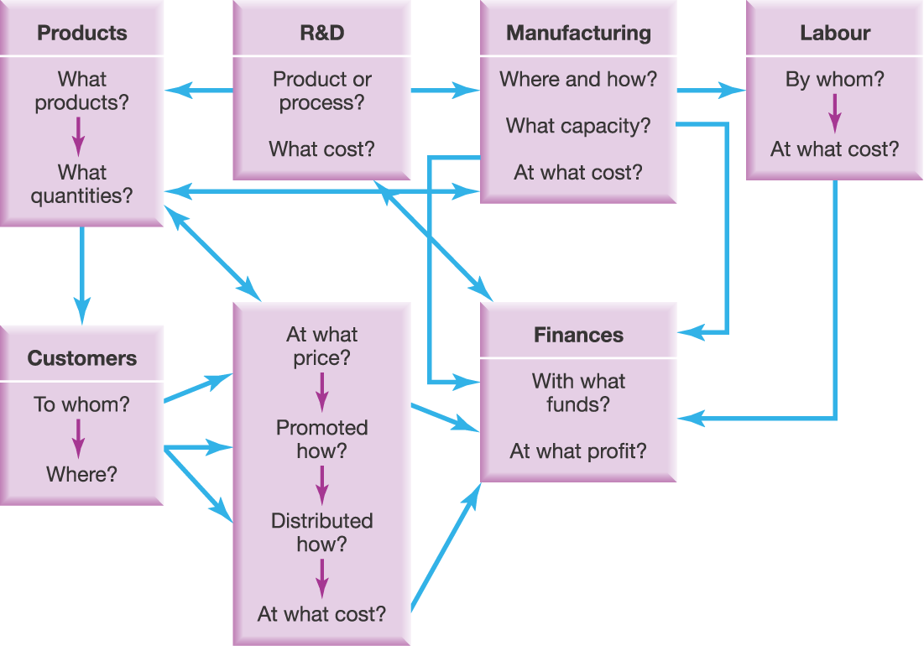
Resource Integration in a New Product Launch
Exhibit 9.13

Slide 39
Key Points (1)
Importance of relationship between resource management and strategic success
Strategic success depends on:
People
Formal systems and procedures
Informal behaviours
Structures and processes
Information
Ability to access and process information
Development of new business models
Structures and processes within and between organisations

Slide 40
Key Points (2)
Strategic success depends on: (cont.)
Finance
How financial value is delivered
Type of funding
Expectations of stakeholders
Technology
Competitive forces
Strategic capability
Development, exploitation, organisation and funding
Integration of resources and competences

