Slide 1
Organising for
Success

Slide 2
Organising for Success – Outline (1)
Key challenges in organising for success
Control, knowledge management, coping with change, response to globalisation
Structural types of organisations
Strengths and weaknesses
Organisational processes
Planning systems, performance targets

Slide 3
Organising for Success – Outline (2)
Management of internal and external relationships
Help or hinder success
Three reinforcing strands for organising configurations
Structure, processes and relationships
Implications of configurations for organisational performance and change

Slide 4
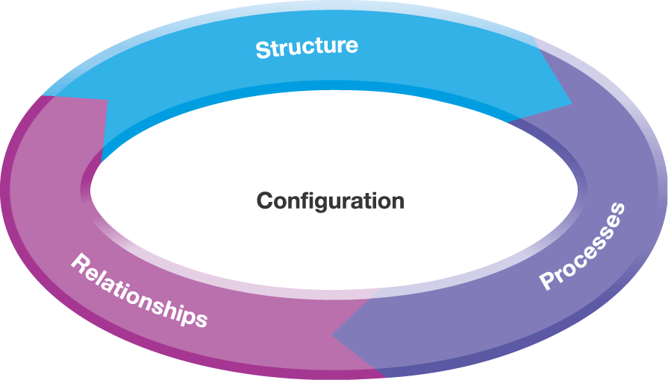
Organisational Configurations
Exhibit 8.1

Slide 5
Organisational Configuration (1)
An organisation’s configuration consists of the structures, processes and relationships through which the organisation operates
Structural design
Roles, responsibilities and lines of reporting
Importance of knowledge management
Risk of undermining strategy implementation

Slide 6
Organisational Configuration (2)
Processes
Supporting people
Influence success/failure
Define how strategies made and controlled
Define interactions and strategy implementation
Relationships
Between organisational units and the centre (parenting)
Outside firm, e.g. outsourcing and strategic alliances

Slide 7
Organisational Structure
Organisational structure describes:
Who is responsible for what
Patterns of communication and knowledge exchange
Skills required to move up the organisation
Types of structure
Emphasis on one structural dimension
Functional; Multidivisional; Holding
Types of structure
Mixture of structural dimensions
Matrix; Transnational; Team; Project

Slide 8
Organisation Design
Challenges shaping structure
Organisational size
Extent of diversification
Type of technology
Control
Change
Knowledge
Globalisation

Slide 9
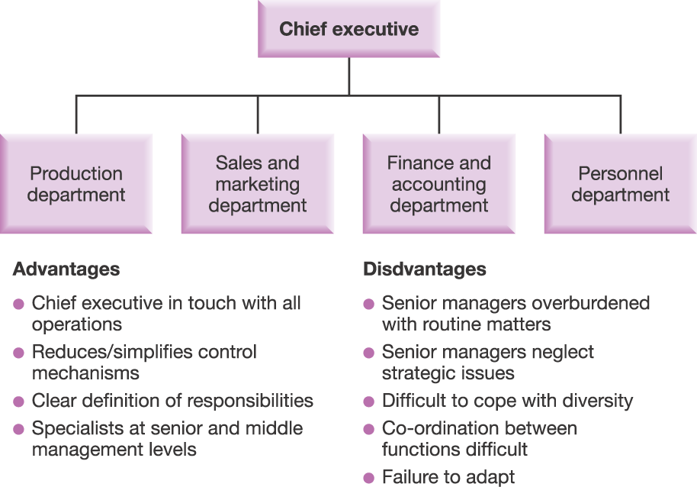
A Functional Structure
Exhibit 8.2

Slide 10
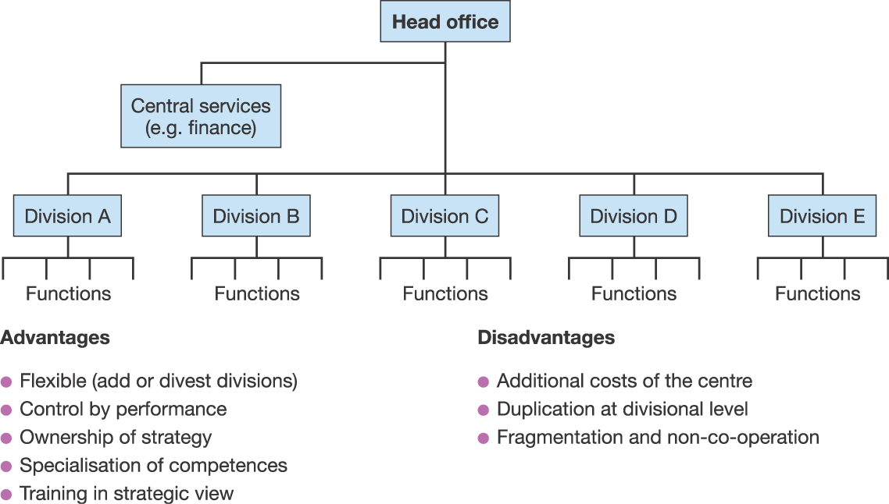
A Multidivisional Structure
Exhibit 8.3

Slide 11
A Holding Company (1)
Investment company
Shareholdings in variety of separate businesses
Subsidiary businesses operate independently, have other shareholders and retain original company name
Portfolio parenting role

Slide 12
A Holding Company (2)
Characteristics
Flexible
Bring in outside shareholders as partners
Sell subsidiaries as conditions change
Hard to control
Hands-off management style
Rights of outside shareholders
Difficult knowledge sharing – little synergy

Slide 13
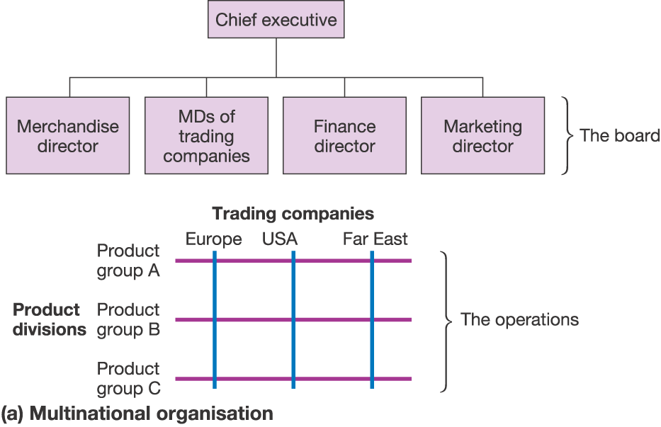
A Multinational Matrix Structure
Exhibit 8.4a

Slide 14
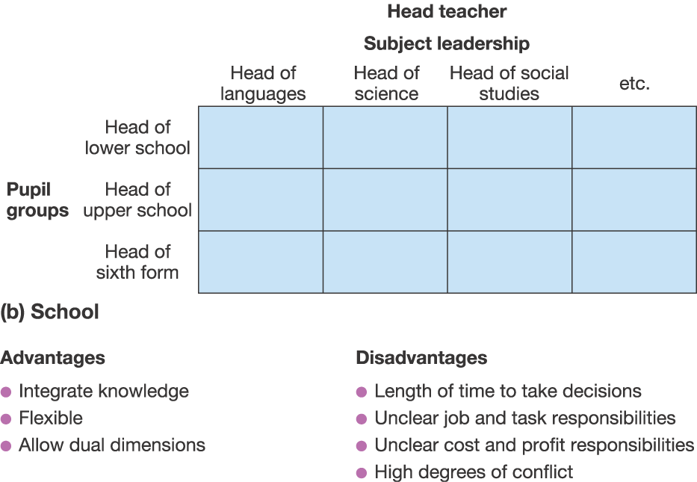
A Matrix Organisation in a School
Exhibit 8.4b

Slide 15
A Transnational Structure
Exploits knowledge across borders
Gets the best of multi-domestic and global strategy
High local responsiveness
High global coordination
National units operate independently, but are a source of ideas and capabilities for the whole organisation
National/regional units achieve greater scale economies by specialising
Corporate centre manages global network

Slide 16
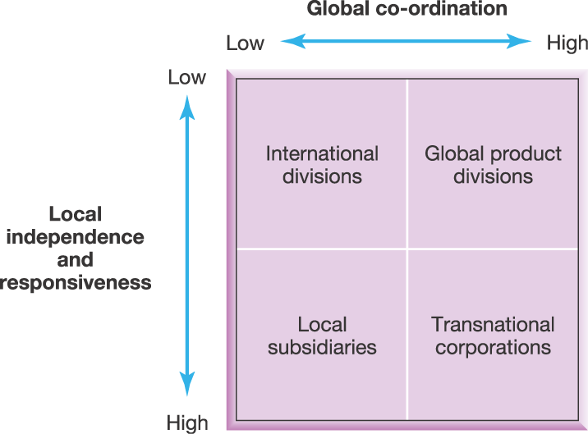
Multinational Structures
Source: Reprinted with permission of Harvard Business School Press. Adapted from C. Bartlett and S. Ghoshal, Managing Across Borders: The transnational corporation, 2nd edition, Random House, 1998. Copyright © 1998 by the Harvard Business School Publishing Corporation; all rights reserved.
Exhibit 8.5

Slide 17
Roles within Transnationals (1)
Product or business managers
Further global competitiveness across borders
Product/market strategists
Architects of business resources & competences
Drivers of product innovation
Coordinators of transnational transactions
Country or territory managers
Sensors of local needs
Build unique competences to become centre of excellence

Slide 18
Roles within Transnationals (2)
Functional managers
Champion worldwide innovation and learning
Scan for best practice and cross-pollinate
Corporate managers
Integrate roles and responsibilities
Leaders and talent spotters

Slide 19
Team-based Structure
Combines both horizontal and vertical co-ordination through cross functional teams
Often built around business processes
Contains mixture of specialists
Advantages
Good for knowledge sharing
Flexible
Highly motivated
Disadvantages
Complexity
Difficulties of control
Problems of scaling up

Slide 20
Project-based Structure (1)
Teams created, undertake the work, then dissolved
For large expensive items or limited time events
Constantly changing organisational structure
Collection of project teams
Created and steered by small corporate group
Set up ad hoc taskforces
for new elements of strategy
to provide momentum

Slide 21
Project-based Structure (2)
Advantages
Flexible
Good accountability and control (clear tasks/defined time)
Effective knowledge exchange
Attract international members due to short project times
Disadvantages
Possible lack of coordination
Proliferation of projects
Breaking up teams hinders knowledge accumulation

Slide 22
Comparison of Structures
Exhibit 8.6

Slide 23
Comparison of Structures
Challenge Structure | Control | Change | Knowledge | Globalisation
Functional | *** | * | ** | *
Multidivisional | ** | ** | * | **
Holding | * | *** | * | **
Matrix | * | *** | *** | ***
Transnational | ** | *** | *** | ***
Team | * | ** | *** | *
Project | ** | *** | ** | **

Slide 24
9 Design Tests for Organisation Structure (1)
Fit with key objectives and constraints
Market advantage test
Structure follows strategy
Parenting advantage test
Fit with parenting role of corporate unit
People test
Fit people available
Feasibility test
Fit legal, stakeholder, union constraints
Goold and Campbell 2002

Slide 25
9 Design Tests for Organisation Structure (2)
General design principles
Specialised cultures test
Value of close collaboration of specialists
Difficult links test
Links which may strain the organisation
Redundant hierarchy test
Too many management layers – blockages/ expense
Accountability test
Clear lines of accountability – control
Flexibility test
To what extent design allows for future change

Slide 26
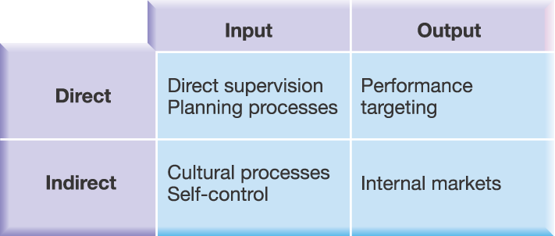
Types of Control Processes
Exhibit 8.7

Slide 27
Control Processes (1)
Direct supervision
Direct control of strategic decisions
Often small/family businesses
Need thorough understanding of business
Can be effective in crisis

Slide 28
Control Processes (2)
Planning processes
Administrative control
Planning and control of resource allocation and monitoring resource utilisation
Budgeting
Support strategy via
Standardisation of work processes (e.g. ISO 9000)
Enterprise resource planning (ERP) systems
Formulae (e.g. public service budgets per capita)

Slide 29
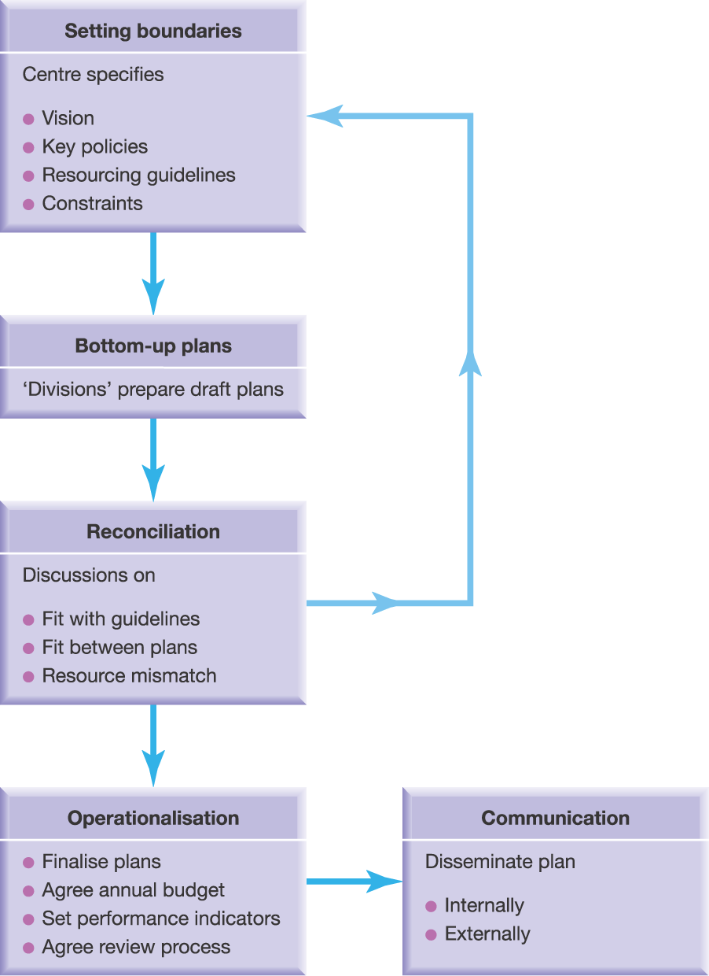
‘Bottom-up’ Business Planning

Slide 30
Control Processes (3)
Self-control
Integration of knowledge and coordination of activities by direct interaction of individuals without supervision
Managers shape the context
Provide the channels of interaction (e.g. IT)
Support with resources

Slide 31
Control Processes (4)
Personal Motivation
Influenced by leadership style
Importance of credibility
Professional role model (Grinding)
Supporting individuals (Minding)
Securing resources (Finding)

Slide 32
Control Processes (5)
Cultural processes
Organisational culture and standardisation of norms
Foster innovation in complex/dynamic environments
Collaborative culture – communities of practice
Danger of core rigidities
Training and development

Slide 33
Control Processes (6)
Performance targeting processes
Focus on outputs of an organisation, e.g. quality, revenues or profit
Public service move to measuring outcomes
Balanced scorecards
Combine qualitative and quantitative measures
Acknowledge expectations of different stakeholders
Relate assessment of performance to choice of strategy

Slide 34
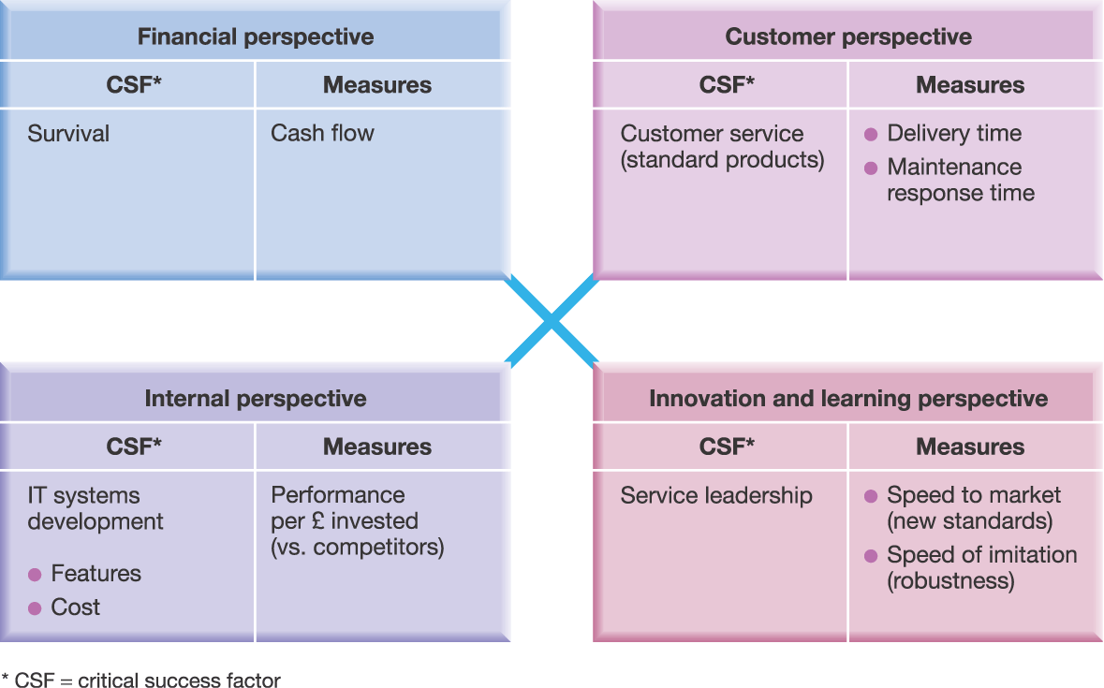
The Balanced Scorecard – An Example

Slide 35
Control Processes (7)
Market processes
Use of internal markets for control
Formalised system of contracting for resources/inputs within the organisation
Internal market
Competitive bidding
Transfer pricing
Service-level agreements
Market processes
Disadvantages
Time spent on bargaining
Creation of bureaucracy
Dysfunctional competition, destroying collaborative culture

Slide 36
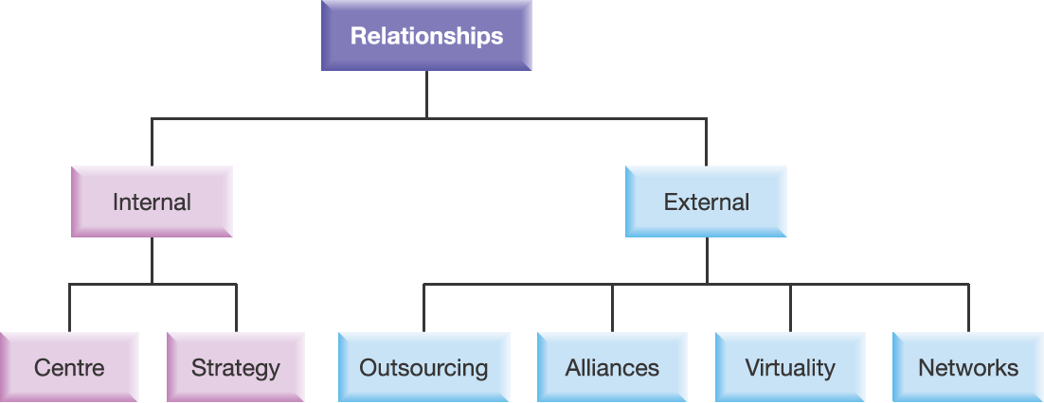
Relating Internally and Externally
Exhibit 8.10

Slide 37
Relating Internally
Relating to the Centre
Devolution
delegation of decision making
appropriate for fast moving markets - decisions close to action
Centralisation vs. devolution
Relating over strategy
Division of responsibilities for strategic decision making
Relating over strategy
Goold and Campbell’s 3 strategy styles:
Strategic planning style – parent as master planner
Financial control – centre sets financial targets, allocates resources, appraises performance
Strategic control – centre shapes behaviour and context

Slide 38
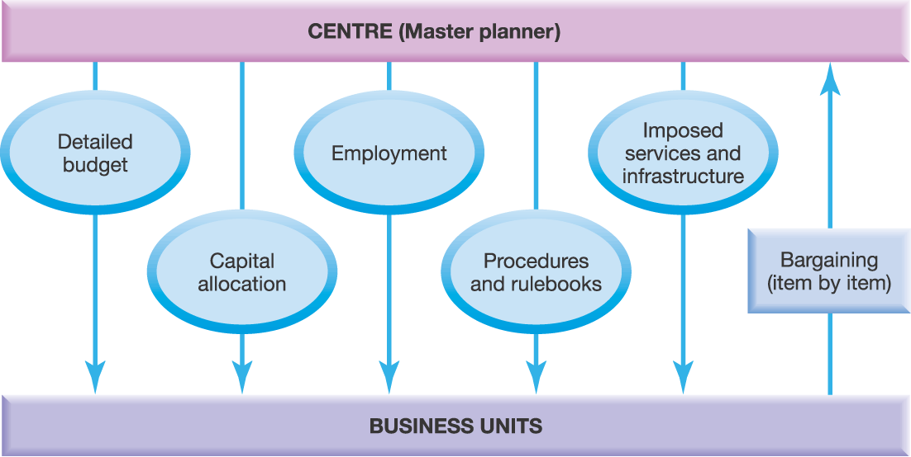
Strategic Planning
Exhibit 8.11

Slide 39
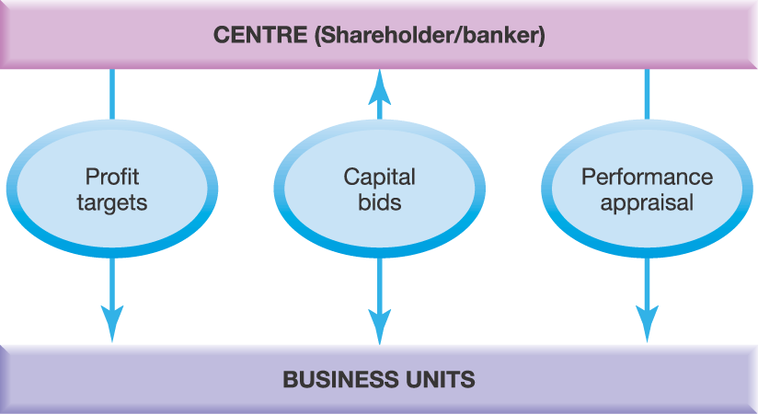
Financial Control
Exhibit 8.12

Slide 40
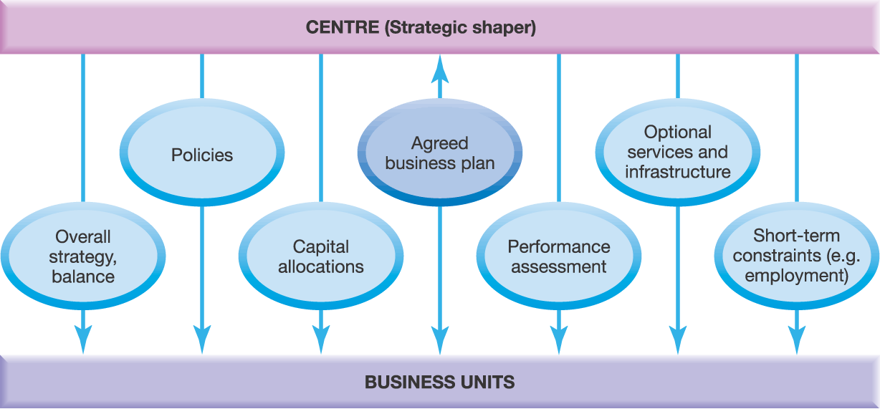
Strategic Control
Exhibit 8.13

Slide 41
Relating Externally (1)
Outsourcing
Management of external suppliers/distributors
Education on strategies, priorities and standards
Tie in via ERP systems or manage by cultural processes/norms
Strategic alliances
Range from contractual to relational
Importance of trust

Slide 42
Relating Externally (2)
Networks
Cooperation key for organising for success
Teleworking, federations of experts, one-stop shops, service network
Value of nodal position
3 requirements for nodal position:
compelling vision
unique resources or competences
networking skills

Slide 43
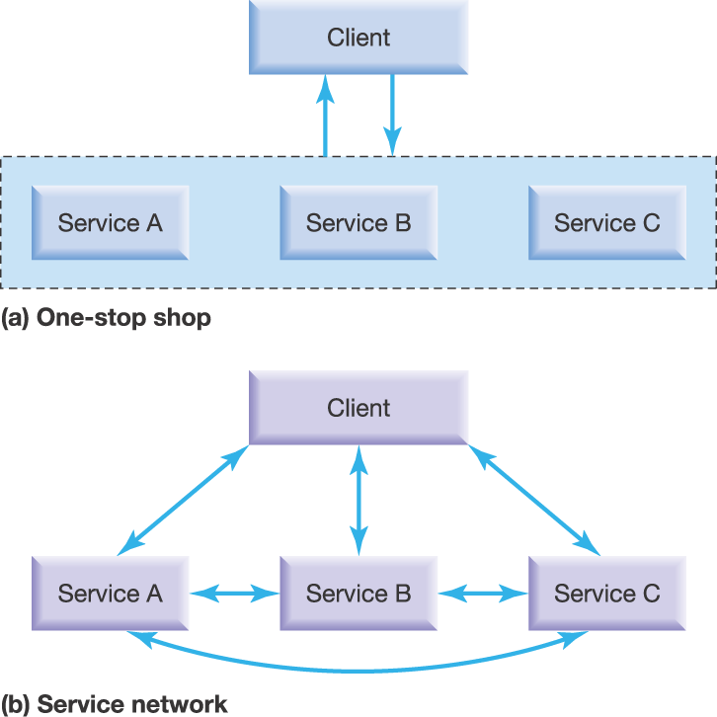
‘Joined up’ services: Smoothing the Network
Exhibit 8.14

Slide 44
Relating Externally (3)
Virtual organisation
Held together by partnership, collaboration and networking
Not by formal structure and physical proximity
Danger of remoteness from learning, loss of core competence

Slide 45
Configurations (1)
Organisation’s configuration
How structures, processes and relationships work together consistently
Stereotypical configurations (Mintzberg)
Simple
Machine bureaucracy
Professional bureaucracy
Divisionalised
Adhocracy
Missionary

Slide 46
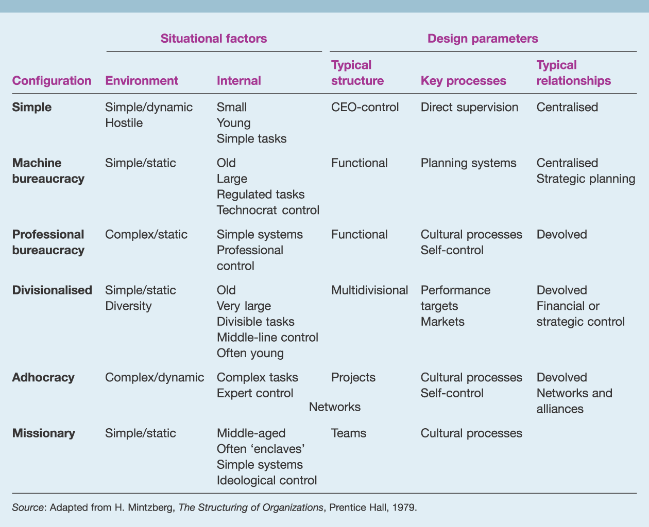
Mintzberg’s six organisational configurations
Exhibit 8.15

Slide 47
Mintzberg’s 6 Organisational Configurations (1)
 | Config. | Simple | Machine Bureaucracy | Professional Bureaucracy
 | Environment | Simple/dynamic Hostile | Simple/static | Complex/ static
 | Internal | Small Young Simple tasks | Old, Large Regulated tasks, Technocrat control | Simple systems Professional control
 | Typical Structure | CEO-control | Functional | Functional
 | Key Processes | Direct supervision | Planning systems | Cultural processes Self-control
 | Typical Relationships | Centralised | Centralised Strategic planning | Devolved
Situational
factors
Design
parameters

Slide 48
Mintzberg’s 6 Organisational Configurations (2)
 | Config. | Divisionalised | Adhocracy | Missionary
 | Environment | Simple/static Diversity | Complex/ dynamic | Simple/static
 | Internal | Old Very large Divisible tasks Middle-line control | Often young Complex tasks Expert control | Middle-aged Often ‘enclaves’ Simple systems Ideological control
 | Typical Structure | Multidivisional | Projects | Teams
 | Key Processes | Performance targets Markets | Cultural processes Self-control | Cultural processes
 | Typical Relationships | Devolved Financial or strategic control | Networks and alliances | Networks
Situational
factors
Design
parameters

Slide 49
Configurations (2)
Reinforcing cycles and implications for change
Created by dynamic interaction between environment, configuration and elements of strategy
Tend to preserve status quo
Managing dilemmas in configurations
Trade-offs between elements

Slide 50
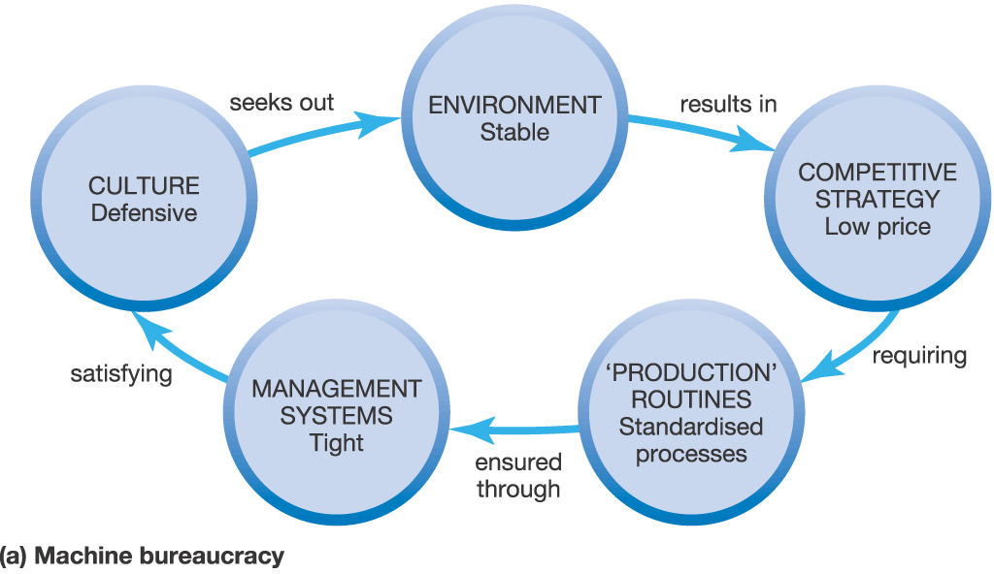
Reinforcing Cycles: Two Examples (1)
Exhibit 8.16a

Slide 51
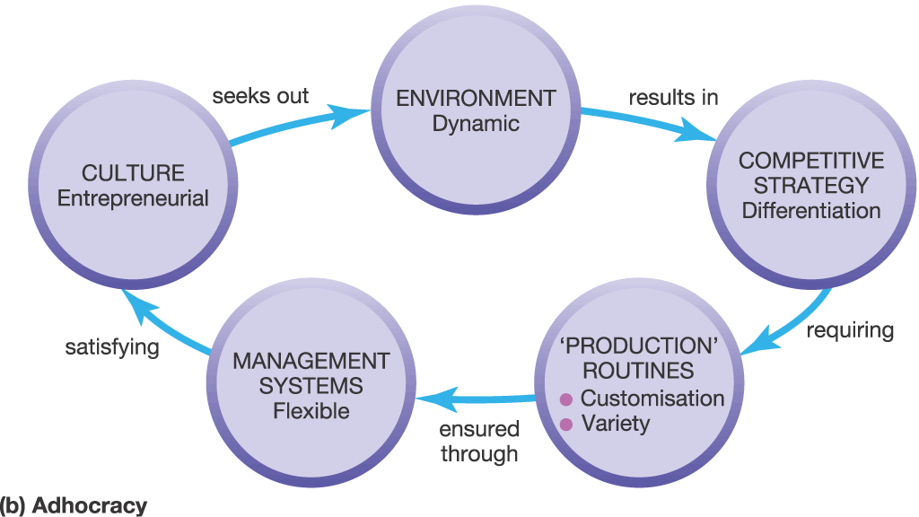
Reinforcing Cycles: Two Examples (2)
Exhibit 8.16b

Slide 52
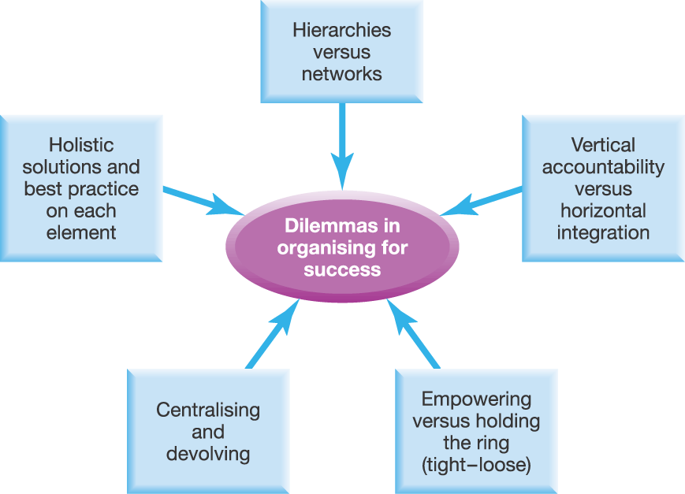
Configurational Dilemmas
Exhibit 8.17

Slide 53
Strategy and Structure
‘Structure follows strategy’ (Chandler 1962)
Adapt the organisation according to the strategy
‘Strategy follows structure’ (Hall & Saias 1980)
Existing organisational structure determines strategic opportunities
‘Structure follows strategy as the left foot follows the right’ (Mintzberg 1990)
Reciprocal relationship

Slide 54
Key Points (1)
Organising for success concerns organisational configuration
Structure, Processes, Relationships
Successful organisation depends on response to key challenges
Control, Change, Knowledge, Globalisation
Many structural types (e.g. functional, divisional, matrix)
Organisational processes facilitate strategy
Focus on inputs or outputs
Direct or indirect

Slide 55
Key Points (2)
Relationships are important for success
Centralisation versus devolution
Strategy style
Choices about outsourcing, alliances, networks and virtuality
Coherent organisational configuration
Mintzberg’s stereotypical organisations
Organisational design dilemmas
Reinforcing cycles

Slide 56
Class room test 01
Introduce your company or any other company you know.
Show what type of organizational structure it has and due to its structure what advantages and disadvantages spelled out?
(20 Marks)

Slide 57
Class room test 02
Identify 07 types of controlling processes available in your working place or any other organization. You have to bring down actual examples for each.
(20 Marks)

