Slide 1
Strategic Decisions and Corporate-Level Strategy

Slide 2
Learning Outcomes (1)
Identify alternative directions for strategy, including market penetration or consolidation, product development, market development, and diversification
Recognise when diversification is an effective strategy for growth
Distinguish between different diversification strategies (related and unrelated) and identify conditions under which they work best

Slide 3
Learning Outcomes (2)
Analyse the ways in which a corporate parent can add or destroy value for its portfolio of business units
Analyse portfolios of business units and judge which to invest in and which to divest

Slide 4
What is a Corporate Parent?
The corporate parent refers to the levels of management above that of the business units, and therefore without direct interaction with buyers and competitors.
Small business like a local builder……

Slide 5
Exhibit 7.1 Strategic Directions and Corporate-Level Strategy
Value creation
Corporate
parenting
Portfolio
management
Diversification
Penetration
Consolidation
Development
Scope decisions

Slide 6
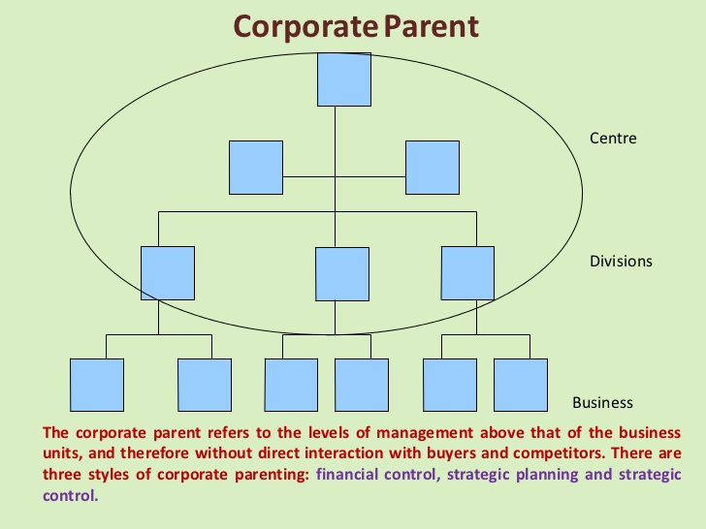

Slide 7
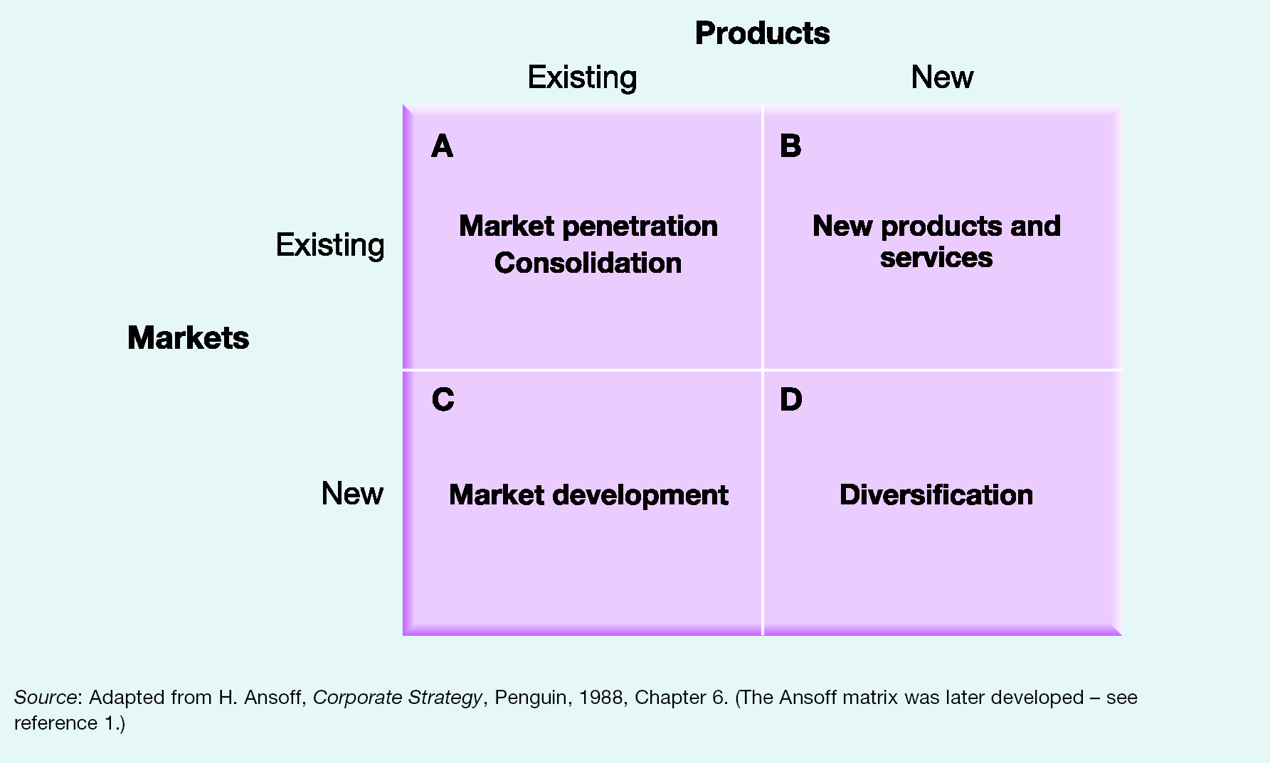
Exhibit 7.2 Strategic Directions (Ansoff Matrix)

Slide 8
What is Market Penetration?
Market penetration refers to a strategy by which an organisation takes increased share of its existing markets with its existing product range.
Cream Cracker biscuits……

Slide 9
Constraints of Market Penetration
Retaliation
from
competitors
Legal
constraints

Slide 10
What is Consolidation?
Consolidation refers to a strategy by which an organisation focuses defensively on their current markets with current products.

Slide 11
Forms of Consolidation
Defending
market share
Downsizing
or divestment

Slide 12
What is Product Development?
Product development refers to a strategy by which an organisation delivers modified or new products to existing markets.
Bourbon biscuits……
Notes:
Use easyJet, start with 1:39 to 2:14 (on getting into car rentals)

Slide 13
Risks of Product Development
New strategic
capabilities
Project
management
risk

Slide 14
What is Market Development?
Market development refers to a strategy by which an organisation offers existing products to new markets.
Elephant House Ice cream Aturupasa Chaarithraya……

Slide 15
Forms of Market Development
New
segments
New
users
New
geographies

Slide 16
What is Diversification?
Diversification refers to a strategy by which an organisation pursues new product offerings and new markets.
Cam Beer by Lion brewery……

Slide 17
Reasons for Pursuing Diversification (1)
Efficiency gains
University Resources……
Stretching corporate parenting capabilities
Increasing market power

Slide 18
Reasons for Pursuing Diversification (2)
Responding to market decline
Kodak Film roll……
Spreading risk
Expectations of powerful stakeholders
Enron fate……

Slide 19
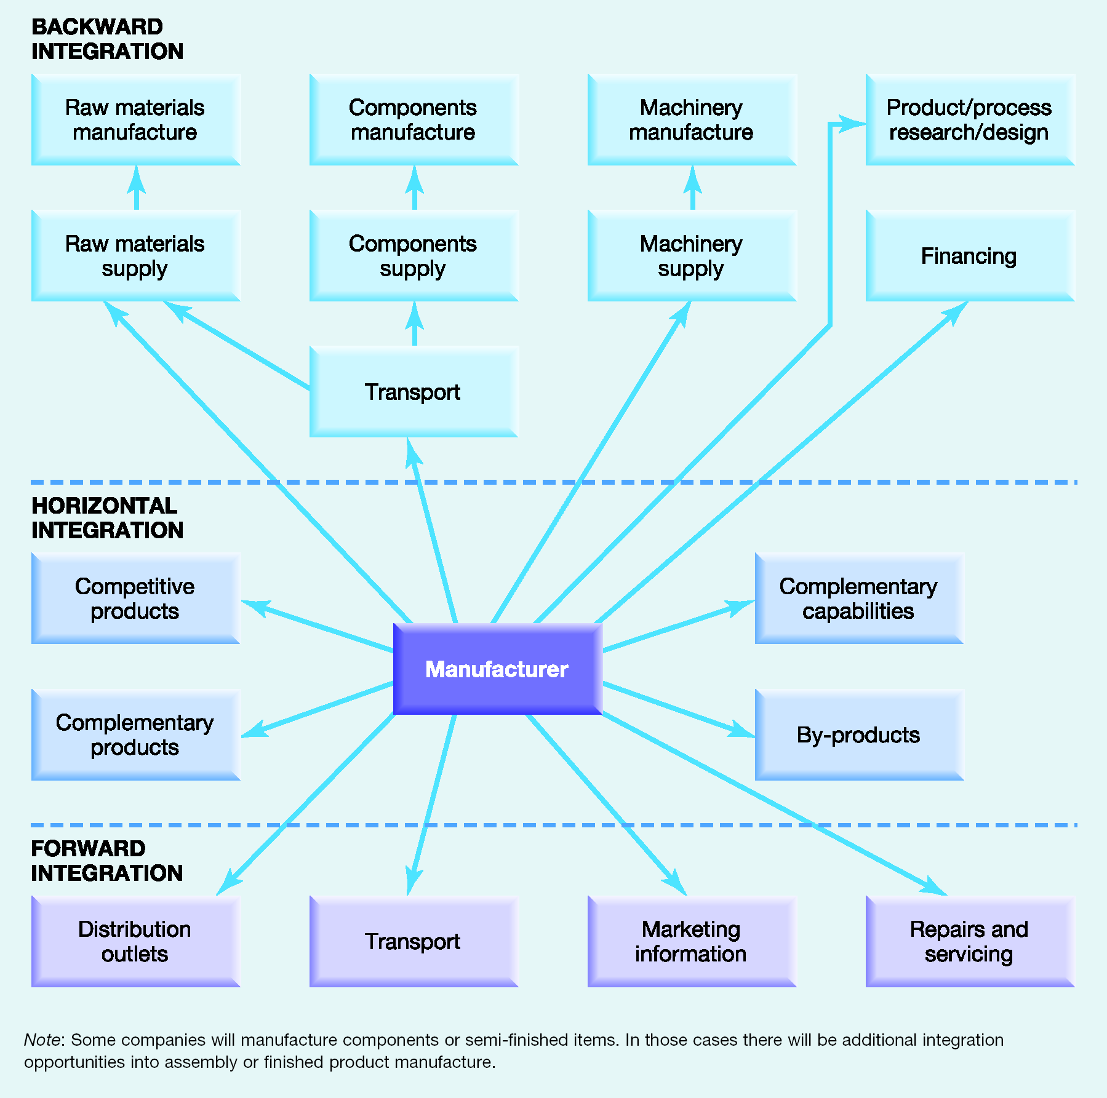
Exhibit 7.3 Related Diversification Options
Cargills Bank……
SMAK water bottles……
Asiri Health..www.doc.lk……
Notes:
Use easyJet, 11:46 -12:10 on how the Internet ties its businesses together.

Slide 20
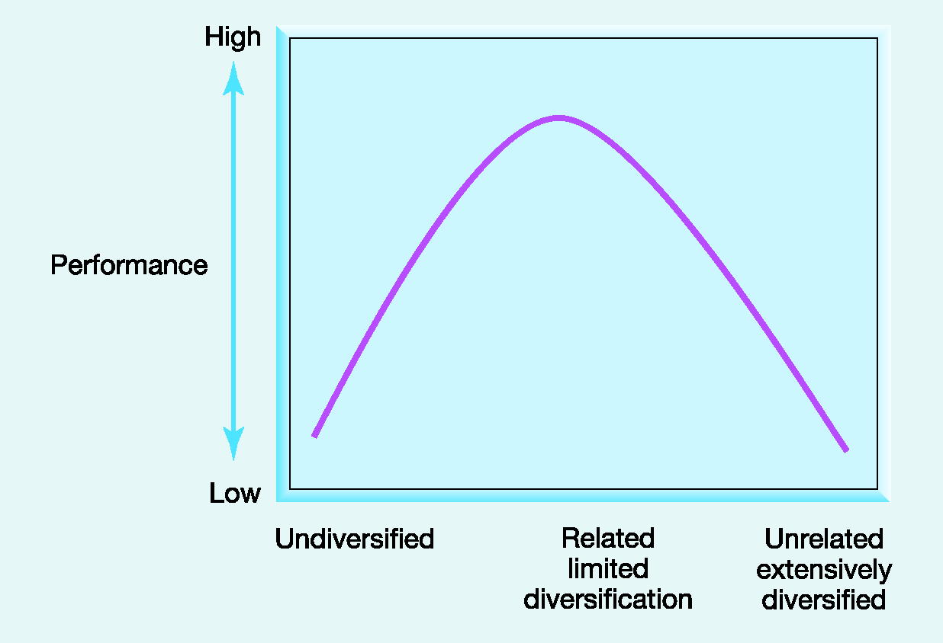
Exhibit 7.4 Diversification and Performance
LAUFGS Holdings
Power and energy
Retail and consumer
Industrial
Leisure
Logistics
Property and real estate

Slide 21
Value-Adding Activities
Envisioning
Coaching and
facilitating
Providing central
services and
resources
Intervening

Slide 22
Value-Destroying Activities
Adding management costs
Adding bureaucratic complexity
Obscuring financial performance

Slide 23
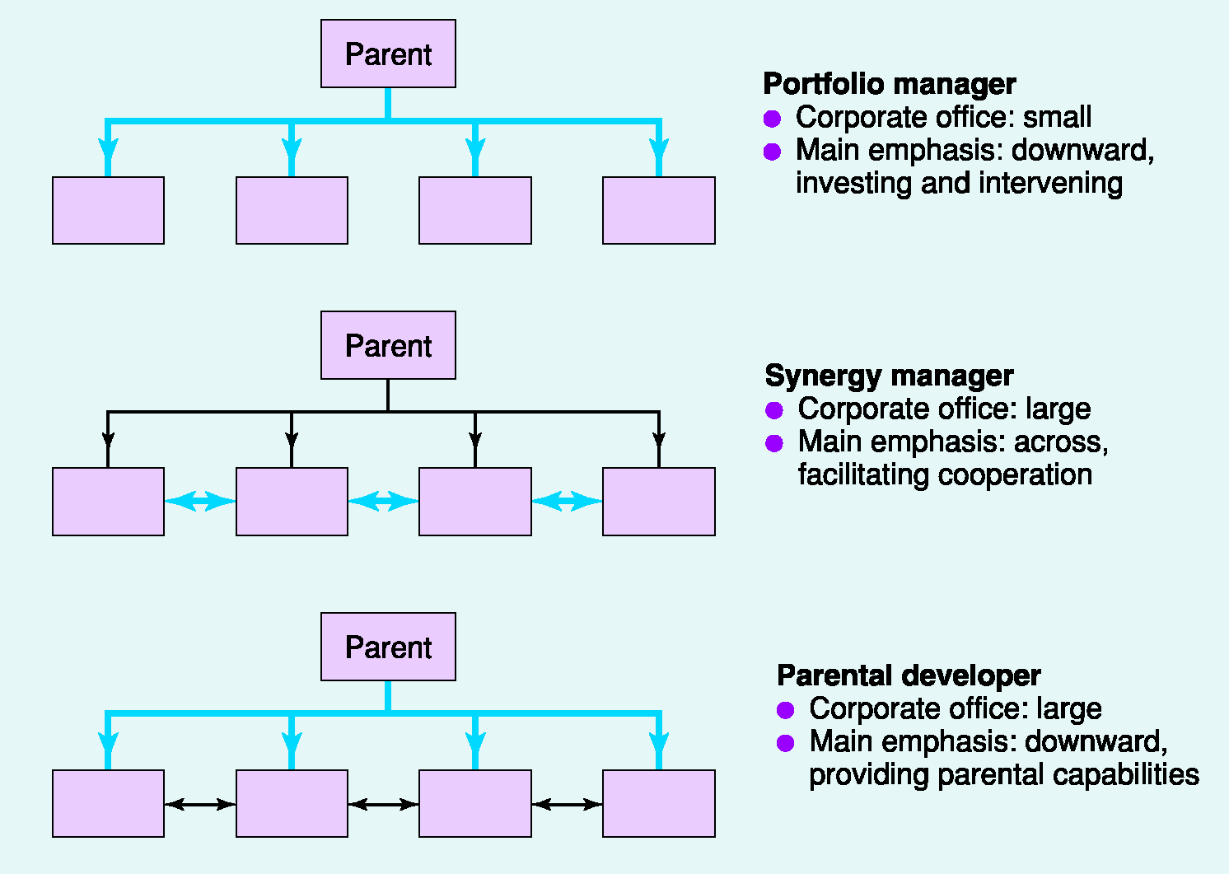
Exhibit 7.5 Portfolio and Synergy Managers and Parental Developers

Slide 24
Problems Achieving Synergy
Excessive costs
Overcoming self-interest
Illusory synergies

Slide 25
Challenges for Parental Developers
Identifying parent capabilities
Parental focus
The ‘crown jewel’ problem
Sufficient ‘feel’

Slide 26
Portfolio Matrices
Growth/Share (BCG) Matrix
Directional Policy (GE-McKinsey) Matrix
Parenting Matrix

Slide 27
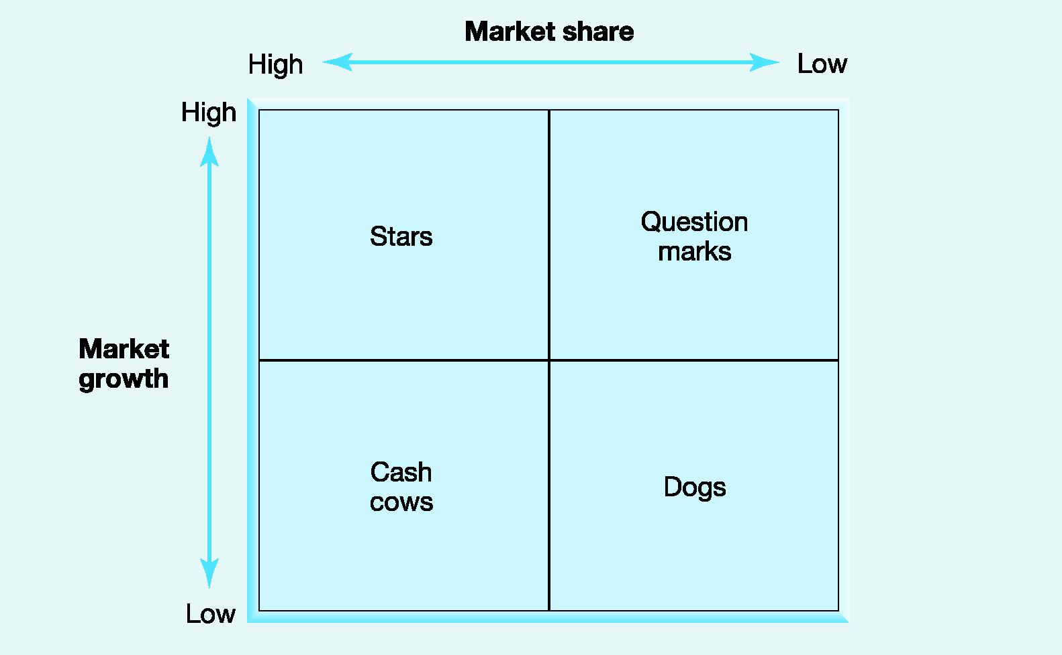
Exhibit 7.7 The Growth Share (BCG) Matrix

Slide 28
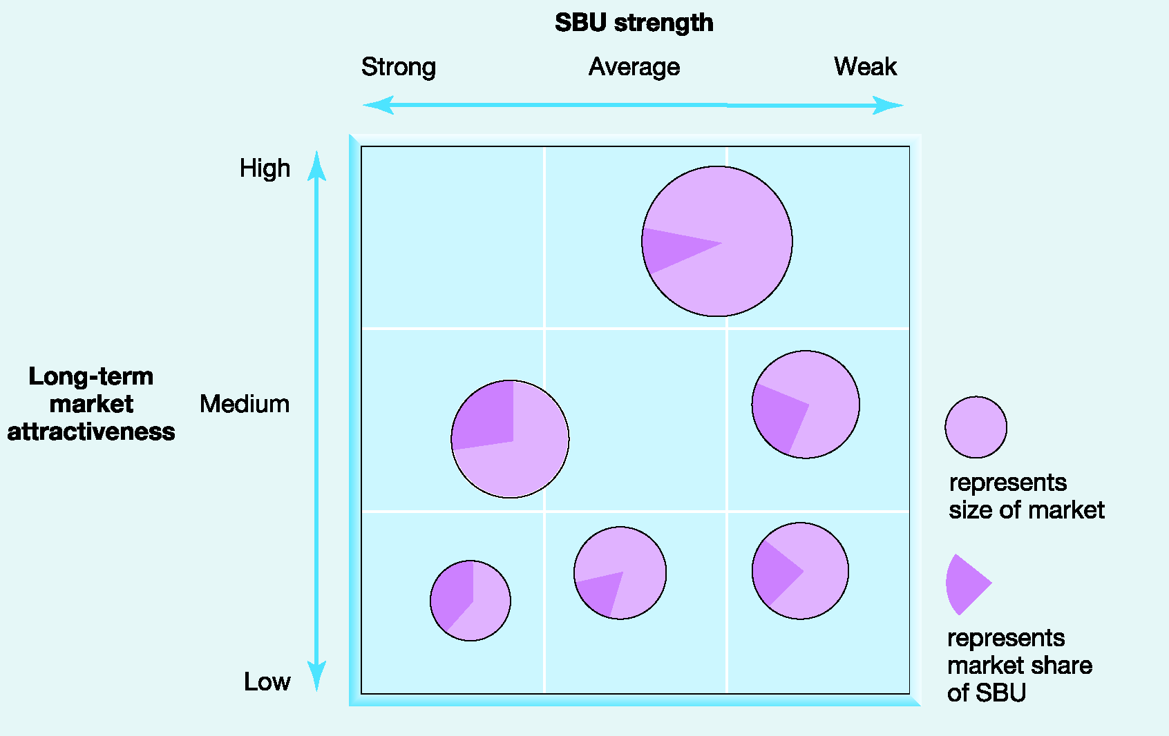
Exhibit 7.8 The Directional Policy (GE-McKinsey) Matrix

Slide 29
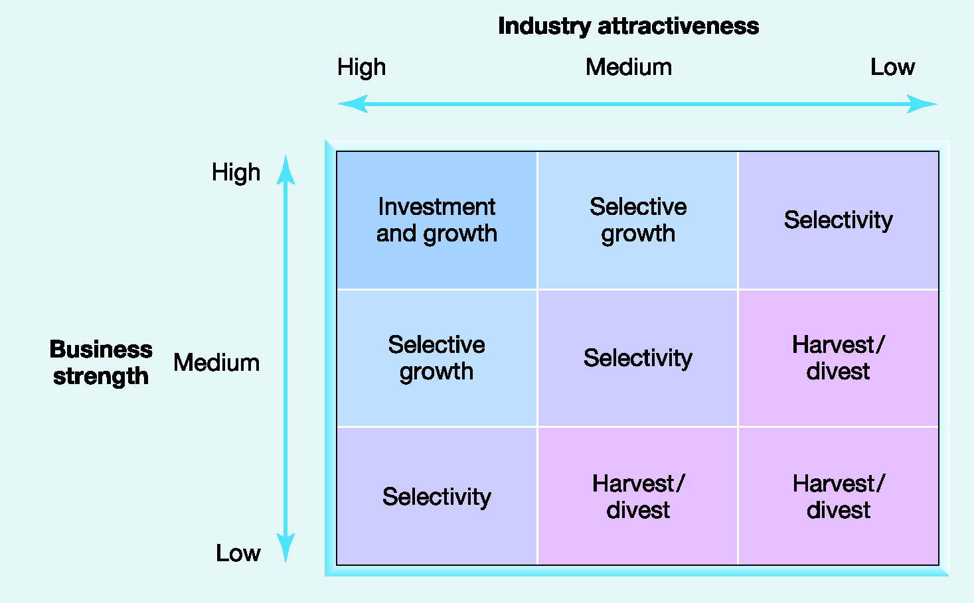
Exhibit 7.9 Strategy Guidelines Based on Directional Policy Matrix

Slide 30
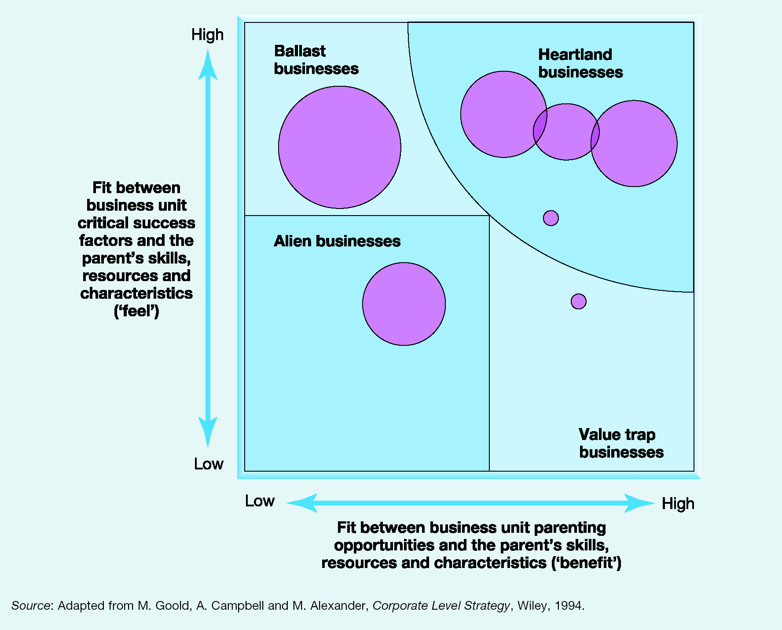
Exhibit 7.10 The Parenting Matrix

