Slide 1
Strategic Decision Making in Oligopoly Markets
BEC 30325
Managerial Economics

Slide 2
Oligopoly Markets
Interdependence of firms’ profits
  Distinguishing feature of oligopoly
  Arises when number of firms in market is small enough that every firms’ price & output decisions affect demand & marginal revenue conditions of every other firm in market

Slide 3
Strategic Decisions
Strategic behavior
  Actions taken by firms to plan for & react to competition from rival firms
Game theory
  Useful guidelines on behavior for strategic situations involving interdependence
Simultaneous Decisions
  Occur when managers must make individual decisions without knowing their rivals’ decisions

Slide 4
Dominant Strategies
Always provide best outcome no matter what decisions rivals make
When one exists, the rational decision maker always follows its dominant strategy
Predict rivals will follow their dominant strategies, if they exist
Dominant strategy equilibrium
  Exists when when all decision makers have dominant strategies

Slide 5
Prisoners’ Dilemma
All rivals have dominant strategies
In dominant strategy equilibrium, all are worse off than if they had cooperated in making their decisions

Slide 6
Prisoners’ Dilemma
 | Bill
 |  | Don’t confess | Confess
Jane | Don’t confess | A 2 years, 2 years | B 12 years, 1 year
 | Confess | C 1 year, 12 years | D 6 years, 6 years
B
J
J
B

Slide 7
Making Mutually Best Decisions
For all firms in an oligopoly to be predicting correctly each others’ decisions:
  All firms must be choosing individually best actions given the predicted actions of their rivals, which they can then believe are correctly predicted
  Strategically astute managers look for mutually best decisions

Slide 8
Nash Equilibrium
Set of actions or decisions for which all managers are choosing their best actions given the actions they expect their rivals to choose
Strategic stability
  No single firm can unilaterally make a different decision & do better

Slide 9
Super Bowl Advertising: A Unique Nash Equilibrium
 |  |  | Pepsi’s budget
 |  |  | Low | Medium | High
Coke’s budget |  | Low | A $60, $45 | B $57.5, $50 | C $45, $35
 |  | Medium | D $50, $35 | E $65, $30 | F $30, $25
 |  | High | G $45, $10 | H $60, $20 | I $50, $40
C
P
P
C
C
P
Payoffs in millions of dollars of semiannual profit

Slide 10
Nash Equilibrium
When a unique Nash equilibrium set of decisions exists
  Rivals can be expected to make the decisions leading to the Nash equilibrium
  With multiple Nash equilibria, no way to predict the likely outcome
All dominant strategy equilibria are also Nash equilibria
  Nash equilibria can occur without a dominant strategy

Slide 11
Sequential Decisions
One firm makes its decision first, then a rival firm, knowing the action of the first firm, makes its decision
  The best decision a manager makes today depends on how rivals respond tomorrow

Slide 12
Game Tree
Shows firms decisions as nodes with branches extending from the nodes
  One branch for each action that can be taken at the node
  Sequence of decisions proceeds from left to right until final payoffs are reached
Roll-back method (or backward induction)
  Method of finding Nash solution by looking ahead to future decisions to reason back to the current best decision

Slide 13
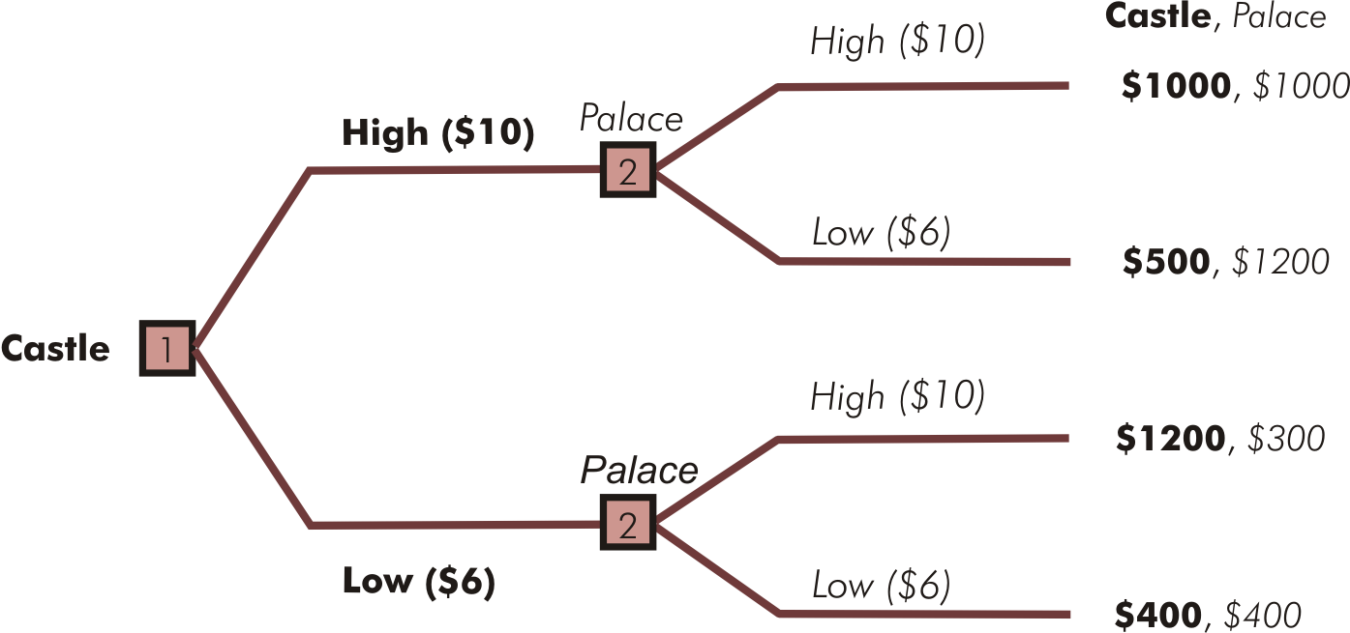
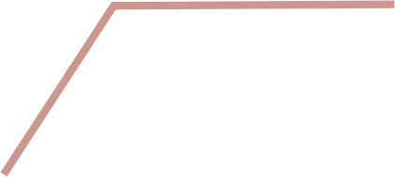



Sequential Pizza Pricing
Panel A – Game tree
Panel B – Roll-back solution

Slide 14
First-Mover & Second-Mover Advantages
First-mover advantage
  If letting rivals know what you are doing by going first in a sequential decision increases your payoff
Second-mover advantage
  If reacting to a decision already made by a rival increases your payoff
Determine whether the order of decision making can be confer an advantage
  Apply roll-back method to game trees for each possible sequence of decisions

Slide 15
First-Mover Advantage in Technology Choice
 | Motorola’s technology
 |  |  | Analog | Digital
Sony’s technology |  | Analog | A $10, $13.75 | B $8, $9
 |  | Digital | C $9.50, $11 | D $11.875, $11.25
S
M
S
M
Panel A – Simultaneous technology decision

Slide 16
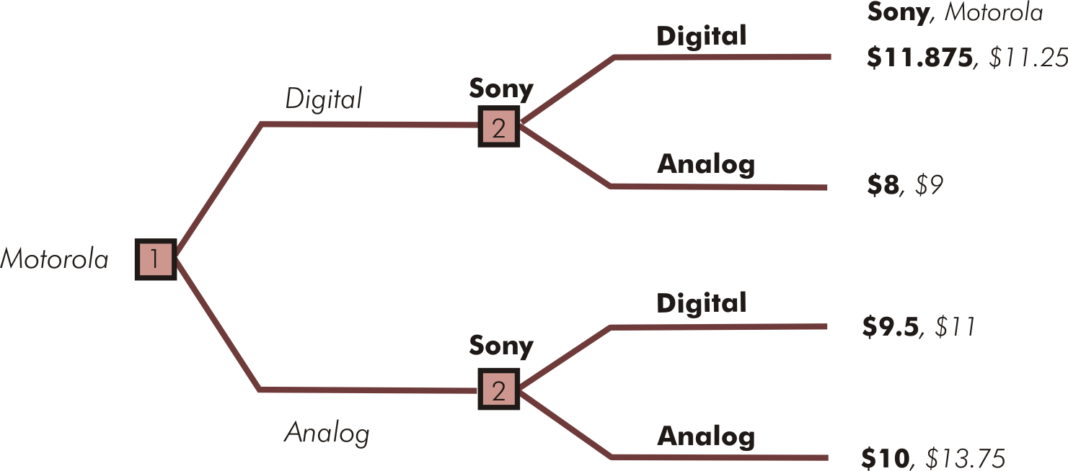




First-Mover Advantage in Technology Choice
Panel B – Motorola secures a first-mover advantage

Slide 17
Cartels
Most extreme form of cooperative oligopoly
Explicit collusive agreement to drive up prices by restricting total market output
Illegal in U.S., Canada, Mexico, Germany, & European Union

Slide 18
Cartels
Pricing schemes usually strategically unstable & difficult to maintain
  Strong incentive to cheat by lowering price
When undetected, price cuts occur along very elastic single-firm demand curve
  Lure of much greater revenues for any one firm that cuts price
  Cartel members secretly cut prices causing price to fall sharply along a much steeper demand curve

Slide 19
Tacit Collusion
Far less extreme form of cooperation among oligopoly firms
Cooperation occurs without any explicit agreement or any other facilitating practices

Slide 20
Strategic Entry Deterrence
Established firm(s) makes strategic moves designed to discourage or prevent entry of new firm(s) into a market
Two types of strategic moves
  Limit pricing
  Capacity expansion

Slide 21
Limit Pricing
Established firm(s) commits to setting price below profit-maximizing level to prevent entry
  Under certain circumstances, an oligopolist (or monopolist), may make a credible commitment to charge a lower price forever

Slide 22
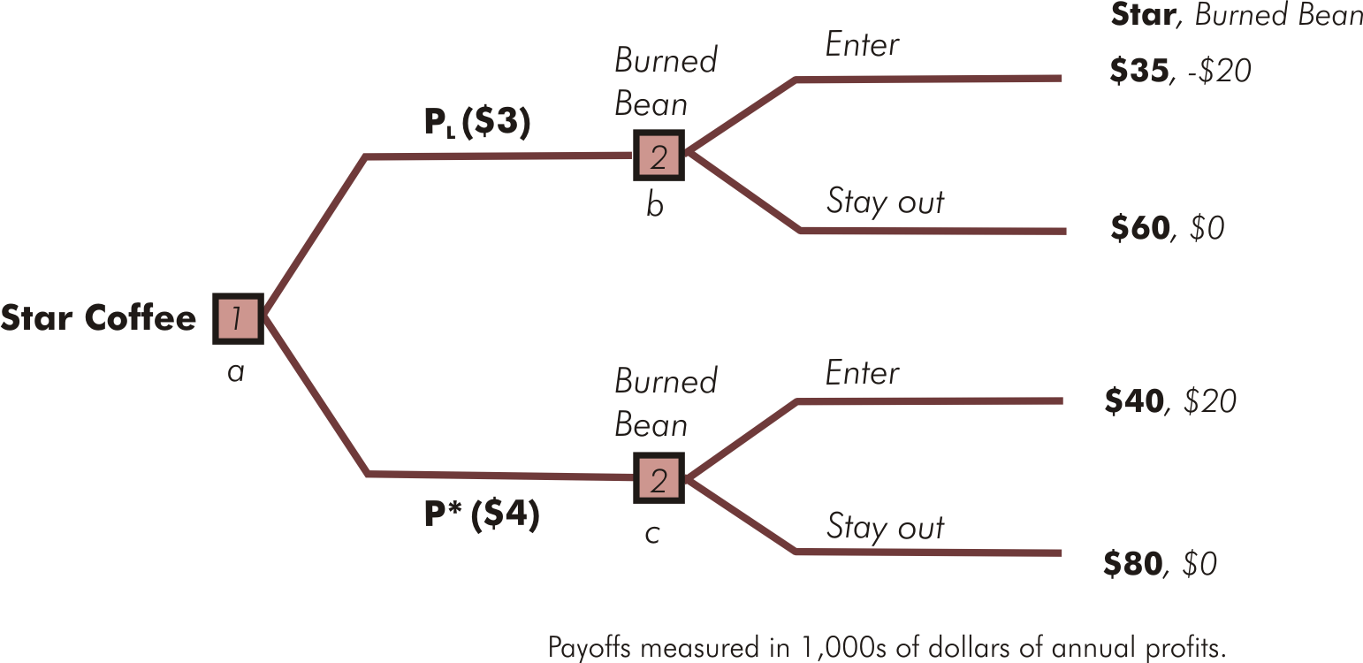

Limit Pricing: Entry Deterred

Slide 23
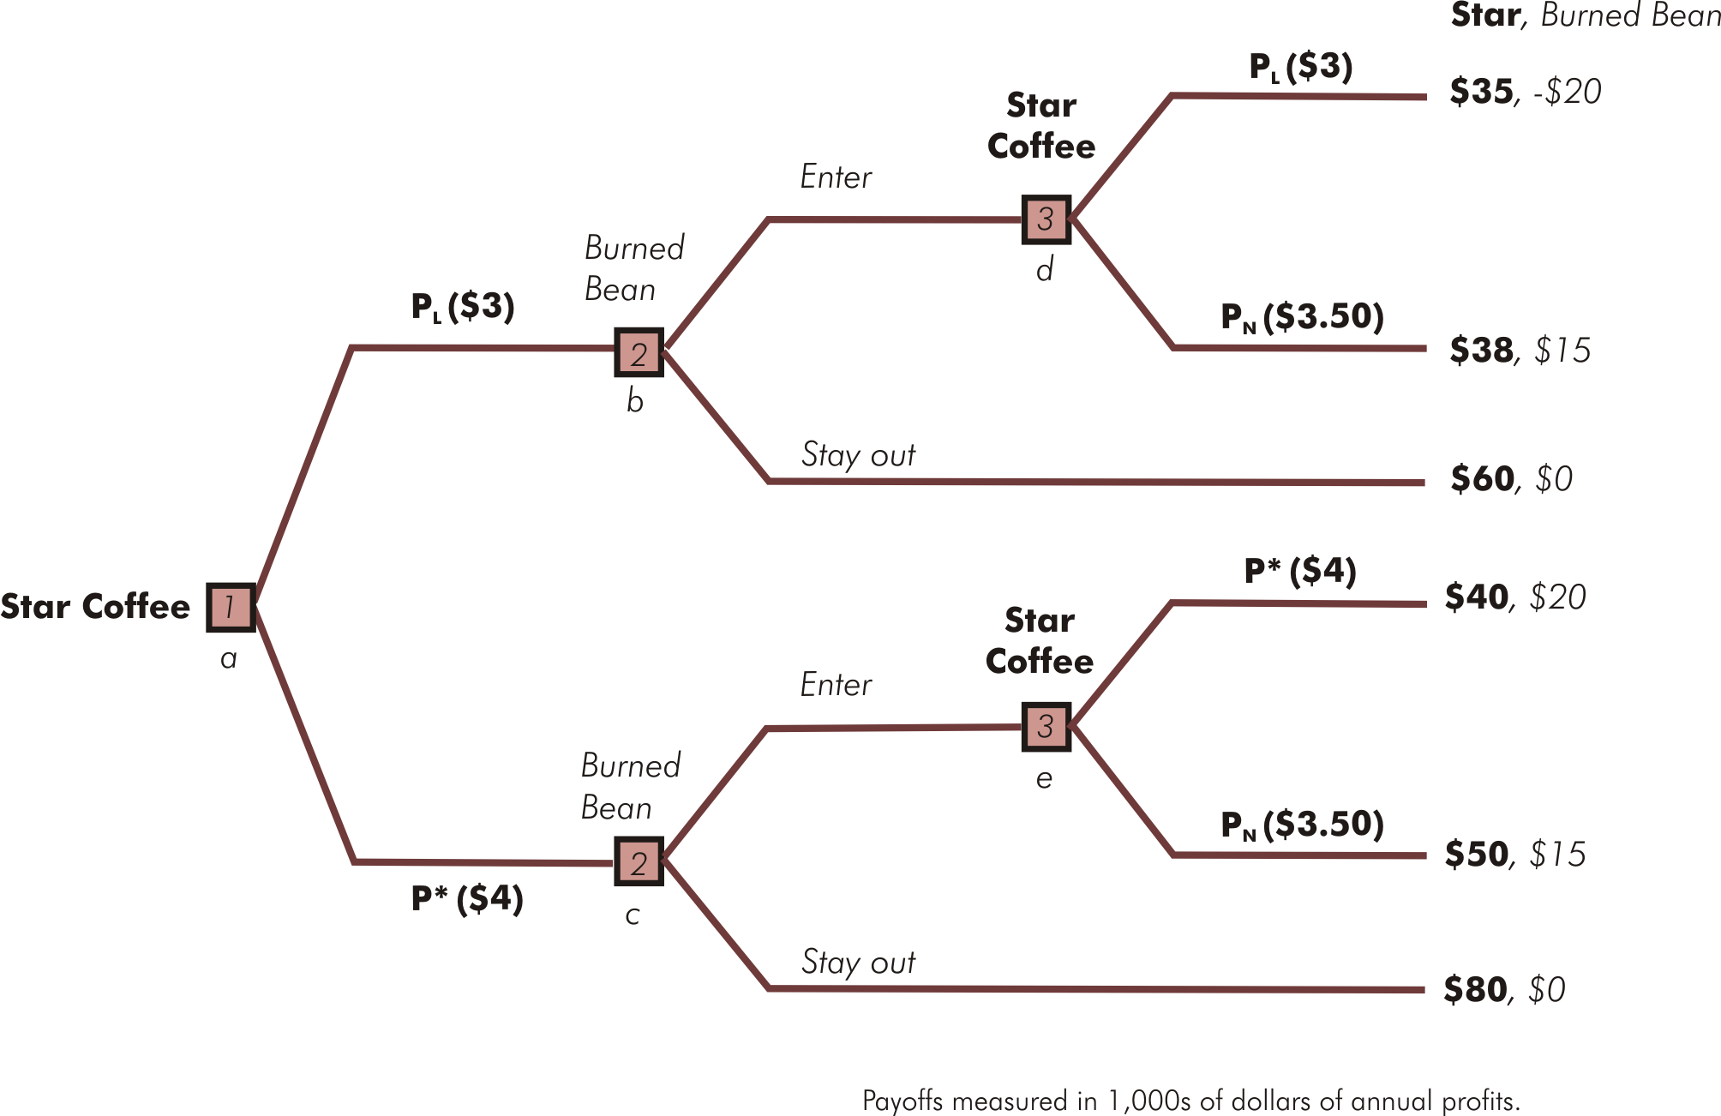
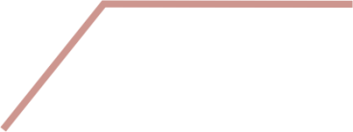

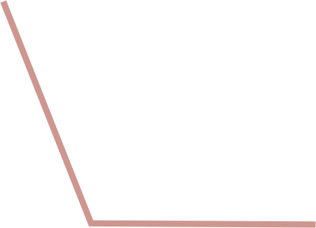



Limit Pricing: Entry Occurs

Slide 24
Capacity Expansion
Established firm(s) can make the threat of a price cut credible by irreversibly increasing plant capacity
When increasing capacity results in lower marginal costs of production, the established firm’s best response to entry of a new firm may be to increase its own level of production
  Requires established firm to cut its price to sell extra output

Slide 25
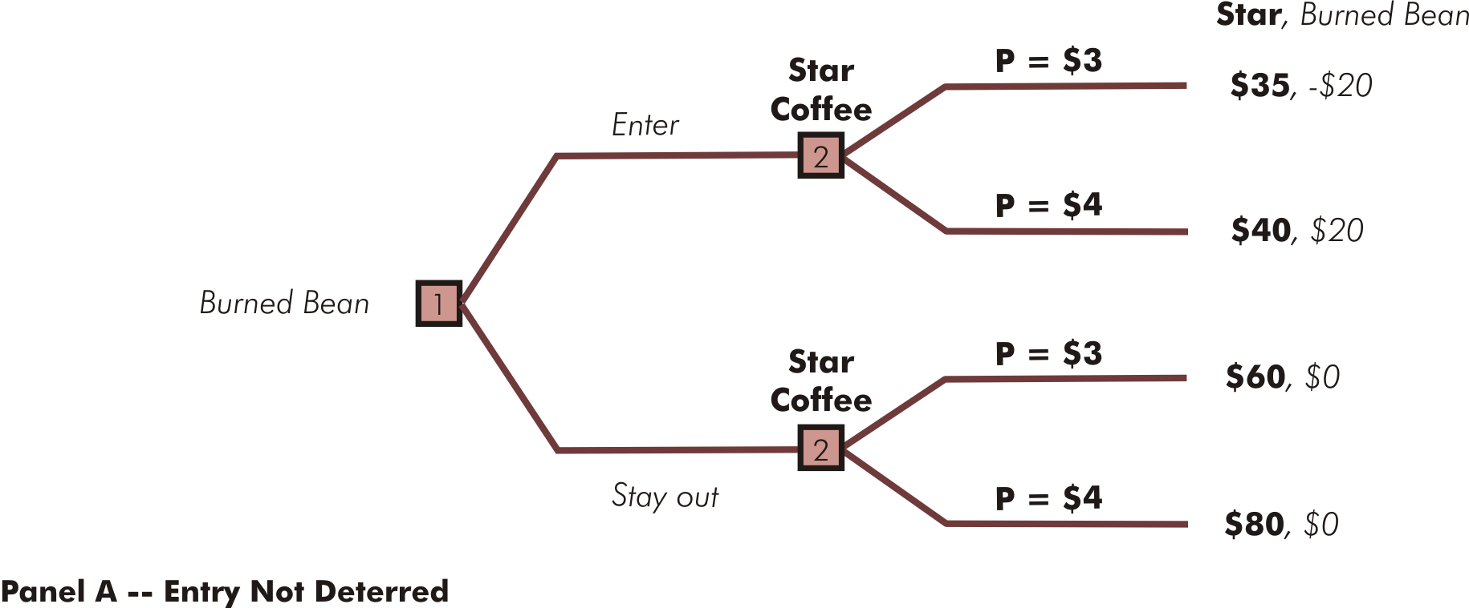

Excess Capacity Barrier to Entry

Slide 26
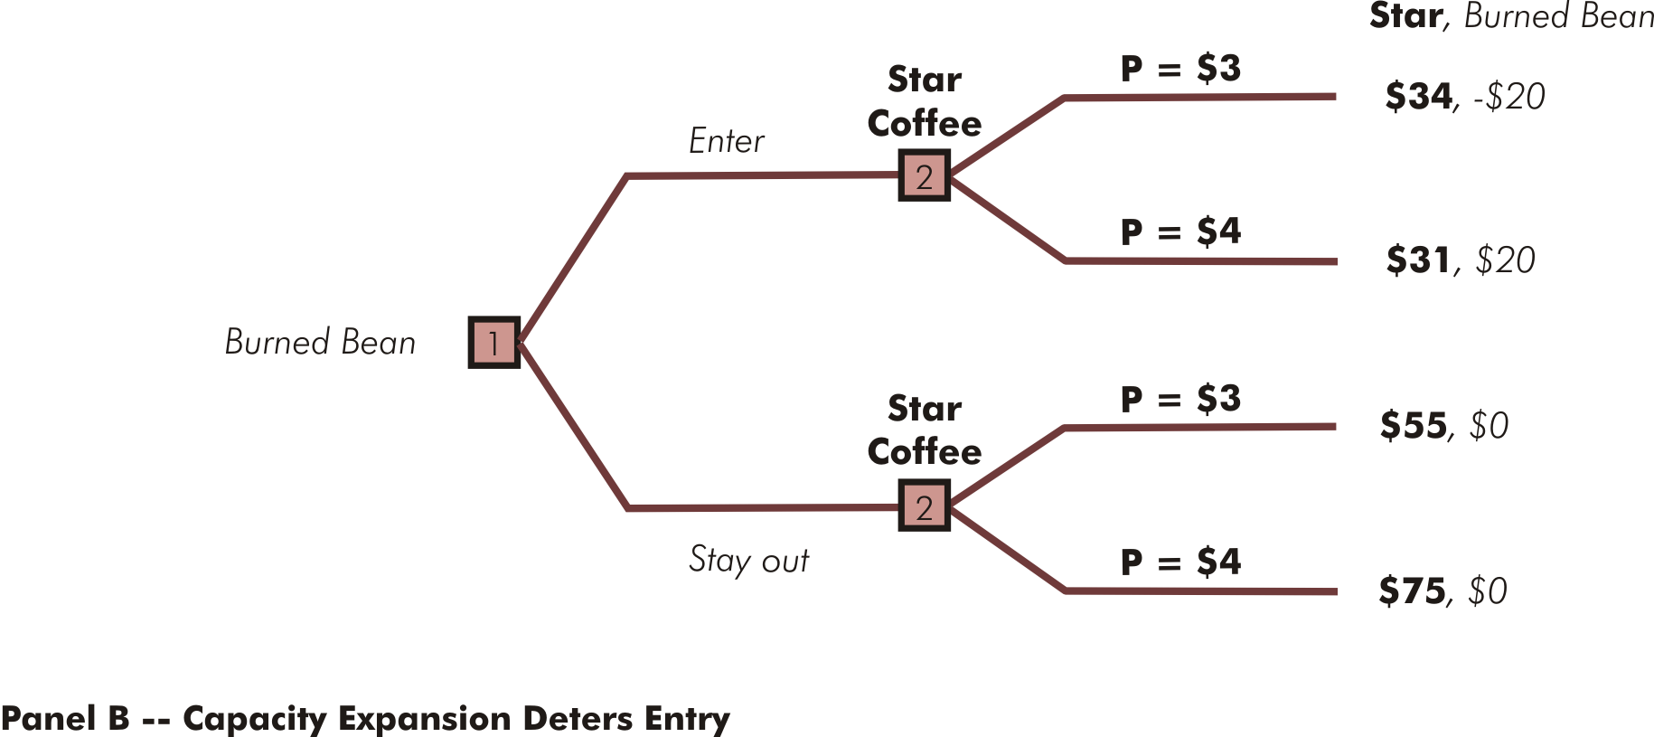



Excess Capacity Barrier to Entry

