Slide 1
Project Management
MGT 30725
Indike Manthilake MBA, Msc, Bsc, CSM, PMI-ACP
indikem@gmail.com

Slide 2
Lesson 5 – The Project Schedule
Agenda
The Scheduling Process
Time Estimate

Slide 3
Learning Objectives
Understand the importance of project schedules and good project time management
Discuss the process of planning schedule management
Define activities as the basis for developing project schedules
Describe how project managers use network diagrams and dependencies to assist in activity sequencing
Understand the relationship between estimating resources and project schedules
Explain how various tools and techniques help project managers perform activity duration estimates

Slide 4
Importance of Project Schedules
Managers often cite delivering projects on time as one of their biggest challenges
Time has the least amount of flexibility; it passes no matter what happens on a project
Schedule issues are the main reason for conflicts on projects, especially during the second half of projects

Slide 5
Project Time Management Processes
Planning schedule management: determining the policies, procedures, and documentation that will be used for planning, executing, and controlling the project schedule
Defining activities: identifying the specific activities that the project team members and stakeholders must perform to produce the project deliverables
Sequencing activities: identifying and documenting the relationships between project activities
Estimating activity resources: estimating how many resources a project team should use to perform project activities
Estimating activity durations: estimating the number of work periods that are needed to complete individual activities
Developing the schedule: analyzing activity sequences, activity resource estimates, and activity duration estimates to create the project schedule
Controlling the schedule: controlling and managing changes to the project schedule

Slide 6
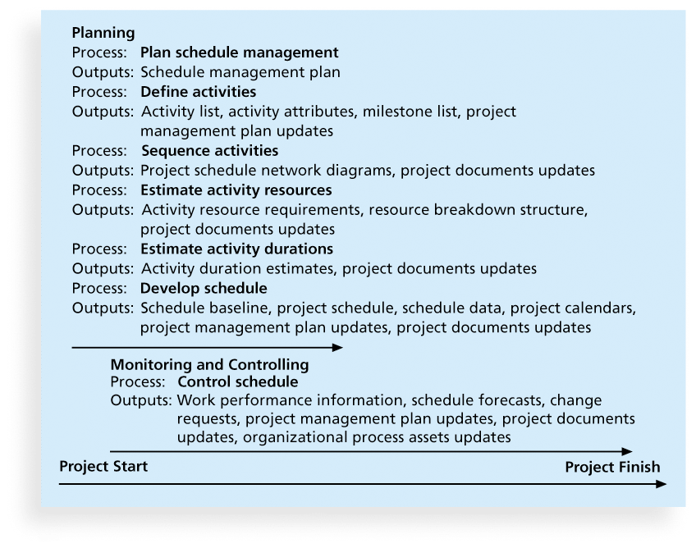
Project Time Management Summary

Slide 7
Planning Schedule Management
The project team uses expert judgment, analytical techniques, and meetings to develop the schedule management plan
A schedule management plan includes:
Project schedule model development
The scheduling methodology
Level of accuracy and units of measure
Control thresholds
Rules of performance measurement
Reporting formats
Process descriptions

Slide 8
Defining Activities
An activity or task is an element of work normally found on the work breakdown structure (WBS) that has an expected duration, a cost, and resource requirements
Activity definition involves developing a more detailed WBS and supporting explanations to understand all the work to be done so you can develop realistic cost and duration estimates

Slide 9
Activity Lists and Attributes
An activity list is a tabulation of activities to be included on a project schedule that includes
the activity name
an activity identifier or number
a brief description of the activity
Activity attributes provide more information such as predecessors, successors, logical relationships, leads and lags, resource requirements, constraints, imposed dates, and assumptions related to the activity

Slide 10
Milestones
A milestone is a significant event that normally has no duration
It often takes several activities and a lot of work to complete a milestone
They’re useful tools for setting schedule goals and monitoring progress
Examples include obtaining customer sign-off on key documents or completion of specific products

Slide 11
Sequencing Activities
Involves reviewing activities and determining dependencies
A dependency or relationship is the sequencing of project activities or tasks
You must determine dependencies in order to use critical path analysis

Slide 12
Three types of Dependencies
Mandatory dependencies: inherent in the nature of the work being performed on a project, sometimes referred to as hard logic
Discretionary dependencies: defined by the project team., sometimes referred to as soft logic and should be used with care since they may limit later scheduling options
External dependencies: involve relationships between project and non-project activities

Slide 13
Estimating Activity Resources
Before estimating activity durations, you must have a good idea of the quantity and type of resources that will be assigned to each activity; resources are people, equipment, and materials
Consider important issues in estimating resources
How difficult will it be to do specific activities on this project?
What is the organization’s history in doing similar activities?
Are the required resources available?
A resource breakdown structure is a hierarchical structure that identifies the project’s resources by category and type

Slide 14
Activity Duration Estimating
Duration includes the actual amount of time worked on an activity plus elapsed time
Effort is the number of workdays or work hours required to complete a task
Effort does not normally equal duration
People doing the work should help create estimates, and an expert should review them

Slide 15
Activity Time Estimate
Analogous Estimating (Top down)
Estimating the duration or cost of an activity or a project using historical data from a similar activity or project.
Uses parameters from a previous, similar project, such as duration, budget, size, weight, and complexity, as the basis.
Used when limited knowledge is available.
Generally less costly and less time consuming than other techniques, but it is also less accurate
Form of expert judgment

Slide 16
Activity Time Estimate
Parametric Estimating
Uses a statistical relationship between historical data and other variables to calculate an estimate for activity.
This technique can produce higher levels of accuracy
e.g. house costs $115/sqft, or office building cost $254/sqft, software development costs $3 per line of code, etc..
e.g. activity duration on a design project is estimated by the number of drawings multiplied by the number of labor hours per drawing
e.g. on a cable installation, the meters of cable multiplied by the number of labor hours per meter.
If the assigned resource is capable of installing 25 meters of cable per hour, the duration required to install 1,000 meters is 40 hours. (1,000 meters divided by 25 meters per hour).

Slide 17
Activity Time Estimate
Three-Point Estimating
Expected calculated from Most-likely (average or frequent), Optimistic (shortest), Pessimistic (longest).
Activity | Duration |  |  | Expected Duration
 | P | M | O
A | 8 | 5 | 1
B | 8 | 4 | 2
C | 15 | 8 | 5
D | 20 | 10 | 5
Project (Total) | -

Slide 18
Developing the Schedule
Uses results of the other time management processes to determine the start and end date of the project
Ultimate goal is to create a realistic project schedule that provides a basis for monitoring project progress for the time dimension of the project
Important tools and techniques include Gantt charts, critical path analysis, and critical chain scheduling, and PERT analysis

Slide 19
Gantt Charts
Gantt charts provide a standard format for displaying project schedule information by listing project activities and their corresponding start and finish dates in a calendar format
Symbols include:
A black diamond: a milestones
Thick black bars: summary tasks
Lighter horizontal bars: durations of tasks
Arrows: dependencies between tasks

Slide 20
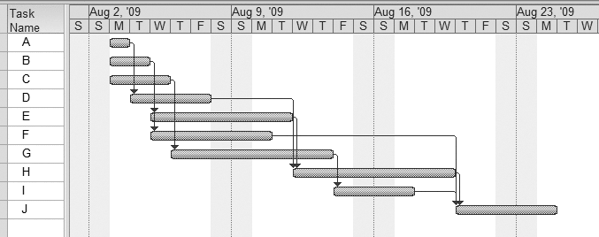
Gantt Chart for Project

Slide 21
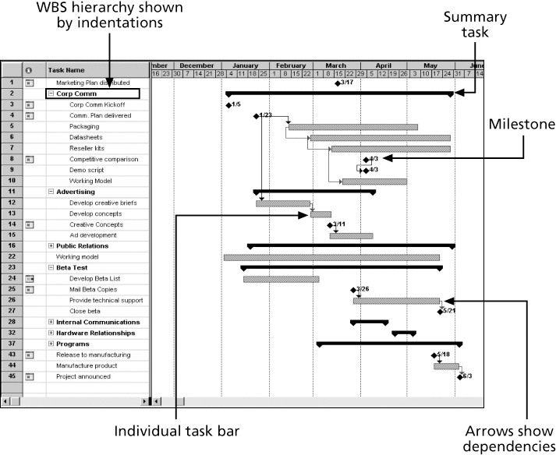
Gantt Chart for Software Launch Project

Slide 22
Schedule Control Suggestions
Perform reality checks on schedules
Allow for contingencies
Don’t plan for everyone to work at 100% capacity all the time
Hold progress meetings with stakeholders and be clear and honest in communicating schedule issues

Slide 23
Controlling the Schedule
Goals are to know the status of the schedule, influence factors that cause schedule changes, determine that the schedule has changed, and manage changes when they occur
Tools and techniques include
Progress reports
A schedule change control system
Project management software, including schedule comparison charts like the tracking Gantt chart
Variance analysis, such as analyzing float or slack
Performance management, such as earned value (Cost Management)

Slide 24
Reality Checks on Scheduling
First review the draft schedule or estimated completion date in the project charter
Prepare a more detailed schedule with the project team
Make sure the schedule is realistic and followed
Alert top management well in advance if there are schedule problems

Slide 25
Group Work
Expected Duration - Exercise
Refer ABC superMKT case study and answer questions

Slide 26
Lesson 6 – The Project Schedule
Agenda
PERT and Critical Path Analysis

