Slide 1
Project Management
MGT 30725
Indike Manthilake MBA, Msc, Bsc, CSM, PMI-ACP
indikem@gmail.com

Slide 2
Lesson 4 – Scoping out the Project
Agenda
Documenting Project Scope, Goals and Objectives

Slide 3
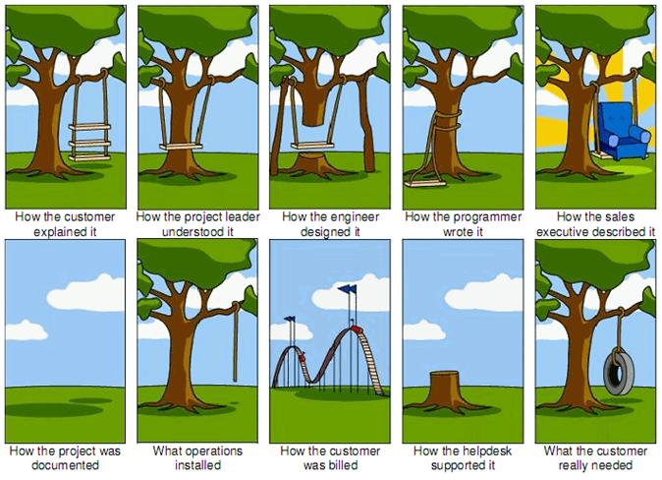
Scope Matters

Slide 4
What is Project Scope Management?
Scope refers to all the work involved in creating the products of the project and the processes used to create them
A deliverable is a product produced as part of a project, such as hardware or software, planning documents, or meeting minutes
Project scope management includes the processes involved in defining and controlling what is or is not included in a project
Scope creep - additional scope or features without addressing the effects on time, cost, resources or customer’s approval.

Slide 5
Scope Management
Product Scope & Project Scope
Product Scope
the features and functions that characterize a product or service
Project
Project Scope
the work that must be done to deliver a product or service

Slide 6
Project Scope Management Processes
Collecting requirements: defining and documenting the features and functions of the products produced during the project as well as the processes used for creating them
Defining scope: reviewing the project charter, requirements documents, and organizational process assets to create a scope statement
Creating the WBS: subdividing the major project deliverables into smaller, more manageable components
Verifying scope: formalizing acceptance of the project deliverables
Controlling scope: controlling changes to project scope throughout the life of the project

Slide 7
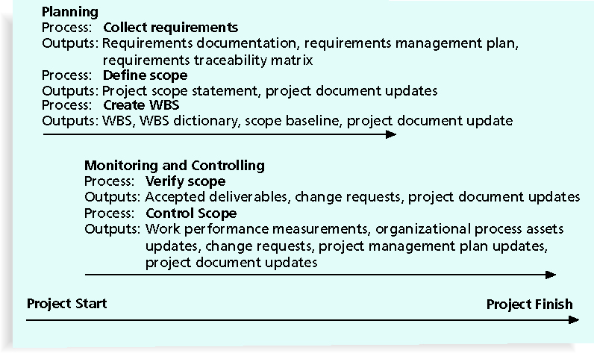
Project Scope Management Summary

Slide 8
Collecting Requirements
A requirement is “a condition or capability that must be met or possessed by a system, product, service, result, or component to satisfy a contract, standard, specification, or other formal document” (PMBOK® Guide, 2008)
For some projects, it is helpful to divide requirements development into categories called elicitation (req. gathering), analysis, specification, and validation
It is important to use an iterative approach to defining requirements since they are often unclear early in a project

Slide 9
Methods for Collecting Requirements
Interviewing
Focus groups and facilitated workshops
Using group creativity and decision-making techniques
Questionnaires and surveys
Observation
Prototyping
Software tools

Slide 10
Documenting Requirements
Requirements documents are often generated by software and include text, images, diagrams, videos, and other media; they are often broken down into different categories such as functional, service, performance, quality, training requirements, and so on
A requirements management plan describes how project requirements will be analyzed, documented, and managed
A requirements traceability matrix (RTM) is a table that lists requirements, various attributes of each requirement, and the status of the requirements to ensure that all requirements are addressed

Slide 11
Sample Requirements Traceability Matrix

Slide 12
Defining Scope
Key inputs for preparing the project scope statement include the project charter, requirements documentation, and organizational process assets such as policies and procedures related to scope statements as well as project files and lessons learned from previous, similar projects
As time progresses, the scope of a project should become more clear and specific

Slide 13
Further Defining Project Scope

Slide 14
Creating the Work Breakdown Structure (WBS)
A WBS is a deliverable-oriented grouping of the work involved in a project that defines the total scope of the project
WBS is a foundation document that provides the basis for planning and managing project schedules, costs, resources, and changes
Decomposition is subdividing project deliverables into smaller pieces
A work package is a task at the lowest level of the WBS

Slide 15
WBS (Work Breakdown Structure)
Decomposition
Level 0
Project
Level 1
WBS Elements
Level 2
Level 3
Work Package

Slide 16
Sample Intranet WBS

Slide 17
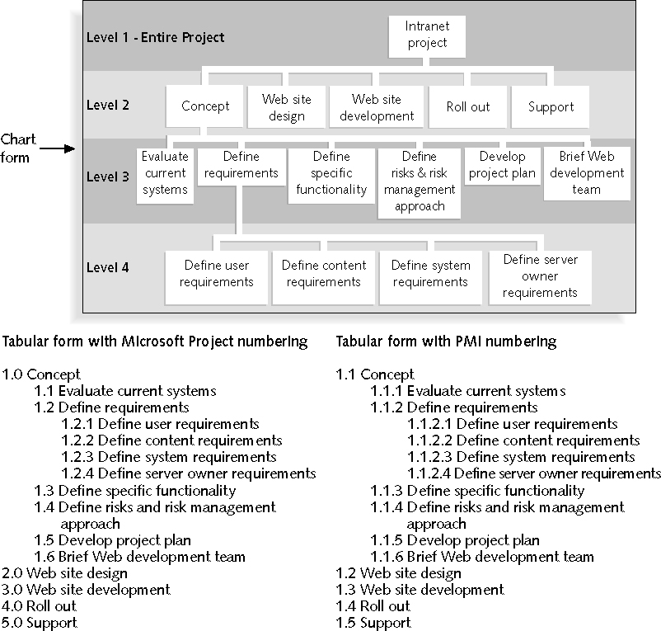
Sample Intranet WBS Organized by Phase

Slide 18
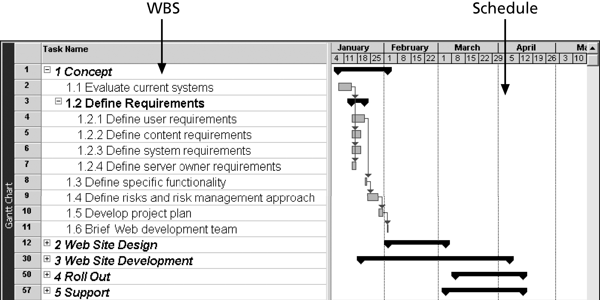
Intranet WBS and Gantt Chart in Microsoft Project

Slide 19
Approaches to Developing WBSs
The analogy approach: review WBSs of similar projects and tailor to your project
The top-down approach: start with the largest items of the project and break them down
The bottom-up approach: start with the specific tasks and roll them up

Slide 20
The WBS Dictionary and Scope Baseline
Many WBS tasks are vague and must be explained more so people know what to do and can estimate how long it will take and what it will cost to do the work
A WBS dictionary is a document that describes detailed information about each WBS item
The approved project scope statement and its WBS and WBS dictionary form the scope baseline, which is used to measure performance in meeting project scope goals

Slide 21
Advice for Creating a WBS and WBS Dictionary
A unit of work should appear at only one place in the WBS
The work content of a WBS item is the sum of the WBS items below it
A WBS item is the responsibility of only one individual, even though many people may be working on it
The WBS must be consistent with the way in which work is actually going to be performed; it should serve the project team first and other purposes only if practical

Slide 22
Advice for Creating a WBS and WBS Dictionary (continued)
Project team members should be involved in developing the WBS to ensure consistency and buy-in
Each WBS item must be documented in a WBS dictionary to ensure accurate understanding of the scope of work included and not included in that item
The WBS must be a flexible tool to accommodate inevitable changes while properly maintaining control of the work content in the project according to the scope statement

Slide 23
What Went Wrong?
A project scope that is too broad and grandiose can cause severe problems
Scope creep and an overemphasis on technology for technology’s sake resulted in the bankruptcy of a large pharmaceutical firm, Texas-based FoxMeyer Drug
In 2001, McDonald’s fast-food chain initiated a project to create an intranet that would connect its headquarters with all of its restaurants to provide detailed operational information in real time; after spending $170 million on consultants and initial implementation planning, McDonald’s realized that the project was too much to handle and terminated it

Slide 24
Verifying Scope
It is very difficult to create a good scope statement and WBS for a project
It is even more difficult to verify project scope and minimize scope changes
Scope verification involves formal acceptance of the completed project scope by the stakeholders
Acceptance is often achieved by a customer inspection and then sign-off on key deliverables

Slide 25
Controlling Scope
Scope control involves controlling changes to the project scope
Goals of scope control are to:
Influence the factors that cause scope changes
Assure changes are processed according to procedures developed as part of integrated change control
Manage changes when they occur
Variance is the difference between planned and actual performance

Slide 26
Best Practices for Avoiding Scope Problems
1. Keep the scope realistic. Don’t make projects so large that they can’t be completed. Break large projects down into a series of smaller ones.
2. Involve users in project scope management. Assign key users to the project team and give them ownership of requirements definition and scope verification.
3. Use off-the-shelf hardware and software whenever possible. Many IT people enjoy using the latest and greatest technology, but business needs, not technology trends, must take priority.
4. Follow good project management processes. As described in this chapter and others, there are well-defined processes for managing project scope and others aspects of projects.

Slide 27
Suggestions for Improving User Input
Develop a good project selection process and insist that sponsors are from the user organization
Have users on the project team in important roles
Have regular meetings with defined agendas, and have users sign off on key deliverables presented at meetings
Deliver something to users and sponsors on a regular basis
Don’t promise to deliver when you know you can’t
Co-locate users with developers

Slide 28
Suggestions for Reducing Incomplete and Changing Requirements
Develop and follow a requirements management process
Use techniques such as prototyping, use case modeling, and JAD to get more user involvement
Put requirements in writing and keep them current
Create a requirements management database for documenting and controlling requirements

Slide 29
Suggestions for Reducing Incomplete and Changing Requirements (continued)
Provide adequate testing and conduct testing throughout the project life cycle
Review changes from a systems perspective
Emphasize completion dates to help focus on what’s most important
Allocate resources specifically for handling change requests/enhancements

Slide 30
Summary Scope Management
Collect Requirements
Interviews
Define Scope
Create WBS
Workshops
Questionnaires / Surveys
Document Analysis
Prototypes
Requirements Document
Project Scope Statement
WBS

Slide 31
Group Work
Develop WBS - Exercise
Think of a Project completing a Three year degree. Each year has two semesters and each semester has four subjects. Last semester has only the final project
Think of above project and develop a WBS.

Slide 32
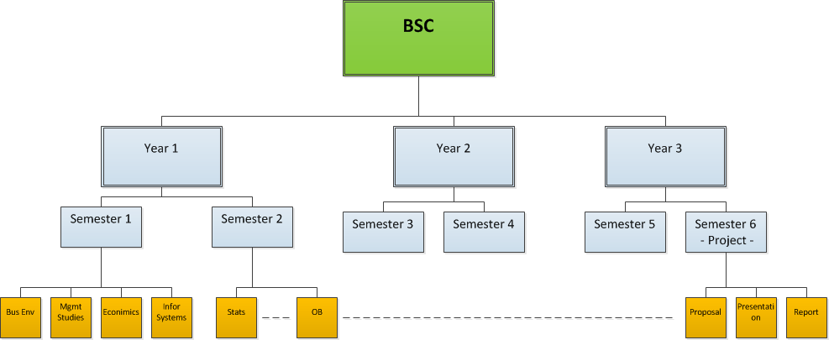
Group Work

Slide 33
Lesson 5 – The Project Schedule
Agenda
The Scheduling Process
Time Estimate

