Slide 1
Management of Information Technology
Introduction

Slide 2
About the Lecturer
Chathura Rajapakse Dr. of Engineering (Tokyo Tech)
Senior Lecturer
Department of Industrial Management
University of Kelaniya
chathura@kln.ac.lk
071 3102034
Specialization: Computational Intelligence and Systems Science
Business Intelligence
Agent-Based Systems
Social Simulation
Information Systems

Slide 3
Assignment Plan
No. of assignments: Two
Mid-term Test: 8th week
Nature of assignments: group/individual work
Evaluation: Report and a presentation
Presentation schedule: 6th and 12th week
Assignment notification: 4th and 10th week
Percentage taken for grading: 40%

Slide 4
Management of Information Technology
The process of managing all of the information technology resources of a firm in accordance with its needs and priorities
What is Information Technology?
Application of computers and telecommunications equipment to store, retrieve, transmit and manipulate data, often in the context of a business or other enterprise.

Slide 5
Discussion
What are the IT resources of an organization?
ICT Staff
Hardware
Data Centers
IT Resources
Software
Networks
Data

Slide 6
Discussion
What involves management of IT?
Management functions
Budgeting
Staffing
Change management
Organizing and Controlling
Technological aspects
Software design
Network planning
Tech support

Slide 7
Discussion
Why is Management of IT necessary?
Creating value by the use of IT
How can a university create value to its students through IT?
How does an online business organization create value through IT?
How does a bank create value to its customers using IT?
Alignment with the business strategy is very important
Increasing pressure from the environment

Slide 8
Digital Economy
An economy that is based on digital technologies including digital communication networks
Also known as Internet economy, new economy or web economy
Provides a global platform for people and organizations to interact, communicate, collaborate and search for information

Slide 9
Digital Economy
What’s there in the platform of digital economy?
Digitizable products: databases, news and information, books, magazines, TV and Radio programs, movies games, music and software
Financial transactions conducted electronically: cards, virtual currencies, cryptocurrencies
Physical goods such as home appliances embedded with microprocessors and networking capabilities

Slide 10
Old Vs. New Economy
Compare different activities in old and new economy
Taking photos
Travelling
Shopping
Transportation
Office environments
Banking
What are the opportunities available for entrepreneurs in digital economy?

Slide 11
Business Models in Digital Economy
Business Model:
A method of doing business by which a company can generate revenue to sustain itself
How do network computing and Internet technologies change the way of doing business?
E commerce:
Business transactions are done electronically over the Internet and other computing networks
E business:
Performing business functions of a company electronically, in order to enhance its operations

Slide 12
Representative Business Models of the Digital Age
Name-Your-Own-Price
Let the customer name the price he/she is willing to pay and map it with a suitable seller in the company database (Ex: Priceline.com)
Reverse Auctions
A tendering system in which (larger) buyers request for quotes from sellers for a particular product
Affiliate Marketing
Marketing partners place banner ads for a company (Ex: Amazon.com) on their website
Group Purchasing
Purchase orders of many buyers (individuals/SMEs) are aggregated to offer products at a lesser price
E-marketplaces
Where buyers and sellers meet online

Slide 13
Discussion
What were the reasons for the dot com crisis?
Lack of proper vision – Playing with other’s money
Lack of meaningful business plans
Less experience
Failure in developing adequate infrastructure to gain customer satisfaction and repeat purchases
More focus on building websites than developing a strategy
Urgency to become first to market to win competitive advantage

Slide 14
Business Pressures, Organizational Responses and IT Support
From where does business pressures come?
Changing environmental, organizational and technological factors
Results in competitive business environments
Organizations need to response to these pressures
IT plays a vital support role

Slide 15
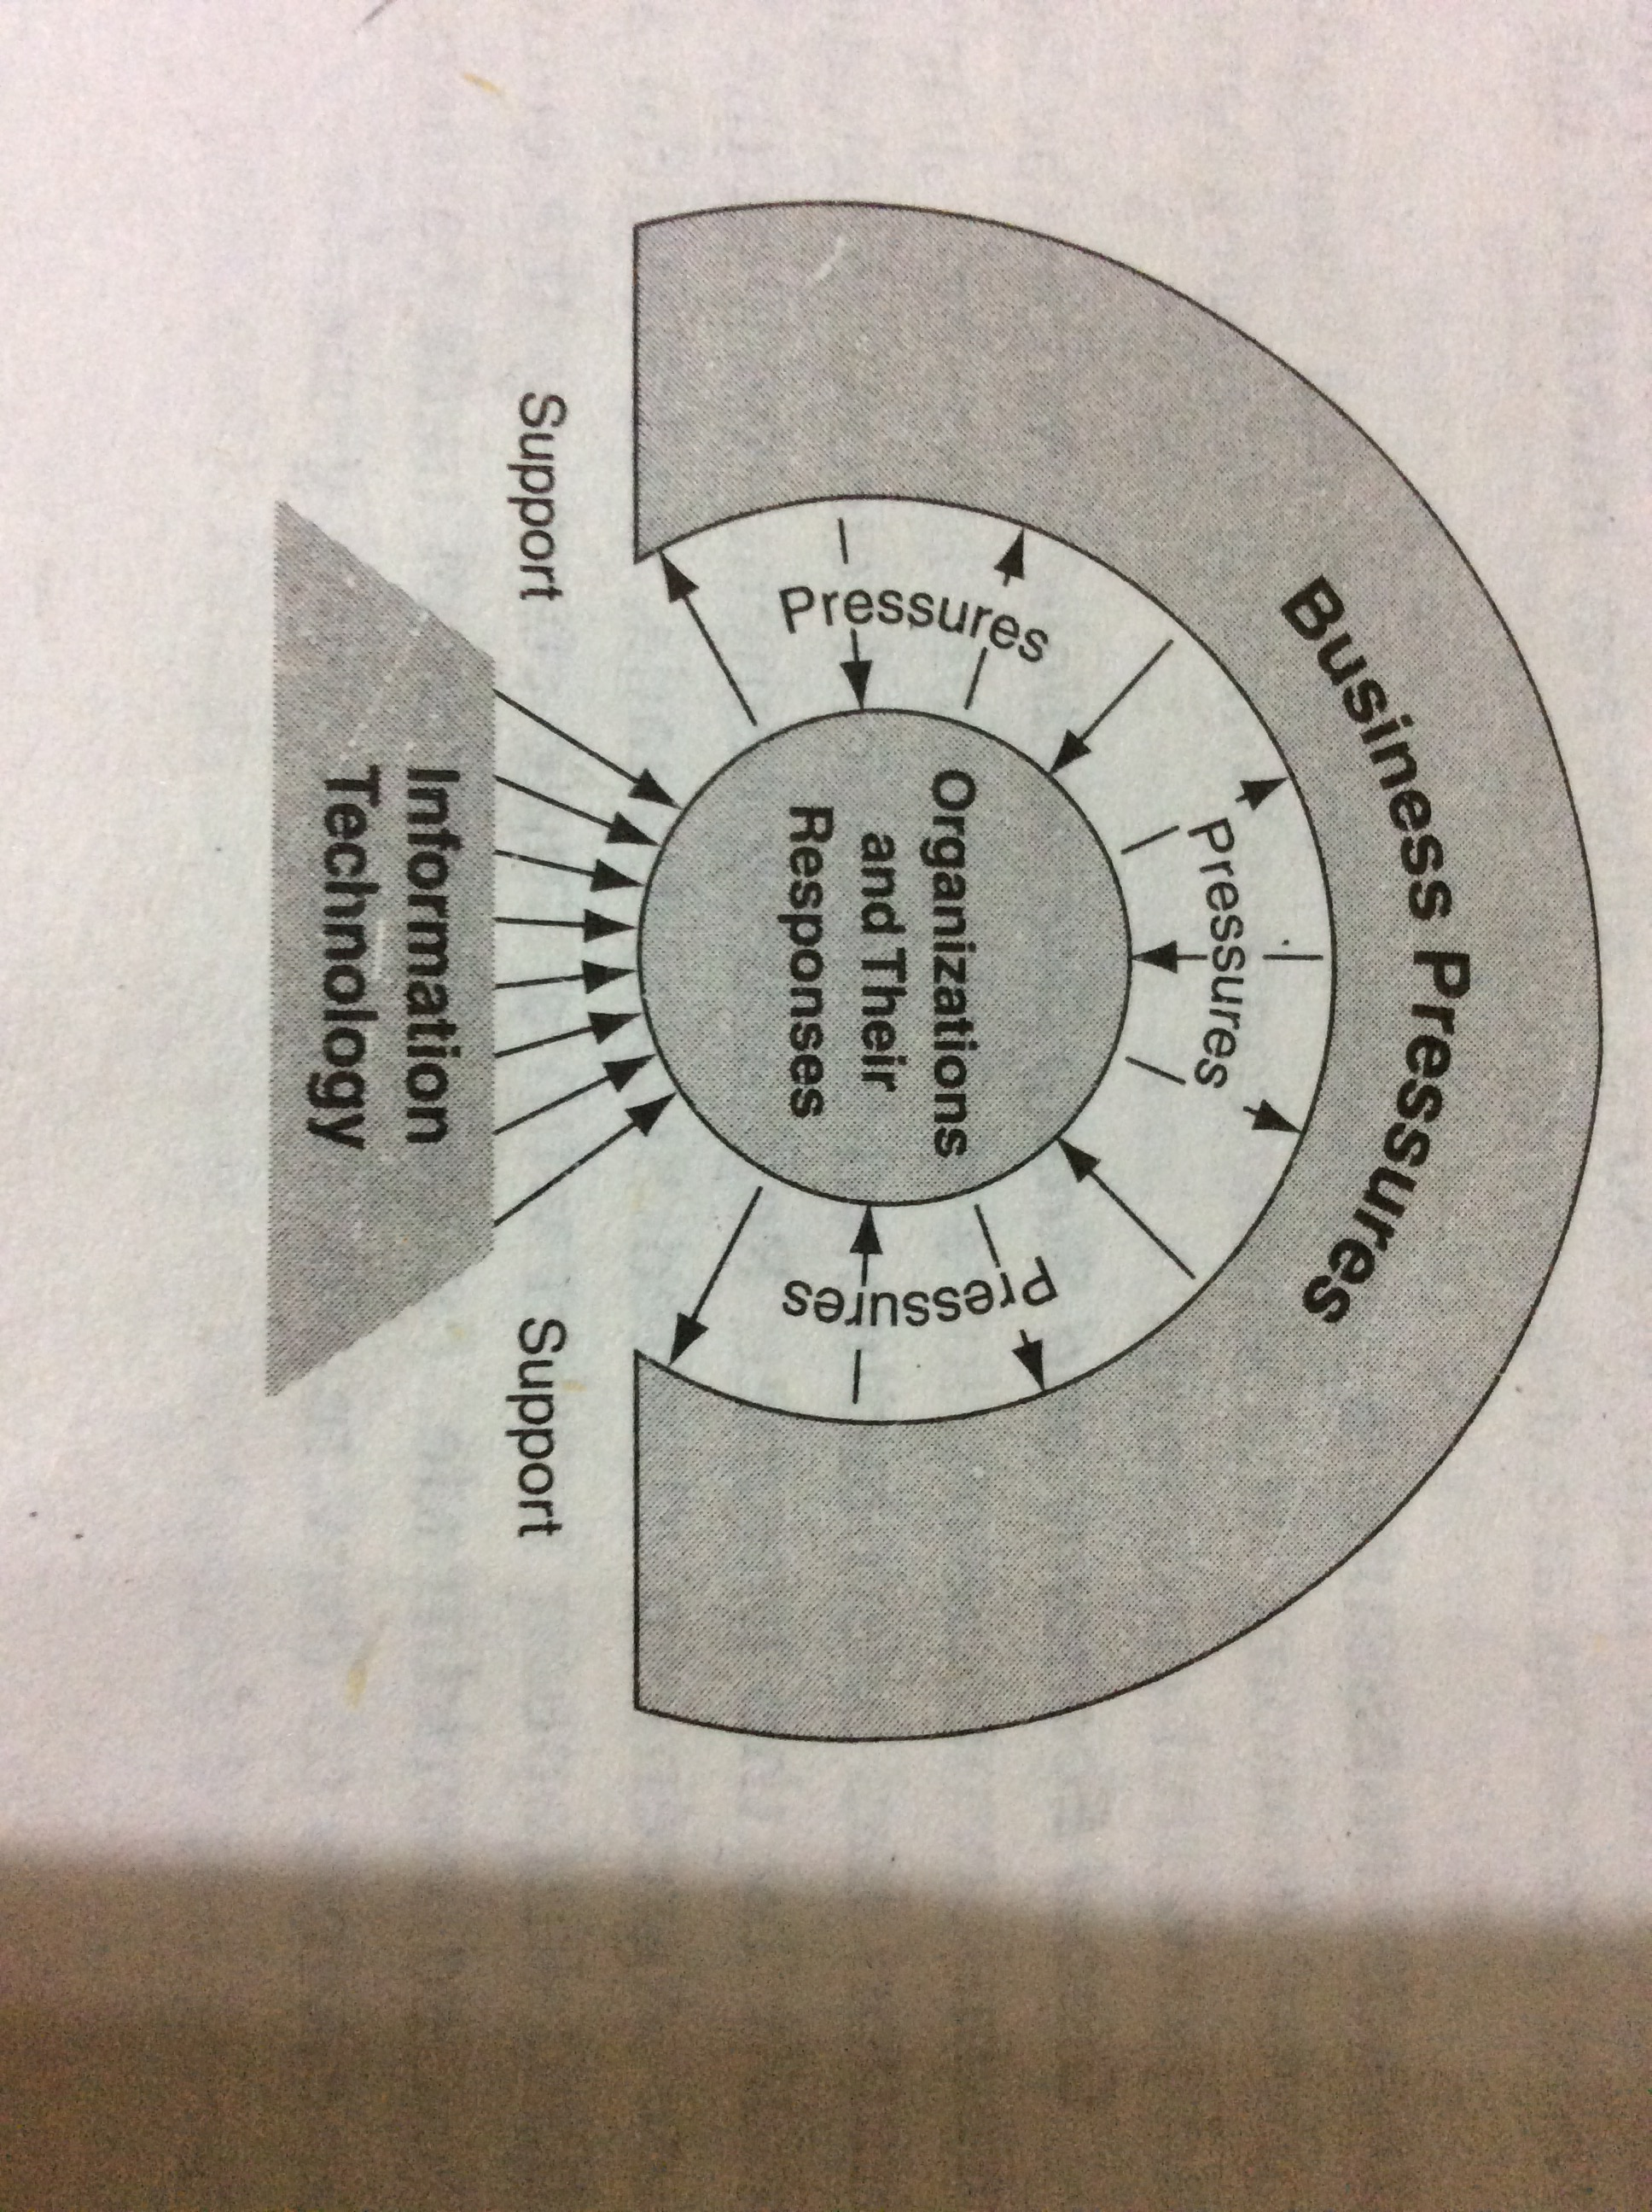
Business Pressures, Organizational Responses and IT Support

Slide 16
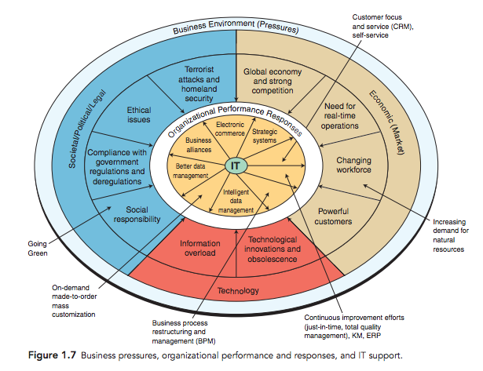
Business Pressures, Organizational Responses and IT Support

Slide 17
Business Pressures
Can be discussed under three categories
Market pressures
Pressure that comes from a global economy and strong competition, the changing nature of the workforce and powerful customers
Societal pressures
Pressures related to the society: the next society would be a knowledge society and a society with aging populations
Technology pressures
Pressures related to the technological changes

Slide 18
Market Pressures
Global economy and strong competition
Globalization!
Products and services flow freely around the globe
Cost of labor is a particular pressure in a global market
Differences in labor costs
What would they do?
Move to places where cost of labor is low
Crowd sourcing
What would be the challenges?
Need for faster communication
Need for communicating in multiple languages
Dealing with different cultures, ethics and legal conditions
How can IT support?

Slide 19
Market Pressures
Need for real time operations
Decision making needs to be very fast
Information processing needs to be faster
Changing nature of the workforce
Workforce is getting diverse
Women, single parents, minorities, disabled, homebound, etc.
How IT could be used to integrate such a diverse workforce?
Education
Telecommuting
Powerful customers
Consumer sophistication and increase of expectations
Need for faster delivery of information
To compete with firms that do so
Need for customization
Make-to-order, online designing, faster delivery

Slide 20
Technology Pressures
Technological innovation and obsolescence
What do technology innovations do?
New products, alternative service options, higher quality
What are the technologies that changed the world?
Genetic engineering
Web-based information technology
Today’s state-of-the-art technology will be obsolete tomorrow
Information overload
Information generated and stored on the Internet and in organizations growing exponentially
What are the challenges?
Accessibility, navigation and management of data, information and knowledge for decision making
Data warehousing and mining, Cloud computing, big data

Slide 21
Societal Pressures
Social Responsibility
Why are social issues important to companies?
Companies have a social responsibility
Ex: preserving environment, education, etc.
Government regulations and deregulations
Social concerns (ex: health) leads to government regulations
Additional costs of regulations make competition difficult
Terrorist attacks and protection
Pressure to protect themselves from terror attacks
Ex. Cyber attacks, 9/11 attack

Slide 22
Societal Pressures
Ethical Issues
What do you call ethics?
Standards of right and wrong
Information ethics: standards of right and wrong in information processing activities
Ethical issues related to employees, customers and suppliers
Privacy
Concerns over privacy of individuals
Copyrights
Safeguarding rights of intellectual property
Ownership of information
Who owns information and whether they are properly compensated when using it
Code of ethics
Formalizing some rules and expected actions

Slide 23
Discussion
Does a company have the right to monitor employees’ emails and websites they visit from company’s computers?
Should the access to the Internet be restricted for employees during work hours?
Should software be free?

Slide 24
Organizational Responses
What can organizations do in response
Strategic systems: Systems that provide organizations with strategic advantage (Ex: FedEx overnight delivery system)
What are the challenges of such systems?
Customer focus: attempts to provide super customer service
Why such systems are necessary?
Continuous improvement: continuously conducting programs to improve productivity and quality
What are the examples?
TQM, Six Sigma, Knowledge Management, JIT processing, Change Management
How can IT support?
Collecting information, monitoring performances, analytics, share information

Slide 25
Organizational Responses
Restructuring business processes: changing the structure of the business process when continuous improvements face limitations
Initially known as BPR
How can IT support?
Automation, distributed operations, new business models, manufacturing flexibility, rapid and paperless transactions
Make-to-order and mass customization: manufactured in large quantity but customized to individual needs
Ex: interactive communication between buyer and the designer
Business alliances: forming alliances with other companies
IT can support to form collaborative portals, electronic data transmission
Electronic business and e commerce

Slide 26
Some Useful Terms
ERP systems
Data warehouse
Big data
Cloud computing
Internet of things
Office automation
Bring your own device
Client server architecture

