Slide 1
IT Applications for Decision Making

Slide 2
Operations Research
Initiated in England during the world war II
Make scientifically based decisions regarding the best utilization of war materials
Later used for improving efficiency and productivity in civilian sector
Decision situations involve:
What are the decision alternatives
Infinite alternatives could exist
Under what restrictions is the decision made
What is an appropriate objective criterion for evaluating the alternatives

Slide 3
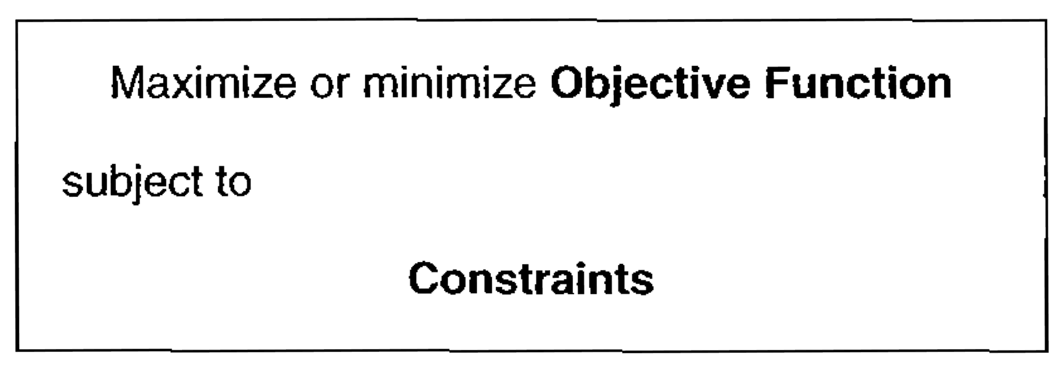
OR model example
Forming a maximum-area rectangle out of a wire of length L inches
Generally

Slide 4
Solving an OR model
There is no single general technique to solve all mathematical models
Linear programming
Linear objective and constraint functions
Integer programming
Variables assume integers
Dynamic programming
Original problem can be decomposed into more manageable sub problems
Network programming
A problem could be modeled as a network
Non-linear programming
Functions of the model are non-linear
Solutions are iteratively obtained by algorithms
Iteratively by a set of fixed computational rules
Need computer support
Often have to use heuristics or rules of thumb
Look for a good solution than the optimal solution
complexity

Slide 5
Queuing and Simulation
Deal with the study of waiting lines
Not optimization models but determine measures of performance of the waiting lines
What are the common measures?
Average waiting time in queue
Average waiting time for service
Utilization of service facilities
Queuing models utilize probability and stochastic models to analyze waiting lines
Simulation imitates the behavior of the real system to measure the performance
Next best thing to observing the real system

Slide 6
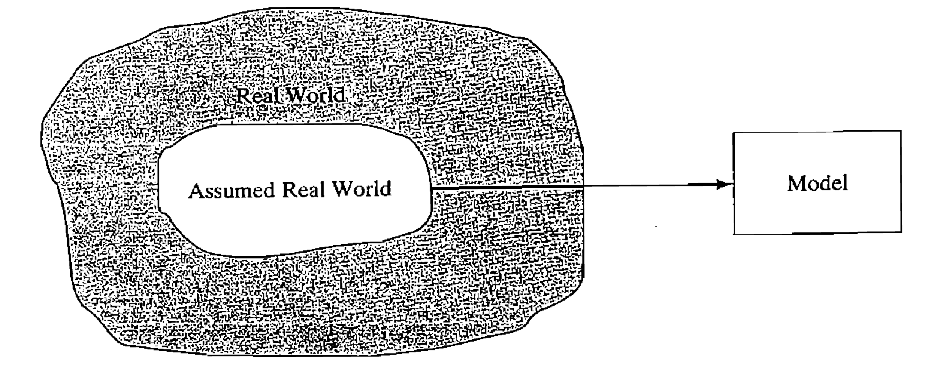
Model development

Slide 7
Phases of an OR study
Defining the problem
Identification of the three main components
Model construction
Translation of the problem definition into mathematical relationships
Model solution
Use well-defined optimization algorithms to solve the model
Model validation
Checks whether the proposed model adequately predicts the behavior of the system under study
Implementation
Translation of the results into understandable operating instructions to be issued to the people who will administer the recommended system

Slide 8
Two variable LP Model
Reddy Mikks produces both interior and exterior paints from raw materials M1 and M2. A market survey indicates that the daily demand for interior paint cannot exceed that for exterior paint by more than one ton. Maximum daily demand for interior paint is 2 tons.
find the optimum product mix that maximizes the total daily profit.

Slide 9
Two variable LP model
Three basic components
Decision variables that we seek to determine
Objective (goal) that we want to optimize (maximize or minimize)
Constraints that the solution must satisfy
Decision variables
X1: Tons of exterior paint produced daily
X2: Tons of interior paint produced daily
Objective function
Maximize (5X1 + 4X2)

Slide 10
Two variable LP model
Constraints
6X1 + 4X2 <= 24 (1)
X1 + 2X2 <= 6 (2)
X2-X1 <= 1 (3)
X2 <= 2 (4)
X1 > 0, X2 > 0 (5)
Feasible solution:
Any solution that satisfies all five constraints
Ex: X1 = 3, X2 = 1
What is an optimal solution?

Slide 11
Exercise
For the above problem, construct each of the following constraints and express it with a linear left hand side and a constant right hand side
The daily demand for interior paint exceeds that of exterior paint by at least one ton
The daily usage of raw material M2 in tons is at most 6 and at least 3
The demand for interior paint cannot be less than the demand for exterior paint
The minimum quantity that should be produced of both the interior and exterior paint is 3 tons
The proportion of interior paint to the total production of both interior and exterior paints must not exceed 5

Slide 12
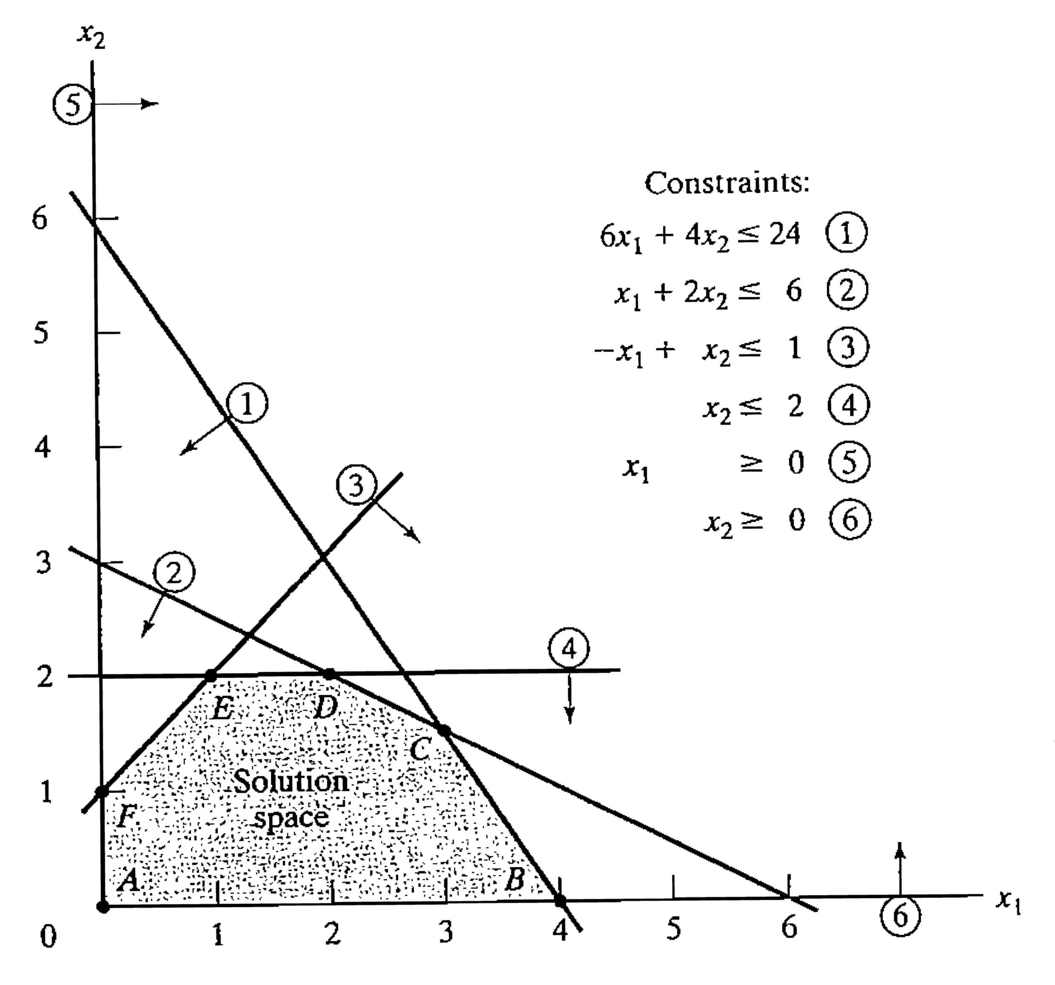
Graphical solution for the LP model

Slide 13
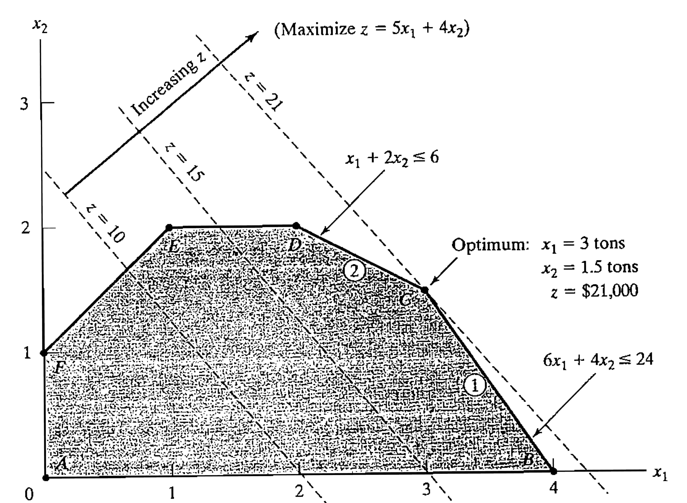
Graphical solution of the LP model

Slide 14
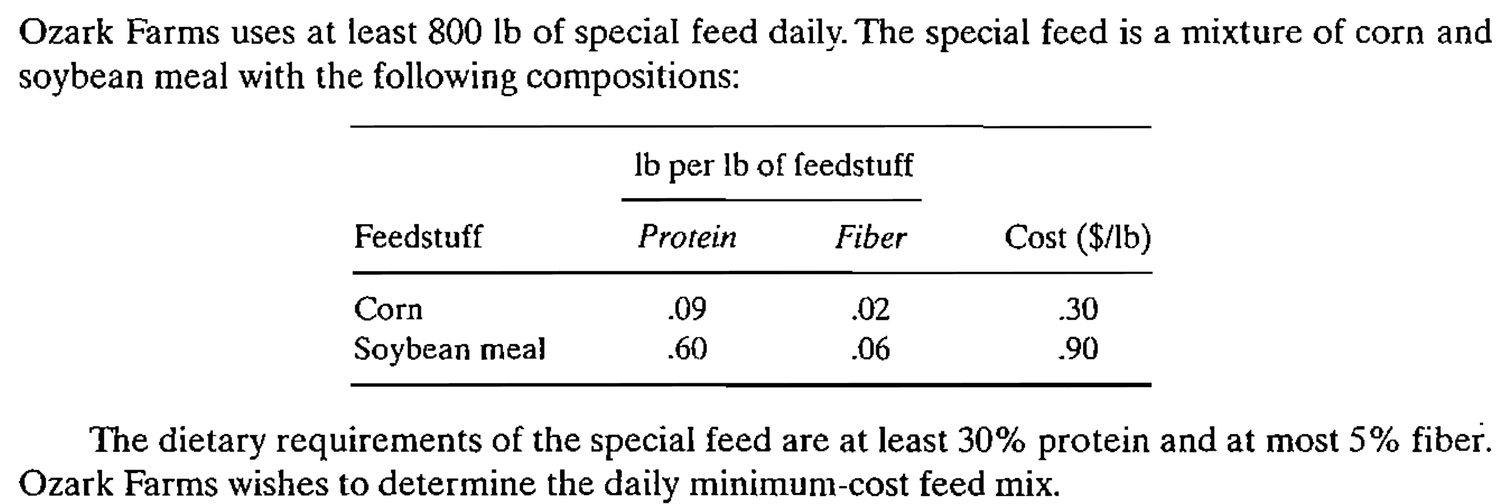
Minimization Problem

Slide 15
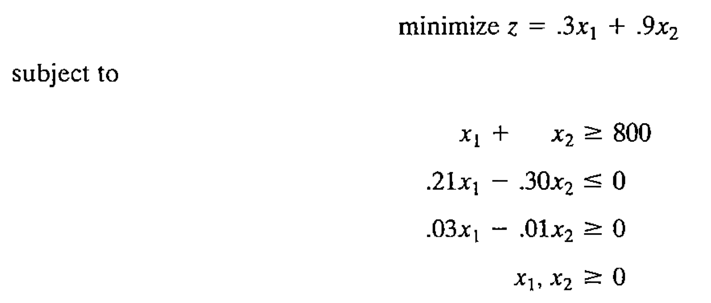
Minimization problem

Slide 16
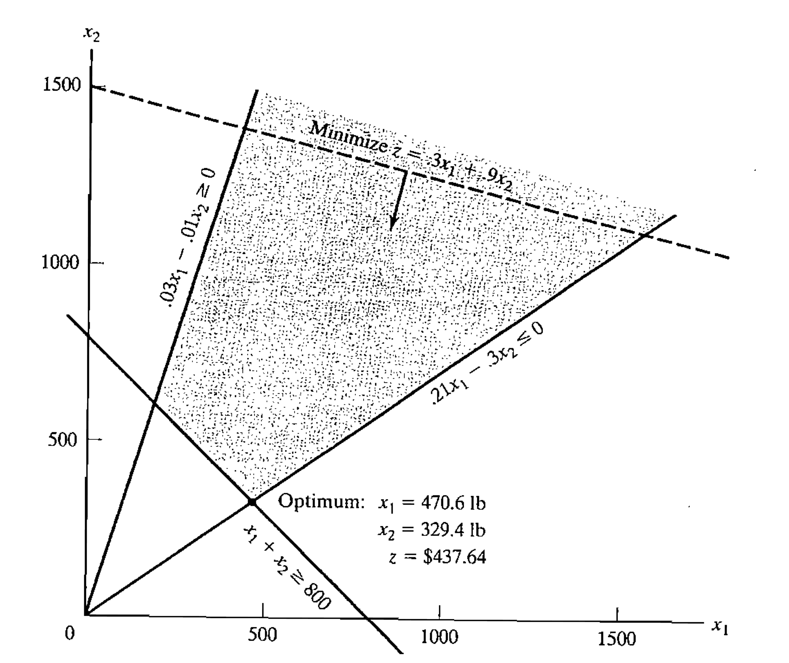
Graphical solution to the minimization problem

Slide 17
MS Excel Solver
Can find an optimal (maximum or minimum) value for a formula in one cell — called the objective cell
Subject to constraints, or limits, on the values of other formula cells on a worksheet.

Slide 18
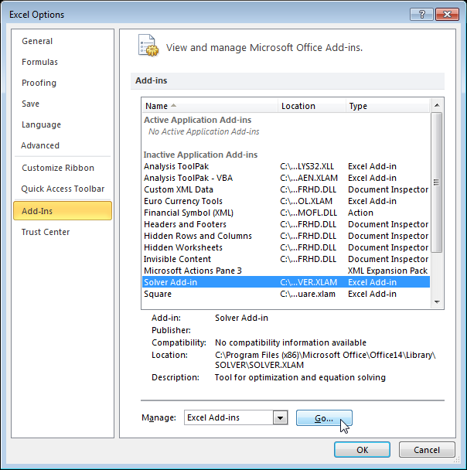
Excel Solver – Add-In (Step 1)
File -> Options

Slide 19
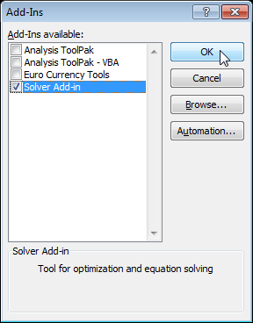
Excel Solver – Add-In (Step 2)

Slide 20
Where to find
Data tab

Slide 21
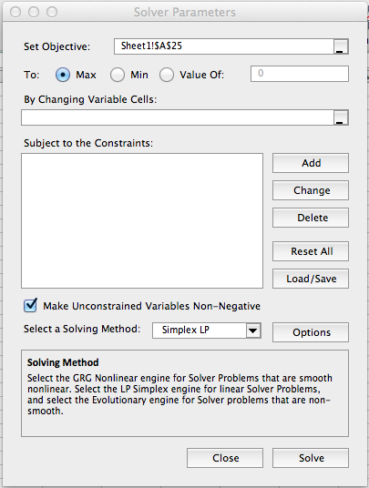
Solver interface

Slide 22
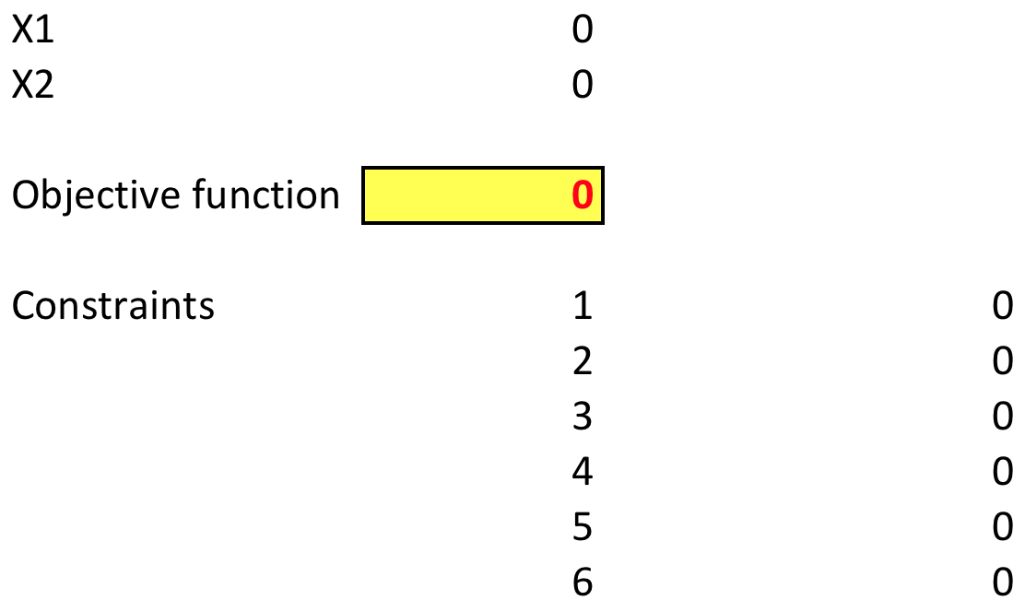
Solve an LP using solver

Slide 23
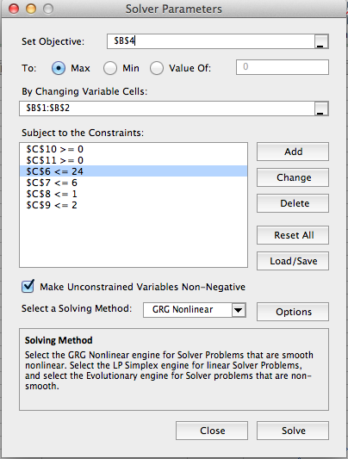
Solve an LP using Solver

Slide 24
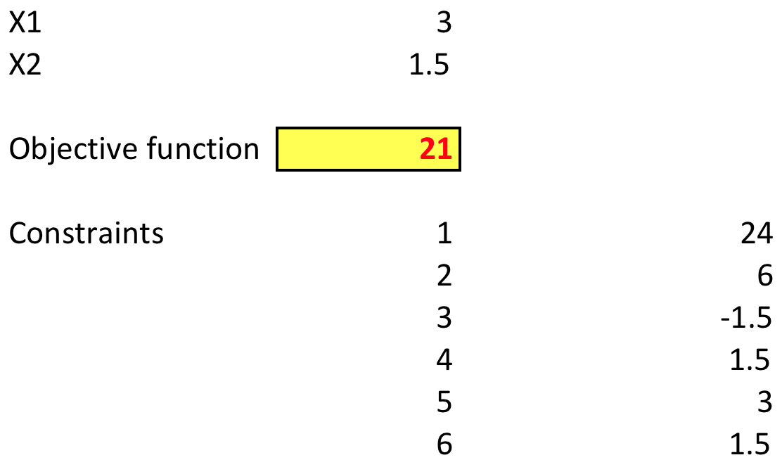
Solve an LP model using solver

Slide 25
Application of LP
Few of the examples:
Urban planning
Currency arbitrage
Investment
Production planning and inventory control
Blending and oil refining
Manpower planning

Slide 26
Investment Example
Investors are presented with multitudes of investment opportunities
Examples:
Capital budgeting for projects
Bond investment strategy
Stock portfolio selection
Establishment of bank loan policy
Role of OR
Select the optimal mix of opportunities that will maximize return while meeting the investment conditions set by the investor

Slide 27
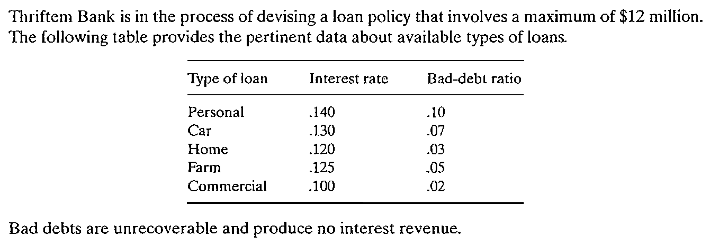
Investment decision example – loan policy

Slide 28
Decision Model
Variables – Amount of loans in each category
X1: personal loans
X2: car loans
X3: home loans
X4: farm loans
X5: commercial loans
Objective function
Maximize z = Total interest – Bad debt
Formulate this problem and solve using Excel solver as an exercise

Slide 29
Transportation Model
A special class of linear programming that deals with shipping a commodity from a source to a destination
Ex. From factories to warehouses
Objective:
Determining the shipping schedule minimizing the total shipping cost while satisfying the demand and supply constraints
General Representation
m sources and n destinations: Nodes
Routes between sources and destinations represented by arcs (links)
Arc represents two information
C_{ij}: Cost of transportation between i and j
X_{ij}: Amount transported between i and j
Unknowns (x_{ij}) are determined while minimizing the costs (c_{ij})

Slide 30
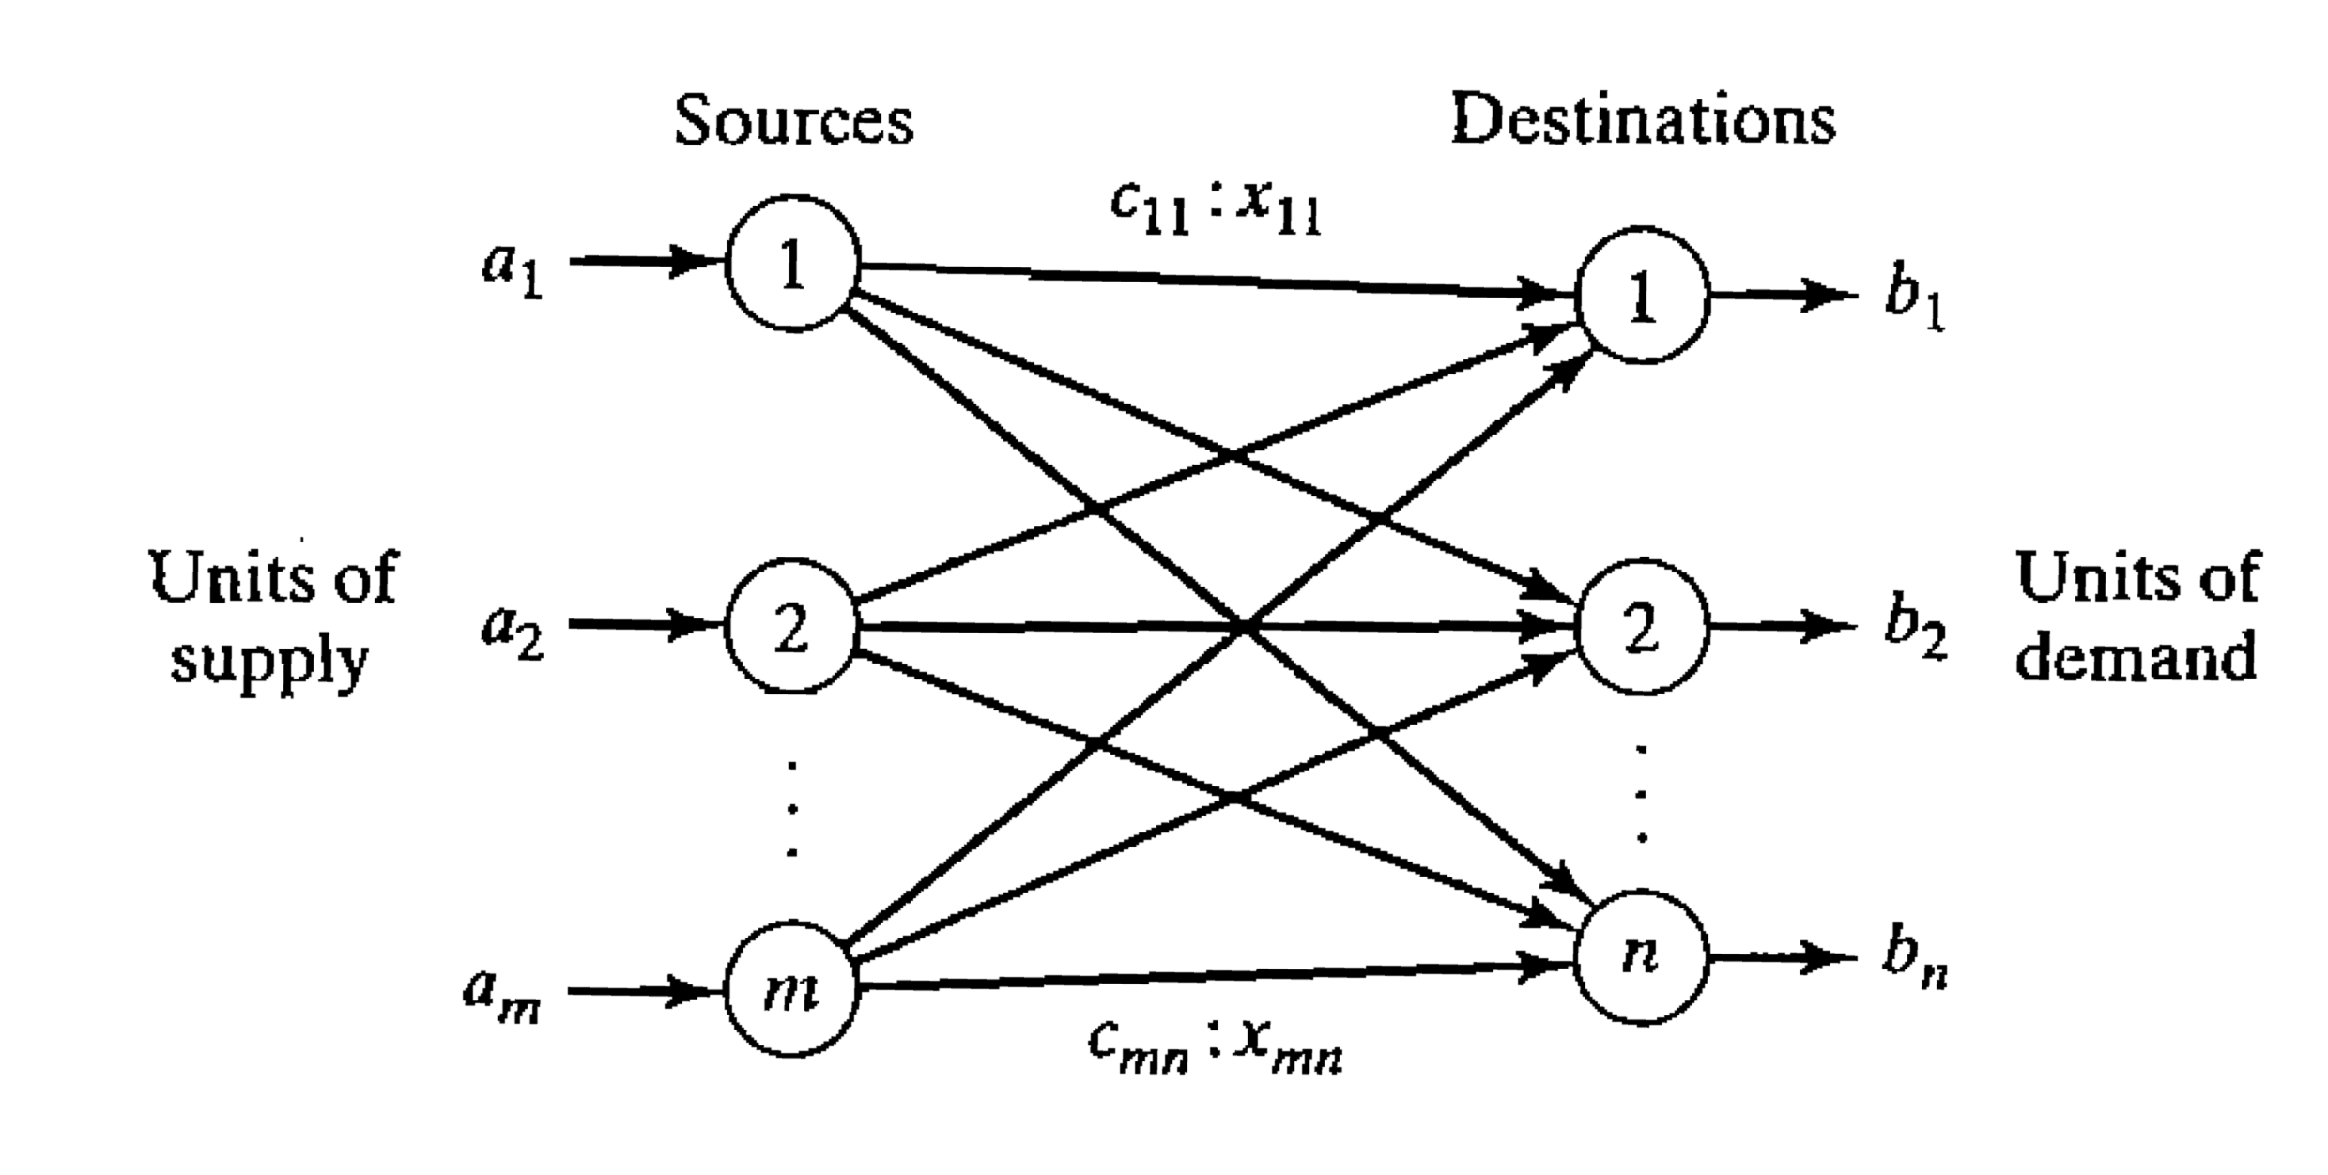
Representation of the Transport Model

Slide 31
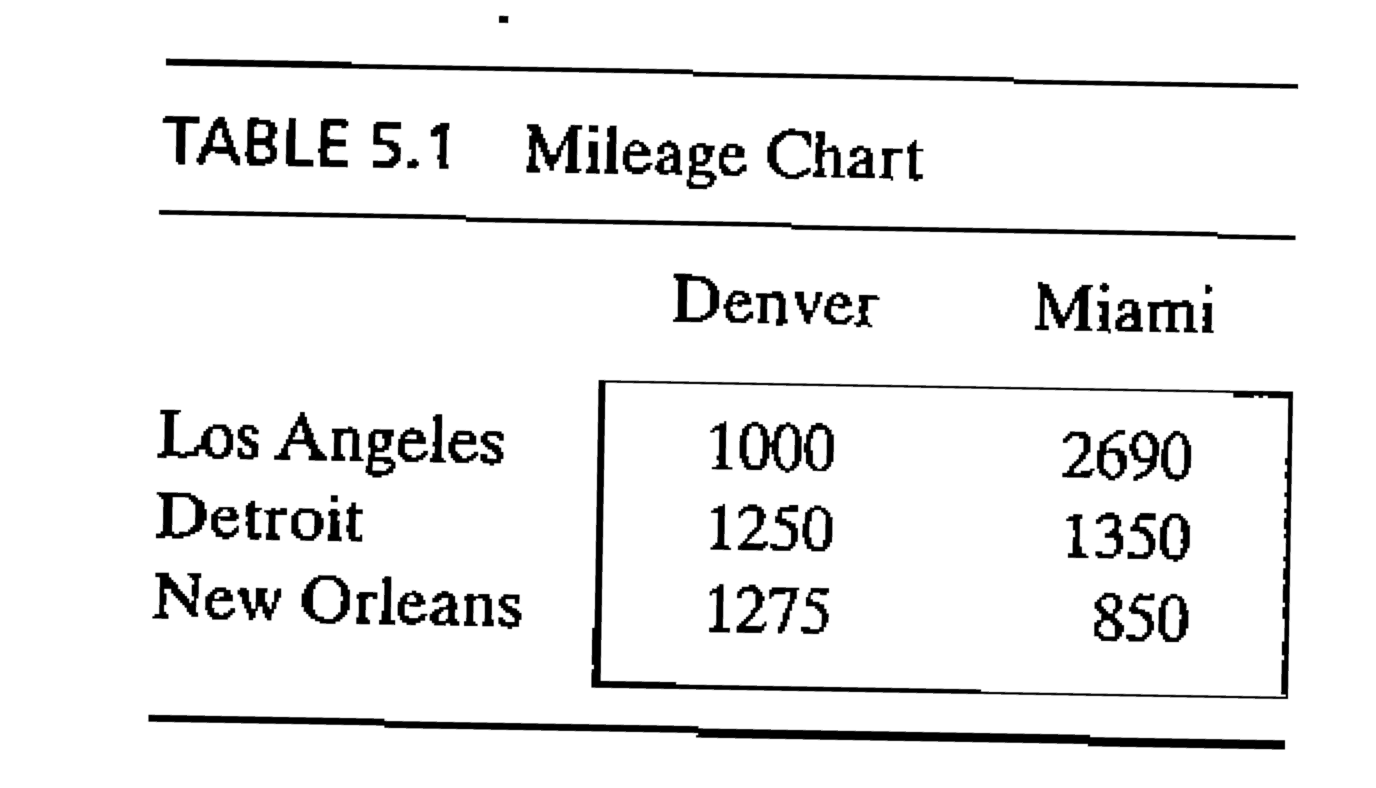
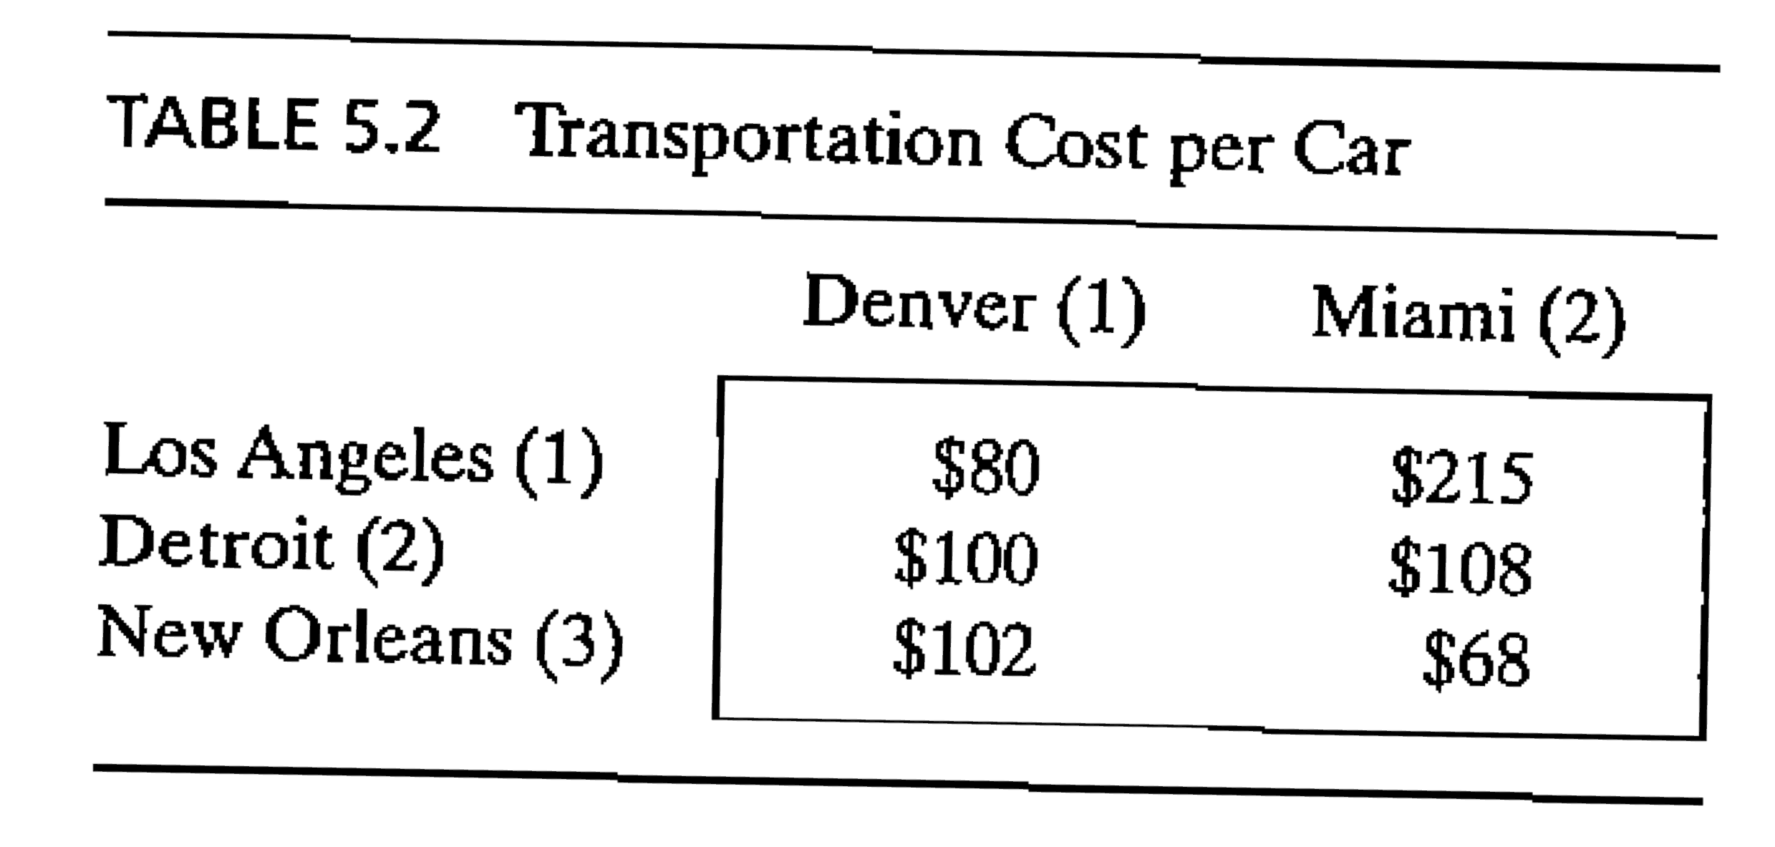
Example

Slide 32
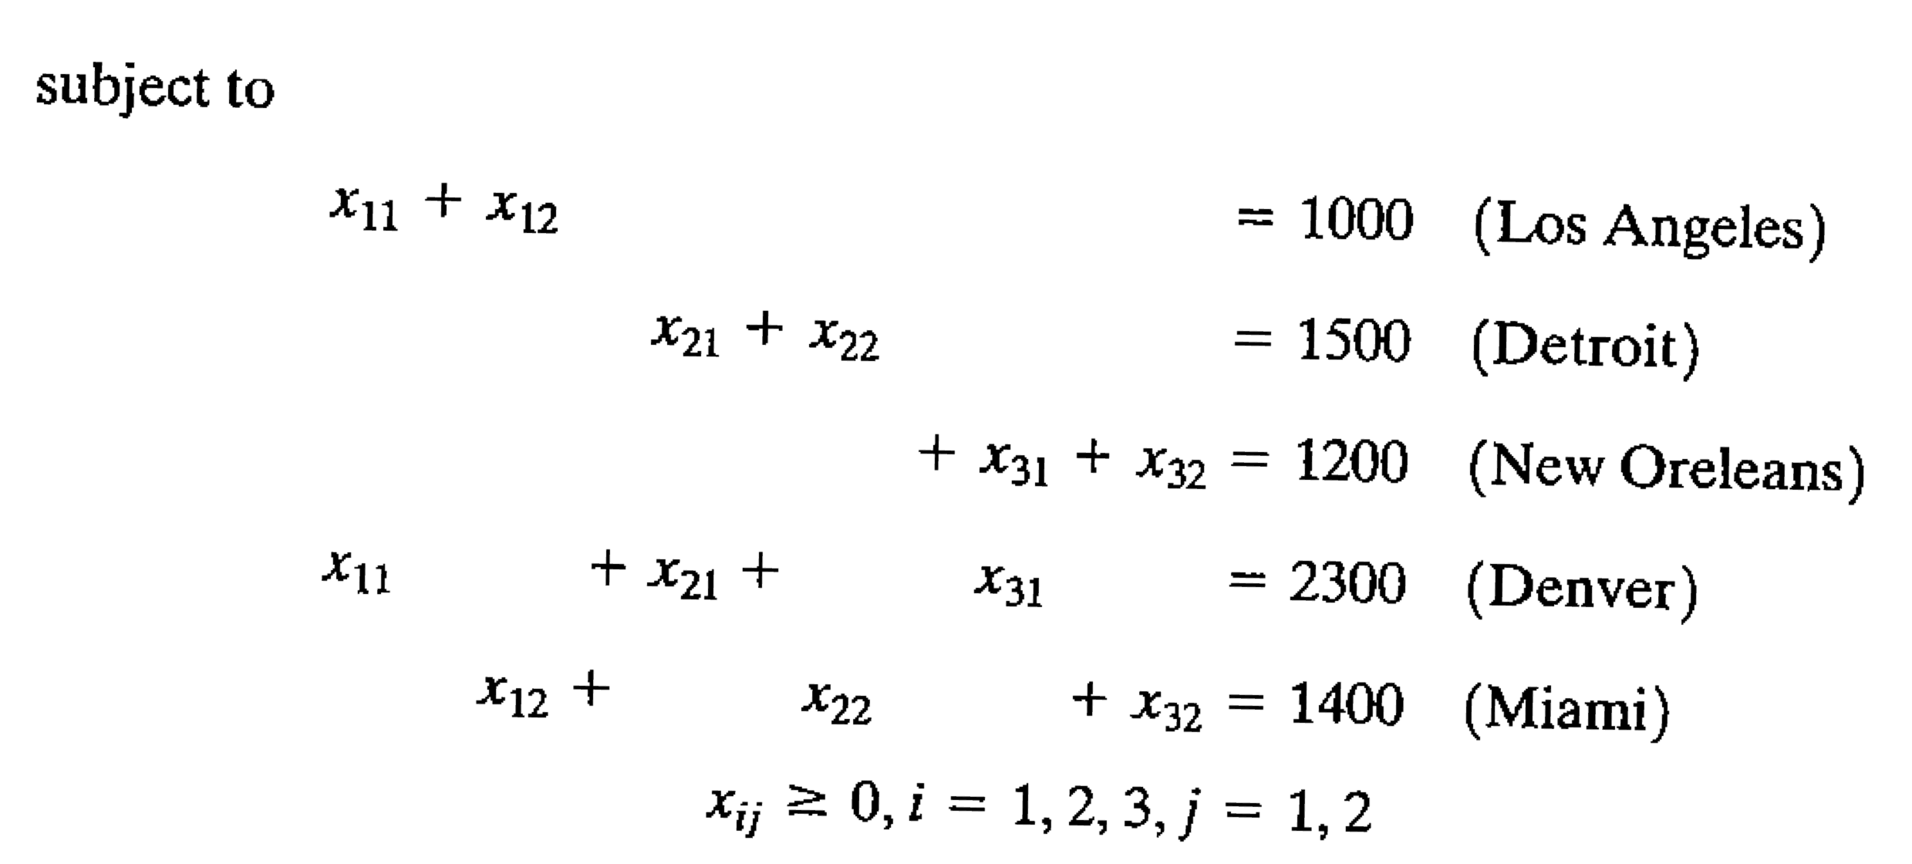
Model

Slide 33
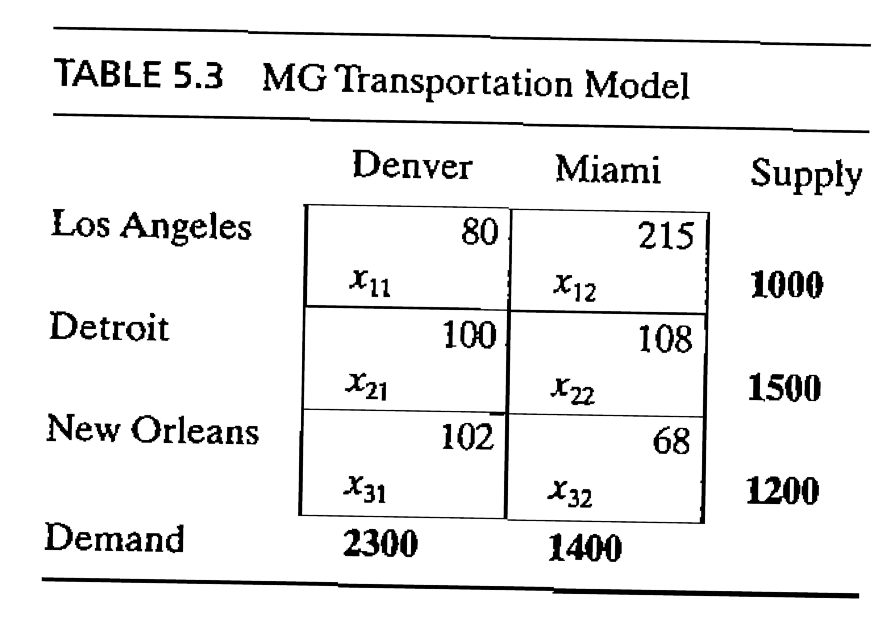
Transportation Tableau
Tableau method is possible since all constraints are equations
Total supply from three sources is equal to total demand from destinations
Assumption of the transportation algorithm: The model is balanced

Slide 34
Balancing Transportation Model
When inequalities exist
Ex:
Suppose Detroit plant capacity is 1300 (instead of 1500 previously)
Total supply (3500 cars) is less than total demand (3700 cars)
Solution:
Adding a dummy source or a dummy destination to balance the model
Dummy source with 200 capacity is added
Unit transportation cost is zero since the plant does not exist
If supply is higher than demand (Ex. :demand at Denver is 1900 now)
Add a dummy destination
Add very high unit cost of transportation to avoid the excess moved to the dummy destination

Slide 35
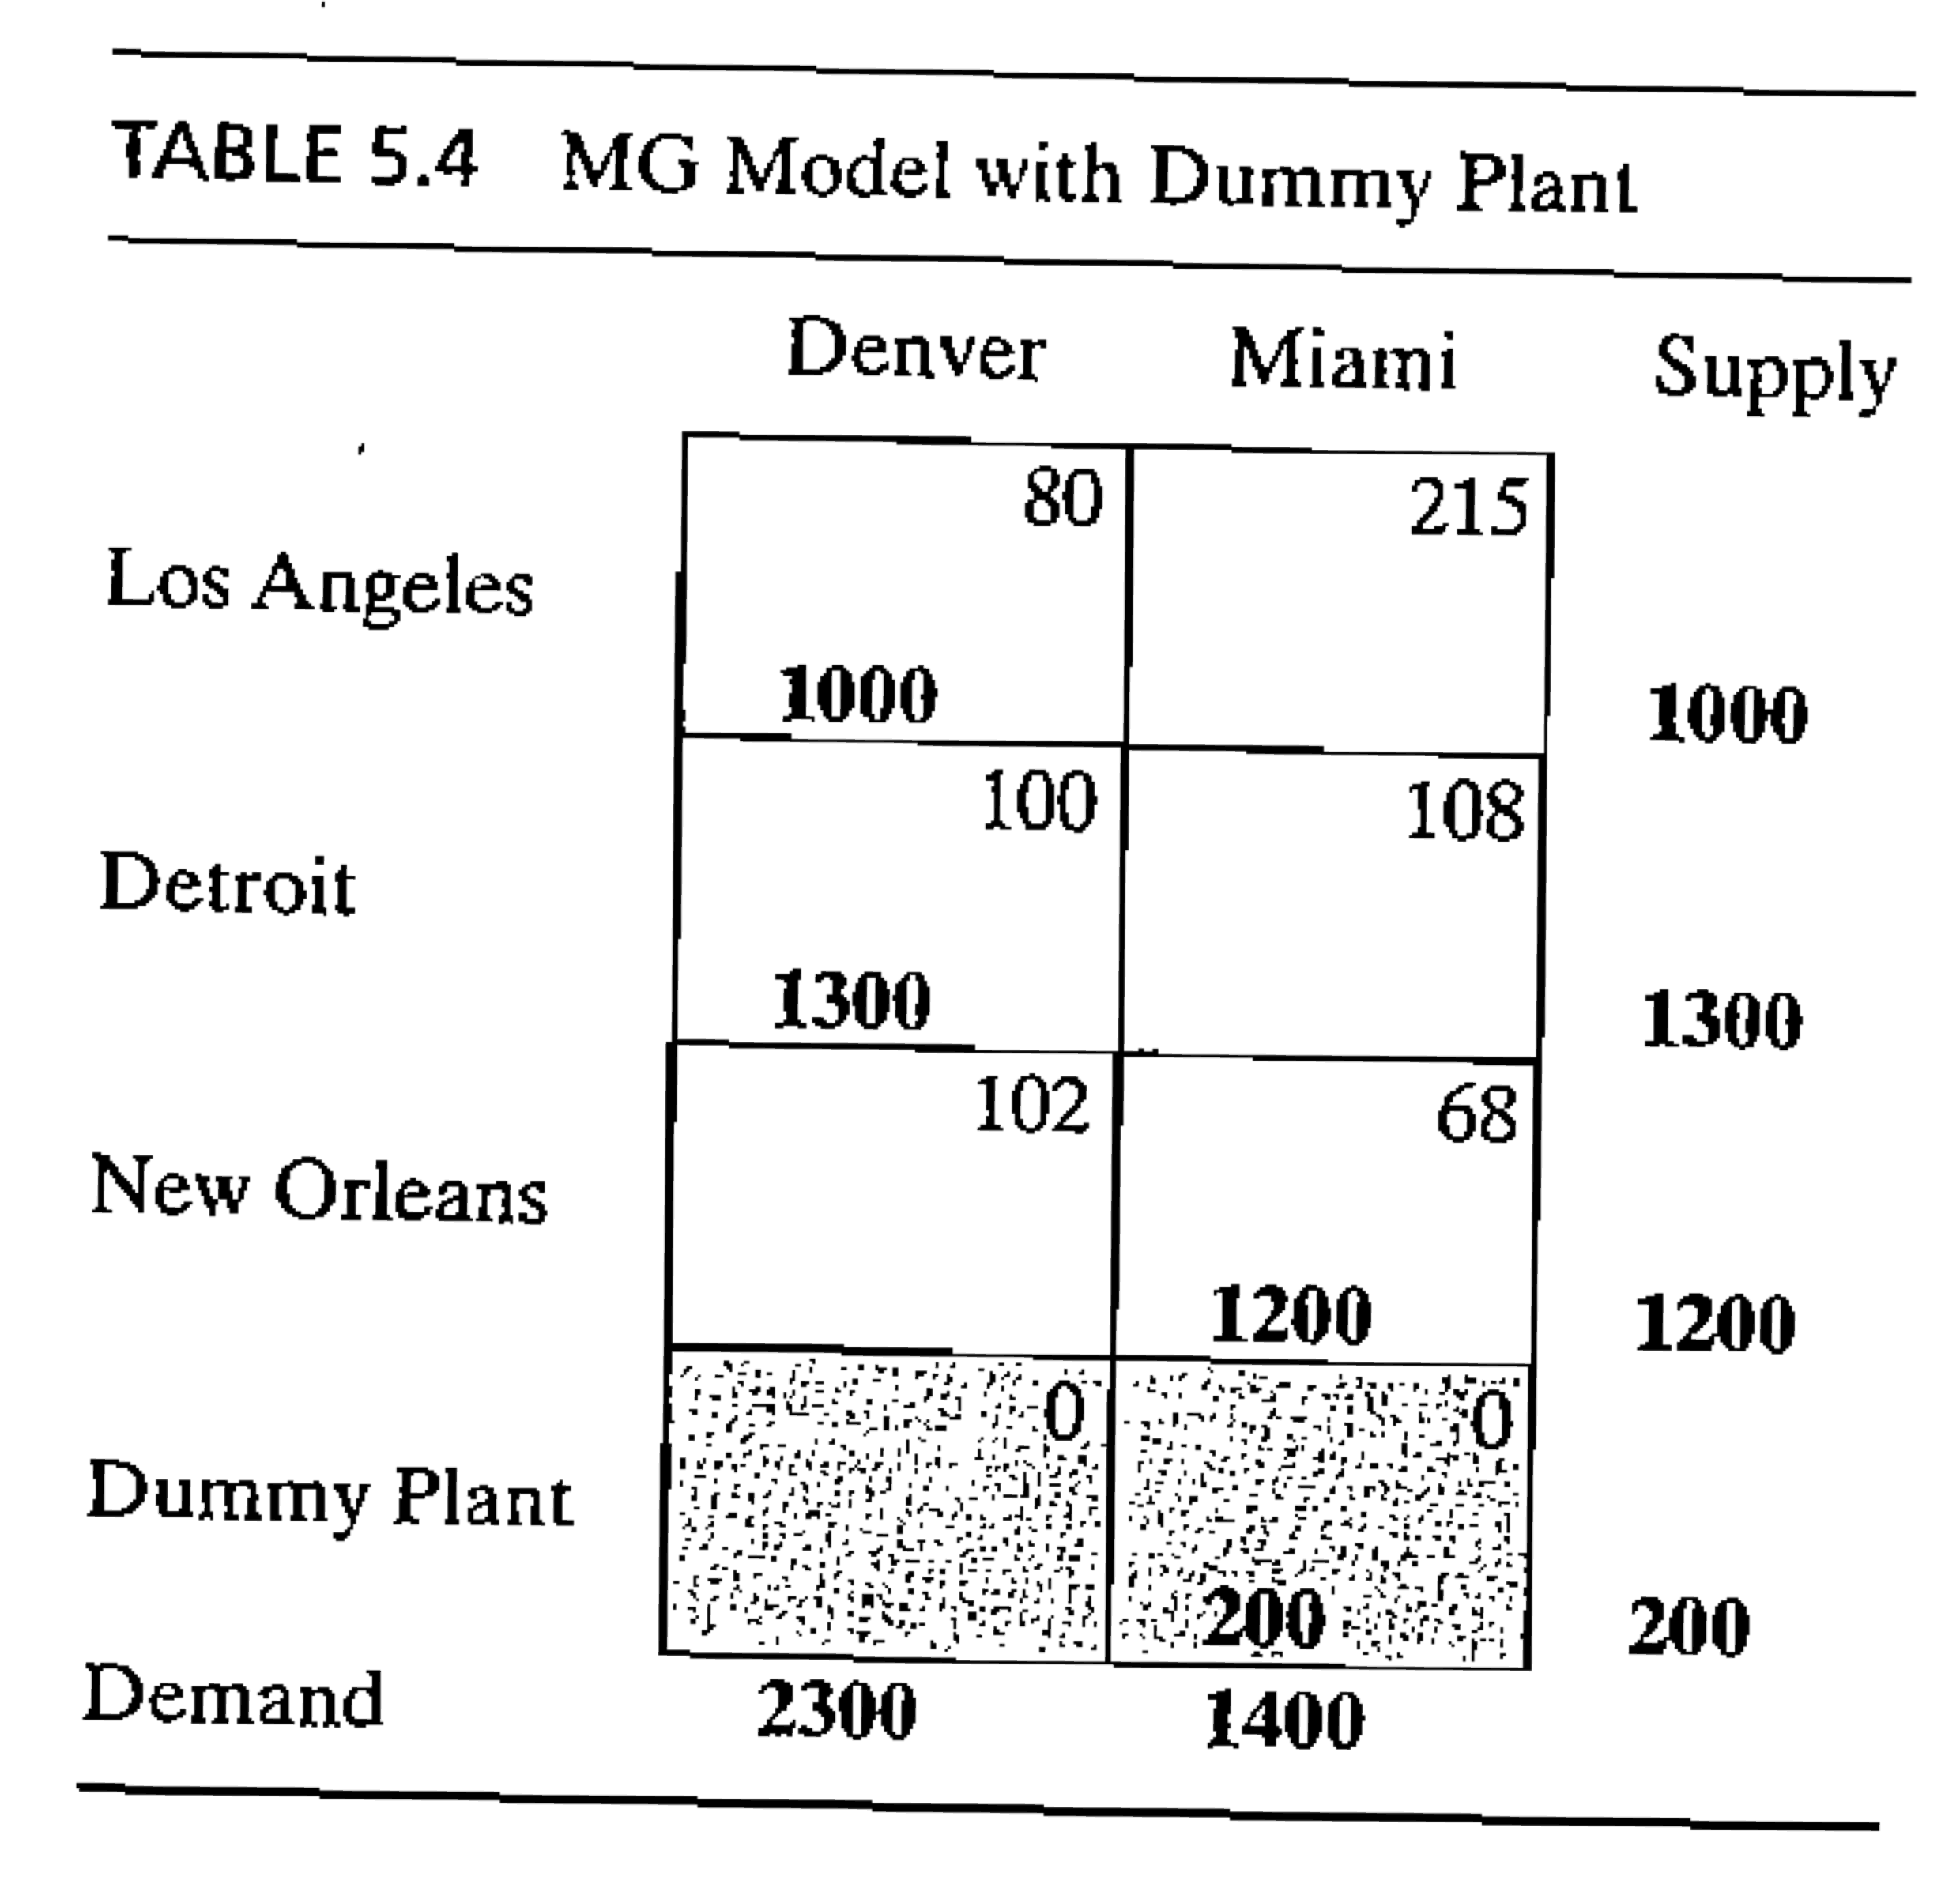
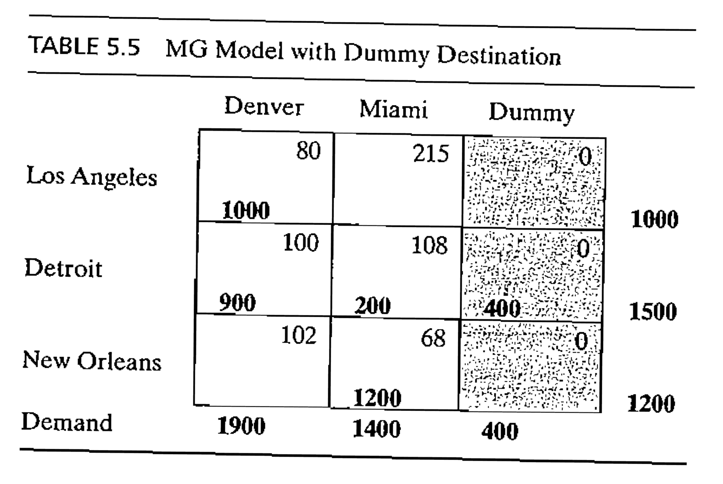
Answer with a Dummy Source

