Slide 1
Information Systems Development

Slide 2
Systems Development Life Cycle
Traditional approach of systems development
Why such approach was necessary?
  To formalize the process
Waterfall model: initial SDLC form
  One stage had to be completed to start the next stage

Slide 3
Systems Development Life Cycle

Slide 4
Roles in Systems Development
Systems Analyst
  Business analyst, business systems analyst
  An IS professional; an expert in analyzing/designing information systems
Programmers
  IS professionals who modify existing programs or write new programs to satisfy user requirements
Technical Specialists
  Those who are experts in specific technologies
System Stakeholders
  All those who are affected by the systems development project
  End users, managers, etc.

Slide 5
System Investigation
Understanding the business problem
  The more time spent, greater chance for success
  Not only internal
Feasibility studies
  Determines the probability of success of the proposed systems development project
  Technical feasibility
    Whether hardware, software, communication infrastructure could be made available
  Economic feasibility
    Breakeven analysis, ROI, NPV, etc.
  Behavioral feasibility
    Human issues
    Skill analysis and training requirements

Slide 6
Systems Analysis
Examination of the business problem that the organization plans to solve with an information system
  Defines the business problem, identifies its causes, specifies the solution, and identifies the information requirements that the solution must satisfy
Result:
  Do nothing and continue to use the existing system unchanged
  Modify or enhance the existing system
  Develop a new system

Slide 7
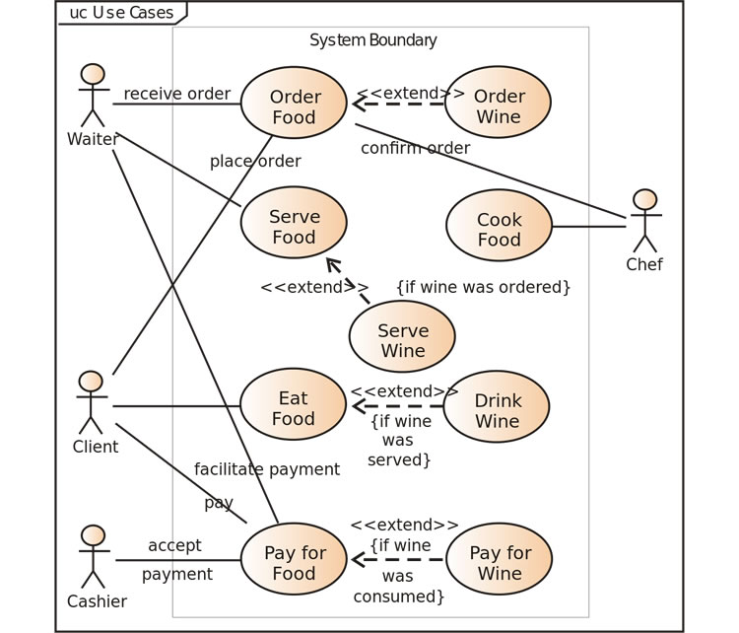
Use Case Diagrams

Slide 8
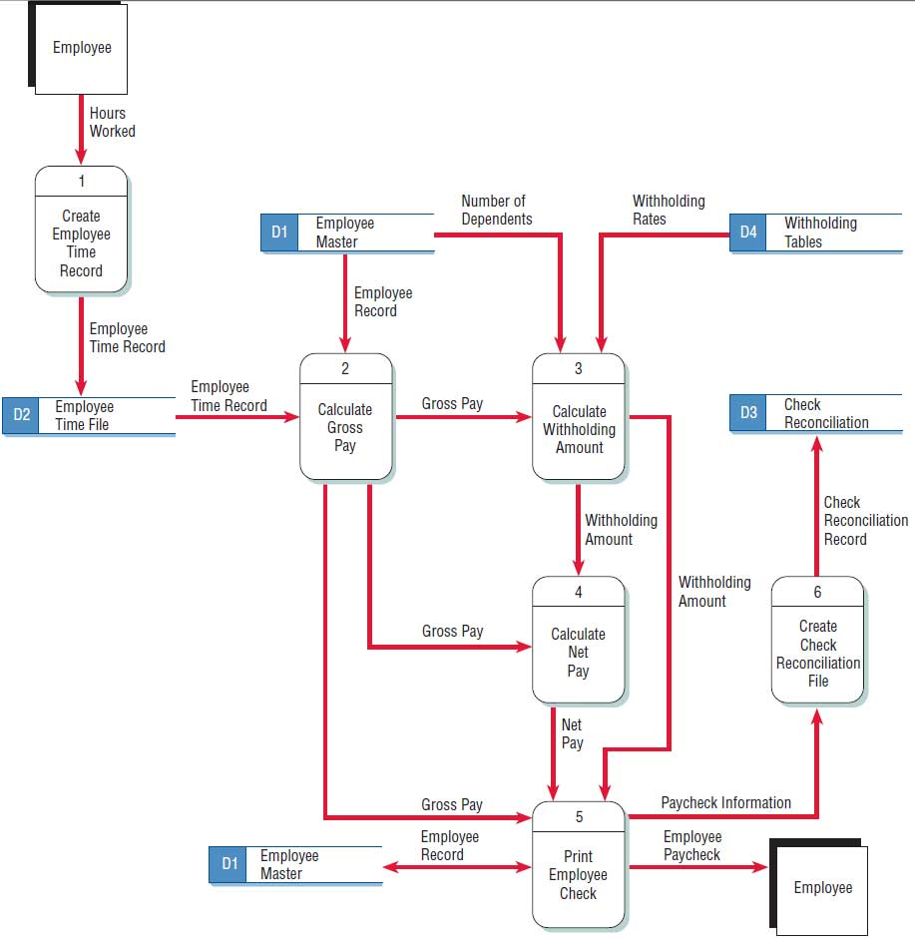
Data Flow Diagram

Slide 9
Systems Design
How the system will help solving the business problem
  System outputs, inputs, and user interfaces
  Hardware, software, databases, telecommunications, personnel, and procedures
  How these components are integrated
Logical systems design
  States what the system will do, with abstract specifications.
Physical systems design
  States how the system will perform its functions, with actual physical specifications.
Scope Creep: Users request for added functionality
Runaway Projects: Projects that far exceed planned budgets and deadlines

Slide 10
Logical Design
Physical design is based on the available technology – so it does change dynamically
Logical design is all about the business and its logic
  Changes only if the business change
Entity-Relationship diagram is a part of the logical design
Relational schema based on the E-R Diagram belongs to the physical design

Slide 11
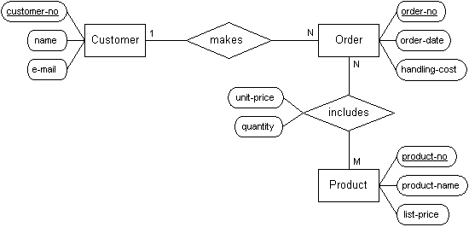
Entity-Relationship Diagram

Slide 12
Physical Design
Has three parts
  User interface design
    How inputs and outputs are made
  Data design
    How the data is arranged.
    Stems from the E-R diagram
  Process design
    How data is flowed in the system, validated and secured
    Making modules

Slide 13
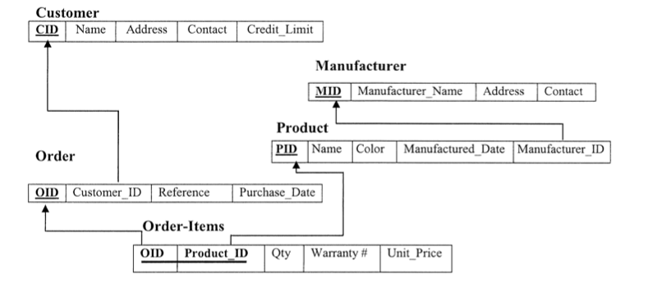
Data Design - Relational Schema

Slide 14
Modules – Pseudo codes

Slide 15
Programming
Two options in implementing systems
  Buy a packaged software
  Develop in-house
What are the roles of programming in each option
What are the benefits of custom software?
What are the drawbacks of custom software?

Slide 16
Programming: Implementing an algorithm

Slide 17
Testing
Checks to see if the computer code will produce the expected and desired results under certain conditions.
Why is testing necessary?
What kind of errors are tested for?
  Syntax errors, logical errors
Good-enough software
  Software released knowing the existence of bugs
  Unavoidable as software complexity increases
  Still meets functional objectives and all show-stopper bugs have been removed

Slide 18
Implementation
Process of converting from the old system to the new system
Four approaches:
  Parallel conversion: Both systems run simultaneously
  Direct conversion: old system is cut off and the new system is turned on at a certain point in time
  Pilot conversion: Introduces the new system in one part of the organization, such as in one plant or in one functional area
  Phased conversion: introduces components of the new system, such as individual modules, in stages.

Slide 19
Operation and Maintenance
After implementation, operation continues until the system no longer meets its objectives
  Audits are performed to evaluate its costs and benefits
Maintenance is required throughout the operations
  Debugging
  Updates
  New functionality

Slide 20
Example
Organize the suppliers of a manufacturing organization
What are the requirements?
How is the database designed?
What are the interfaces?
How does the system work?

Slide 21
Alternative Methods for Systems Development
Prototyping
  Used when the problem is not clear/complex
  Identifies a set of requirements and build the first prototype
  Iterative development
  Advantages
    Speeds up development
    Clarification/elicitation of requirement
  Disadvantages
    Excessive iterations
    Time consuming

Slide 22
Alternative Methods for Systems Development
Joint Application Design
  Group-based method for collecting user requirements and creating system designs
  Used in analysis and design phases
  All users take part in discussions for requirement elicitation at regular group meetings
  Analysts talk to and observe all individual users to elicit their requirements
  Has advantages and disadvantages

Slide 23
Alternative Methods for Systems Development
Rapid Application Development
  Rapidly creating applications using JAD, prototyping and integrated CASE tools
  A typical RAD package includes
    Graphical User Interface Environment
    Code generator
    Re-usable components
      Object oriented development
      Common and standard objects
    Programming language

Slide 24
Systems Development Outside IS Department
End User Development
  Current IT users are not fully dependent on IS staff
  Users do lots of ad-hoc programming while IS staff having control over hardware, software etc.
External acquisition of software
  Make-or-buy decision involved
  Cost of off-the-shelf software could be lower
  Quality could be higher
  However, has disadvantages as well

