Slide 1
Information Technology Planning

Slide 2
What is IT Planning
Organized planning of IT infrastructure and applications portfolios done at various levels of the organization
Important for both planners and end-users
Why important for end-users?
They often plan IT in their respective units
Participate in corporate IT planning
Strategic Thinking and Planning was considered as the number one concern for CIOs (cio.com, 2003)

Slide 3
Brief History of IT planning
Early years of IT (1960s):
Developing new applications and revising existing systems
Operational planning
When organizations were sophisticated in using IT
Managerial planning; Resource allocation control
When IT becomes a driver of competitive advantage
How IT creates business value

Slide 4
How it typically happens
Annual planning cycles established
To identify potentially beneficial IT services
To perform cost-benefit analyses
To subject the list of potential projects to resource-allocation analysis
Entire process is conducted by an IT steering committee
Reviews the list of potential projects
Approves the ones considered as beneficial
Assigns relative priorities
Map the approved projects to a development schedule
The basis for IT resource allocation

Slide 5
How it typically happens
Some extends the process by;
Developing a long-range IT plan (i.e. strategic IT plan)
One that sets the overall direction for infrastructure and resource requirements
Medium-term IT plan
Identifies the applications portfolio, the list of major, selected IS projects
Consistent with the long-term plan
Tactical plan
Budgets and schedules for the current year projects and activities
Pace of changing technology may require changes that were not anticipated in other plans

Slide 6
IT Planning Approaches
Business-led approach
IT investment plan is defined based on the business strategy
Method driven approach
IS needs are identified with the use of techniques and tools (often used or prescribed by consultants)
Technological approach
Analytical modeling (e.g. computer-aided software engineering, CASE) and other tools are used to execute the IT plans
Administrative approach
IT plan is established by the steering committee or management to implement an approved IS initiative
Organizational approach
IT investment plan is derived from a business consensus view of all stakeholders in the organization (management and end-users) of how IT/IS fits organization’s overall business objectives

Slide 7
Four-stage Model of IT Planning
Strategic IT Planning
Establishes the relationship between the overall organizational plan and the IT plan
Information Requirement Analysis
Identifies broad, organizational information requirements to establish a strategic information architecture that can be used to direct specific application development
Resource Allocation
Allocates both IT application development resources and operational resources
Project Planning
Develops a plan that outlines schedules and resource requirements for specific information systems project

Slide 8
Scenario Planning
A methodology in which planners first create several scenarios, then a team compiles as many as possible future events that may influence the outcome of each scenario.
Used when the planning situations involve lots of uncertainty
Reasons for scenario planning
To ensure that you are not focusing on catastrophe to the exclusion of opportunity
To help you allocate resources more prudently
To preserve your options
To ensure that you are still not fighting the last war
To give you the opportunity to rehearse testing and training of people to go through the process

Slide 9
Issues in IT Planning
Interoperability of information systems
Whether different information systems in an organization could “talk” to each other
Complexity of the planning process of inter-organization systems
Could form collaborative planning teams
Ensure collaboration between planners and end-users
Reducing the planning horizon to two to three years is recommended

Slide 10
Business Process Redesign
Pressure comes mainly from 3Cs
Customers, Competition and Change
Customers: know what they want
Competition: generally increasing with respect to price, quality, etc.
Change: Continues to occur as markets, products, services, technology etc. keep changing
Business Process Redesign is a response of an organization to environmental pressures

Slide 11
What is a business process?
A collection of activities that may take one or more inputs and produce an output
Drivers of business process redesign
Fitting commercial software
Process changed to be compatible
Streamlining the supply chain
Needs to change segments of the supply chain to streamline operations and to better collaborate with partners
Participate in e-marketplaces
Needs to connect to them as well as to the organization’s backend processes

Slide 12
Drivers of BPR Contd…
Improving customer service
To properly introduce CRM
Conducting e-procurement
E-procurement requires a complete redesign of the purchase process
Enabling direct online marketing
Direct marketing via Internet requires redesign of order taking and order fulfillment
Reduce cost and improve productivity
Many are continuous small improvements while some are radical changes
Ex. Industrial engineering methods
Automating old processes
Automating existing business processes is not effective

Slide 13
Cycle Time Reduction
Time it takes to complete one cycle of the process
Start to the end
Ex. Success of FedEx is attributable to its ability to reduce the delivery time of packages
Ex. Reducing time to market
Why is cycle time reduction important?
Time is money
Face the competition
Ex. Pharmaceuticle industry

Slide 14
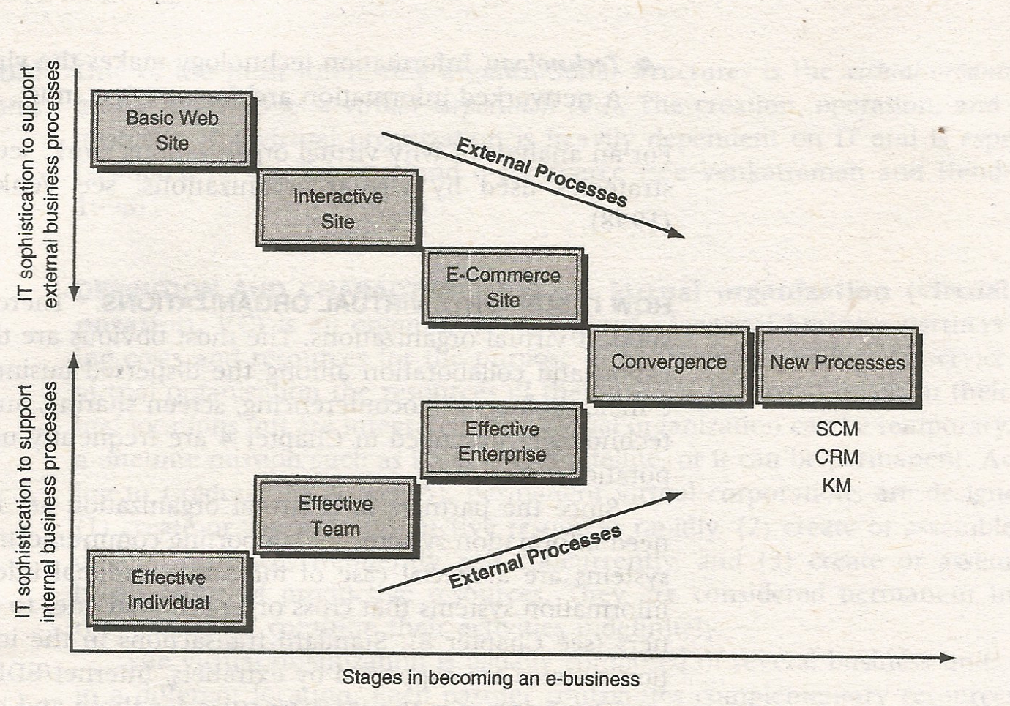
Organization Transformation
An organization with a new face
Business processes, structure, strategy and procedures are completely changed

Slide 15
Change Management
Components of organizational system are interrelated
Business processes, organizational structure and operating procedures
Major changes in business processes and/or technology move organizations out of equilibrium
Creates changes in structure, strategy, people and their roles
When the magnitude of the change is high, resistence comes from employees
Introducing changes to organizations is a critical management task
Driven by a certain set of guidelines

