Slide 1
Information Technology Strategy

Slide 2
Overview

Slide 3
What is a strategy?
Defined as:
A collection of statements that express or propose a means through which an organization can fulfill its primary purpose or mission

Slide 4
Importance of Strategy
Why is strategy important to an organization?
  Set organizational direction
  Competitive advantage
  Sustainability
Different types of strategies
  Functional strategies
    Addresses functional unit’s broad goals and objectives
  Stand-alone strategies
    Addresses individual, one time goals and objectives
  Business strategies
    Direct firm’s functions towards business objectives

Slide 5
Strategies and Plans
Are strategies and plans same?
  Looks same but not so
Plan:
  A detailed description of how an organization can accomplish its primary purpose or mission
  Strategy provides the basis for plans
  Strategy spells out optimal actions required to achieve general objectives but does not specify on how to carry out these actions

Slide 6
Goals and Objectives
Goals without objectives can never be accomplished
Objectives without goals will not take you anywhere
Long-term Vs. Short/mid-term
Intangible Vs. Tangible
Less structured Vs. Concrete

Slide 7
Vision
What company wants to accomplish
  "Our vision is to be earth's most customer centric company; to build a place where people can come to find and discover anything they might want to buy online." - Amazon.com
  Could be short, mid-sized or even longer

Slide 8
Mission
a statement of the purpose of a company, organization or person; its reason for existing; a written declaration of an organization's core purpose and focus that normally remains unchanged over time
Usually
  serve as filters to separate what is important from what is not
  clearly state which markets will be served and how
  communicate a sense of intended direction to the entire organization

Slide 9
Mission Statement - Example
FedEx will produce superior financial returns for shareowners by providing high value-added supply chain, transportation, business and related information services through focused operating companies. Customer requirements will be met in the highest quality manner appropriate to each market segment served. FedEx will strive to develop mutually rewarding relationships with its employees, partners and suppliers. Safety will be the first consideration in all operations. Corporate activities will be conducted to the highest ethical and professional standards.
– Fedex
We are a global family with a proud heritage passionately committed to providing personal mobility for people around the world.
– Ford Motor Corporation

Slide 10
What is the Role of IT Strategy?
Support the organizational strategy
  Guided by the mission statement
  Align IT department’s objectives accordingly
    Measurable/Quantifiable
Look at the given mission statements and think How IT could support

Slide 11
Elements of an IT Strategy Statement
Major elements
  Mission Statement
  Environmental Assessment
  Statement of Objectives
  Expression of Strategy
  Maintenance Process
  Performance Assessment
Also could be categorized as;
  Demand Side, Control Side and Supply Side
  -Dave Aron, Gartner

Slide 12
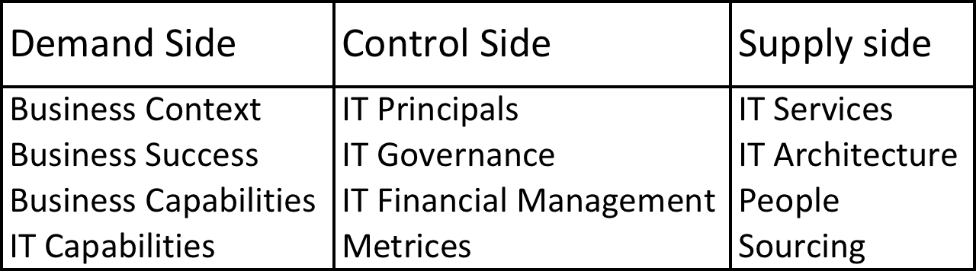
Elements of an IT Strategy

Slide 13
Business and the Environment
Understanding the firm’s business
  Business Context
    Customers and their needs
  What are the firm’s strategies to support its mission
    How will we win?
  What are the business’s capabilities
  IT Markets within the firm
    What services would be required
  IT department’s capabilities and resources

Slide 14
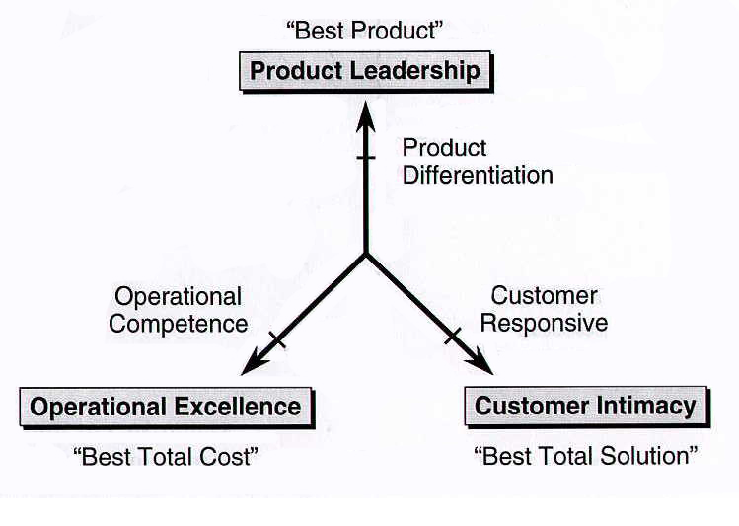
Value Disciplines
http://www.antoniothonis.com/wp-content/uploads/2010/01/valuedisciplines.PNG

Slide 15
Strategies for Competitive Advantage
Cost Leadership Strategy
Differentiation Strategy
Niche Strategy
Growth Strategy – (More market share)
Alliance Strategy
Innovation Strategy – (Keep innovating)
Operational Effectiveness Strategy
Customer-orientation strategy
Time Strategy – (First mover, JIT, cycle time)
Entry-barriers Strategy – (patents, exceptional technologies)
Lock in customer or supplier strategy – (ex. Frequent flyer)
Increase switching costs strategy – (Ex. Inter-organizational systems that increase dependencies)

Slide 16
Business and the Environment
Understanding the firm’s environment
  Threats and opportunities
  What are the trends developing outside
    Knowledge workers
    Work styles
    Connectivity
    Data growth
    Going Green and sustainability
    New computing platforms
  What your competitors are doing?

Slide 17
Control Side of Strategy
IT Principals
  A set of high level principals that guide our actions
IT Governance
  Who makes decisions at what levels using which tools and how they are communicated
  Needs to be designed by the types of decisions
IT Financial Management
  How is IT funded
    Who pay the bills
    Chargeback mechanism
    Why are chargebacks necessary?
      Cost justification, visibility to HoDs, managing unexpected requests
Matrices
  What matrices are used to measure IT success
    Different statistics on the deployment of IT
  How are they mapped with business objectives

Slide 18
Supply Side of Strategy
IT services
  What's the current service catelog? What does it need to be?
IT architecture
  Infrastructure, applications, information and business processes
  What is it now and what does it need to be
People
  Skill inventory and how it is arranged, again now and future
Sourcing
  How sourcing is done

Slide 19
Effective IT Strategy
Comprehensive
  Covers all aspects
Short!
  Around 15 pages
Avoid focusing more on infrastructure
  Make the document unnecessarily lengthy
Avoid WORN
  Write Once Read Never

Slide 20
Strategic Information Systems
Strategic Information Systems (SISs) are the systems that support or shape a business unit’s competitive strategy
What is the difference between “strategic information systems” and “strategic-level information systems”?

Slide 21
Seven Eleven Case
Kei Nagayama and Peter Weill
Read and discuss the case provided pertained to the facts discussed in the lecture

Slide 22
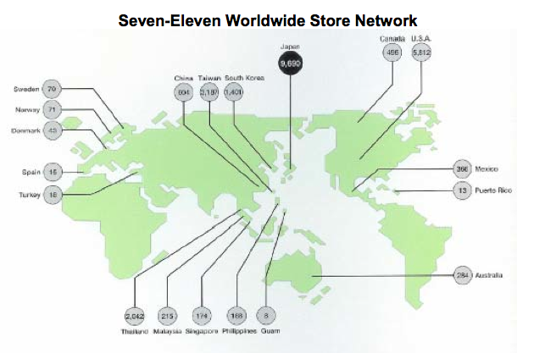
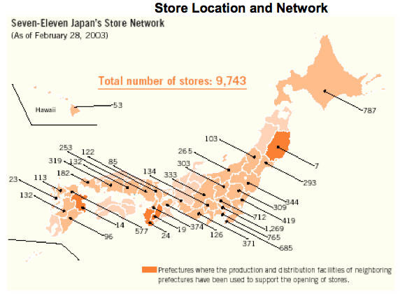
The Seven-Eleven Case

Slide 23
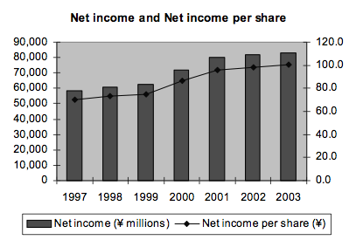
The Seven-Eleven Case

Slide 24
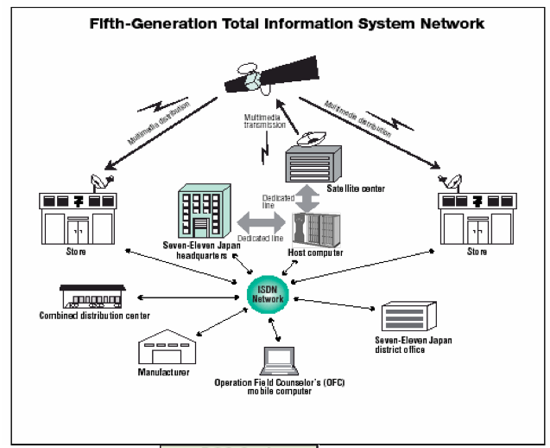
The Seven-Eleven Case

Slide 25
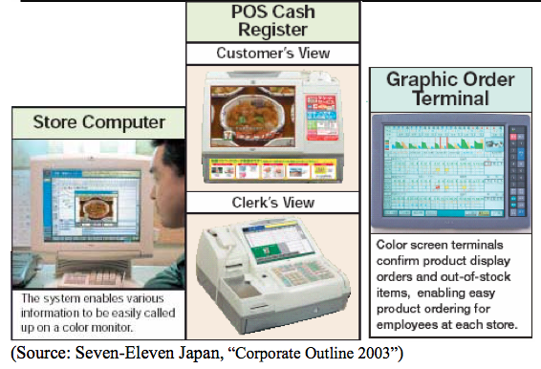
The Seven-Eleven Case

Slide 26
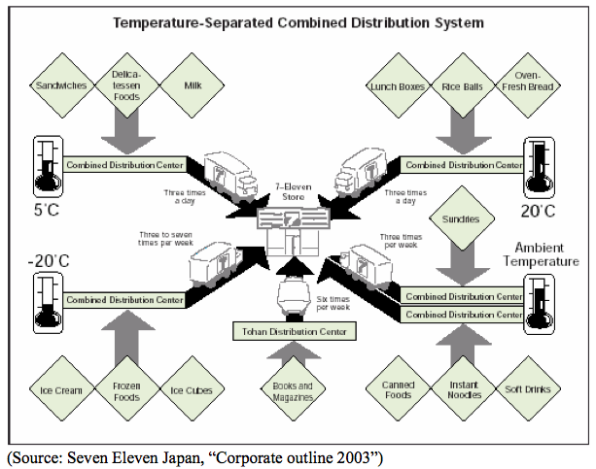
The Seven-Eleven Case

Slide 27
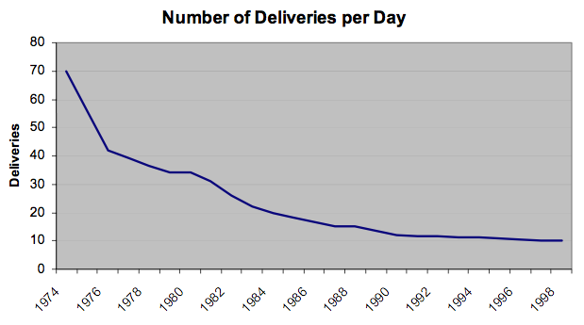
The Seven-Eleven Case

