Slide 1


Slide 2


After studying this lesson successfully, you should be able to
Define what PE
Understand the purposes of PE
Know the overview of the process of PE
Differentiate objective criteria and subjective criteria
Understand PE standards
Describe some commonly used methods of PE
Discuss evaluator biases in PE

Slide 3


1.PE is a process by which organizations evaluate employee job performance.
Werther and Davis
2.PE is the personnel activity by means of which the enterprise determines the extent to which the employee is performing the job effectively
Glueck F.William

Slide 4
PE is defined as the systematic process of identifying, measuring, influencing, and developing job performance of the employees in the organization in relation to the set of norms and standards for a particular period of time in order to achieve various purposes
H.H.D.N.P. Opatha

Slide 5
Management Purposes
  Adminstrative purposes
  Development purposes
Informational Purposes

Slide 6
Administrative purposes | Development Purposes
➢Human power planning | ➢Training
➢Reward Management | ➢Success of training programms
➢Management of promotions | ➢Proper direction
➢Administration of transfers | ➢Better productivity
➢Discipline administration
➢Selection
➢Hiring
➢Management of labor-
management relationship

Slide 7
Contribution of PE to HRM functions
Human Power Planning
Selections
Hiring
Training
Performance Evaluation
promotions
Reward Management
Transfers
Discipline Administration

Slide 8














Slide 9
Objectives are favorable targets to be achieved in future . The organization being concerned should establish targets expected to be achieved through the act of evaluating employee’s job performance.
Always objectives should be clear, understandable and attainable. Some examples of PE objectives are
To ascertain the current level of job performance of each employee
To ascertain strengths and weaknesses of employees
To identify training needs of each employee so as to improve each
employee’s job performance

Slide 10


Solutions for some issues by means of formulating well- defined policies have to be decided. Policies are guidelines to thinking and action and purpose of a policy is to provide direction. Any organization attempting to do PE successfully should formulate clear and appropriate policies in respect of various issues involved in PE. Important issues for which policies should be formulated are:

Slide 11
There are various categories and types of employees working in an organization. Alternative employees on whom PE can be done are given below:
Permanent employees only
Permanent and temporary employees only
All employees ( including casual employees)
Managerial employees only
Non- managerial employees only
A selected group of employees only
A policy decision has to be taken regarding which employees to be evaluated.

Slide 12
There is no specific schedule for evaluating all types of employees. Regarding when to evaluate there are several approaches.
Fixed time approach
This approach alternatively called unitary time approach, or fixed day approach. In this approach employee’s performance are evaluated within a certain period of time that may be one day or two days or several days or one week or several weeks depending on the number of the employees and the workload of the evaluator.

Slide 13
Disadvantages
Advantages
It requires the evaluator to spend a lot of time in filling forms and conducting feedback interviews
It might lead the evaluator to want to “ finish it” quickly resulting in occurrence of incomplete and inaccurate evacuations
Administration of the evaluation is relatively more convenient
The evaluation is done within a time when the evaluator is generally freed from the matters
Comparison of the evaluations of different employees is relatively easier, since all employees are evaluated at a certain time

Slide 14
Arbitrary dates approach
In this approach( alternatively called multiple time approach), evaluating job performance of all employees under the evaluator is done at different dates. Generally an employee’s performance is evaluated on the date the employee was hired( anniversary date)

Slide 15
Disadvantages
Advantages
It does not require spending a lot of time in evaluating
It might not lead to the evaluator to want to “ finish it” quickly
Comparison of PE among employees becomes more difficult
PE may be unfair and inaccurate owing to organizational and environmental causes
Evaluation depend on the evaluators mood
When the evaluator has to do PE while performing other matters and this lead to occur lesser concentration on PE

Slide 16
Job Cycle approach
Job cycle is the required time to complete every duty in the job for once. Job cycle may include a full completion of a major task.
Eg: Teaching a certain subject for one class and
evaluating performance.

Slide 17

➢Annually
➢Semi-annually
➢Quarterly
➢Monthly
➢Biweekly
➢Weekly
➢Daily
➢Any other time

Slide 18
Immediate superior
Immediate superior and immediate superior’s superior
Several supervisors
Committee
Outsider
Subordinates
Customers/ Clients
Self
Combination

Slide 19


The factors on which an employee is evaluated are called
the criteria.
PE criteria can be developed with respect to the following:
Traits
Traits refer to particular qualities or characteristics the
employee possesses
Eg: Job knowledge, trust, cooperation, honesty, initiative

Slide 20
➢Behaviours
Behaviours are the ways the employee acts in relation to the job. Basically behaviours involve particular activities carried out by the employee in performing the job.
Eg: punctually, attendance, planning works, organizing work
Results
Results are outcomes produced by the employee. Eg: number of units produced, number of units sold

Slide 21
PE Criteria
Objective criteria | Subjective criteria
➢Objective criteria are factors of evaluation that quantifiable distinctly ➢Easier to measure and verify ➢Verifiable by others | ➢Subjective criteria are factors of evaluation that are not quantifiable distinctly ➢Difficult to measure and verify ➢Not verifiable by others ➢Based on human judgment

Slide 22
Job | Objective criteria | Subjective criteria
University Lecturer | Number of lectures done | Sensitivity to student’s needs and subject knowledge _{u}▪ Cooperation and interpersonal relations ▪Pity towards patients and commitment to work ▪Technical ability and originality
 | during the academic year
 | and number of topics
 | covered
Salesman | Number of units sold
 | and number of new
 | customers created
Medical Expert | ▪Number of patients
 | cured and number of
 | hours of consultation
Project engineer | ▪Total cost of completing a
 | project and number of
 | projects completed
Examples o
f objective and s
bjective criteria

Slide 23


PE standards in order to assess how well and how far employees are performing their jobs. PE standards indicate rating scales. these scales should be developed systematically and fairly .
Eg: Standards for assessing job performance of sales staff. this scale may be determined in relation to the criterion of number of units sold
Excellent Good Average Poor
Very poor
units 81-100
units 61-80
units 41-60
units 21-40
units 01-20

Slide 24
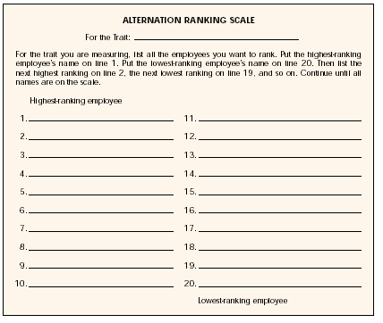
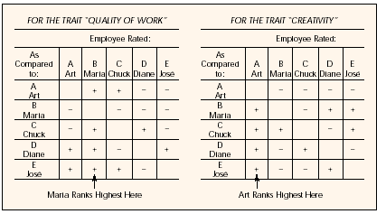
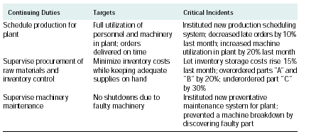
PE Methods
It refers to techniques that can be used in evaluating job performance of employees.
➢Graphic Rating scales
➢Multiple choice Method
➢Rank Order Method
➢Essay Method
➢MBO Method
➢360° Method

Slide 25


This method is the most widely used PE method and is also one of the oldest method. Under this method, the evaluator is supposed to provide a subjective evaluation of an employee’s performance along a scale from very poor to excellent or from very low to very high. Scales are established for a number of specific traits or qualities such as job knowledge and loyalty.

Slide 26
Advantages and disadvantages on Graphic rating scales
Advantages | Disadvantages
➢Easier to understand ➢Easier to administer ➢Applicable to large number of employees ➢Evaluators need little training | ➢Emphasizes on traits only ➢The rating is generally subjective ➢More susceptibility to evaluator errors

Slide 27
Nelu Company Performance Evaluation Form
Evaluation period………………………………..to………………………………………………………….................. Name …………………………………………………………………………………………………………………………………… Job……………………………………………………………Section/Department……………………………………………
Criteria | Excellent (05) | Good (04) | Satisfactory (03) | Poor (02) | Very Poor (01)
1. Job Knowledge (Theoretical)
2. Job Knowledge (Practical)
3. Initiative
4. Creativity
5. Loyalty
6. Commitment
7. Attendance
8. Discipline
9. Respect
10. Trust
Overall Score
Average Score
Comments

Slide 28
This method has four or five statements under each performance evaluation criterion and the evaluator is supposed to select the statement which best applies to the employee being evaluated.
All the advantages and disadvantages of the graphic rating scales are relevant to this method and in addition to the disadvantage that the evaluation form of this method becomes longer as there are four or five statements relating to the each criterion.

Slide 29
Statements of the criterion of Attendance
Attendance: Coming to work regularly
Marks
1. Perfect attendance | 10
2. Not more than one day of no-pay leave during the evaluation | 08
3.Not more than two day of no-pay leave during the evaluation | 06
4.Not more than three day of no-pay leave during the evaluation | 04
5. Four or more days of no-pay leave | 02

Slide 30
In rank order method the evaluator is required to rate employees from the best to the worst on some given criteria.
Advantages | Disadvantages
➢Easy to compare employees ➢Valuable in personnel selection and in generating order of merit rankings for salary administration | Group of employees being evaluated is larger in number ➢Difference between first person and second person may be greater or smaller than the difference between fourth person and fifth person

Slide 31
Ranking
Employees | Attendance | Commitment | Quality of work | Quantity of work | Total Number | Rank Order
A | 1 | 1 | 1 | 2 | 5 | 1
B | 2 | 2 | 3 | 1 | 8 | 2
C | 3 | 5 | 2 | 3 | 13 | 3
D | 4 | 3 | 5 | 4 | 16 | 4
E | 5 | 4 | 4 | 5 | 18 | 5

Slide 32
Under this method the employees are evaluated in pairs taking an employee at a time and comparing him/her against every other. Overall performance of employee or performance on one specific criterion of the employees can be considered for the evaluation.
Advantages | Disadvantages
➢Highly accurate comparison ➢Results are more precise | ➢Cannot be used easily in situation with a large number ➢Time consuming

Slide 33
Compare employees
Employee | 2 | 3 | 4 | 5 | 6 | 7 | Points | Rank
1. Nilanthi
2. Lakshmi
3. Jeevani
4.Padma
5. Nelum
6. Menike
7. Manel

Slide 34
Compare employees
Employee | 2 | 3 | 4 | 5 | 6 | 7 | Points | Rank
1. Nilanthi | 1 | 1 | 1 | 1 | 1 | 1 | 06 | 1
2. Lakshmi |  | 3 | 2 | 2 | 2 | 2 | 04 | 3
3. Jeevani |  |  | 3 | 3 | 3 | 3 | 05 | 2
4.Padma |  |  |  | 5 | 6 | 7 | 0 | 7
5. Nelum |  |  |  |  | 6 | 7 | 1 | 6
6. Menike |  |  |  |  |  | 7 | 2 | 5
7. Manel |  |  |  |  |  |  | 3 | 4

Slide 35
In this method the evaluator prepares and maintains a logbook for employees under his/ her span of control with the intention of recording important incidents of negative and positive behaviors of each employee as they occur over the period of PE.
Advantages | Disadvantages
➢More practical and more accurate ➢Helps the evaluator refresh his/ her memory over the evaluation period ➢Helps fair assessment ➢More useful in identifying the training/development aspect of the employee ➢Easy to give and take feedback | Extra work required of the evaluator to note down these incidents ➢Time consuming ➢Consequently the evaluator may be reluctant to use this method ➢Employee may tend to steal or misplace the logbook

Slide 36
Critical incidents of a Restaurant Waiter
Positive
Put a fire out immediately before spreading (24/08/2015)
Make arrangements to return a valuable parcel to a regular customer who
had forgotten it ( 01/10/2015)
Negative
A seemingly important customer left owing to delay( 27/ 07/2015)
Broke two glasses of water because of negligence ( 21/08/2015)

Slide 37


This method requires the evaluator to write an essay ( a paragraph/ paragraphs) in respect of the subordinate’s strengths, weaknesses and so on.
Advantages | Disadvantages
➢Simple and very easy ➢Different essays may focus on different facets of person’s performance | ➢Difficult to compare ➢More subjective ➢Additionally some form of PE methods will have to be used ➢Unequal writing skills in Evaluators

Slide 38


This is a method of PE generally used by large organizations. By giving question papers on pertinent fields of jobs and then assessing the answers received for those, relevant knowledge, skills, and intelligence etc of each employee are determined.
Advantages | Disadvantages
➢Large number of employees can be evaluated ➢Probability of occurring individual partialities of evaluators is lower | ➢Employee’s actual job result is not done ➢Does not encourage the employee’s commitment to the job practically

Slide 39
)
MBO is a method that deals with determining objectives to be accomplished by the employee within a certain period of time and assessing the degree of success in accomplishing those objectives. MBO focuses on results and does not focus on mainly on traits and behaviours of the employee. Hence this is a result oriented PE method

Slide 40
Advantages | Disadvantages
➢Objectivity in evaluation is enhanced and subjectivity in evaluation is minimized. This will result in increasing the degree of accuracy of PE ➢Setting clear and specific goals has a greater positive effect on performance improvement than does the “ do the best you can” approach ➢Subordinate’s motivation and commitment will increasing owing to subordinate participation ➢Creativity of subordinate is permitted and may be enhanced through subordinate participation ➢It improves vertical communication between the superior and the subordinate ➢It will facilitate controlling process ➢Job ambiguity is greatly decreased | ➢Increase the amount of paper work required of managers to report progress towards objectives ➢Focuses on results of the employee only ignoring traits and behaviours ➢May be used as a “ whip” by management to get the employees to do what managements want him/her to do, not what the employee feels is best

Slide 41
MBO Process
1. Study of job
2. Agreement of duties
3. Establishment of objectives
7. Feedback
4. PE criteria and standards
5. On-going discussion
6. Evaluation

Slide 42




PE form is a specific form used by an evaluator for the purpose of PE an employee. This form indicates the method or methods, criteria and standards being used.
PE procedure is the method used for handling the PE form basically. A procedure outlines specific steps to follow in particular recurring situations.

Slide 43






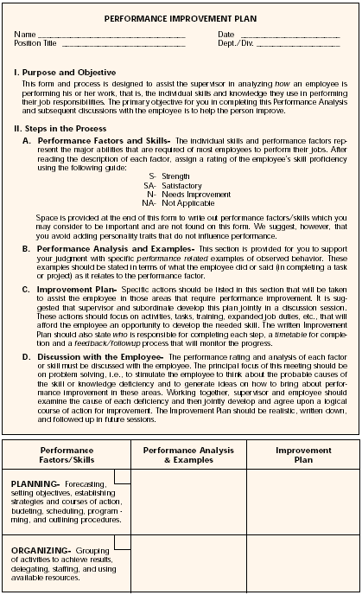
Approaches in Designing PE form and
Procedure
This approach involves designing a single form and procedure common to PE of all employees working in the organiz
ation.

Slide 44


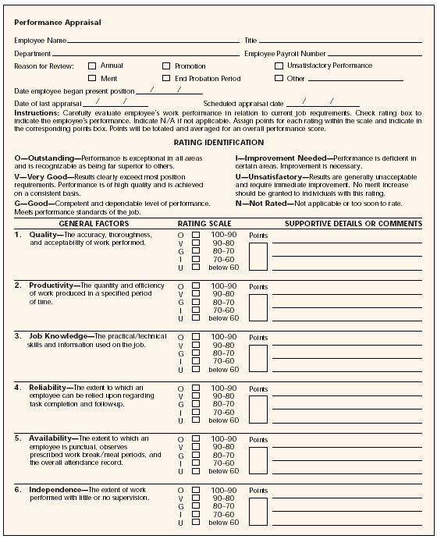
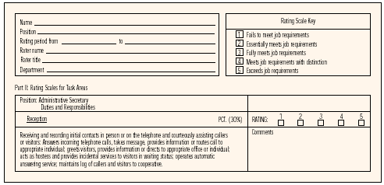
This approach focuses on designing separate forms and procedures for different types of employees
Eg:
Managerial employees
Managerial employee evaluation
Office employees
Factory employees
Sales employees
Field employees
Sales employee evaluation

Slide 45

Forms and procedure should be designed
separately
Make the form as brief as possible
Present them in a language, which can be understood well by evaluators
Develop the procedure lucidly. Indicate each step
separately and lucidly
Introduce a suitable weighting according to the significance of each evaluation criterion
Eg: Traits- Behaviours- Results-
20%
30%
50%
100%

Slide 46
6. Design the form so as to have several sections/ parts
It may be more appropriate if the content of the form includes the followings:
Part I- identification information( such as name of the evaluee, job title, department and unit, date etc.)
Part II- Evaluation on results, behaviours and traits Part III- Comments of evaluator( for notes on present
deficiencies, strengths/ potentials and actions to be taken to fulfill potentials shown or correct deficiencies and other remarks)
Part IV- Comments of evaluee about evaluation given
Part V- Comments of reviewing official(s)

Slide 47

Training of evaluators refers to a systematic endeavour to improve efficiency and effectiveness of evaluators in PE.
Evaluator Training Methods
Lectures
Case Study method
Role Playing
Programmed Instruction
Special Course of PE

Slide 48
This is the step where the evaluation of job performance of an employee is actually done by evaluator.

Slide 49


Once evaluation of performance of an employee is done results of the evaluation should be discussed with the employee( evaluee) by the evaluator/s. Generally this discussion is done through an interview what is called PE interview/ Performance review interview
Tell – and – sell
Tell- and Listen
Problem solving
Mixed

Slide 50
Tell- and- Sell
Alternatively this is called directive interview. Here, the evaluator tells the degree to which the evaluee has performed the job during
the period of PE and sells him/her to steps to be taken for improvement.

Slide 51
Tell- and Listen
This type provides the evaluee with a chance to explain reasons, excuses and defensive feelings regarding performance rating given by the evaluator.

Slide 52
Problem Solving
This involves a participative problem solving in which active and open dialogue is established between the evaluator and the evaluee. Special problems being faced by the evaluee relating to job performance are identified and attempt is made mutually by the evaluator and the evaluee to find out solutions for those problems

Slide 53
Mixed
There are two alternatives under mixed type.
First alternative is a combination of the tell- and- sell the problem solving interviews.
Second alternative is a combination of the tell-
and- listen and problem solving types.

Slide 54
Decisions should be taken by the respective authorities for various purposes for which PE is done
Eg: Determine salary increment
Completed PE forms will become reference documents, which will be used in future for various purposes
Eg: promotions
These forms will have to be fill in a proper way and should be kept on files for several years.
Computers can also be used in this regard

Slide 55
This is the final step of the model of PE process.
Review - refers to a systematic attempt to find out whether the PE program is being carried out in the manner it was planned and to determine whether improvements can be made for more successful program.
Renewal – refers to reprogramming of the PE program so as to incorporate all the improvements determined through review.

Slide 56
Halo effect
Central Tendency
Harshness and Leniency
Recency effect
Personal Prejudice
Unawareness

