Slide 1
Pre-seen in a nut shell – June 2016
By Trevin Hannibal (CIMA Passed Finalist, Pg.Dip.BA, MBA (Cardiff Metropolitan University)
Case of Ruhunu Putra Energy Group of Companies

Slide 2
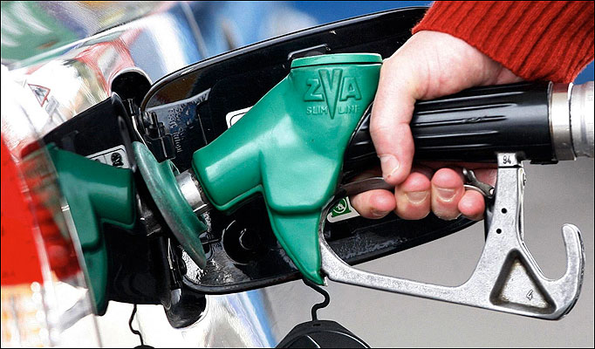
Company profile
Name :Ruhunu Putra Energy PLC (RPE)
Chairman/CEO : Mr. Sanath Jayamuni
RPE operates in the following sectors:
Auto air conditioning
Energy
Supermarkets
Tea
Manufacturing
Leisure

Slide 3
Background
Initially started with Ruhunu Putra Auto Air Conditioning (Pvt)
Has branches in Galle, Matara, Kurunegala, Kaluthara and Kandy
Ruhunu Putra Energy (Pvt) was established in order to enter in to the auto gas industry:
Converting vehicles into gas
Importing LP Gas
Ruhunu Putra Energy (RPE) was listed on the Colombo Stock Exchange (CSE) in 2009

Slide 4
Vision of RPE
To be the most preferred and trusted Sri Lankan multinational that touches the day-to-day lives of people in Sri Lanka and beyond, through a diverse group of companies.

Slide 5
Mission of RPE
Serve the rural community, customers and all other stakeholders with love, through our core business – gas and petroleum, and build a diversified business conglomerate, based on the four main principles of:
Reducing cost of living
Enhancing youth skills
Bridging regional disparity
Enhancing local and global markets

Slide 6
Structure of the Group
Comprises of:
Ruhunu Putra Energy PLC (RPE)
Ruhunu Putra Supermarkets (Pvt) Limited (RPS)
Ruhunu Putra Tea Export (Pvt) Limited (RPT)
Ruhunu Putra Leisure (Pvt) Limited (RPL)

Slide 7
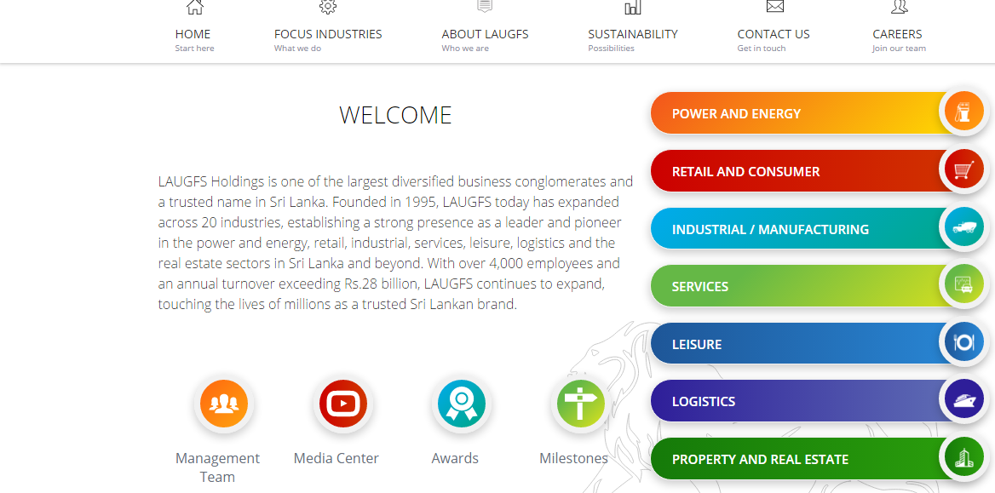
Similar to LAUGFS Holdings*

Slide 8
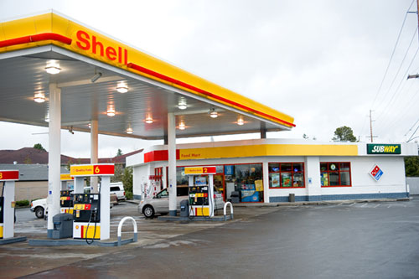
Ruhunu Putra Energy PLC (RPE)
Incorporated in 2002 & Listed on the CSE in 2009
Predominantly in the petroleum and gas retailing industry, pioneering the state of the art filling station concept in Sri Lanka.

Slide 9
Customer facilities at RPE
Nitrogen air, digital air, lubricants, domestic gas cylinders
Car care items under a 24 hour service
The 2141 Dialog SMS facility and direct dialing customer suggestion phone facilities are available
Customers could contact the management for their requirements or any significant inquiries.

Slide 10
Staff @ RPE
Currently there are more than 500 employees working at RPE’s head office and filling stations
RPE also provides adequate training, encourages staff development and provides opportunities for growth

Slide 11
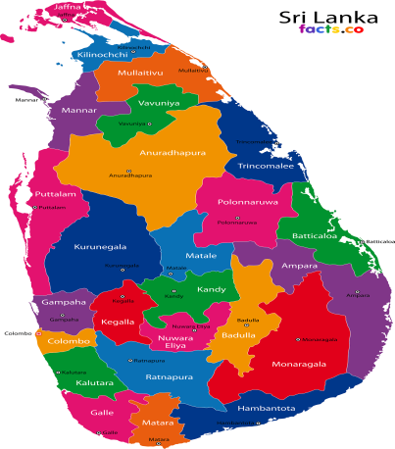
Distribution channel of RPE
3,000 dealers and 20 distributors working across the country.
RPE delivers customised LP gas solutions that serve commercial, industrial and domestic requirements.
Opened up a new filling station at the Hambanthota harbour, which fulfills the fuel needs of the fisheries sector.

Slide 12
Issues @ RPE
Issues in share price
Fluctuating @ Rs. 80 - 85 during the last 6 months, which is lower than the net assets value of the group.
The sharp drop in crude oil price has exerted downward pressure on LP gas and Ruhunu Putra passed on the benefits to customers in 2015.
Even though there are only a few players in the market, the bulk market is severely affected by competition. The company may need more effective strategies to maintain the exiting market dynamics.

Slide 13
Issues @ RPE
Parking lot of the existing office premises was not sufficient and the company entered into a rent agreement for Rs. 25,000 per month.
Further RPE has given their own building in Wattala to Ruhunu Putra Tea Export (Pvt) Limited to be used for blending tea and carrying out the packaging of export orders.

Slide 14
Ruhunu Putra Supermarkets (Pvt) Limited (RPS)
Established in 2006
RPE holds 80% of RPS’s stated capital & 20% by John and Sarath.

Slide 15
Customer facilities
Opening hours of the supermarket outlets till 11 pm
A convenience store was jointly operated with the fuel retail outlets along with a 24 hour pharmacy.
Most diverse and largest product range in terms of Stock Keeping Units (SKUs), housing up to 26,000 per store

Slide 16
Vision of RPS
“our main concern should be our customers. We target not only individual retail customers but also the customers who purchase in bulk. Our plan is to have 40 outlets and over 30,000 regular customers per month”

Slide 17
Issues at RPS
RPS has not reached targets in terms of customer service, profitability, supply chain and working capital management.
25 outlets were opened and less than 12,000 customers are visiting the outlets each month.
RPS has not gone to outstation cities other than the main ones.
Transaction cost per customer is higher than that of our competitors

Slide 18
Remedial actions
RPS needs to rethink their strategy in designing supermarkets as well as in selecting locations.
Hence a new investment to open 15 new outlets outside the Colombo district is taken into consideration.

Slide 19
Possible scenarios*
The current proposal might be requested for a review in order to expand the number of outlets
A project appraisal is likely to be tested
A restructuring of the operations are also possible

Slide 20
Ruhunu Putra Tea Export (Pvt) Limited (RPT)
Ruhunu Putra Tea Export (Pvt) Limited (RPT) was incorporated 2002
In 2010 RPE invested 100% of the capital required for expansion
It now holds 75% of the share capital of RPT.

Slide 21
Issues at RPT
The cost of manufacturing tea bags is now increasing due to the current crisis in tea industry
RPT specialises in low country tea blending and their markets request only those blends
Most of the small tea growers have now stopped plucking tea leaves and there is a shortage of tea leaves for production
For the first time RPT incurred a loss in year 2015/16.

Slide 22
Possible scenarios*
Since RPT’s performance is not lucrative, the company might maintain the existing plantation and use another crop such as rubber/cinnamon etc.
Since it is low country another product can be grown instead of tea which is not an option in up-country due to the climate and temperature.

Slide 23
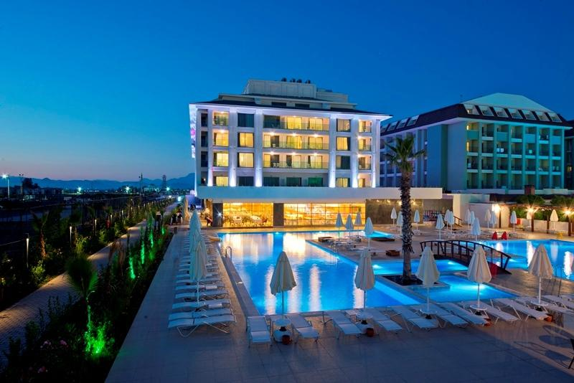
Ruhunu Putra Leisure (Pvt) Limited (RPL)
Established in 2013 with a stated capital of Rs. 853 million
RPE holds 80% of the stated capital & Sanath and his friend saparamadu holds the remaining stake equally
In 2014 RPL launched its first luxury resort, Ruhunu Resort & Spa – Negombo-
consists of 100 luxury rooms
RPE has invested a further Rs. 617.6 million in the resort.

Slide 24
Future initiatives of RPL
A feasibility study is now being carried out for a massive 250-room resort in Aluthgama.
Once completed, the Aluthgama resort would be the group’s largest development in the tourism sector.

Slide 25
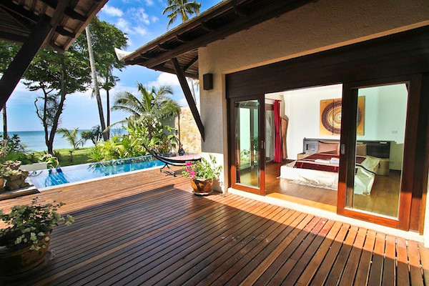
Future initiatives of RPL
Its aim is to be the number one tourist destination in the island with incomparable magnitude and quality.
RPE has given a loan of Rs. 75 million, payable in 5 years at an interest rate of 5% p.a., to fund the new projects in the pipeline

Slide 26
Possible scenarios*
Since the new project requires a funding of Rs.75 million, a financing question is probable which would test your knowledge on
Capital structure
Equity and debt financing etc.
Since RPE is offering this loan, it might be given at a subsidized rate.
Hence APV calculations are probable

Slide 27
Ruhunu Putra Group - future strategies and impacts
The group started a small plastic manufacturing plant close to the in 2009.
Has entered into an agreement with CPC to buy naphtha (feedstock), the main raw material needed to produce plastic.
The company uses plastic injection molding in which it offers products such as
Electronic housings
Containers
Bottle caps
Automotive interiors
Combs
Brand name- Ruhunu Petro

Slide 28
Main concerns of the group
More focus to be given for Ruhunu Putra Auto Air Conditioning (Pvt) Limited
“Current environment is good for new investments in this industry in Sri Lanka and as such we should plan our next investment in this industry” – Sanath
“We should invest in this industry via RPE, and amalgamate both Ruhunu Putra Auto Air Conditioning (Pvt) Limited and Cooling Air (Pvt) Limited”. – Sanath
Cooling Air (Pvt) Limited, one of the leading air condition installers and service providers for apartments in Sri Lanka.

Slide 29
Main concerns of the group
The importance of recruiting an expert to study the existing ERP system of the group.
The group finance director had sent a memo with his concerns suggesting to close down RPT and re-invest in the supermarket sector.

Slide 30
Main concerns of the group
He had also suggested that one of the initial departments in the group that converted vehicles into gas, which is now incurring losses due to declining business in the auto gas industry, should be closed down too.
Monika(head of the group’s strategic business development unit) also suggested that they should look for a viable merger or acquisition relating to the tea industry to experience fast growth.

Slide 31
Possible scenarios*
A business valuation is highly probable in the context of a merger with Cooling Air (Pvt) Limited, if the board of directors would initiate the thought of Mr.Sanath
Monikas suggestion of a viable merger or acquisition relating to the tea industry to experience fast growth is also a plausible scenario to be considered.

Slide 32
Group structure

Slide 33
Notes of the pre-seen
The remaining notes of the pre-seen are on the financial statements of the group
A ratio analysis of the financial statement attached in the pre-seen could be initiated for a on the surface study.
The unseen might comprise of question which needs the financial statements of the pre-seen as a reference
Eg: Income statement forecast/ cash flow forecast etc.
The purpose of the unseen in to provide a better understanding on the industry in which your 50 mark question will be based upon.

