Slide 1
Psychology of learning
Session iv- CA

Slide 2
Remember
Human behavior is determine either by genetic factors or learning factors
mqoa., yeisrsu cdkuh idOl fyda bf.Ksus idOl j,ska kSrakh flfra
What is learning? bf.Ksu hkq l=ulao
How people learn? mqoa.,hska bf.K.kafka flfiao

Slide 3
Usefulness of learning
To understand how to do work
To develop concept and thought
To change attitudes and behavior
To learn or transfer culture
For intelligent and creativity
You cannot learn from formal education classes only. Do you agree Tng jsOsu;a wdldrhg muKla bf.kSu l, fkdyel

Slide 4
Learning and organizational issues
Organizations spent lot of money on training. Can organizations satisfy with the training outcome. Is there adequate changes in employees behavior?
Organizations expect some particular behavior from employees. But there are many issues. Organizations take many actions to change employee behavior as they expected. But what is the result can they happy?
All problems are due to lack of learning? bf.Ksula isoqfkdjqk l, mqyqKqj widra:l fjs

Slide 5
Definition
Education is any long term learning activity aimed at preparing individuals for a variety of roles in society. The focus is primarily on individual and his needs. Secondly on community as a whole
wOHdmkh iudcfha jsjsO N=usld i|yd mqoa.,hska iqodkuslsrsfus os.=ld,sk bf.Ksfus l%shdj,shls

Slide 6
Definition ..development
Is any learning activity which is directed toward future needs rather than present needs, and which is concerned more with career growth than immediate performances.
wkd.; wjYH;d fmrgqlrf.k lrkq ,nk bf.Ksfus l%shdj,shls

Slide 7
Definition..Training
Training is any learning activity, which is directed toward the acquisition of specific knowledge and skill for the purpose or an occupation or task. The focus of training is the job or task.
Is planned process to modify attitudes, knowledge, skill, or behavior through learning experiences to achieve performances in activity or range of activity
oekg lrkq ,nk /lshdj fyda ldraHka jvd fyd|ska lsrsug wjYH oeKqu l=I,;d yd wdl,am jraOkh lsrsfus wruqKska lrkq ,nk bf.Ksfus l%shdj,shls

Slide 8
What is Learning- definition
Learning is relatively permanent change in behavior, which reflects knowledge, understanding, or skill achieved through experience
bf.Ksu hkq w;aoelsus ;=,ska ,nd.;a oeKqu wjfndaOh l=I,;d jsoydmdk yeisrsfus we;sjk ia:djr fjkialush
Learning is an adaptive process because it enhance our ability to change bf.Ksu .e,mSfus l%shdj,shls th wmf.a fjkiajsfus yelshdj mq,q,a lrhs

Slide 9
Definition …Learning
Is the process by which a new capability is attained kj yelshdjka w;am;alr.ekSfus l%shdj,shls

Slide 10
Without proper learning
there is no effective training
or
behavioral change
bf.Ksulska f;dr mqyqKqjla fyda yeisrsfus fjkila ke;

Slide 11
Memory
Experiences
Actions

Slide 12
Learning & Memory
Learning & Memory are central to the study of Psychology
There is relationship between learning and memory
mqyqKqj yd u;lh w;r iusnkaOhla we;

Slide 13
Types of learning
Habituation – the simplest kind of learning, is the phenomenon by which we get used to mqreoq bf.KSula njg fmrf,a
Associated learning – kind of learning in which an association is formed between two events isoaOska folla tlg iusnkaOlsrsfuka ,nk bf.Ksu
classical conditioning learning
operant conditioning learning
Cognitive learning – learning involving mental activity udkisl l%shdj,sh yryd bf.Ksu
Social learning iudch ;=,ska bf.Ksu

Slide 14
Learning theories
Conditioning theories
classical conditioning
operant conditioning
Social learning theory
Cognitive learning theory

Slide 15
Classical conditioning theory
Kind of learning in which a previously neutral stimulus acquire the power to elicit a response after repeated pairing with an unconditioned stimulus that ordinarily elicits a particular response
l,ska wiusnkaaOs; W;af;aclhla idudkH W;af;aclhla iu. ld,hla iusnkaOlsrsfuka miqj idudkH W;af;aclhg ,ndoqka m%;spdrhu Bg ,nd.ekSug Yla;shla ,nd.ekSu

Slide 16
Pavlov’s Experiments on Salivation
S R
Unconditioned Stimulus (US) food powder
Unconditioned Response (UR) salivation
Conditioned Stimulus (CS) beat of a metronome (neutral stimulus)
Conditioned Response (CR) salivation to the sound

Slide 17
Generalization
The tendency to transfer the conditioned response to stimulus that is similar but not identical to the one originally paired with the unconditioned stimulus l,ska iusnkaO l, W;af;aclhu fkdjqk;a Bg iudk W;af;aclhlg ;;ajdfrdamkh l, m%;spdrh ,noSfus keushdj
We learn to generalize idudkHlrkh lsrsug bf.Ksu

Slide 18
Discrimination
Learning to respond differently to two similar (but not identical) stimulus. iudk jqj;a kshus; W;a;f;aclhka follg fjkia wdldrfhka m%;spdr oelajSug bf.Ksu
We learn to discriminate fjkiaj y|qkd.ekSug bf.Ksu

Slide 19
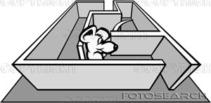
Operant conditioning theory
Type of learning in which the consequences of a behavior determine whether or not the behavior will be repeat. lsishus yeisrsulg ,efnk m%;sM,h tu yeisrsu kej; lrkafkao hkak ;SrKh lrhs
R S

Slide 20
Remember
Some of our behaviors are due to conditioning
wmf.a iuyr yeisrsus ;;ajdfrdamkh l, yeisrsush

Slide 21
Thorndike's law of effect and law of exercise
When a outcome of a particular behavior is desired there is a tendency to repeat the same behavior lsishus yeisrsulg ,efnk M,h ys;lr kus tu yeisrsu kej; kej; lsrsug fm,Usula we;

Slide 22
Skinners principles
Reinforcement Yla;slrkh: event (or consequence) following a behavior which increases the probability that the behavior will occur again. lsishus yeisrsulska miqj isoqjk foa fyda isoaOsh tu yeisrsu kej; isoqjSfus iusNdjs;dj jevslsrsu
Operant: response that an organism makes to bring about an effect.

Slide 23
Types of reinforcement
Positive reinforcement : stimulus which when added to a situation increases the probability of the occurrence of a response. W;af;ackhla tl;=lsrsu lsishus m%;spdrhl M,h isoqjsfus iusNdjs;dj jevslsrsu Okd;aul Yla;slrkhlafjs
Negative reinforcement: stimulus which when removed to a situation increases the probability of the occurrence of a response. W;af;ackhla bj;alsrsu lsishus m%;spdrhl M,h isoqjsfus iusNdjs;dj jevslsrsu iDKd;aul Yla;slrkhlafjs

Slide 24
Yla;slrk rgdj Schedule of reinforcement
The way of reinforcement:
For reinforcement to be effective, it must be prompt. Yla;slrkhla iM,odhsjSug kus th tu wjia:dfjsoSu jsh hq;=h
Pattern of by which reinforcement is administered:
Continuous :pattern of reinforcement by which the organism is reinforced every time that it emits the desired response. wLKav Yla;slrkh
Partial: the desired response is rewarded only part of the time. wraO Yla;slrkh

Slide 25
Schedule of reinforcement
Partial reinforcement wraO Yla;slrkh
interval schedules of reinforcement ld, mrdihla wkqj
fixed ia:djr
variable jsp,Hh
ratio schedules of reinforcement wkqmd;hla mrsos
fixed ia:djr
variable jsp,Hh

Slide 26
wlue;s W;af;acl Aversive stimulus
Stimulus that the subject does not like. mqoa.,hd wlue;s W;af;aclhka
Punishment ovqju: is consequence that decreases the probability that a behavior will recur. lsishu yeisrsula isoqjsfus iusNdjs;dj wvqlrk M,hla

Slide 27
Remember
Some of our behaviors are due to fear or rewards wfma iuyr yeisrus Nsh fyda m%;sodk ksid isoqfjs

Slide 28
Operant conditioning
Based on law of effect (Thorndike) – rewarded behavior is likely to be repeated we.hSula l, yeisrus kej; isoqjSug bv we;
Desired
undesired
Positive
Reinforcement
Punishment
Offering
Negative
Reinforcement
negative
Reinforcement
Withdrawing

Slide 29
Cognitive learning theory
Learning is a complex process bf.Ksu ixlSraK l%shdj,shls
Human beings are not just creatures of the environment but bring to it certain capacities for understanding the nature of the world and for demonstrating their understanding when motivated to do so. usksiqkag ;u mrsirh f;areus.ekSfus yelshdjla we;

Slide 30
Cognitive learning theory
Thought process is;=js,s oduh
Mental imagery udkisl ixl,am
Expectation wfmaCIdjka
Concept – describe a class or category that subsumes a number of individual instances. Ex dwelling (hut, house, tent, apartment etc)

Slide 31
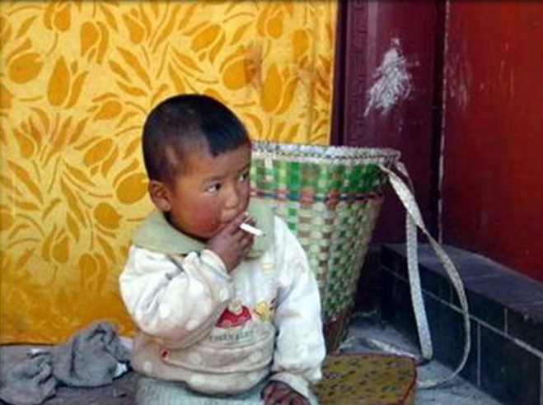
Social learning theory
Observational learning – based on the imitation of models wdlD;ska wkqlrkh lsrsu
Modeling – type of learning that involve observing and imitating other persons’ behavior ksrsCIKh yd wdlD;shlajSu

