Slide 1
Strategic Marketing Planning Process

Slide 2
Marketing Plan

Slide 3
Marketing Planning Process
Marketing
Plan
Marketing Mix
Business Goal
Marketing Strategy

Slide 4
Essential Content of a Marketing plan
Objectives- Organizations mission statement
Marketing analysis-
  PESTEL
  Porters 5 Forces
  Internal Audit
Situation Analysis: Normally this will include a market analysis, a SWOT analysis (strengths, weaknesses, opportunities, and threats), and a competitive analysis. The market analysis will include market forecast, segmentation, customer information, and market needs analysis.
Marketing Objectives
Marketing Strategy: This should include at least a mission statement, objectives, and focused strategy including market segment focus and product positioning.
,

Slide 5
Tactical plan: This would include enough detail to track sales month by month and follow up on plan-vs.-actual analysis. Normally a plan will also include specific sales by product, region, or market segment, by channels, manager responsibilities, and other elements. The forecast alone is a bare minimum.
Control & evaluation
Expense Budget: This ought to include enough detail to track expenses month by month and follow up on plan-vs.-actual analysis. Normally a plan will also include specific sales tactics, programs by management responsibilities, promotion, and other elements. The expense budget is also a bare minimum.
Operational considerations

Slide 6
Evaluation and control

Slide 7
Annual Plan control
Sales Analysis: consists of measuring and evaluating actual sales in relations to goals
Market share analysis: Companies sales in relative to competitors
Marketing expense-to-sales analysis: sales force to sales, advertising to sales, sales promotions to sales, market research to sales, sales admin to sales
Financial analysis: Expense to sales ratio should be analyzed in an overall financial framework
Market-based scorecard analysis:
  Customer performance score card
  Stakeholder performance score card

Slide 8
Profitability control
Marketing-Profitability analysis
  Identify functional expenses
  Assigning functional expenses to marketing entities
  Preparing a profit an loss statement for each marketing entity
Determining corrective action
Direct vs Full costing
  Direct cost
  Traceable common costs
  Non traceable common costs

Slide 9
Efficiency control
Sales force efficiencies | Advertising efficiency | Sales-promotion efficiency | Distribution efficiency
Avg calls per sales person Avg sales call time per contact Avg Revenue per sale Avg Cost per sale % of orders per 1000 Entertainment cost per sales Num of new customers per period Number of lost customers Sales force cost | Cost per 100 target buyers reached by media % of audience who saw, associated press ad Consumer opinin on the ads content and effectiveness Before and after measures o attitude No of enquires stimulated by the ad Costs per inquire | % sales sold on deal Display costs per sales dollar % of coupons redeemed Number of inquires resulted from a demonstration | Logistics costs as a % of sales % of orders filled correctly % of on time delivery Number of billing errors

Slide 10
Strategic control
Marketing Effectiveness Review: 5 major attributes of marketing orientation -Customer philosophy, integrated marketing organization, adequate marketing information, strategic orientations and operational efficiencies .
Marketing Audit: A comprehensive systematic, independent, and a periodic examination of a company’s or business unit’s marketing environment, objectives, strategies and activities with a view of determining problem areas and opportunities and recommending a plan of action to improve companies marketing performance

Slide 11
Developing Strategic Plan for sustainable development

Slide 12
Sustainable Development
"Development that meets the needs of the present without compromising the ability of future generations to meet their own needs."
(Brundtland Commission) report
Notes:
Have you listed any needs that conflict with one another? For example, if you listed clean air to breathe, but also listed a car for transportation, your needs might conflict. Which would you choose, and how would you make your decision? If within ourselves, we have conflicting needs, how much is that multiplied when we look at a whole community, city, country, world? For example, what happens when a company’s need for cheap labor conflicts with workers’ needs for livable wages? Or when individual families’ needs for firewood conflict with the need to prevent erosion and conserve topsoil? Or when one country’s need for electricity results in acid rain that damages another country's lakes and rivers

Slide 13
Marketing Impact on Society as a whole
False wants and too much materialism: marketing is seen to create false wants that benefit industry more than they benefit consumers
Too few social goods: Business has been accused of overselling private goods at the expense of public goods
Cultural Pollution :Constantly assaulted by marketing and advertising. Commercials interrupt serious programmes, press articles,
Too much political power: Business wield to much political power
Notes:
False wants and too much materialism: marketing system urges to much interest in material possessions. They are judges by what they own than who they are
Two few social goods : As private good increase they require more public services, eg increase in automobile requires more highways. Over selling private goods result in social costs for cars increase in cars social costs include, traffic, air pollution
Cultural pollution : A recent study found 65% Americans feel constantly bombarded with too many marketing messages
Too mcuh political power :Due to companies spending on advertising media is unable to say anything negative about them, Oil, Tabacco automobile senators industry interest rather than public interest

Slide 14
Marketing’s Impact on Other-businesses
Acquisition of competition: companies expand by acquiring companies than developing their own.eg: Cargills acquiring Kotmale
Marketing Practices that create barriers to entry: bar new companies entering an industry .eg Dialog bared Airtel
Unfair competitive marketing practices: Destroy competition by using unfair practices , price cuts, discourage buyers etc. eg: Supermarket chains in SL been accused of using predatory price cuts to put retailers out of business

Slide 15
Citizen and Public Actions to Regulatory Marketing

Slide 16
Consumerism
An organized movement of citizens and government agencies to
improve the right and power of buyers in relation to sellers
Rights of sellers | Rights of buyers
Right to introduce any products in any size and style | The right not to buy a product that is for sale
Right to charge any price | The right to expect the product to be safe
Right to spend any amount on promotion and products | The right to expect the product to perform as claimed
The right use any product message (providing its not misleading or dishonest)
The right to use any buying incentive programme

Slide 17
Environmentalism
An organized movement of concerned citizens and
government agencies to protect and improve peoples living
environment
Environment sustainability : A management approach that
involves developing strategies that both sustain the environment
and produce profits for the company.
Notes:
The first wave In 1960-70 there was a concern in the damage of eco system caused by strip – mining, forest deletion and acid rains. The 2nd hit in 1970-80 government industry practices impacting the environment eg steel companies and utilities had to invest in billions on environmental control . These two waves have now merged together , today companies are accepting more responsibility for doing no harm to the environment they are shifting from protect to prevent.

Slide 18
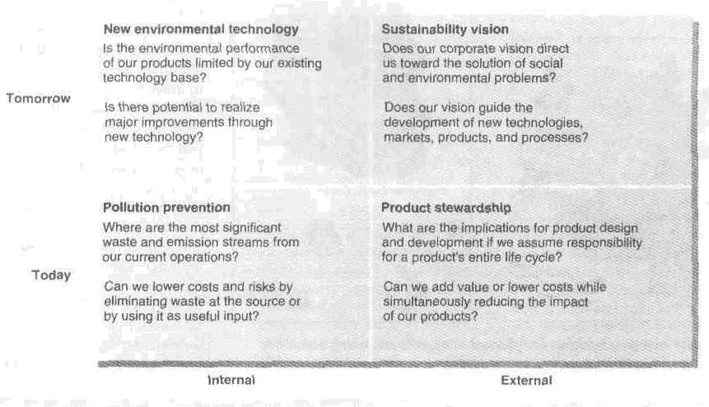
Environmental sustainable grid

Slide 19
Public Actions to Regulatory Marketing
Citizens concerns about marketing practices will usually
lead to the public attention and legislative proposals.
Major marketing decisions that maybe called into
Questions under law:
Selling decisions
Advertising decisions
Channel decisions
Product decisions
Packaging decisions
Competitive relations decisions
Pricing decisions

Slide 20
Business Actions towards Socially Responsible Marketing

Slide 21
Enlightened Marketing
A marketing philosophy holding that a company’s marketing
should support the best long run performance of marketing
systems. It consist of 5 principals:
Consumer- Oriented Marketing: Organize its marketing activities from consumer point of view
Customer Value Marketing: Should put most of its resources into customer value building
Innovative Marketing: Seeks real product and marketing improvement
Sense –of- Mission Marketing: should define its mission is social terms not narrow product terms
Societal Marketing: make decision by considering consumers wants, the companies requirements, consumers long run interest and societies long run interest

Slide 22
Marketing Ethics
Corporate marketing ethic policies :broad
guidelines that everyone in the organization must
follow.
These policies should cover:
Distributor relations
Advertising standards
Customer service
Pricing, product development and general ethical standards

Slide 23
Ethical business carries valuable advertising appeal and has become content for PR campaigns, sales promotions and advertising
There is also evidence to suggest that organizations suffer commercial losses from boycotts (Nestle boycott is said to have cost the firm $40 million)
Survey results show that an ethics code will;
  Strengthen financial performance
  Improve brand image, sales & reputation
  Employee loyalty
  Reduce the vulnerability to pressure groups
  Avoidance of fines
  Avoid loss of business

Slide 24
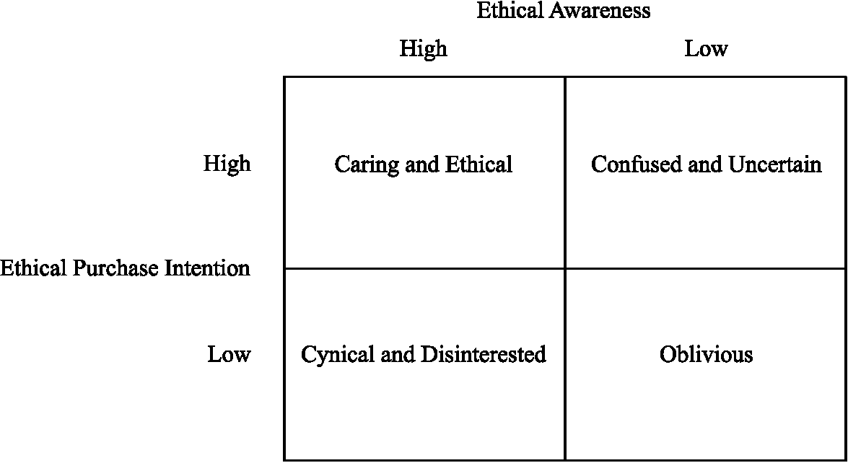
Consumer attitude to ethical purchasing
Marylyn Carrigan, Ahmad Attalla, (2001),"The myth of the ethical consumer - do ethics matter in purchase behaviour?", Journal of Consumer Marketing, Vol. 18 Iss: 7 pp. 560 - 578
Notes:
Caring & ethical- consumers make it their business to discriminate against unethical companies and will respond positively to ethical behavious
This might also lead to consumers being selectively ethical. Companies have to identify which are the ethical issues that matter to this group and ensure they are satisfied with the companies stance on this.
Confused & Uncertain- consumers would shop ethically but have some confusion about corporate ethical behaviour. This group would require more information from companies about their ethical practices.
Cynical & disinterested- these consumer are not convinced that companies are ethical. Even if they are convinced there is no conviction that they would alter their buyer behaviour. They will only purchase if there is no detraction from their brand choice and their perception of value. Ethical marketing will have to be combined with quality, price and brand image in order to attract this group.
Oblivious- this is an unknown quantity. They may or may not be willing to shop ethically. This may or may not have entered into their purchase equation depending on the knowledge factor. Adequate information may incite this group to purchase ethically.

Slide 25
Caring & ethical- consumers make it their business to discriminate against unethical companies and will respond positively to ethical behavious
This might also lead to consumers being selectively ethical. Companies have to identify which are the ethical issues that matter to this group and ensure they are satisfied with the companies stance on this.
Confused & Uncertain- consumers would shop ethically but have some confusion about corporate ethical behaviour. This group would require more information from companies about their ethical practices.
Cynical & disinterested- these consumer are not convinced that companies are ethical. Even if they are convinced there is no conviction that they would alter their buyer behaviour. They will only purchase if there is no detraction from their brand choice and their perception of value. Ethical marketing will have to be combined with quality, price and brand image in order to attract this group.
Oblivious- this is an unknown quantity. They may or may not be willing to shop ethically. This may or may not have entered into their purchase equation depending on the knowledge factor. Adequate information may incite this group to purchase ethically.

Slide 26
The prevalent issues can be categorized in the following manner;
Misleading advertising- the use of misleading or exaggerated claims in advertising is a critical issue. Positioning a product in this manner is ethically unsound and can create confusion in the mind of the customer. It can also create negative publicity and may result in legal censure.
E.g: under UK food law, the use of health claims is controlled. The brand owners are prevented from commenting about any positive effects that the consumption of their products will have on a disease. Any health propositions must be backed up by hard evidence
Taste & decency- ASA’s research has revealed the consumer’s reaction to the use of bad language in advertising. (www.asa.org.uk). The use of shocking advertising is used to generate a spin-off publicity. (E.g. Benetton ). This involves the use of unusual, provocative and controversial images and communication.

Slide 27
Ethical Issues
Communication tool | Ethical issue
Personal selling | -Questionable sales techniques -Overselling -Misrepresentation -Conflicts of interest
Advertising | -Advertising to children -Advertising that manipulates behavior -Deceptive advertising
Sales Promotion | -Deceptive sales promotions
Direct marketing | -Mis presentation of products -Violations of consumer privacy -No intention of fulfilling orders
Notes:
Most organizations do not intend to behave unethically. From the perspective of the bottom line customers who perceive that they have been unethically treated will not re-purchase from that particular company.
The above table identifies some of the pitfalls that an organization would need to consider when implementing an Integrated Marketing Communications strategy.

